Slide 1


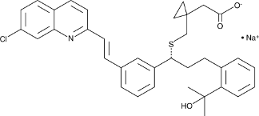
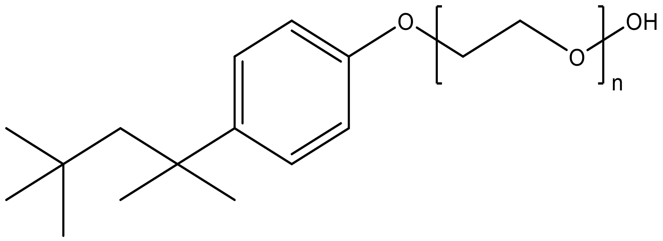
Physico-Chemical investigation of additive-mediated Triton X-100 – Montelukast drug interactions using phase separation and UV-visible spectroscopy
Sadia Kamal Tonny, Poster ID: Phy-106 Prof. Dr. Shahed Rana Department of Chemistry, Jahangirnagar University, Savar, Dhaka-1342
Montelukast Sodium USP
Triton X-100 (n = 9–10)
INTRODUCTION
CLOUD POINT BEHAVIOUR
UV-Visible SPECTROSCOPY
• Surfactants are amphiphilic; reduce surface & interfacial tension.
• Accumulate at interfaces; increase solubility, mobility, bioavailability of hydrophobic organics.
• Triton X-100: low-toxic, non-ionic surfactant. Used in drug delivery, protein solubilization, DNA extraction, virus deactivation.
• Montelukast Sodium: selective leukotriene receptor antagonist; prevents chronic asthma, allergic rhinitis, exercise-induced bronchoconstriction (not a rescue drug).
• CP of 4% TX-100 decreases with increasing Montelukast concentration.
• Salts decrease CP (salting‑out): Na₃PO₄ > Na₂SO₄ > NaCl (same ionic strength); similar trend for K salts.
• Hydrotropes generally increase CP, except choline chloride & p-toluidine hydrochloride.
• Short-chain alcohols increase CP; butanol decreases it (more hydrophobic).
• Absorption spectra of TX-100 + 0.01 mM Montelukast recorded in water & additive media.
• CMC determined from break in Absorbance vs log[TX-100] plots.
• CMC values obtained in: water, methanol, ethanol, propanol, K₂SO₄, KCl, K₃PO₄.
• Pure Montelukast spectrum used as reference.
OBJECTIVES
THERMODYNAMICS
• Investigate modes of interaction between TX-100 and Montelukast.
• Examine clouding behavior of TX-100–Montelukast mixture in aqueous solution & with additives.
• Determine thermodynamic parameters (ΔG°, ΔH°, ΔS°).
• Study UV-Vis absorption spectra and calculate CMC, binding constant (Kb), partition constant (Kc), partition coefficient (Kx).
• Enthalpy-entropy compensation plots confirm similar clouding mechanism in water, KNO₃, nicotinamide.
• ΔG°, ΔH°, ΔS° evaluated from CP variation.
Variation of CP of 4% TX-100 + Montelukast in aq. medium
CP in Na-salts
CP in Hydrotropes
Enthalpy-entropy (KNO₃)
METHODOLOGY
• UV-Visible spectroscopy: determine CMC, binding/partition constants.
• Cloud Point (CP) measurements: assess phase separation.
• Thermodynamic calculations: ΔG°, ΔH°, ΔS° from CP data.
Enthalpy-entropy compensation (aq. medium)
CP in K-salts
CP in Alcohols
Enthalpy-entropy (Nicotinamide)
Abs. spectra (water)
CMC (water)
Pure Montelukast spectrum
Abs. spectra (MeOH)
CMC (MeOH)
Abs. spectra (EtOH)
CMC (EtOH)
Abs. spectra (PrOH)
CMC (PrOH)
Abs. spectra (K₂SO₄)
CMC (KCl)
CMC (K₃PO₄)
CMC (K₂SO₄)
CONCLUSIONS
• Phase separation and micellization of TX-100–Montelukast mixed system examined via CP and UV-Vis.
• CP decreased with increasing Montelukast concentration.
• CP decreased with Na/K salts (salting-out): trivalent > divalent > monovalent effect at same ionic strength.
• CP generally increased with hydrotropes (except choline chloride, p-toluidine HCl) and short-chain alcohols (butanol decreased).
• CMC values determined from UV-Vis absorbance vs. log[TX-100] plots in water and various additive media.
• Thermodynamic parameters and binding/partition constants quantified.

