Slide 1
Shapes
Unraveling the Web of Information: A Comprehensive Study on Bangla Misinformation, Disinformation, Satire and Fake News
Hrithik Majumdar Shibu
Reg No: 2018331052
Nasrullah Sami
Reg No: 2018331036
Supervisor Mahruba Sharmin Chowdhury Assistant Professor Department of CSE, SUST
Presenter Name

Slide 2
Outline
Introduction
Objective
Related Works
Gaps in Literature
Our Approach
Why Classify?
Data Collection
Methodology
Results
Real-Time Examples
What We Accomplished

Slide 3
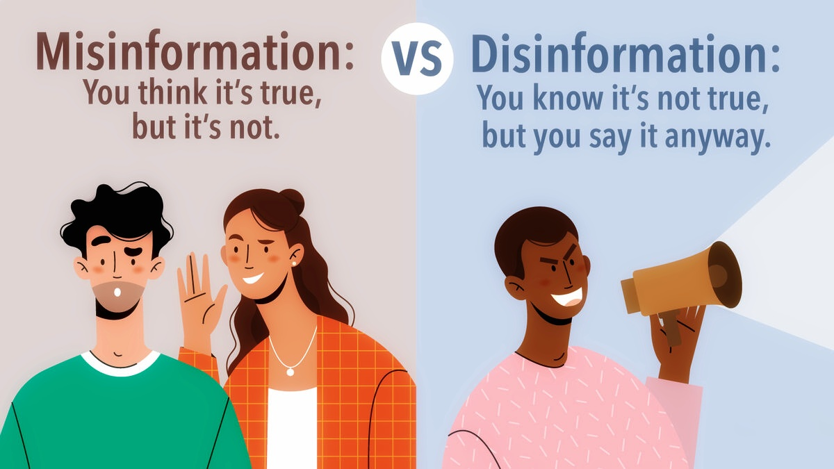
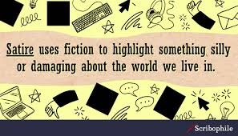
Introduction
Misinformation 🙁
Disinformation 😥
Satire 😂
REAL!!! 👍

Slide 4
Comprehension With Examples
Misinformation :
“Eating chocolates can make you immune to common cold.”
Disinformation :
“A celebrity endorsed a controversial product, accompanied by doctored photos to make it seem real.”
Satire :
“A town plans to tax residents based on the number of selfies they take.”

Slide 5
Objectives
Collect, Combine, and Enrich the fake news dataset
Find improved accuracy on binary classification with the latest models.
Create a new benchmark multi-labeled dataset for Misinformation, Disinformation and Satire classification.
Find the best model and accuracy for the new 4-way classification.

Slide 6
Related Works
AUTHOR | MODEL | WORK | CLASS
Hossain et al.¹ | SVM, LR, RF, BERT etc. | Benchmark dataset for Bangla fake news detection | Binary – Fake or Real
Sharma et al.² | CNN + feature extraction model | Satire detection | Binary – Satire or Non-Satire
George et al.³ | CNN-LSTM | Fake news detection | Binary – Fake or Real
Harbola et al.⁴ | LSTM and BERT | Misinformation classification | Binary – Related or Unrelated

Slide 7
Gaps in Literature
Existing Bangla fake news datasets are imbalanced and suffer from insufficient fake news articles.
Model performances are unreliable.
Fake news can be classified into further sub-categories.

Slide 8
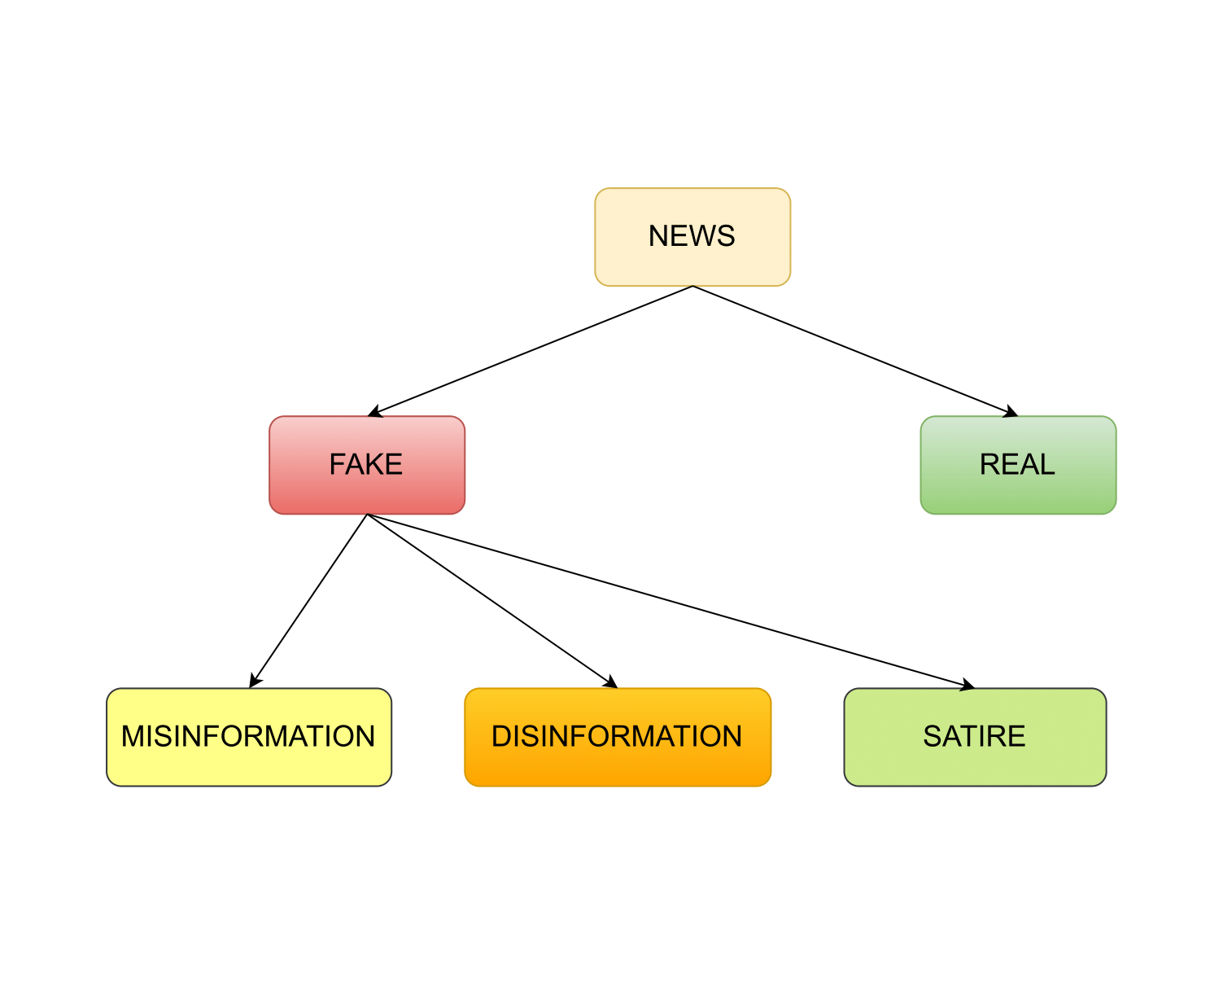
Our Approach
Classify fake news into 3 classes:
Misinformation
Disinformation
Satire
Use the latest NN models & LLMs to achieve greater accuracy.

Slide 9
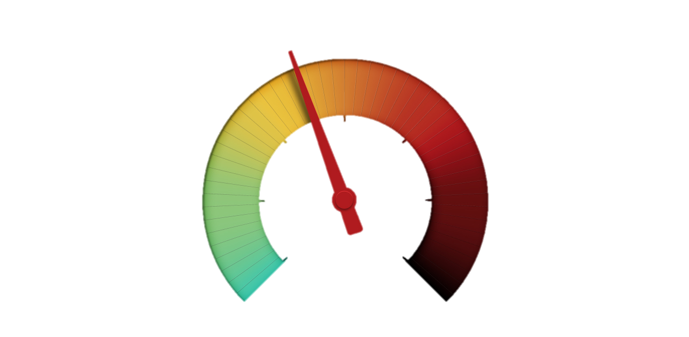
WHY CLASSIFY?
Not all fake news is created equal
Different types of fake news require different techniques for mitigation
Social media platforms and search engines can use the categorization to adjust their algorithms
Researchers can analyze the patterns and impact of different types of fake news
Misinformation
Satire
Disinformation

Slide 10
DATA COLLECTION

Slide 11
Data Collection (4-1)
Category | Sources | Number of Articles
Real | Hossain et al. – BanFakeNews¹ Sadik Al Jarif – Kaggle⁵ Hussain et al.⁶ | 47371
Fake | Sadik Al Jarif – Kaggle Hossain et al. – BanFakeNews¹ Hussain et al.⁶ Data Crawling | 5540
Satire | Sharma et al.² Hossain et al. – BanFakeNews¹ | 2053

Slide 12
Data Collection (Final 4-2)
Category | Sources | Number of Articles
Real | Hossain et al. – BanFakeNews¹ Sadik Al Jarif – Kaggle⁵ Hussain et al.⁶ | 47371
Misinformation | Sadik Al Jarif – Kaggle Hossain et al. – BanFakeNews¹ Hussain et al.⁶ Data Crawling | 7422
Disinformation | Sadik Al Jarif – Kaggle Hossain et al. – BanFakeNews¹ Hussain et al.⁶ Data Crawling | 3081
Satire | Sharma et al.² Hossain et al. – BanFakeNews¹ Data Crawling | 2397

Slide 13
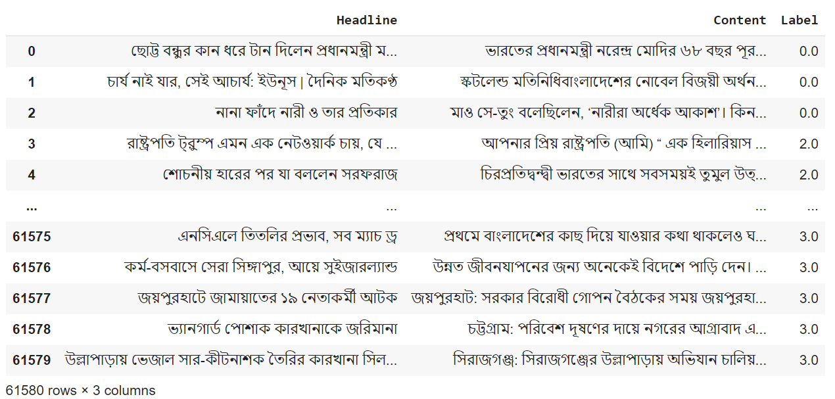
Part of our full dataset

Slide 14
METHODOLOGY

Slide 15
Classical Machine Learning Models
Support Vector Machine (SVM)
Logistic Regression (LR)
1
2
Experiments
1
Unigram
2
Bigram
3
Trigram
4
U+B+T
5
C3-gram
6
C4-gram
7
C5-gram
8
C3+C4+C5

Slide 16
Transformers Based Models
1
BanglaBERT
2
SagorBERT
3
XLM-RoBERTa
4
m-BERT-cased
5
m-BERT-uncased
Large Language Based Model
1
BLOOM with QLORA

Slide 17
RESULTS

Slide 18
BINARY classification
0 – Fake
1 – Real

Slide 19
Classical Models
MODEL | Experiment Name | REAL |  | FAKE
 |  | Precision | F1-score | Precision | F1-score
SVM | Unigram | 0.92 | 0.93 | 0.78 | 0.74
SVM | Bigram | 0.91 | 0.93 | 0.78 | 0.72
SVM | Trigram | 0.91 | 0.90 | 0.62 | 0.66
SVM | U+B+T | 0.92 | 0.94 | 0.79 | 0.75
SVM | C3-gram | 0.96 | 0.98 | 0.80 | 0.77
SVM | C4-gram | 0.97 | 0.97 | 0.79 | 0.77
SVM | C5-gram | 0.96 | 0.96 | 0.81 | 0.77
SVM | C3+C4+C5 | 0.97 | 0.97 | 0.79 | 0.77

Slide 20
Transformers & LLM Based Models
MODEL | REAL |  | FAKE
 | Precision | F1-score | Precision | F1-score
BanglaBERT | 0.89 | 0.94 | 0.97 | 0.69
SagorBERT | 0.92 | 0.95 | 0.95 | 0.79
M-BERT-Cased | 0.92 | 0.95 | 0.93 | 0.79
M-BERT-Uncased | 0.92 | 0.96 | 0.99 | 0.81
XLM-RoBERTa | 0.90 | 0.94 | 0.89 | 0.72
BLOOM | 0.92 | 0.96 | 0.99 | 0.81

Slide 21
4-way classification
0 – Satire
1 – Disinformation
2 – Misinformation
3 – Real

Slide 22
Classical Models
MODEL | ACCURACY | F1-SCORE
LR | 0.81 | 0.80
SVM | 0.83 | 0.81

Slide 23
Transformers & LLM Based Models
MODEL | ACCURACY | F1-SCORE
BanglaBERT | 0.85 | 0.84
SagorBERT | 0.82 | 0.81
XLM-RoBERTa | 0.80 | 0.80
m-BERT-cased | 0.83 | 0.83
m-BERT-uncased | 0.82 | 0.82
BLOOM | 0.87 | 0.84

Slide 25
REAL-TIME EXAMPLES

Slide 26
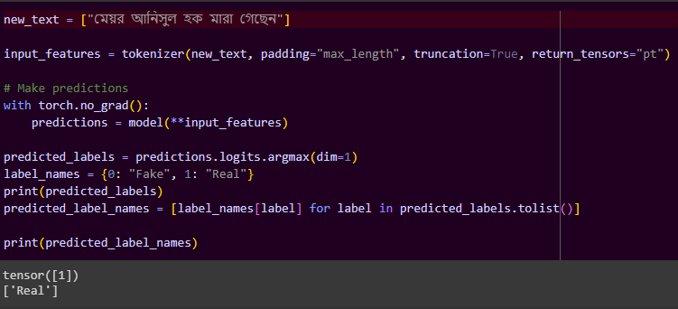
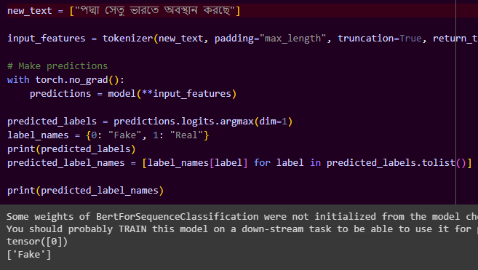
News: মেয়র আনিসুল হক মারা গেছেন
Prediction: REAL
News: পদ্মা সেতু ভারতে অবস্থান করছে
Prediction: FAKE

Slide 27


What We Accomplished
1
Created a dataset of nearly 60K news articles with 13K fake news articles.
2
Manually annotated 13K fake news articles into misinformation, disinformation and satire
3
Applied Classical, Transformers based & LLMs for classification
4
Use high-performance machines to maximize the results of resource-intensive models

Slide 28
References
M. Z. Hossain, M. A. Rahman, M. S. Islam, and S. Kar, “Banfakenews: A dataset for detecting fake news in bangla.”
A. S. Sharma, M. A. Mridul, and M. S. Islam, “Automatic detection of satire in bangla documents: A cnn approach based on hybrid feature extraction model.”
M. Z. H. George, N. Hossain, M. R. Bhuiyan, A. K. M. Masum, and S. Abujar, “Bangla fake news detection based on multichannel combined cnn-lstm.”
Harbola, Aditya and Manchanda, Mahesh and Negi, Deepti, “Misinformation classification using LSTM and BERT model”
https://www.kaggle.com/datasets/sadikaljarif/bangla-fake-news-detection-dataset
M. G. Hussain, M. Rashidul Hasan, M. Rahman, J. Protim, and S. Al Hasan, “Detection of bangla fake news using mnb and svm classifier.”

Slide 29
Thank you!!!
Any Queries?

