Slide 1

Neural networks II
Associated notebook: https://github.com/samueljackson92/sciml-workshop/blob/master/nn-2-lecture/example-neural-networks-cnn.ipynb

Slide 2
Overview
Pictures
Intro to convolutional neural networks
Building blocks of CNNs
Deep CNNs
Advanced CNNs – Residual blocks
Sequences
Intro to recurrent neural netowrks

Slide 3
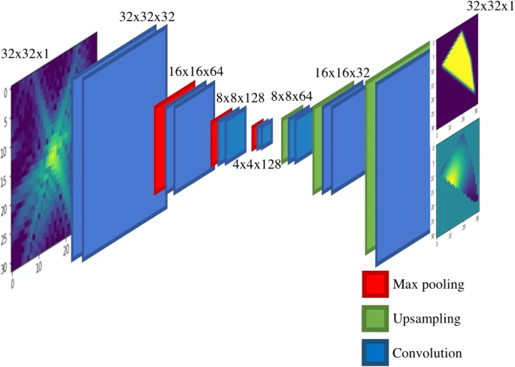
Showcase
CDI-NN Argonne
Predicting structure and strain from diffraction images
Once trained there are no parameters for users to adjust
Provides real-time experimental feedback
Scientific Reports volume 8, Article number: 16520 (2018)

Slide 4
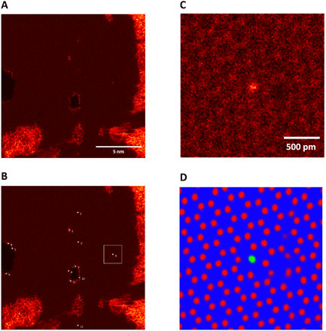
Showcase
Deep learning networks are developed for automated image analysis and recognition of the defects
Convolutional NNs used to segment the images
Science Advances 27 Sep 2019:
Vol. 5, no. 9, eaaw8989

Slide 5
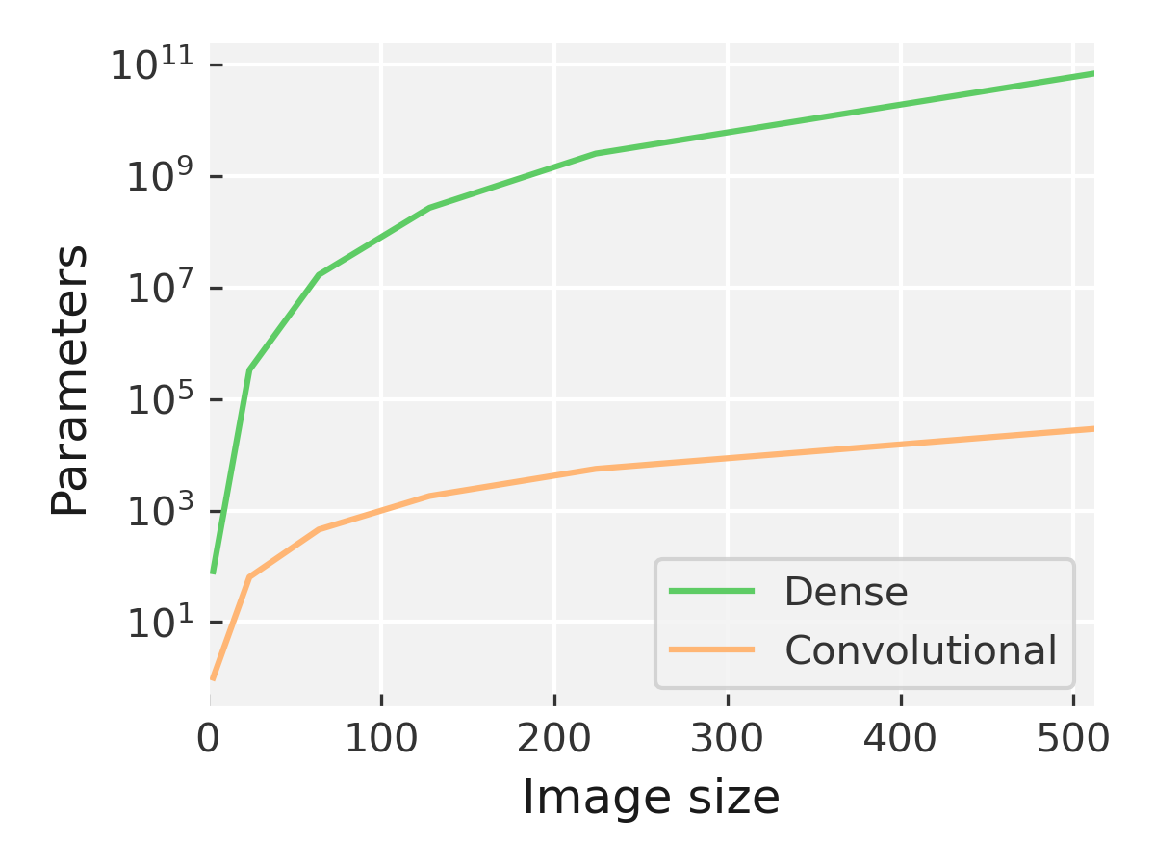
Some pitfalls with MLPs for images
No spatial awareness
Parametric explosions

Slide 6
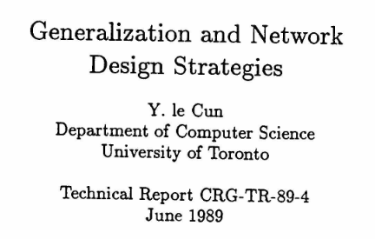
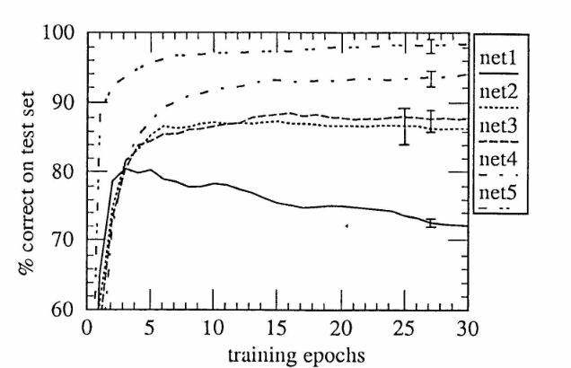
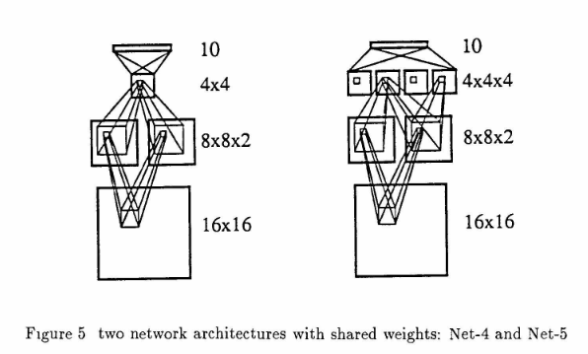
Early CNNs
LeCun – restricting the number of parameters in a NN leads to better generalisation
Also makes it possible to fit in memory
Originally trained for digit recognition for the postal service

Slide 7
Structure of a convolutional layer
Kernel
Pooling
Activation

Slide 8
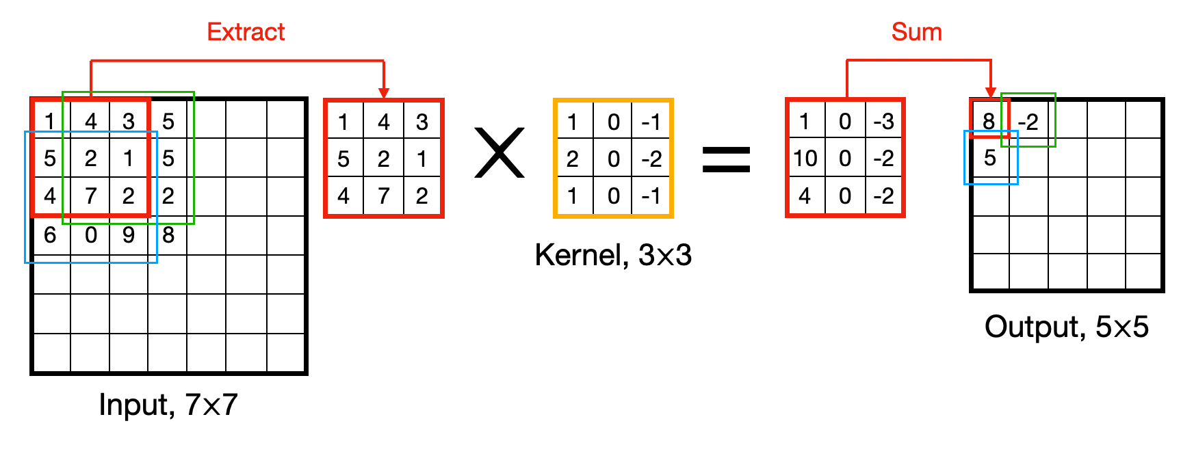
Convolution in action: Kernel
Input + kernel -> activation map

Slide 9
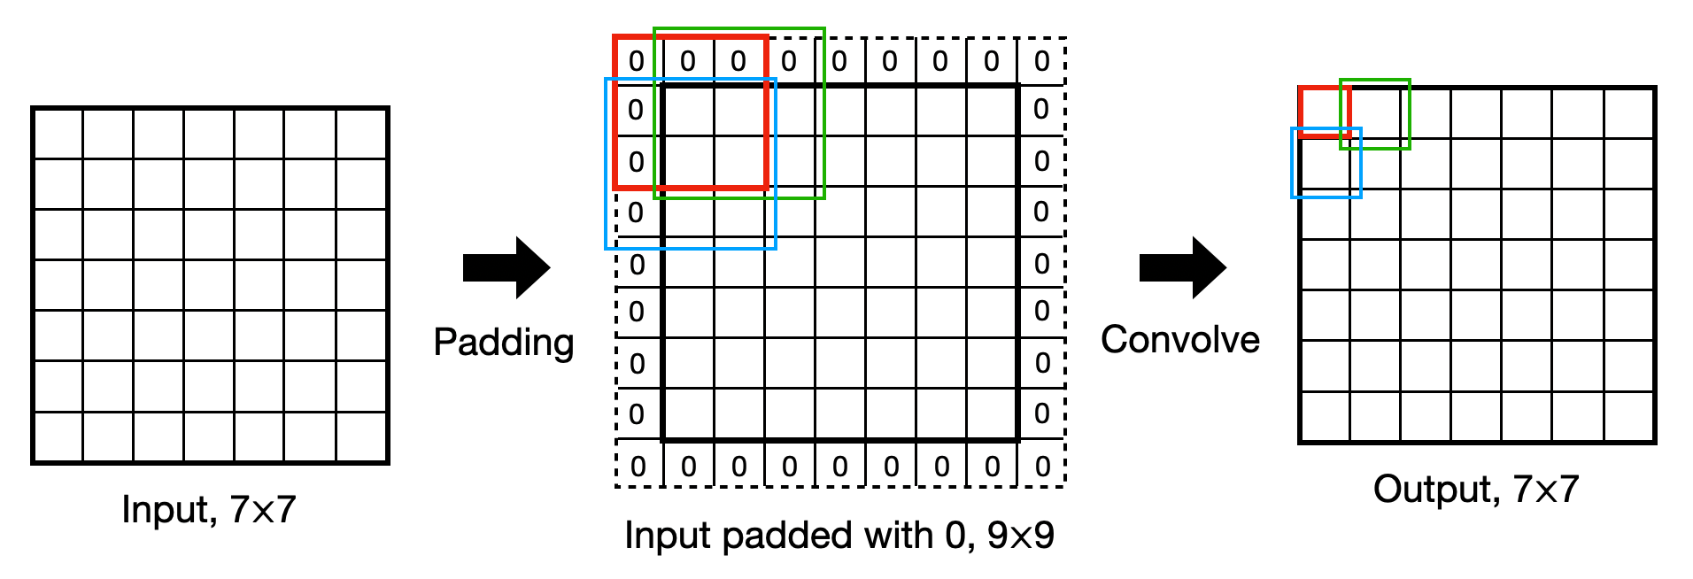
Convolution in action: Padding
Padding around the outside of images
SAME: pad with zeros to make output.shape == input.shape
VALID: no padding output.shape < input.shape

Slide 10
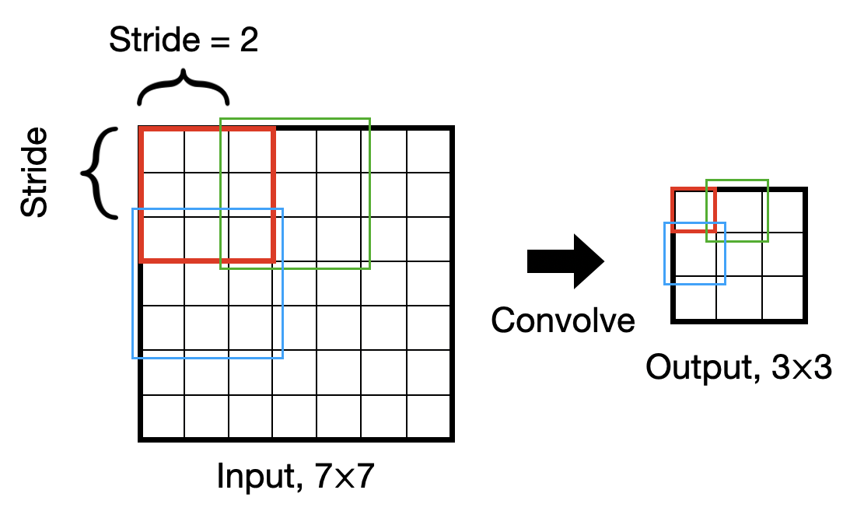
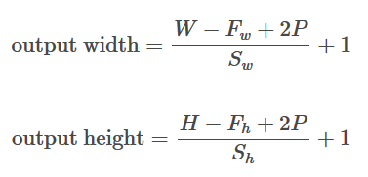
Convolution in action: Striding
Controls how the filter slides across the image

Slide 11
Go to notebook
Lets try building and understanding some filters

Slide 12
Convolution in action: Pooling
Use to compress between layers
3
1
7
2
5
1
0
9
Max Pool (2, 2)
5
9
8
2
4
9
8
9
4
3
1
1

Slide 13
Convolution in action: Putting it together
Input image – 1 channel
Activations – 3 channels
Output – 3 channels reduced dimensions
Activation function
Max pooling
3 filters

Slide 14
A deep CNN
(224, 224, 64)
(112, 112, 128)
VGG-16
(56, 56, 256)
(28, 28, 512)
(14, 14, 1024)
(w, h, c)
Conv + ReLU
Max Pool
Fully connected (dense) layer

Slide 15
Batch normalisation
Very deep CNNs can be difficult to train
Weights often go to zero or infinity
Normalise the outputs from intermediate layers
Makes weights deep in the NN more robust to changes early in the NN
Batch normalization
Max pooling

Slide 16
Building blocks: Convolution block
from tensorflow.keras.layers import Conv2D, MaxPool2D, BatchNormalization
model.add(Conv2D(16, (5, 5), activation=‘relu’))
model.add(MaxPool2D((2, 2)))
model.add(BatchNormalization())

Slide 17
Go to notebook
Let’s build a CNN for classification

Slide 18
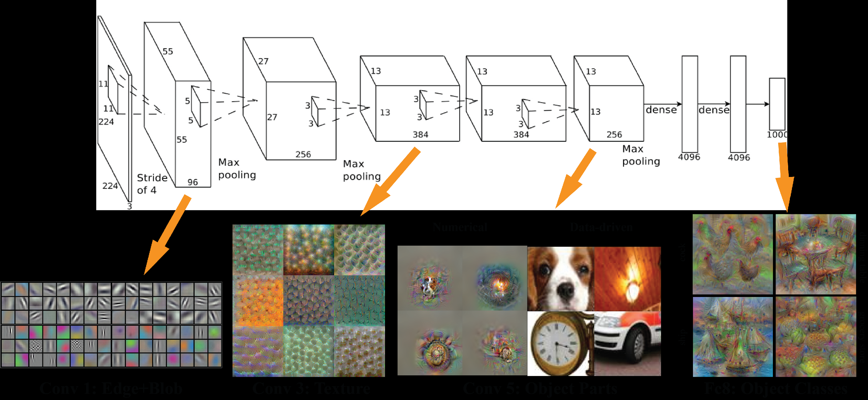

Hierarchy of filters
Stacking deep networks means that different levels of features are learned at different depths
Textures
Parts
Edges

Slide 19
Advanced CNNs: Residual blocks
A connection that passes the input over a block of convolutions
Useful in very deep architectures
Allows network to learn to skip blocks
Allows gradient to pass back through the network more effectively in backprop

Slide 20
Some other network types
Recurrent networks

Slide 21
Recurrent networks: Use cases
One to one
Variable length inputs and outputs
Sequential data e.g. time series data, text etc.
One to many
Many to one

Slide 22
How an RNNs work (brief view)
‘Hidden’ state (h) at time t updated based on h at t-1 and input (x) at t
Weights (W) same for each pass
Loss calculated at the end and backpropagated to W_{hh} and W_{xh}
y_{t}
h_{t-1}
h_{t}
h_{t+1}
h_{t+2}
x_{t}

Slide 23
Concept checklist
Origins of convolutional neural networks
Building blocks of CNNs – kernel, padding, stride
Max pooling
Deep CNNs
Batch normalisation
Feature detection in different layers
Residual blocks
Recurrent neural networks

Slide 24
Thank you
Twitter:@ml_sci

