Slide 1

Neural networks I
Associated notebook:https://github.com/stfc-sciml/sciml-workshop/blob/master/course_1.0/03_DNN_basics.ipynb

Slide 2
Overview
History of deep neural nets (DNN)
Layers of a DNN
Structure of a neuron
Activation functions
Backpropagation
Optimisation
Regularisation

Slide 3
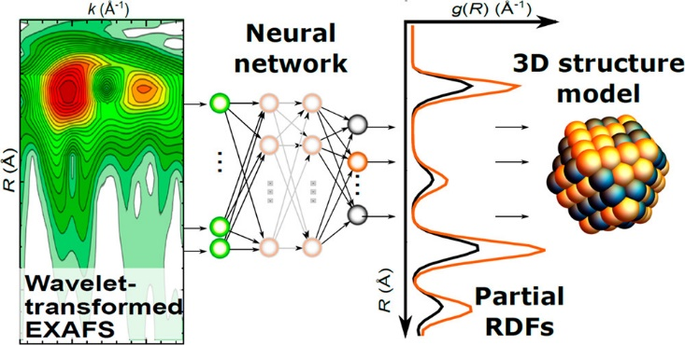
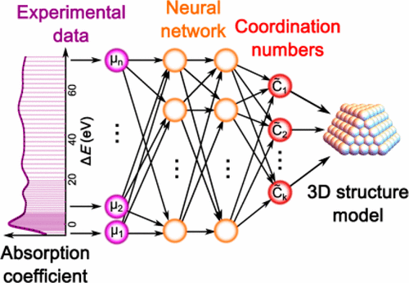
Showcase
Multi Layer Perceptrons (MLPs) for interpreting X-ray spectroscopy
Transforming an EXAFS signal into a partial RDF to assist with 3D model building using an MLP
XANES spectra used to estimate coordination numbers of atomic sites using an MLP
Processing of each spectrum takes less than 1 second
Gets coordination up to the 4th coordination shell
Nano Lett. 2019, 19, 1, 520–52
J. Phys. Chem. Lett. 2017, 8, 20, 5091–5098

Slide 4
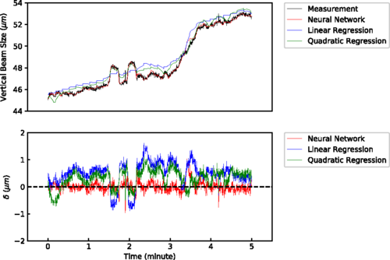
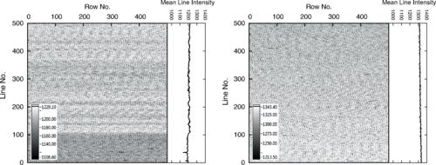
Showcase
Stabilisation of synchrotron beam at Advanced Light Source
“Learned” how changes in the configurations and positions of the magnetic excitations affected the width of the resulting photon beam
Precision is better than the 2–3% previously achieved at the ALS
Allows the synchrotron to probe the dynamics of chemical reactions
With ML
No ML
Phys. Rev. Lett. 2019, 123, 194801

Slide 5
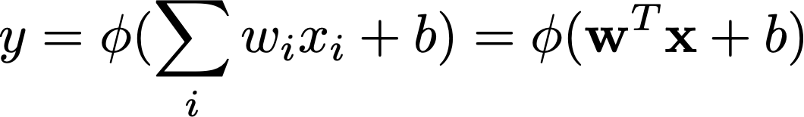
Neural networks
Early NN
Originally a device
Intended for binary classification
Produces a single output from a matrix of inputs, weights and biases

Slide 6
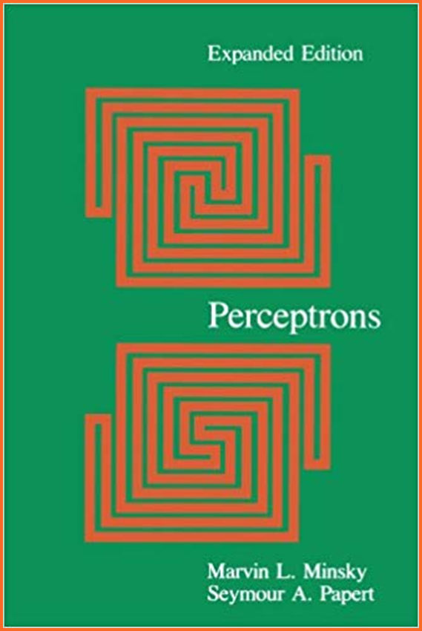
Neural networks
Single layer
Minsky and Papert showed they could not solve non-linear classification

Slide 7
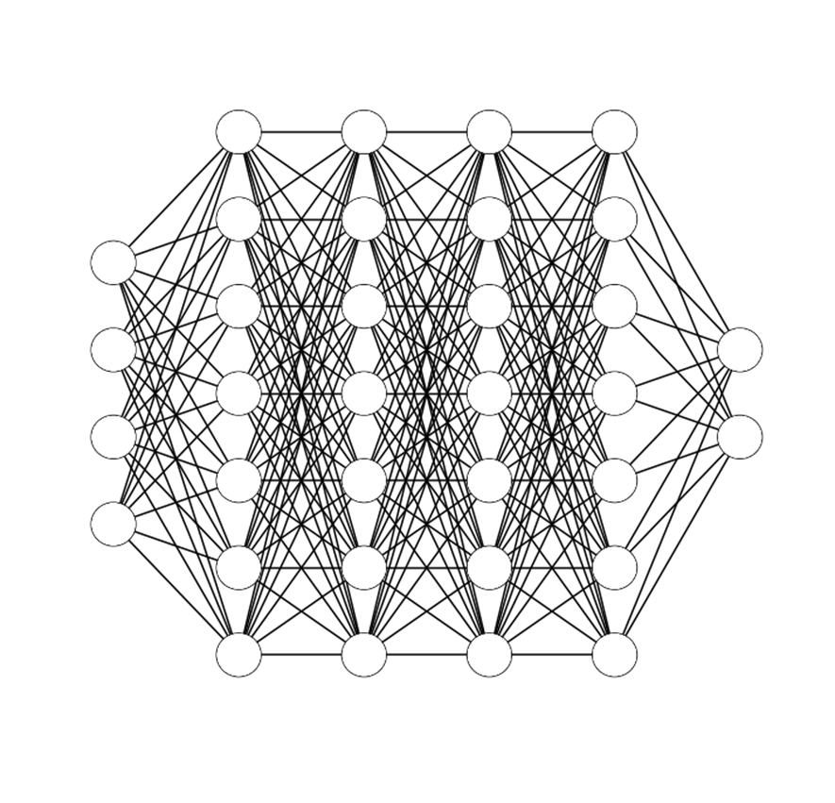
Neural networks
Back propagation
Now gradients could be used to minimise error
Modifications back propagate through the network using the chain rule

Slide 8
Deep neural networks: Multi layer perceptron
Input layer
Output layer
Hidden layers

Slide 9






Dense layers
Also called fully connected layers
Activation function
$$x$$
$$y=g\left(z\right)$$
Output signal
$$x$$
$$y$$
$$z= w^{T}.x+b$$
Bias
$$x$$
Weights
Input signals

Slide 10
Two ways to program a NN (tensorflow/keras)
from tf.keras.models import Sequential
from tf.keras.layers import Dense
model = Sequential()
model.add(Dense(2, input_dim=1))
model.add(Dense(1))
Sequential:
Quick and easy
from tf.keras.models import Model
from tf.keras.layers import Input
from tf.keras.layers import Dense
visible = Input(shape=(2,))
hidden = Dense(2)(visible)
model = Model(inputs=visible, outputs=hidden)
Functional:
More complex, but flexible

Slide 11
Building block: Dense layer
from tensorflow.keras.layers import Dense
From tensorflow.keras.models import Sequential
model = Sequential()
model.Add(Dense(units))

Slide 12
Building block: Dense layer (input)
from tensorflow.keras.layers import Dense
Model.add(Dense(units, input_dim=dim))

Slide 13
Building block: Dense layer (output)
from tensorflow.keras.layers import Dense
Model.add(Dense(units))
Here number of units is the number of classes or the number of variables you want to fit

Slide 14
Building block: Activation layer
from tensorflow.keras.layers import Activation
model.add(Activation(‘tanh’))

Slide 15
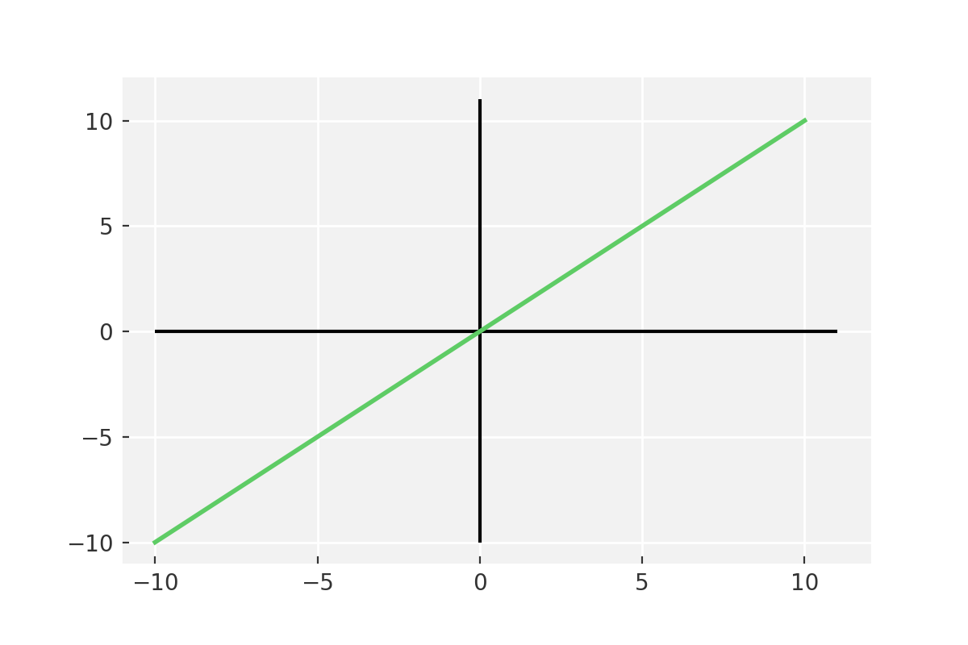
Activation function: Linear
The simplest form of activation function

Slide 16
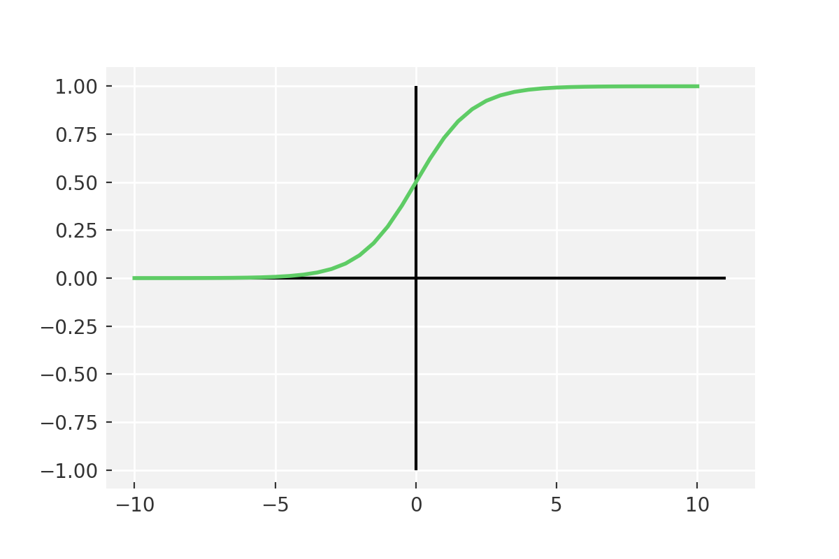
Activation function: Sigmoid
Vanishing gradient problem
Secondly , its output isn’t zero centered. It makes the gradient updates go too far in different directions. 0 < output < 1, and it makes optimization harder.
Sigmoids saturate and kill gradients.
Sigmoids have slow convergence.

Slide 17
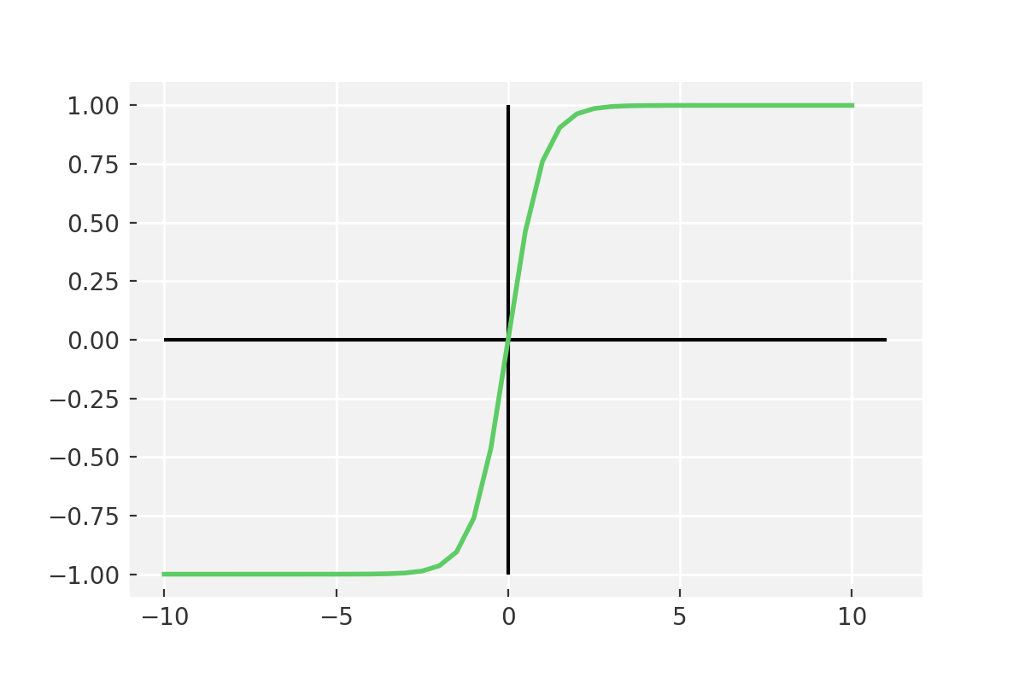
Activation function: Tanh
Output is zero centered
Usually preferred to sigmoid as it converges better
Still it suffers from vanishing gradient problem

Slide 18
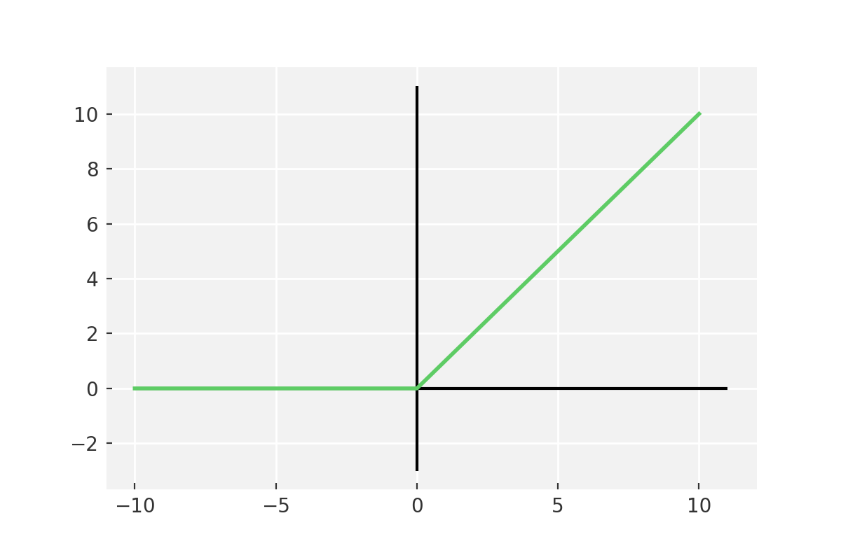
Activation function: ReLU
6 times improvement in convergence from Tanh function
Should only be used within Hidden layers of a neural network model

Slide 19
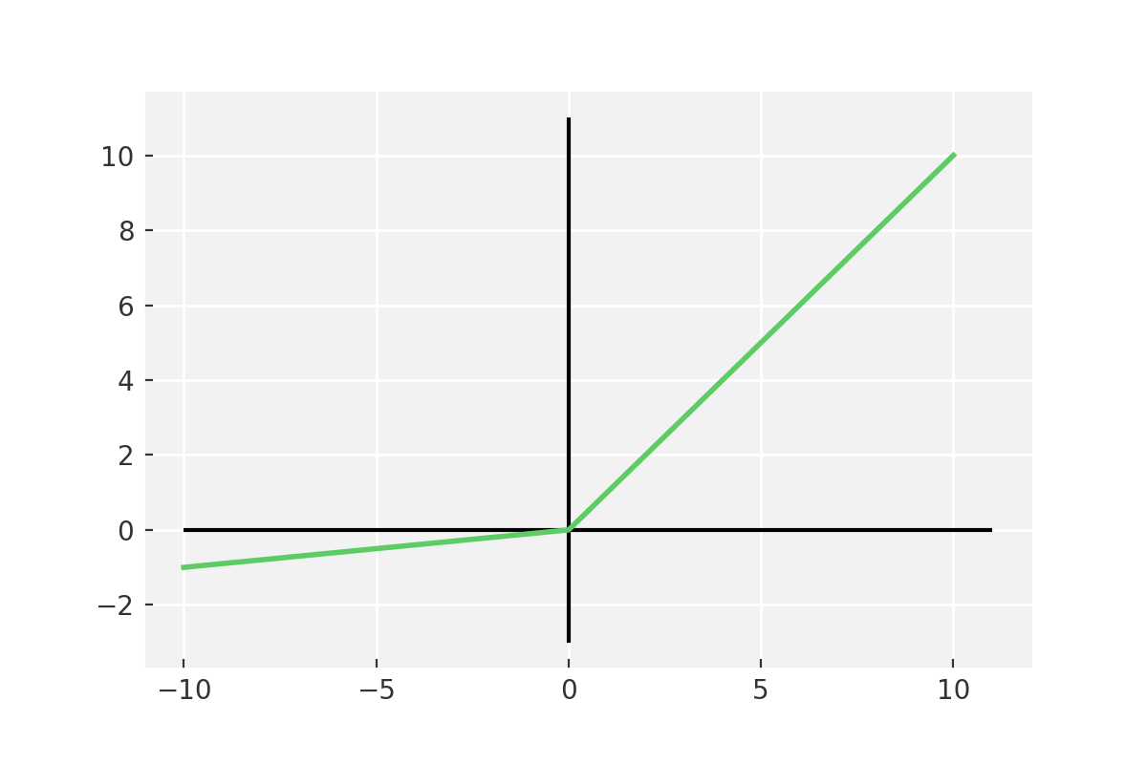
Activation function: LeakyReLU
Some ReLu gradients can be fragile during training and can die.
Cause a weight update which will makes it never activate on any data point again.
ReLu could result in Dead Neurons.
keras.layers.LeakyReLU(alpha=0.3)

Slide 20
Go To Notebook
Its time to build your first neural network

Slide 21
Back Propagation
Notation:
dL/dy[l] => dy[l]
Backprop
y[0]
y[1]
y[2]
y[l]
Loss(L)
dw[1]
db[1]
dw[2]
db[2]
dw[l]
db[l]
dy[l]
dy[1]
dy[2]

Slide 22
Optimisation
First order
Minimise the gradient of the loss function with respect to the parameters
Relatively quick, but ignores curvature
Second order
Calculate the second derivative of the loss function with respect to parameters
Slower per step, but includes curvature so can be quicker overall

Slide 23
Optimisation Stochastic gradient descent
Gradient descent – calculate the gradient of the loss of the entire set with respect to parameters
SGD – calculated per sample rather than on the entire batch
Much quicker to calculate, but can lead to high variance
Mini-batch SGD – calculate loss gradient on batches of set size
Best of both worlds

Slide 24
Building block: Optimiser
from tensorflow.keras import optimizers
sgd = optimizers.SGD(learning_rate=0.01, decay=1e-6, momentum=0.9, nesterov=True)

Slide 25
Optimisation: Momentum
High variance oscillations in SGD makes it hard to converge
Momentum softens the oscillations in irrelevant directions
from tensorflow.keras import optimizers
sgd = optimizers.SGD(learning_rate=0.01, decay=1e-6, momentum=0.9, nesterov=True)

Slide 26
Optimisation: Nesterov
Momentum still has problems
M is high even close to the minimum, so we often overshoot
Nesterov accelerated gradient jumps out on the momentum direction, and estimates a correction to updated the parameters
from tensorflow.keras import optimizers
sgd = optimizers.SGD(learning_rate=0.01, decay=1e-6, momentum=0.9, nesterov=True)

Slide 27
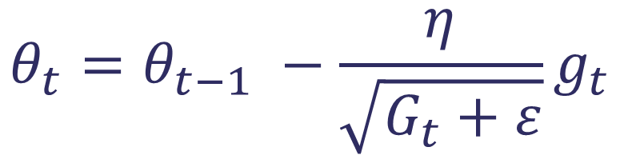
Optimisation: Adaptive methods
Some parameters update much more often than others
Therefore different learning rates can be appropriate for different parameters
Adagrad modifies the learning rate η at each time step for every parameter based on the past gradients computed for that parameter
Current gradient
Old parameter
New parameter
$$θ_{t}=θ_{t−1} −\frac{η}{\sqrt{G_{t}+ε}}g_{t}$$
Sum of previous gradients

Slide 28
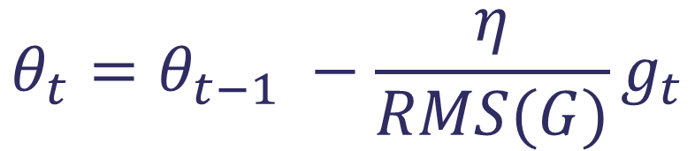
Optimisation: AdaDelta
Adagrad suffers because the gradients from all previous steps are accumulated, so the learning rate continuously decays
AdaDelta circumvents this by storing gradients only from n previous steps
Old parameter
New parameter
Current gradient
$$θ_{t}=θ_{t−1} −\frac{η}{RMS(G)}g_{t}$$
RMS of n previous gradients

Slide 29
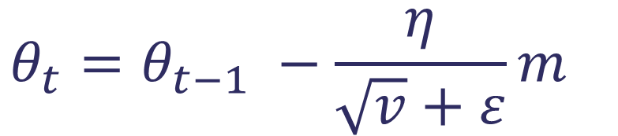
Optimisation: Adam
Similar to AdaDelta
Add in information about the mean of the momentum of previous steps too
Works very well in most situations
Mean of last n gradients
Old parameter
New parameter
$$θ_{t}=θ_{t−1} −\frac{η}{\sqrt{v}+ε}m_{}$$
Variance of last n gradients

Slide 30
Building block: Adam optimizer
from tensorflow.keras import optimizers
adam = optimizers.Adam(learning_rate=0.001, beta_1=0.9, beta_2=0.999, epsilon=1e-07, amsgrad=False)

Slide 31

Optimizer: Which one
SGD and variants work fine for dense datasets
Adaptive optimizers are much better for sparse datasets
Adam works well in practice and outperforms other Adaptive techniques.

Slide 32
Go to notebook
Its time to compile and run the network

Slide 33
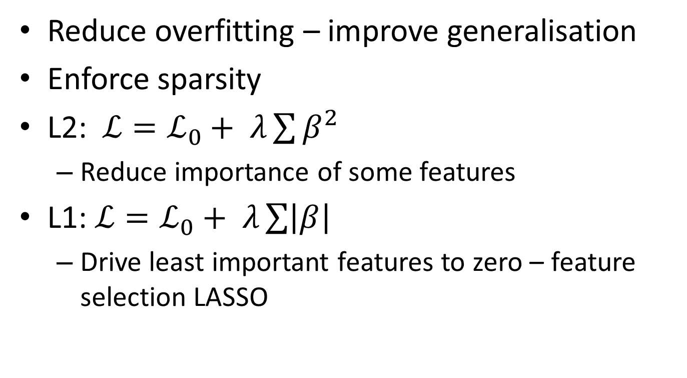
Regularisation
Reduce overfitting – improve generalisation
Enforce sparsity
L2: $ℒ=ℒ_{0}+ λ\sum{β^{2}}$
Reduce importance of some features
L1: $ℒ=ℒ_{0}+ λ\sum{\left|β\right|}$
Drive least important features to zero – feature selection LASSO

Slide 34
Building block: Regularisation
from tensorflow.keras.regularizers import l1
reg = l1(0.001)
model.add(Dense(32, activity_regularizer=reg))
model.add(Conv2D(32, (3,3), activity_regularizer=reg))

Slide 35
Dropout
from tensorflow.keras.layers import Dropout
model.add(Dropout(0.5))

Slide 36
Go to notebook
Its time to compile and run the network one more time

Slide 37
Concept checklist
Origins of neural networks
Types of layers – input, hidden, output
Dense/fully-connected layers
Activation functions
Loss functions
Back propagation
Batch/epoch
Optimisers
Regularisation/Dropout

Slide 38
Thank you
Twitter:@ml_sci

