Slide 1



atools training session
Geert Jan Bex (geertjan.bex@uhasselt.be)
License: this presentation is released under the Creative Commons CC BY 4.0, see https://creativecommons.org/licenses/by/4.0/deed.ast

Slide 2

http://bit.ly/2qouLp2

Slide 3
Conventions
Commands and file names inline, e.g., $HOME
Command line
Scripts
$ vim my_file.txt
#!/usr/bin/env bash
echo "hello world"
script.sh

Slide 4
Introduction
Patterns for parallel computing
embarrassingly parallel workloads
…
Happens a lot
many scientific domains
Support for pattern
make it easy to do
do the bookkeeping for you

Slide 5
Scenario: parameter exploration

Slide 6
Use case: parameter exploration
temperature | pressure | humidity
293.0 | 1.0e05 | 87
… | … | …
313.0 | 1.3e05 | 75
#!/bin/bash –l
#PBS –l nodes=2:ppn=36 -l walltime=00:15:00
cd $PBS_O_WORKDIR mpirun weather –p 1.0e05 –t 293.0 –h 87
job_01.pbs
#!/bin/bash –l
#PBS –l nodes=2:ppn=36 -l walltime=00:15:00
cd $PBS_O_WORKDIR mpirun weather –p 1.003e05 –t 293.3 –h 67
job_30.pbs
Many multinode computations
…
#!/bin/bash –l
#PBS –l nodes=2:ppn=36 -l walltime=00:15:00
cd $PBS_O_WORKDIR mpirun weather –p 1.3e05 –t 313.0 –h 75
job_60.pbs
…

Slide 7
Solution: aenv
temperature | pressure | humidity
293.0 | 1.0e05 | 87
… | … | …
313.0 | 1.3e05 | 75
data.csv
#!/bin/bash –l
#PBS –l nodes=2:ppn=36 -l walltime=00:15:00
module load atools
source <(aenv --data data.csv)
cd $PBS_O_WORKDIR mpirun weather –p $pressure –t $temperature \
–h $humidity
job.pbs
$ module load atools
$ array_ids=$(arange --data data.csv)
$ qsub -t ${array_ids} job.pbs

Slide 8
Data exploration: steps
Write PBS script with parameters
add line to initialize parameters: aenv
Create Excel sheet with data
Convert to CSV format
Submit with qsub -t …

Slide 9
Torque job arrays
Torque supports job arrays, i.e.,
$ qsub –t 1-100 job_array.pbs
#!/bin/bash –l
#PBS –l nodes=2:ppn=36
cd $PBS_O_WORKDIR cfd-sim –i "params-$PBS_ARRAYID" \
–o "result-$PBS_ARRAYID"
job_array.pbs
#!/bin/bash –l
#PBS –l nodes=2:ppn=36
cd $PBS_O_WORKDIR cfd-sim –i "params-1" \
–o "result-1"
#!/bin/bash –l
#PBS –l nodes=2:ppn=36
cd $PBS_O_WORKDIR cfd-sim –i "params-100" \
–o "result-100"
…

Slide 10
And MapReduce?
Supported through scheduler → job dependencies
$ array_ids=$(arange --data data.csv)
$ prolog_id=$(qsub prolog.pbs)
$ batch_id=$(qsub -W depend=afterok:${prolog_id} \
-t ${array_ids} job.pbs)
$ qsub -W depend=afterok:${batch_id} epilog.pbs

Slide 11
Job dependencies
data.txt.1
job.pbs
result.txt.1
data.txt.2
job.pbs
result.txt.2
data.txt
result.txt
prolog.pbs
epilog.pbs
…
…
data.txt.7
job.pbs
result.txt.7

Slide 12
atools features

Slide 13
Logging
Logging for
bookkeeping: success/failures?
redo failures
performance analysis
Scheduler provides logs
inconvenient
not always user-accessible

Slide 14
Logging: alog
#!/bin/bash –l
#PBS –l nodes=2:ppn=36
module load atools/1.4.4
source <(aenv --data data.csv)
cd $PBS_O_WORKDIR
alog --state start mpirun weather –p $pressure –t $temperature \
–h $humidity
alog --state end --exit $?
job.pbs
1 started by r1i1n3 at 2016-09-02 11:47:45
2 started by r1i1n3 at 2016-09-02 11:47:45
3 started by r1i1n3 at 2016-09-02 11:47:46
2 failed by r1i1n3 at 2016-09-02 11:47:46: 1
3 completed by r1i1n3 at 2016-09-02 11:47:47
…
job.pbs.log145485

Slide 15
Monitoring: arange
For running or finished job
$ arange --data data.csv \
--log job.pbs.log145485 \ --summary

Slide 16
Resuming jobs: arange again
Resume a job that hit the walltime
Redo failed work items
$ array_ids=$(arange --data data.csv \
--log job.pbs.log145485)
$ qsub -t ${array_ids} -l walltime=5:00:00 \
job.pbs
$ array_ids=$(arange --data data.csv \
--log job.pbs.log145485 \
--redo)

Slide 17
Adapting PBS files: acreate
Automatically adapt PBS file for atools
only logging
logging and using aenv
$ acreate job.pbs > job_atools.pbs
$ acreate --data data.csv \
job.pbs > job_atools.pbs

Slide 18
Simple aggregations: areduce
Almost automatic data aggregation:
Takes care of
missing files (failed items)
incomplete data (failed items), use --t $(arange --data data.csv \ --log job.pbs.log145485 \ --list_completed)
correct order
For CSV, use --mode csv
single column row
areduce --t 1-100 \
--pattern output-{t}.txt \
--output output.txt
PBS_ARRAYID

Slide 19
Non-trivial aggregations: areduce
More general data aggregation:
Reductor can be any executable
"appends" new data to existing file
takes two command line arguments
name of file with all output data
name of file to "append"
extra argument using --reduce_args …
areduce –-t 1-100 --data data.csv \
--pattern output-{t}.txt \
--empty empty.bin \
--reduce reductor.sh \
--out output.bin

Slide 20
Job statistics: aload
Load balance is mostly taken care of by scheduler, but
do all jobs approximately the same amount of work?
Use aload to analyze runs
report on work items: --list_tasks
report on nodes: --list_slaves
$ aload -–log run.pbs.log445948

Slide 21
CSV formats
atools is flexible
tries to determine CSV dialect by reading part of file & analyzing
default: 1024 bytes
Specify number of bytes to use: --sniff <nr_bytes>
use for CSV files with long lines

Slide 22

Help on atools
See documentation http://atools.readthedocs.io/
Each command has help, use -h or --help
http://bit.ly/2qh9kGK

Slide 23
Hold your horses, my C/C++/Fortran/R
program doesn't do command line
arguments, and I hate programming that!
No worries, there's an app
for that: parameter-weaver

Slide 24
Interlude: parameter-weaver

Slide 25
Motivation
Dealing with command line arguments and configuration files is
boring
error prone
fragile
parameter-weaver
takes parameter description file (CSV)
parameter type/name/default value
generates data structure/functions to easily access
command line arguments
parameters in configuration files
Works for C/C++/Fortran/R
for Python, use argparse/ConfigParser in standard library
Code generation ⇒ no dependencies, no libraries!

Slide 26
C example: code generation
Parameter description file
Code generation
Creates cl_params.c, cl_params.h, cl_params_aux.c, cl_params_aux.h
int rank 2
int max_nr_points 1000
int delta_nr_points 100
int bucket_size 10
int verbose 0
params.txt
$ module load parameter-weaver
$ weave –l C -d params.txt

Slide 27
C example: code use
In C program
…
#include "cl_params.h"
…
int main(int argc, char *argv[]) {
…
Params params;
initCL(&params);
parseCL(&params, &argc, &argv);
if (params.verbose)
dumpCL(stderr, "# ", &params);
tree_spatial_dims_alloc(params, &center, &extent);
…
finalizeCL(&params);
return 0;
}
overhead.c

Slide 28
Features
Supports all basic types
C/C++: int, float, double, char, char*
Fortran: integer, real, double precision, character(len=…), logical
Parameters can be
on command line
in configuration file
Parameters have default values

Slide 29

Help on parameter-weaver
See documentation http://parameter-weaver.readthedocs.io/
Each command has help, use -h
http://bit.ly/2NeoB3Q

Slide 30
Scaling

Slide 31
What you hope/expect for…
strong scaling
weak scaling
execution time
nr. processes
Is this going
to happen?
system size
execution time ∼
nr. processes

Slide 32

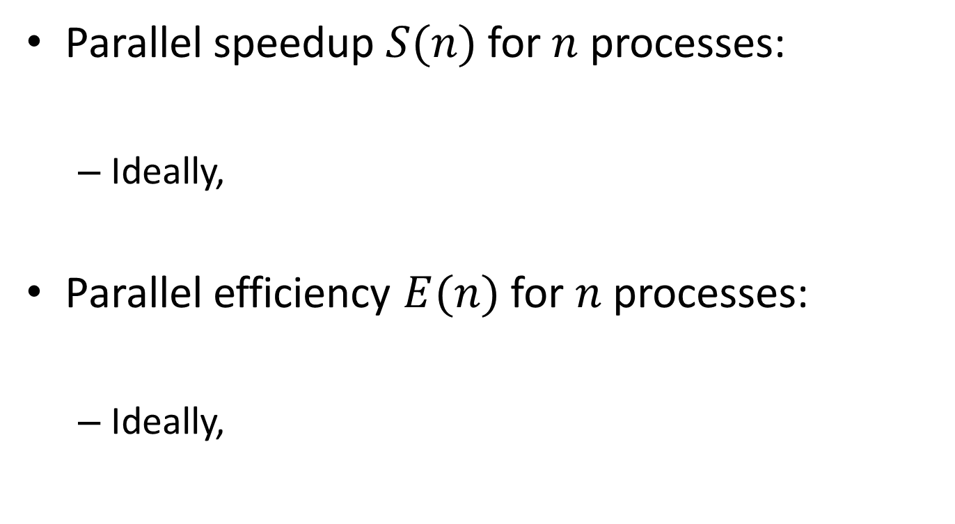



Definitions
Parallel speedup $S(n)$ for $n$ processes:
Ideally,
Parallel efficiency $E(n)$ for $n$ processes:
Ideally,
$$S(n)=\frac{T_{1}}{T_{n}}$$
$$S(n)=n$$
$$E(n)=\frac{T_{1}}{nT_{n}}$$
$$E(n)=1$$

Slide 33
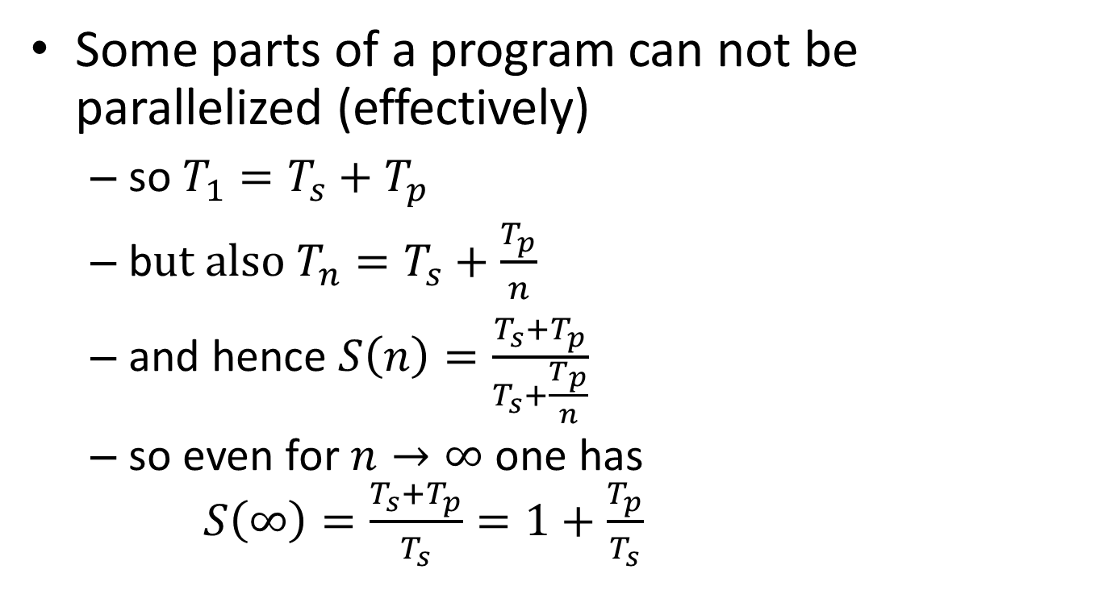
Strong scaling: oops!?!
Some parts of a program can not be parallelized (effectively)
so $T_{1}=T_{s}+T_{p}$
b$ut also T_{n}=T_{s}+\frac{T_{p}}{n}$
and hence $S\left(n\right)=\frac{T_{s}+T_{p}}{T_{s}+\frac{T_{p}}{n}}$
so even for $n→∞$ one has $S\left(∞\right)=\frac{T_{s}+T_{p}}{T_{s}}=1+\frac{T_{p}}{T_{s}}$
Hard limit on speedup due to serial part: Amdahl's law

Slide 34
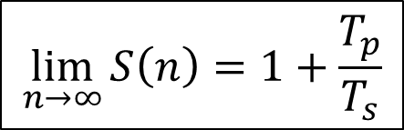

Amdahl's law
speedup
nr. processes
$$\lim_{n→∞}{S\left(n\right)=1+\frac{T_{p}}{T_{s}}}$$
$$\lim_{n→∞}{E\left(n\right)=0}$$

Slide 35
It gets worse…
Overhead!
communication takes time
finite bandwidth
non-zero latency
resource contention
memory subsystem: L3 cache, RAM, QPI
network access
speedup
nr. processes

Slide 36
Picking the sweet spot
sweet spot
speedup
sweet spot
2
4
8
nr. processes
efficiency
2
4
8
nr. processes

Slide 37
Throughput computing
N independent tasks
Total number of cores n << N
Execution time single task, 1 thread: t₁
Execution time single task, n threads: t_{n}
Multithreading or not?
However: memory, total time to solution?

Slide 38
atools tuning

Slide 39
How to use atools well?
Work items may need to use at least a node
no technical reason, just credits/policies
time(work item) > 1 minute
Remember: limits to number of jobs in queue
Limit number of concurrent jobs
e.g., licenses
$ qsub -t ${array_ids}%5 job.pbs
at most 5 tasks concurrently

Slide 40
atools & conflicts
atools module required
in PBS scripts
for submitting jobs
However, conflicts avoided by wrapper scripts

Slide 41
How to kill a cluster in one easy step?
… and earn the scorn of you fellow users?
Just do massive I/O!

Slide 42
Scenarios for disaster
I/O on many small files
Many small read/write operations
Sophisticated workflows with files as intermediate artefacts
Take I/O into account when planning jobs!
Often implemented via I/O redirection in shell
Meta-data IOPS
Exacerbated by using worker/atools!
…
tool1 < input1 > output1
tool2 --input output1 > output2
tool3 --conf output2 --input output1 > output3
…
job.pbs

Slide 43
Tools to help
datasink
simple to use
based on Bash shell I/O redirection
requires parallel file system
quite fast
mem_io
reasonably easy to use
based on Bash shell I/O redirection
uses redis in-memory database
very fast
Pretty new: contact support!

Slide 44
Conclusions

Slide 45
Conclusions
Lot of tools to support your workflow
Designed to make
simple tasks trivial
somewhat tricky things easy
hard stuff doable
Actively supported
Reasonable attempt at documentation
Suggestions & feature requests welcome!
contact geertjan.bex@uhasselt.be

Slide 46

Shameless plug
Defensive Programming & Debugging https://www.futurelearn.com/courses/defensive-programming-and-debugging
Fortran for Scientific Computing https://www.futurelearn.com/courses/fortran-for-scientific-computing

Slide 47
References
atools
website: https://github.com/gjbex/atools
documentation: http://atools.readthedocs.io/
datasink
website: https://github.com/gjbex/datasink
documentation: http://datasink.readthedocs.io/
mem_io
website: https://github.com/gjbex/mem_io
documentation: http://mem_io.readthedocs.io/
parameter-weaver
website: https://github.com/gjbex/parameter-weaver/
documentation: http://parameter-weaver.readthedocs.org/

Slide 48
Appendix: atools implementation

Slide 49
atools implementation
Front end
Bash scripts, wrappers around Python scripts
Bash features in PBS scripts
Back end
Python 2.7.x scripts

Slide 50
Bash feature refresher
Assigning result of command to variable
Creating file handle for command input from command output
$ array_ids=$(arange --data data.csv)
…
source <(aenv --data data.csv)
…
job.pbs

