Slide 1
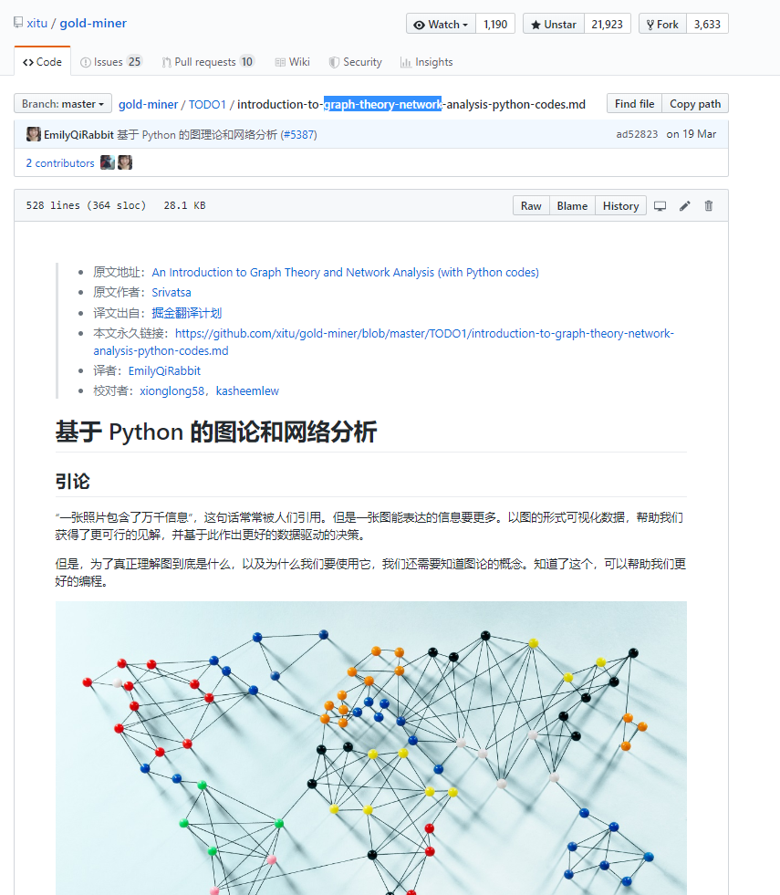
知识图谱
基于Python的图论和网络分析
https://github.com/xitu/gold-miner/blob/master/TODO1/introduction-to-graph-theory-network-analysis-python-codes.md
Notes:
https://github.com/xitu/gold-miner/blob/master/TODO1/introduction-to-graph-theory-network-analysis-python-codes.md

Slide 2
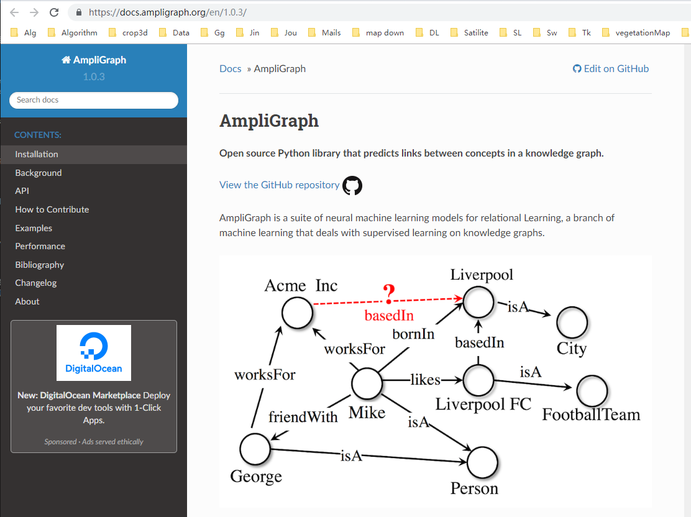
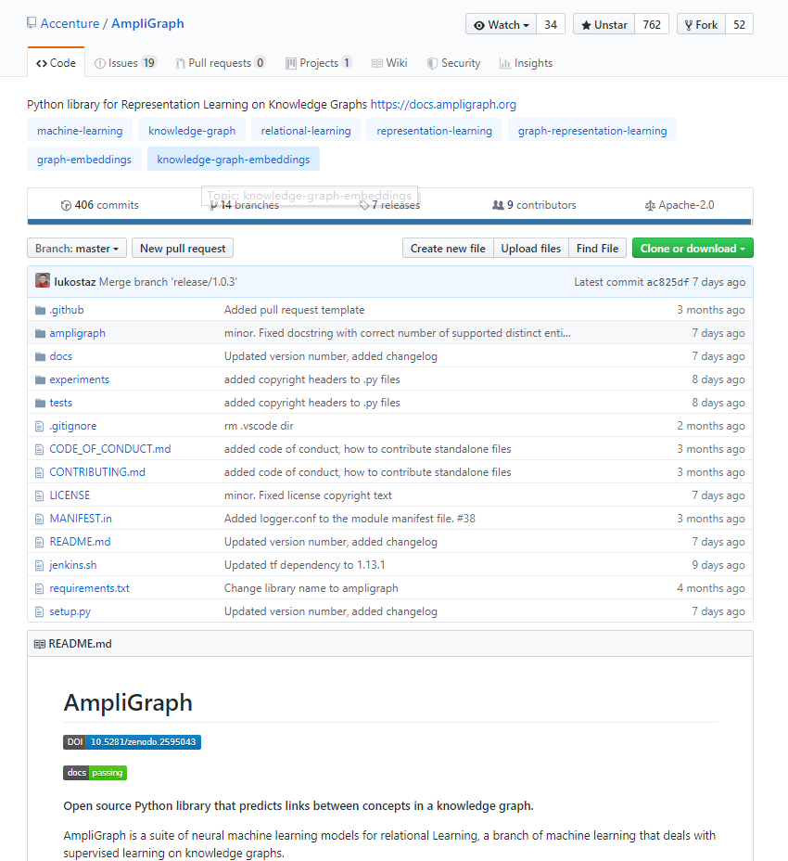
AmpliGraph
https://docs.ampligraph.org/en/1.0.3/
Notes:
https://docs.ampligraph.org/en/1.0.3/

Slide 3
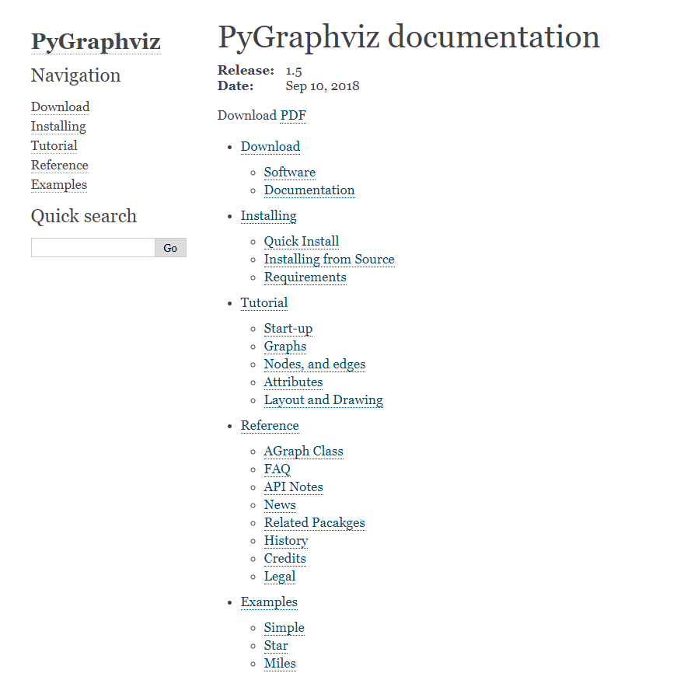
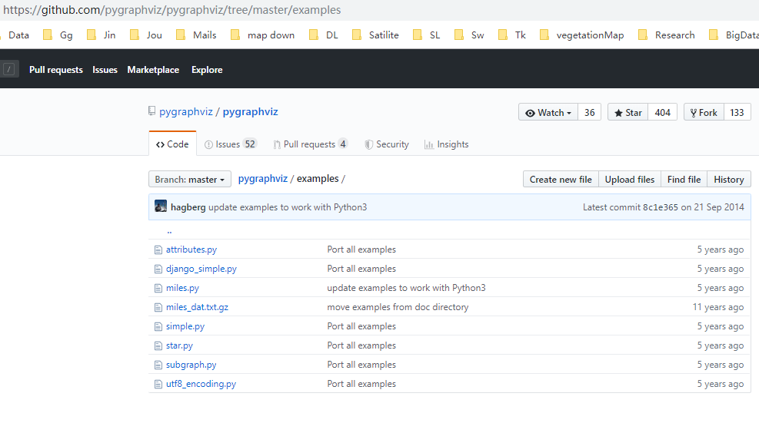
PyGraphviz
http://pygraphviz.github.io/documentation/latest/index.html
https://github.com/pygraphviz/pygraphviz/tree/master/examples
Notes:
http://pygraphviz.github.io/documentation/latest/index.html
https://github.com/pygraphviz/pygraphviz/tree/master/examples

Slide 4
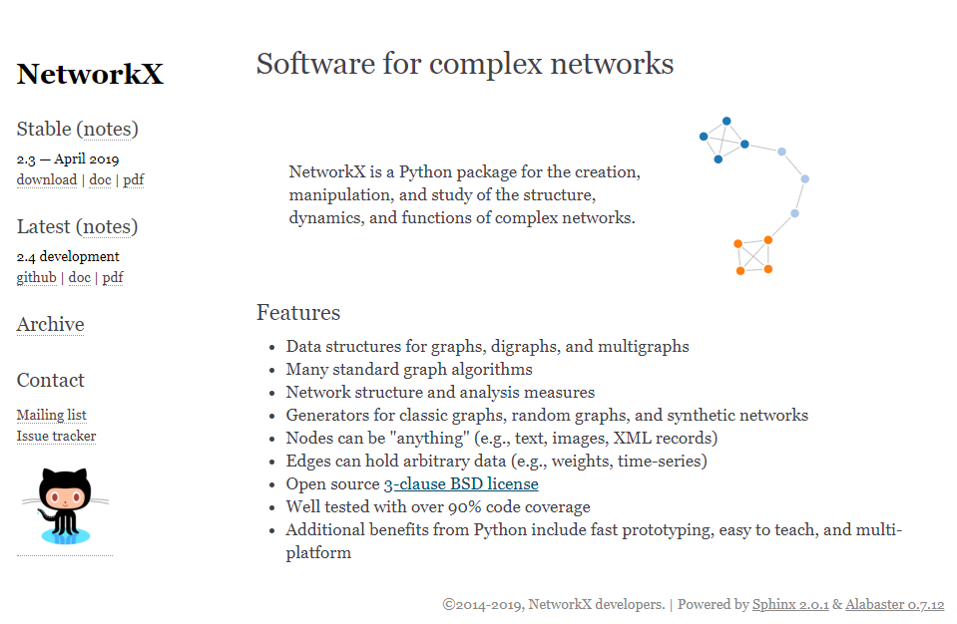
NetworkX
Notes:
https://networkx.github.io/
https://networkx.github.io/documentation/stable/auto_examples/index.html
https://zhuanlan.zhihu.com/p/36700425

Slide 5
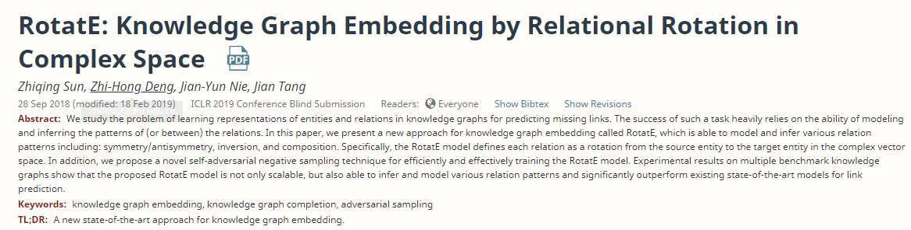
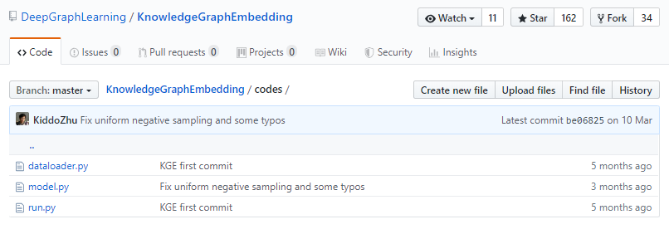
RotatE

Slide 6
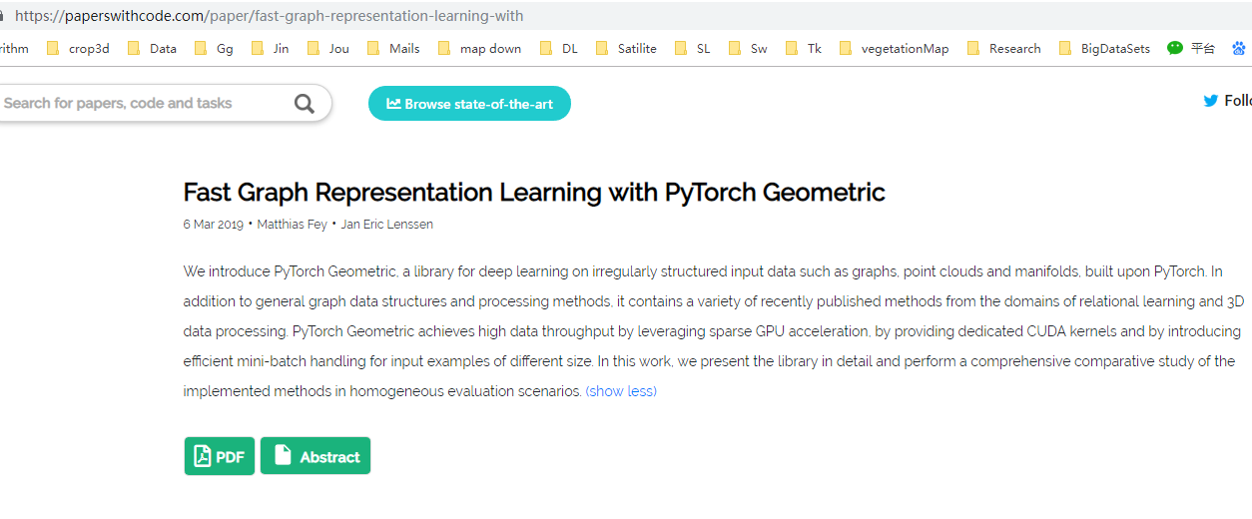
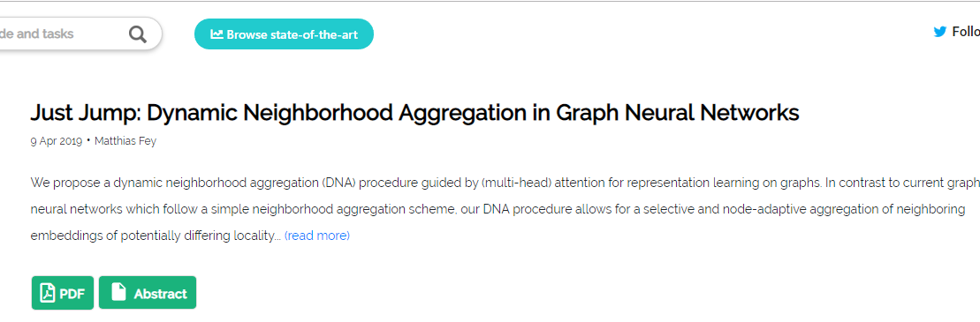
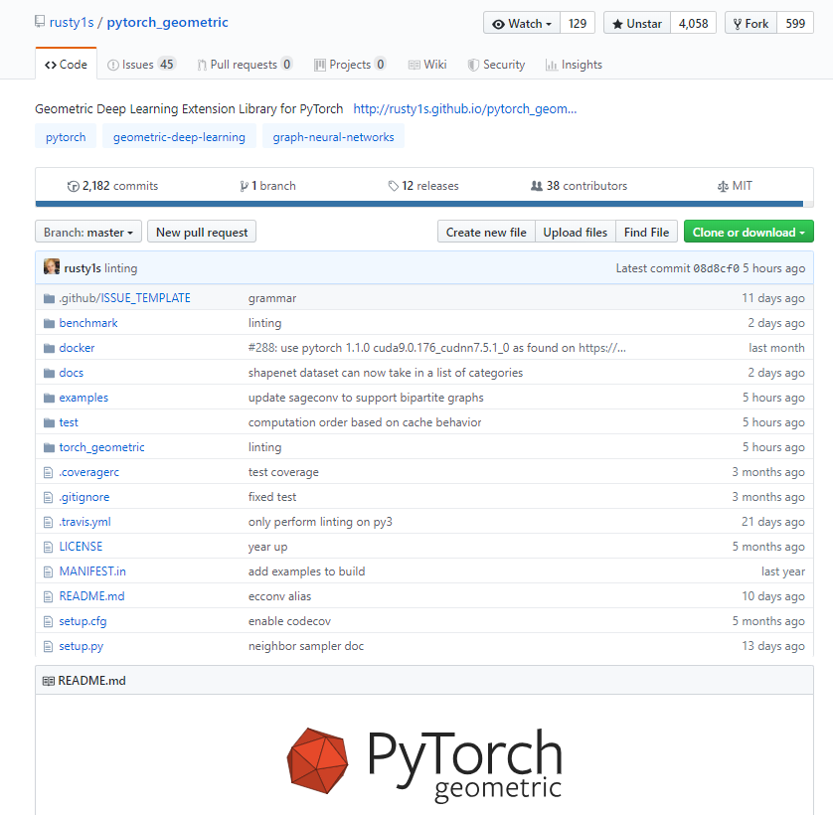

Slide 7
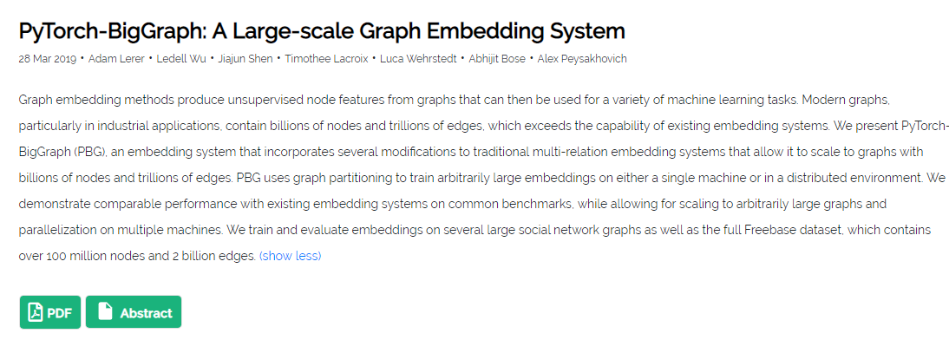
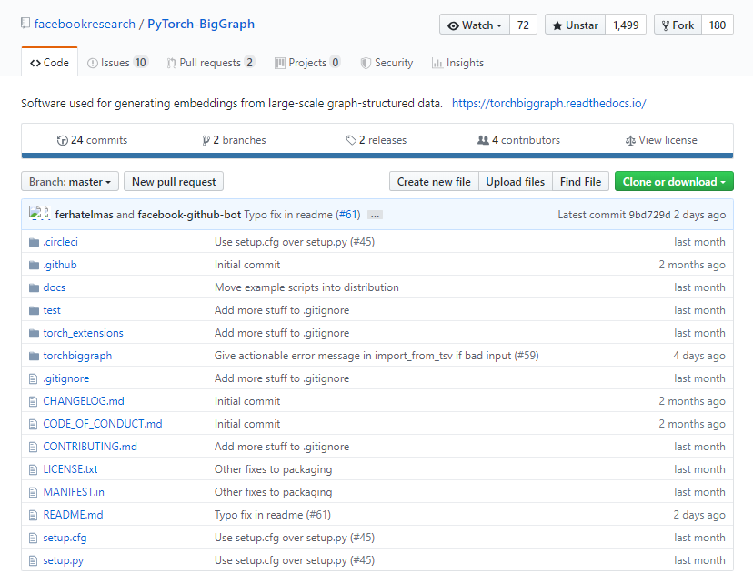
Notes:
https://paperswithcode.com/paper/pytorch-biggraph-a-large-scale-graph
https://github.com/facebookresearch/PyTorch-BigGraph

Slide 8
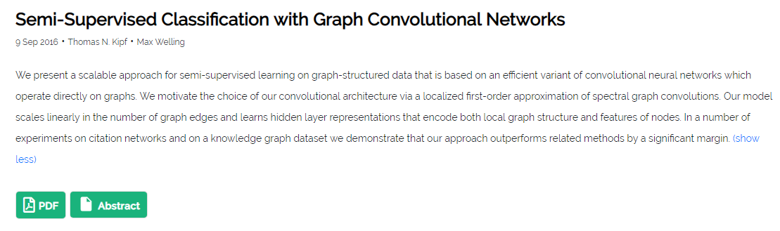
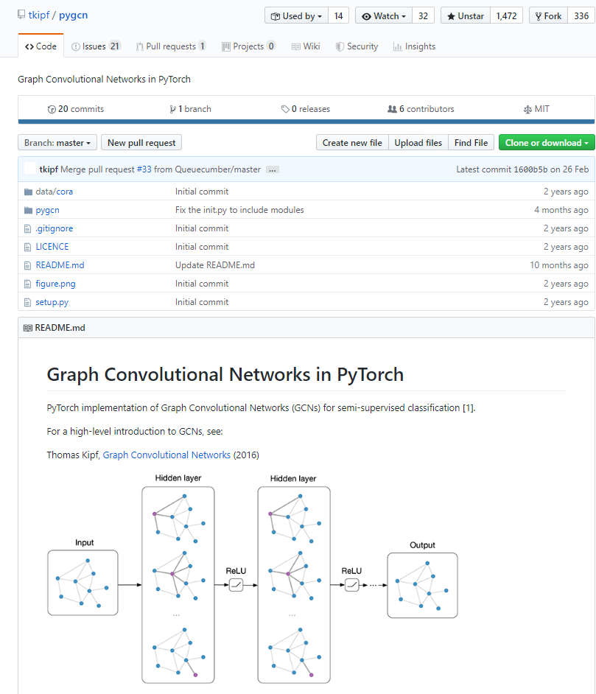

Slide 9
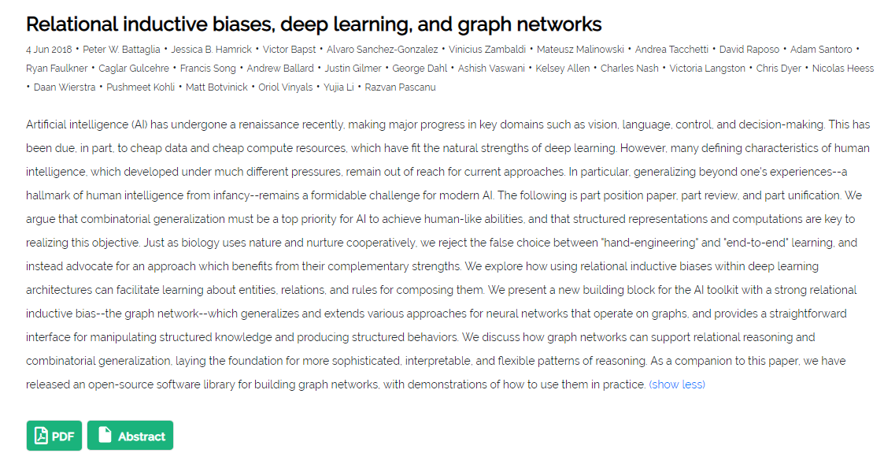
Notes:
https://paperswithcode.com/paper/relational-inductive-biases-deep-learning-and

Slide 10
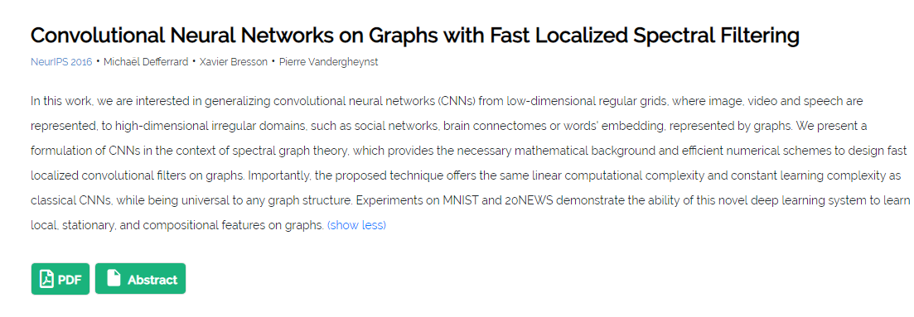
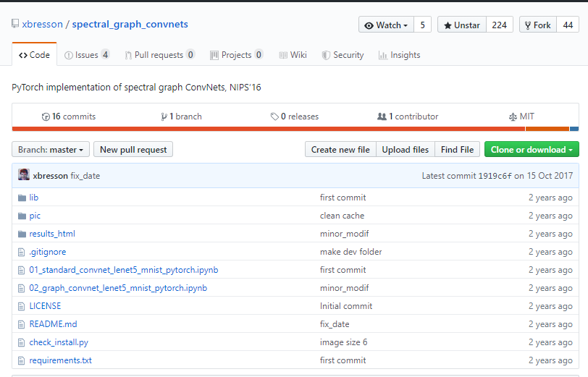
Notes:
https://paperswithcode.com/paper/convolutional-neural-networks-on-graphs-with
https://github.com/xbresson/spectral_graph_convnets

Slide 11
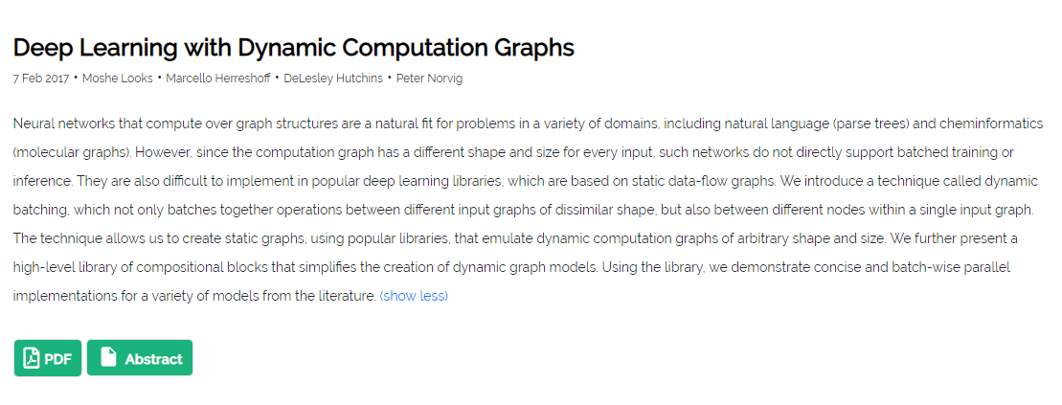
Notes:
https://paperswithcode.com/paper/deep-learning-with-dynamic-computation-graphs

Slide 12
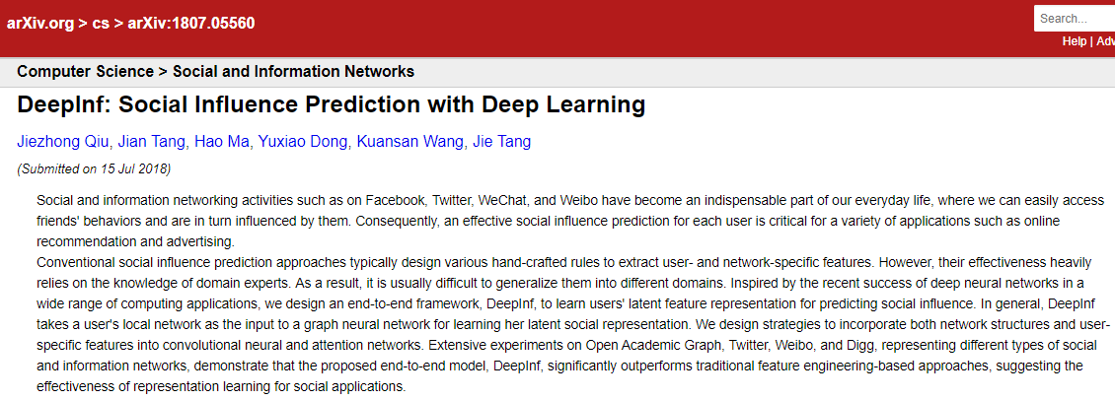
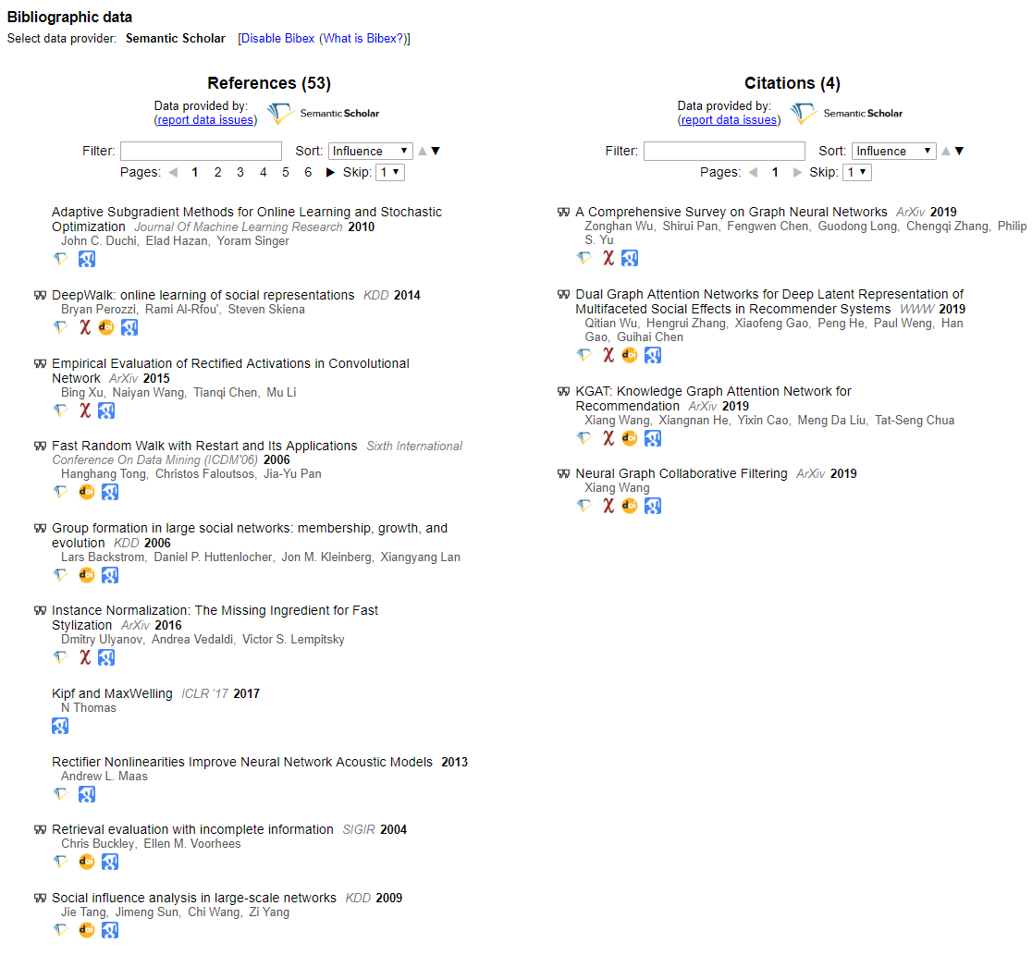
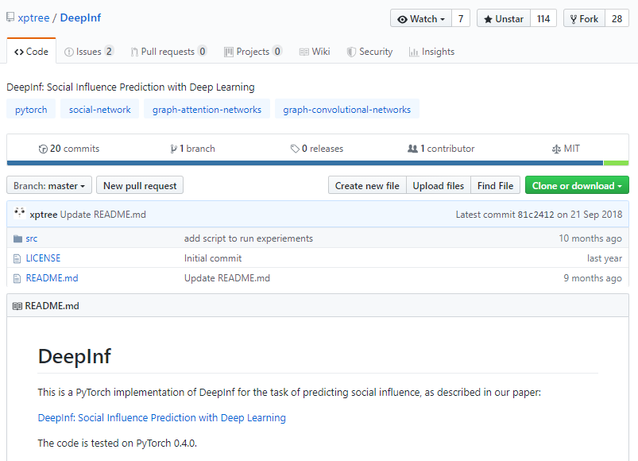
Notes:
https://arxiv.org/abs/1807.05560
https://github.com/xptree/DeepInf

