Slide 1
ECE/CS 552: Arithmetic and Logic
© Prof. Mikko Lipasti
Lecture notes based in part on slides created by Mark Hill, David Wood, Guri Sohi, John Shen and Jim Smith

Slide 2
Basic Arithmetic and the ALU
Number representations: 2’s complement, unsigned
Addition/Subtraction
Add/Sub ALU
  Full adder, ripple carry, subtraction
Logical operations
  and, or, xor, nor, shifts
Overflow

Slide 3
Basic Arithmetic and the ALU
Covered later in the semester:
  Integer multiplication, division
  Floating point arithmetic
These are not crucial for the project

Slide 4
Background
Recall
  n bits enables 2^{n} unique combinations
Notation: b₃₁ b₃₀ … b₃ b₂ b₁ b₀
No inherent meaning
  f(b₃₁…b₀) => integer value
  f(b₃₁…b₀) => control signals

Slide 5
Background
32-bit types include
  Unsigned integers
  Signed integers
  Single-precision floating point
  MIPS instructions (refer to book)

Slide 6
Unsigned Integers
f(b₃₁…b₀) = b₃₁ x 2³¹ + … + b₁ x 2¹ + b₀ x 2⁰
Treat as normal binary number
  E.g. 0…01101010101
  = 1 x 2⁷ + 1 x 2⁶ + 0 x 2⁵ + 1 x 2⁴ + 1 x 2³ + 0 x 2¹ + 1 x 2⁰
  = 128 + 64 + 16 + 4 + 1 = 213
Max f(111…11) = 2³² – 1 = 4,294,967,295
Min f(000…00) = 0
Range [0,2³²-1] => # values (2³²-1) – 0 + 1 = 2³²

Slide 7
Signed Integers
2’s complement
  f(b₃₁…b₀) = -b₃₁ x 2³¹ + … b₁ x 2¹ + b₀ x 2⁰
Max f(0111…11) = 2³¹ – 1 = 2147483647
Min f(100…00) = -2³¹ = -2147483648 (asymmetric)
Range[-2³¹,2³¹-1] => # values(2³¹-1 - -2³¹) = 2³²
Invert bits and add one: e.g. –6
  000…0110 => 111…1001 + 1 => 111…1010

Slide 8
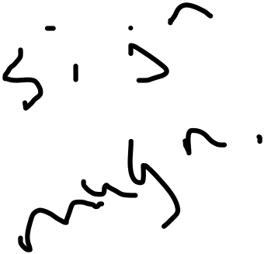
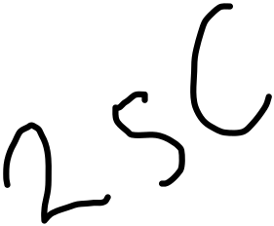


Why 2’s Complement
Why not use sign-magnitude?
2’s complement makes hardware simpler
Just like humans don’t work with Roman numerals
Representation affects ease of calculation, not correctness of answer
000
000
111
001
111
0
001
-1
0
1
-3
1
110
-2
2
010
110
-2
2
010
-3
-1
3
-4
3
-0
101
011
101
011
100
100

Slide 9


Addition and Subtraction
4-bit unsigned example
4-bit 2’s complement – ignoring overflow
0 | 0 | 1 | 1 |  | 3
1 | 0 | 1 | 0 |  | 10
1 | 1 | 0 | 1 |  | 13
0 | 0 | 1 | 1 |  | 3
1 | 0 | 1 | 0 |  | -6
1 | 1 | 0 | 1 |  | -3

Slide 10
Subtraction
A – B = A + 2’s complement of B
E.g. 3 – 2
0 | 0 | 1 | 1 |  | 3
1 | 1 | 1 | 0 |  | -2
0 | 0 | 0 | 1 |  | 1

Slide 11
Full Adder
Full adder (a,b,c_{in}) => (c_{out}, s)
c_{out} = two or more of (a, b, c_{in})
s = exactly one or three of (a,b,c_{in})
a | b | c_{in} | c_{out} | s
0 | 0 | 0 | 0 | 0
0 | 0 | 1 | 0 | 1
0 | 1 | 0 | 0 | 1
0 | 1 | 1 | 1 | 0
1 | 0 | 0 | 0 | 1
1 | 0 | 1 | 1 | 0
1 | 1 | 0 | 1 | 0
1 | 1 | 1 | 1 | 1

Slide 12
Ripple-carry Adder
Just concatenate the full adders
c
in
Full
Full
Full
Full
Add
Add
Add
Add
er
er
er
er
C
out
a
0
b
a
1
b
a
2
b
a
31
b
0
1
2
31

Slide 13
Ripple-carry Subtractor
A – B = A + (-B) => invert B and set c_{in} to 1
Full
Full
Full
Full
Add
Add
Add
Add
C
out
1
er
er
er
er
a
0
b
a
1
b
a
2
b
a
3
b
0
1
2
3

Slide 14
Combined Ripple-carry Adder/Subtractor
Control = 1 => subtract
XOR B with control and set c_{in0} to control
Full
Full
Full
Full
Add
Add
Add
Add
C
out
er
er
er
er
operation
b
0
b
1
b
2
b
31
a
0
a
1
a
2
a
31

Slide 15
Logical Operations
Bitwise AND, OR, XOR, NOR
  Implement w/ 32 gates in parallel
Shifts and rotates
  rol => rotate left (MSB->LSB)
  ror => rotate right (LSB->MSB)
  sll -> shift left logical (0->LSB)
  srl -> shift right logical (0->LSB)
  sra -> shift right arithmetic (old MSB->new MSB)

Slide 16
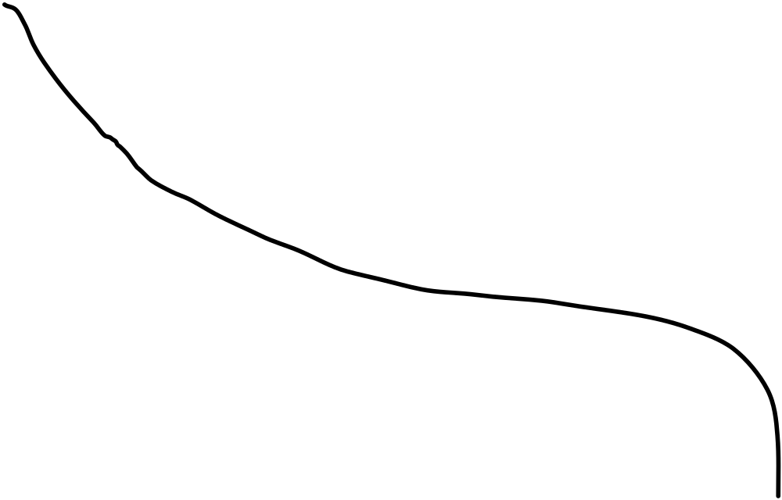
Shifter
x₇
x₆
x₅
x₄
x₃
x₂
x₁
x₀
s₀
Shift by 1
s₁
Shift by 2
s₂
Shift by 4
Right shift logic shown: missing inputs are 0
  Left shift logic similar
Rotate: wraparound instead of 0 inputs

Slide 17
All Together
operation
invert
carry
in
a
x
result
u
M
b
x
u
Add
M

Slide 18
Overflow
With n bits only 2^{n} combinations
  Unsigned range [0, 2^{n}-1]
  2’s complement range [-2^{n-1}, 2^{n-1}-1]
Unsigned Add
5 + 6 > 7: 101 + 110 => 1011
f(3:0) = a(2:0) + b(2:0) => overflow = f(3)
Carryout from MSB

Slide 19
Overflow
More involved for 2’s complement
-1 + -1 = -2:
111 + 111 = 1110
110 = -2 is correct
Can’t just use carry-out to signal overflow

Slide 20
Addition Overflow
When is overflow NOT possible?
  (p1, p2) > 0 and (n1, n2) < 0
  p1 + p2
  p1 + n1 not possible
  n1 + p2 not possible
  n1 + n2
Just checking signs of inputs is not sufficient

Slide 21
Addition Overflow
2 + 3 = 5 > 4: 010 + 011 = 101 =? –3 < 0
  Sum of two positive numbers should not be negative
    Conclude: overflow
-1 + -4: 111 + 100 = 011 > 0
  Sum of two negative numbers should not be positive
    Conclude: overflow
Overflow = f(2) * ~(a2)*~(b2) + ~f(2) * a(2) * b(2)
Notes:
If I add 2 pos. numbers and get a negative result => overflow
If I add 2 neg. numbers and get a positive result => overflow

Slide 22
Subtraction Overflow
No overflow on a-b if signs are the same
Neg – pos => neg ;; overflow otherwise
Pos – neg => pos ;; overflow otherwise
Overflow = f(2) * ~(a2)*(b2) + ~f(2) * a(2) * ~b(2)

Slide 23
What to do on Overflow?
Ignore ! (C language semantics)
  What about Java? (try/catch?)
Flag – condition code
Sticky flag – e.g. for floating point
  Otherwise gets in the way of fast hardware
Trap – possibly maskable
  MIPS has e.g. add that traps, addu that does not
  Useful for extended precision in software

Slide 24
Zero and Negative
Zero = ~[f(2) + f(1) + f(0)]
Negative = f(2) (sign bit)

Slide 25
Zero and Negative
May also want correct answer even on overflow
Negative = (a < b) = (a – b) < 0 even if overflow
E.g. is –4 < 2?
  100 – 010 = 1010 (-4 – 2 = -6): Overflow!
Work it out: negative = f(2) XOR overflow

Slide 26
Summary
Binary representations, signed/unsigned
Arithmetic
  Full adder, ripple-carry, adder/subtractor
  Overflow, negative
Logical
  Shift, and, or
  Next: high-performance adders
  Later: multiply/divide/FP

