Slide 1
ECE/CS 552: Carry Lookahead
© Prof. Mikko Lipasti
Lecture notes based in part on slides created by Mark Hill, David Wood, Guri Sohi, John Shen and Jim Smith

Slide 2
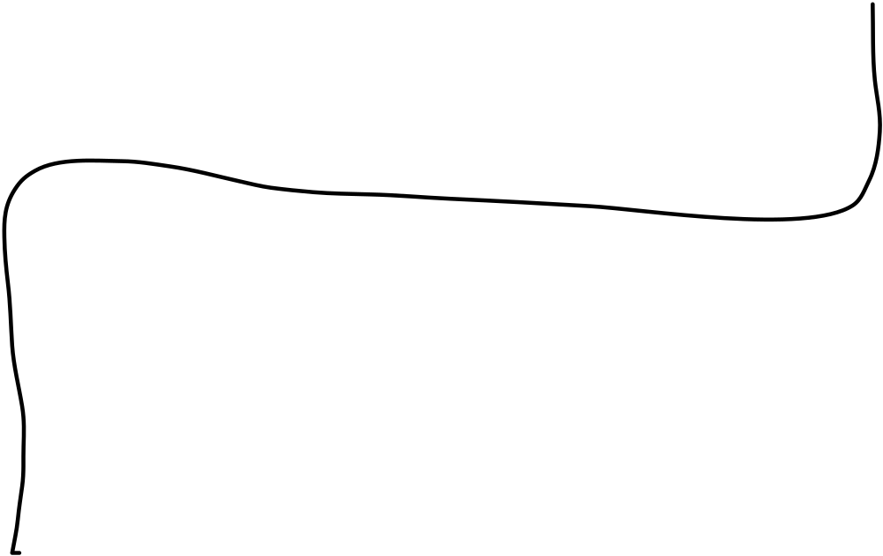
Combined Ripple-carry Adder/Subtractor
Full
Full
Full
Full
Add
Add
Add
Add
C
out
er
er
er
er
operation
b
0
b
1
b
2
b
31
a
0
a
1
a
2
a
31
The above ALU is too slow
  Gate delays for add = 32 x FA + XOR ~= 64

Slide 3
Carry Lookahead
Theoretically, in parallel
  Sum₀ = f(c_{in}, a₀, b₀)
  Sum_{i} = f(c_{in}, a_{i}…a_{0,}, b_{i}…b₀)
  Sum₃₁ = f(c_{in}, a₃₁…a₀, b₃₁…b₀)
Any boolean function in two levels, right?
  Wrong! Too much fan-in!

Slide 4
Carry Lookahead
Need compromise
  Build tree so delay is O(log₂ n) for n bits
  E.g. 2 x 5 gate delays for 32 bits
We will consider basic concept with
  4 bits
  16 bits
Warning: a little convoluted

Slide 5


Carry Lookahead
0101 0100
0011 0110
Need:
both 1 to generate carry
one or both 1s to propagate carry
Define: g_{i} = a_{i} * b_{i} ## carry generate
p_{i} = a_{i} + b_{i} ## carry propagate
Recall: c_{i+1} = a_{i} * b_{i} + a_{i} * c_{i} + b_{i} * c_{i}
= a_{i} * b_{i} + (a_{i} + b_{i}) * c_{i}
= g_{i} + p_{i} * c_{i}

Slide 6
Carry Lookahead
Therefore
c₁ = g₀ + p₀ * c₀
c₂ = g₁ + p₁ * c₁ = g₁ + p₁ * (g₀ + p₀ * c₀)
= g₁ + p₁ * g₀ + p₁ * p₀ * c₀
c₃ = g₂ + p₂ * g₁ + p₂ * p₁ * g₀ + p₂ * p₁ * p₀ * c₀
c₄ = g₃ + p₃*g₂ + p₃*p₂*g₁ + p₃*p₂*p₁*g₀ + p₃*p₂*p₁*p₀*c₀
Uses one level to form p_{i} and g_{i}, two levels for carry
But, this needs n+1 fanin at the OR and the rightmost AND

Slide 7
4-bit Carry Lookahead Adder
c
0
c
4
Carry Lookahead Block
g
p
3
a
3
b
3
g
2
p
2
a
2
b
2
g
p
a
b
g
p
a
b
3
1
1
1
1
0
0
0
0
c
3
c
2
c
c
1
0
s
3
s
2
s
s
1
0

Slide 8
Hierarchical Carry Lookahead for 16 bits
c
0
c
15
Carry Lookahead Block
G
P
a,b
12-15
G
P
a,b
8-11
G
P
a
b
G
P
a
b
4-7
4-7
0-3
0-3
c
12
c
8
c
c
4
0
s
12-15
s
8-11
s
s
4-7
0-3

Slide 9
Hierarchical CLA for 16 bits
Build 16-bit adder from four 4-bit adders
Figure out G and P for 4 bits together
G_{0,3} = g₃ + p₃ * g₂ + p₃ * p₂ * g₁ + p₃ * p₂ * p₁ * g₀
P_{0,3} = p₃ * p₂ * p₁ * p₀ (Notation a little different from the book)
G_{4,7} = g₇ + p₇ * g₆ + p₇ * p₆ * g₅ + p₇ * p₆ * p₅ * g₄
P_{4,7} = p₇ * p₆* p₅ * p₄
G_{12,15} = g₁₅ + p₁₅ * g₁₄ + p₁₅* p₁₄ * g₁₃ + p₁₅ * p₁₄ * p₁₃ * g₁₂
P_{12,15} = p₁₅ * p₁₄ * p₁₃ * p₁₂

Slide 10
Carry Lookahead Basics
Fill in the holes in the G’s and P’s
G_{i, k} = G_{j+1,k} + P_{j+1, k} * G_{i,j} (assume i < j +1 < k )
P_{i,k} = P_{i,j} * P_{j+1, k}
G_{0,7} = G_{4,7} + P_{4,7} * G_{0,3} P_{0,7} = P_{0,3}* P_{4,7}
G_{8,15} = G_{12,15} + P_{12,15} * G_{8,11} P_{8,15} = P_{8,11} * P_{12, 15}
G_{0,15} = G_{8,15} + P_{8,15} * G_{0,7} P_{0,15} = P_{0,7} * P_{8, 15}

Slide 11
CLA: Compute G’s and P’s
G
12,15
G
G
G
8,11
4,7
0,3
P
12,15
P
P
P
8,11
4,7
0,3
G
8,15
G
0,7
P
8,15
P
0,7
G
0,15
P
0,15

Slide 12
CLA: Compute Carries
g
- g
g
8
- g
11
g
4
- g
7
g
0
- g
3
12
15
p
- p
p
- p
p
- p
p
0
- p
3
12
15
8
11
4
7
c
12
c
c
c
8
4
0
G
8,11
G
0,3
P
8,11
P
0,3
c
8
c
0
G
0,7
P
0,7
c
0

Slide 13
Other Adders: Carry Select
Two adds in parallel; with and without c_{in}
  When C_{in} is done, select correct result
Full Adder
0
c
Full Adder
0
Full Adder
1
next
select
2-1 Mux
select

Slide 14
Other Adders: Carry Save
 | 7 | 9
+ | 1 | 8
C,S | 0,8 | 1,7
Final | 8+1=9 | 7
A + B => S
Save carries A + B => S, C_{out}
Use C_{in} A + B + C => S1, S2 (3# to 2# in parallel)
Used in combinational multipliers by building a Wallace Tree
c
b
a
CSA
c
s

Slide 15

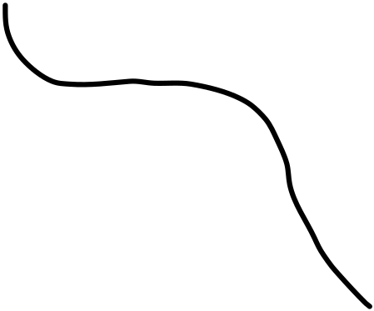



Adding Up Many Bits
f
e
d
c
b
a
CSA
CSA
CSA
S₀
CSA
S₂
S₁

Slide 16
Summary
Carry lookahead
Carry-select, Carry-save
State of the art: parallel prefix adders
  aka. Brent-Kung, Kogge-Stone, …
  Generalization of CLA
  Physical design (e.g. wiring) of primary concern
  Covered in ECE 555

