Slide 1
A few BLAST details
Julin Maloof
April 17, 2018
Slides courtesy of Venkatsean Sundaresan

Slide 2


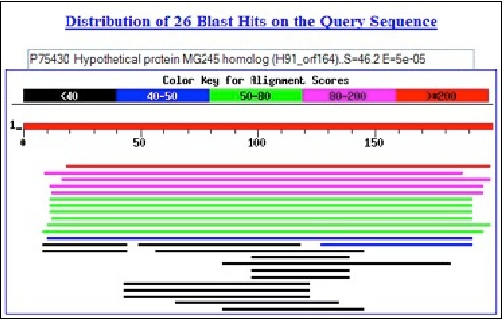
BLAST
(Basic Local Alignment Search Tool)
QUERY sequence(s)
BLAST results
BLAST program
BLAST
database
• Search for similarity to infer “homology”
• “mutual best hits” or reciprocal BLAST

Slide 3
BLAST
BLAST is optimized to search large databases quickly.
How does it do this?

Slide 4
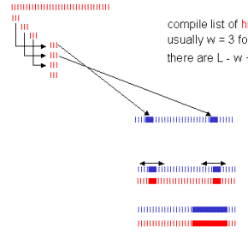
BLAST: Heuristic algorithm
Query sequence of length L (this is the sequence with which you do a search)
Compile list of words (w) from query
usually w=3 for proteins
There are L-w+1 words in sequence L
Begin with high scoring words
Compare word list with sequences in database and identify matches
Extend matches in both directions until further extension causes the score to drop by a certain amount
High scoring segment pair HSP
Galisson EMBER (2000)

Slide 5
Q :ROBJOEZACANNLIZ
Break this up into 3 letter words
ROB,OBJ,BJO,..,ZAC,…ANN,…NLI,LIZ
Search sequences S1, S2, etc. in database
Find a match with the word ZAC then extend on both sides until no or weak matches
Q :ROBJOEZACANNLIZ
S1:TOMZOEZACANNLIA
Q :ROBJOEZACANNLIZ
S2:TOMZOEZACAMYLEA

Slide 6
Search with high scoring words first for better chance of high scoring alignments
Q:LVAAVGVCWDILRAAA
In the above example, BLOSUM62 scores for matches to LVA and CWD are 12 and 26 respectively, so search with CWD
Q:LVAAVGVCWDILRAAA
|| |||||| |
S:AGGAVVVCWDILKAGG

Slide 7
useful parameters
Word size: the size of the chunks that the query sequence is chopped into
Threshold: minimum score for a word match to be considered to seed an extension

Slide 8
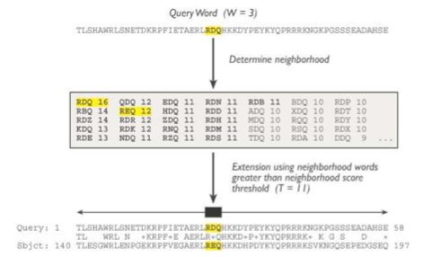
How BLAST works
Seed using neighborhood words greater than neighborhood score threshold (T=11)
HSP = High-scoring Segment Pair – a segment pair whose score will not increase by further extension or by trimming
Score (S) = measures alignment quality (scoring matrix - gaps)
E value (E) = number of different alignments with score S that are expected to occur by chance in a search of that database

Slide 9
BLAST Summary
BLAST essentially computes regions of high “similarity” in local alignments of 2 proteins
BLAST breaks search into “chunks” by finding all subsequences (stretches of similarity, or “words”) of length k (e.g., k=3) that occur in both seqs
build score on matches (scoring matrix, gap cost)
extend from subsequences to see if you can increase score
HSP (High-scoring Segment Pair whose score cannot be improved by extension or trimming)
compute total score (when no more extensions are possible)
Then compare BLAST score against precomputed expected scores for all proteins in database
Then rank score

