Slide 1


Deep Learning Prediction of Chemotherapy Response using Multi-Omics Features
Shicheng Guo
Center for Precision Medicine Research
Marshfield Clinic Research Institute
15/10/2019

Slide 2
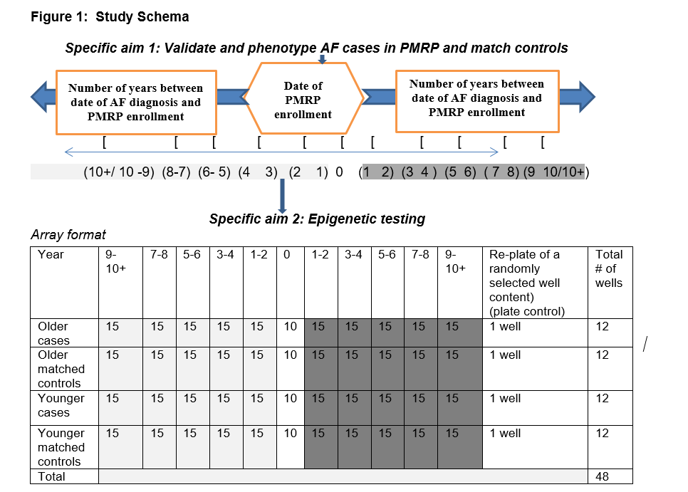

Slide 3
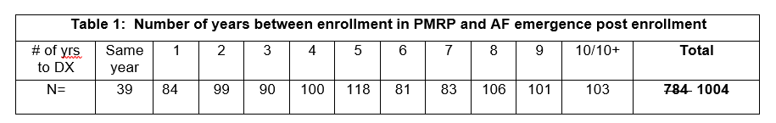
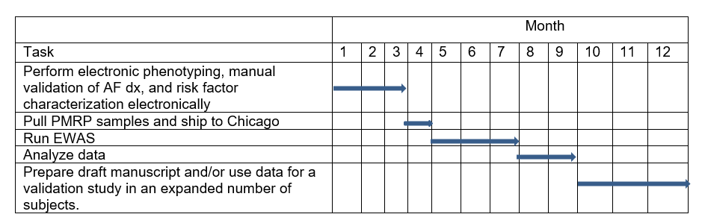

Slide 4
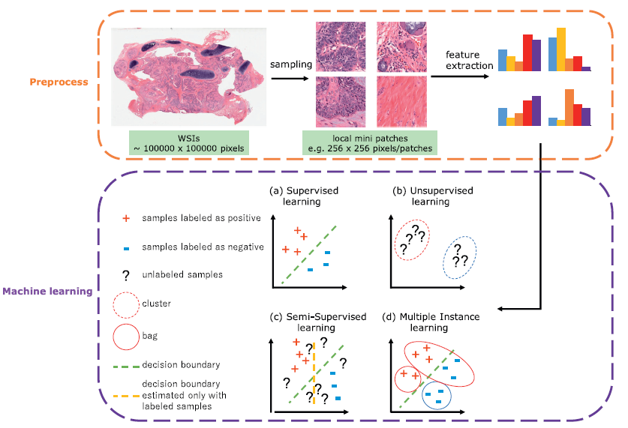
Flowchart for machine learning in digital histological image analysis
D. Komura, S. Ishikawa / Computational and Structural Biotechnology Journal 16 (2018) 34–42

Slide 5
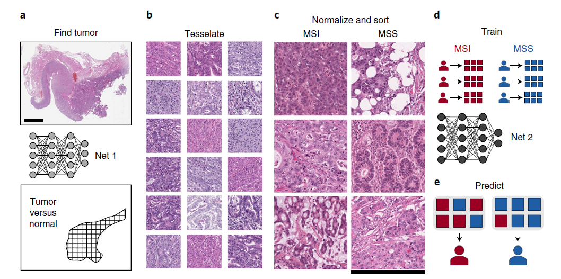
Tumor detection and MSI prediction in H&E histology

Slide 6
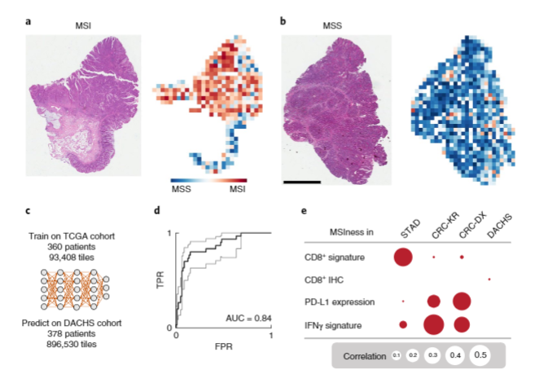
Classification performance in an external validation set

Slide 7
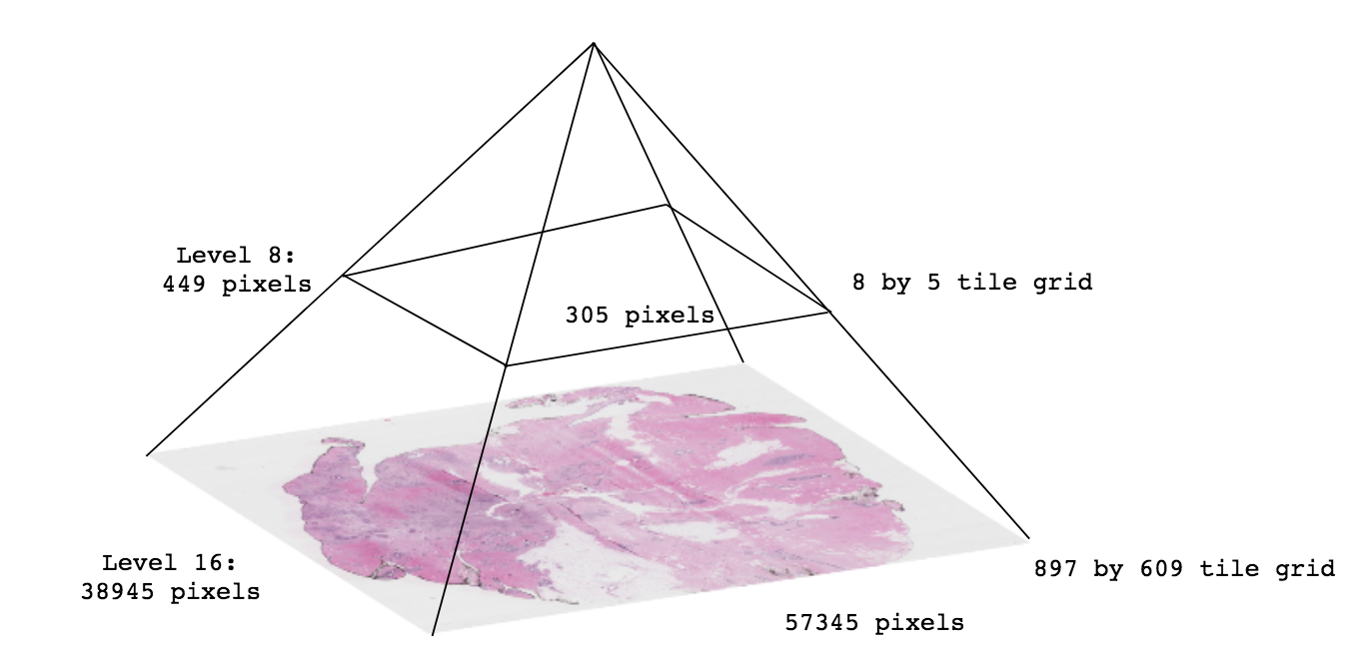
Python package for dealing with whole slide images (.svs) for machine learning, particularly for fast prototyping. Includes patch sampling and storing using OpenSlide. Patches may be stored in LMDB, HDF5 files, or to disk. It is highly recommended to fork and download this repository so that personal customisations can be made for your work.

Slide 8
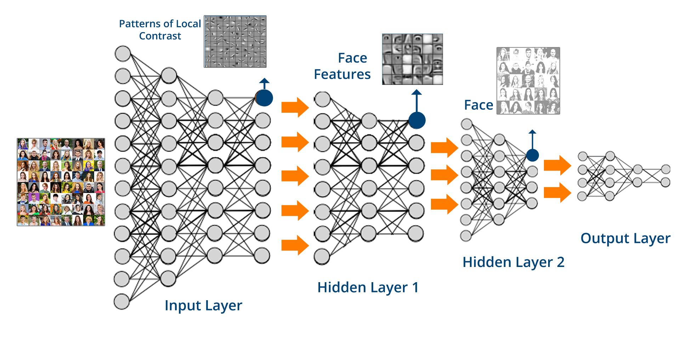
Deep Learning and Deeper Networks in Python

Slide 9
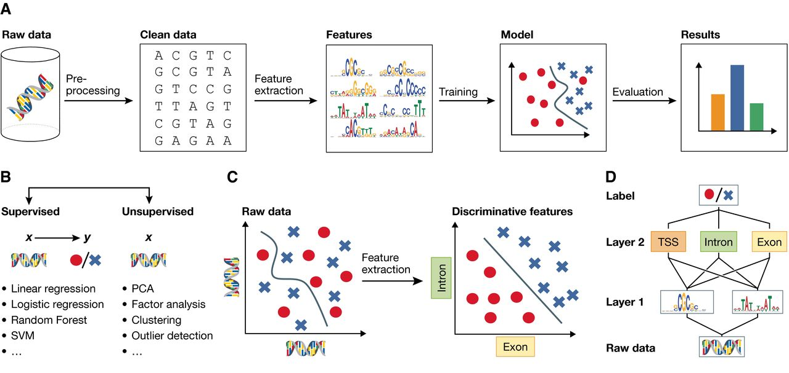
Deep learning for computational biology
Notes:
http://msb.embopress.org/content/12/7/878

Slide 10
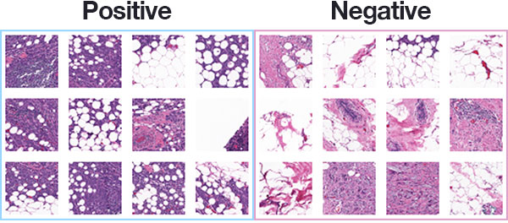
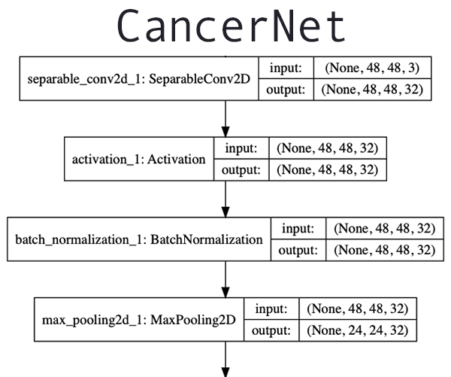
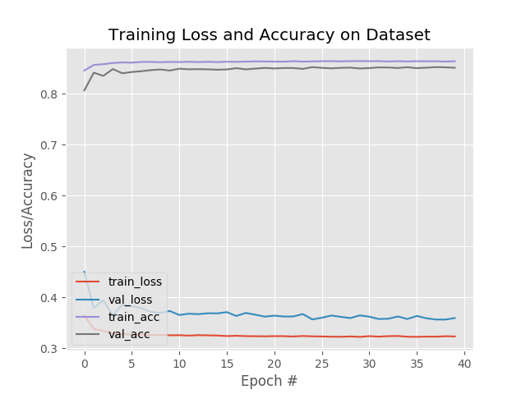
Breast cancer classification with Keras and Deep Learning
Notes:
https://www.pyimagesearch.com/2019/02/18/breast-cancer-classification-with-keras-and-deep-learning/

Slide 11



Acknowledgements
Dr. Steven Schrodi
MCRI
Marshfield, WI
Dr. Momiao Xiong
University of Texas
Houston, TX
Dr. Fereshteh Bashiri
MCRI
Marshfield, WI

Slide 12


Slide 13


