Slide 1


Phenome-wide Association Study Maps Genetic Variation in Epigenetic Factors with Human Complex Disease
Dr. Shicheng Guo¹
Dr. Steven Schrodi^{1,2}
Dr. Mark Craven²
¹Center of Precision Medicine Research, Marshfield Clinic Research Institute
²Computation and Informatics in Biology and Medicine, University of Wisconsin

Slide 2
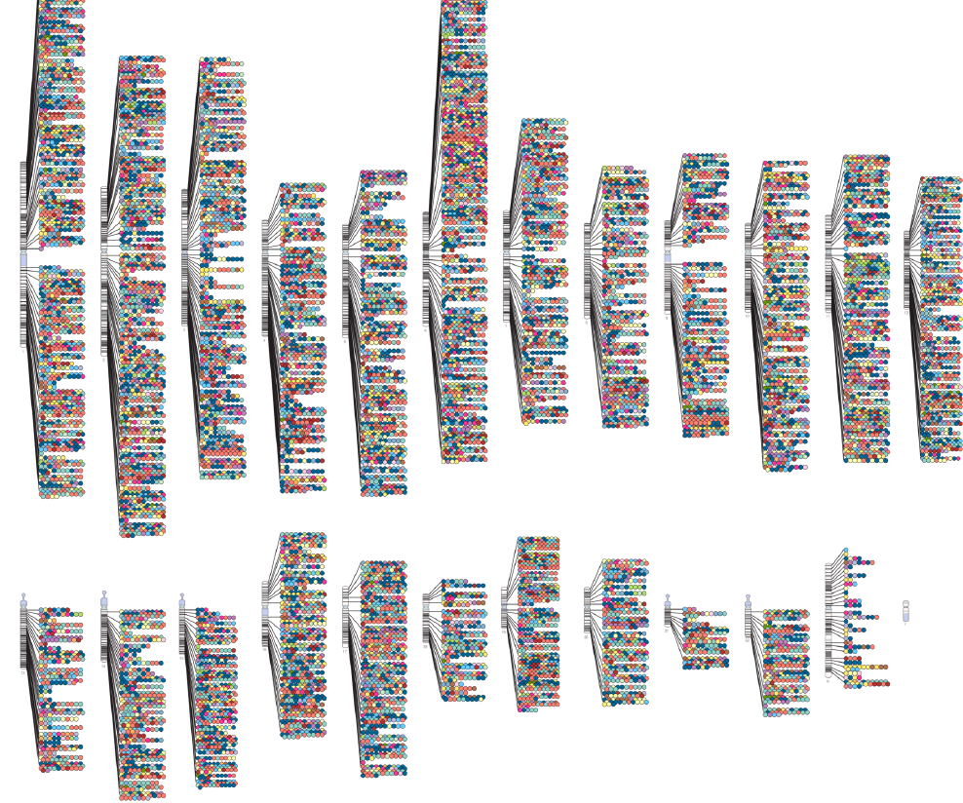
Genome-Wide Association Studies (GWAS) and Genetic Disease
Date to 2018-09-30:
3,596 publications/studies
87,602 unique SNP-trait associations
59,580 SNPs
2,970 Phenotypes
6,221 Phenotypes
Phenome is the set of all phenotypes expressed by a cell, tissue, organ, organism, or species.
http://hupi.fudan.edu.cn/en/
Togninalli, M. et al. The AraGWAS Catalog: a curated and standardized Arabidopsis thaliana GWAS catalog. Nucleic Acids Res 46, D1150-D1156 (2018).

Slide 3
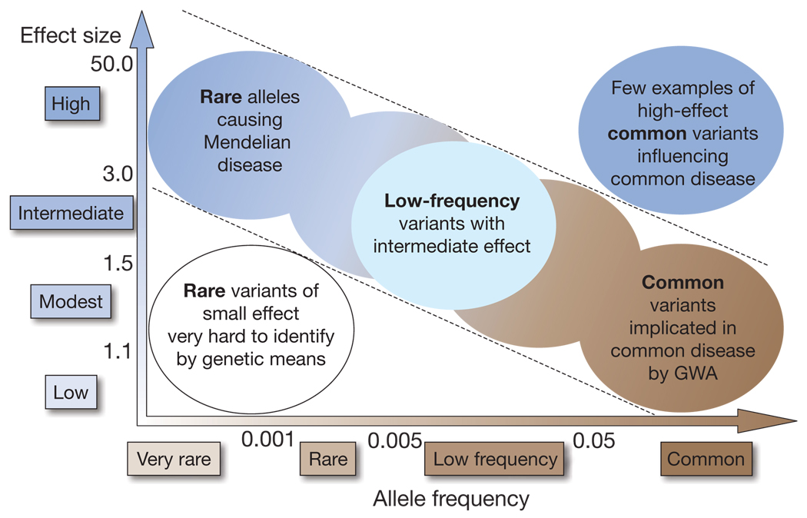
Finding the missing heritability of complex diseases
Copy Number Variation (Insertion and Deletion)
Copy Neutral Variation (Inversion and Translocation)
Interactions between Genetics, Environment
Non-additive genetic variations
Epigenetic Variations (DNA methylation, ncRNA)
Association variation rather than causal variations
Manolio, T.A. et al. Finding the missing heritability of complex diseases. Nature 461, 747-53 (2009).

Slide 4
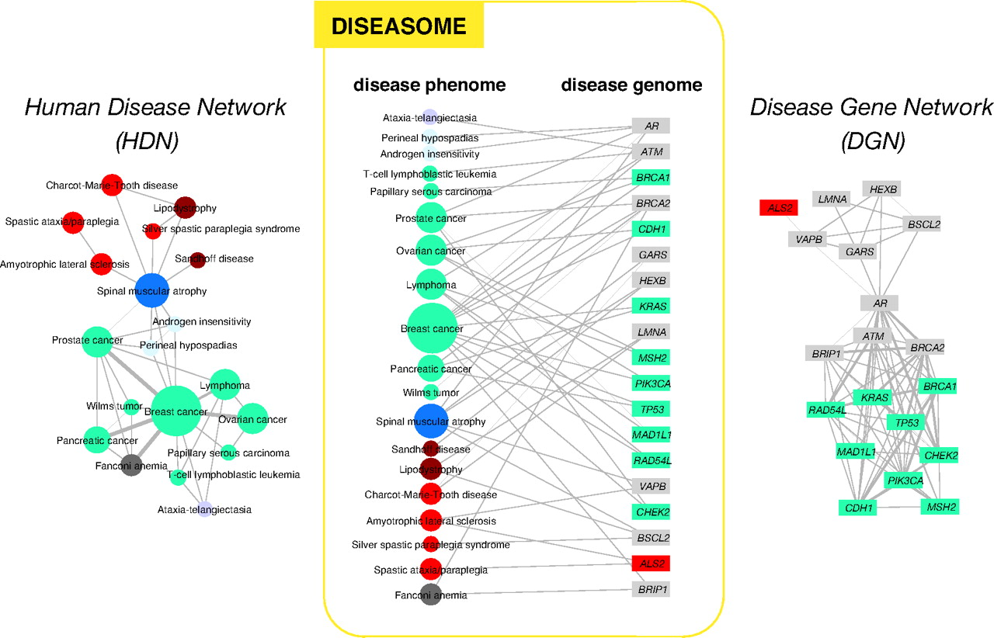
Universal Connection: Nothing in the Real World is Independent
Diseasome: the combined set of all known disorder/disease gene associations.
Goh, K.I. et al. The human disease network. Proc Natl Acad Sci U S A 104, 8685-90 (2007).

Slide 5
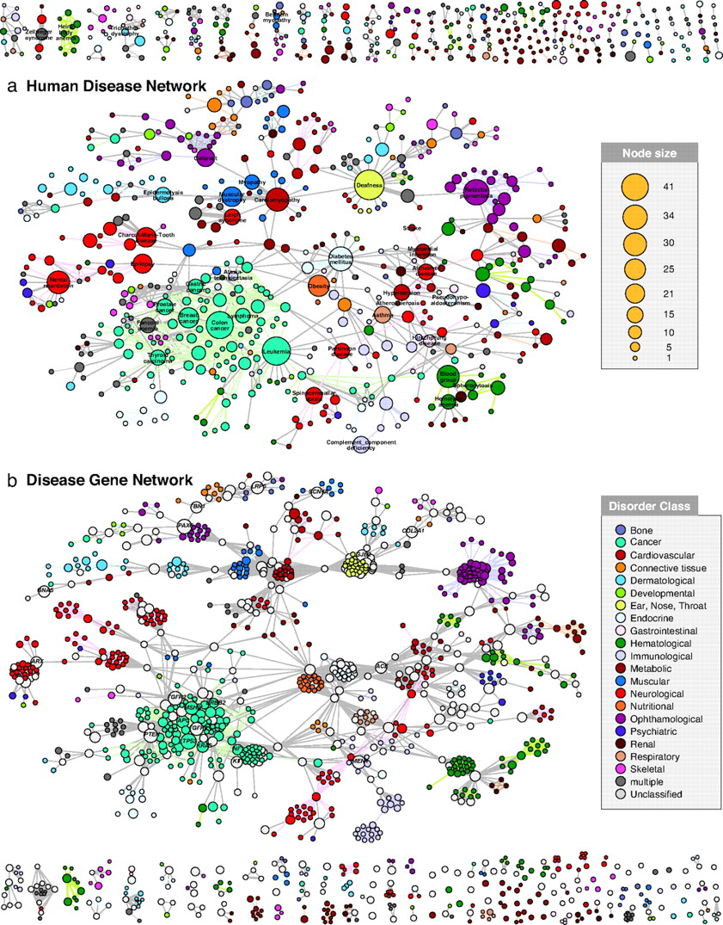
Diseasome Bipartite Network: Human Disease Network and Disease Gene Network
Complex phenotypes comprised different non/independent Intermediate traits shared by different disease
Explain disease pathology and etiology
Discovery shared drugs based on shared molecular and genetic risk genes
Goh, K.I. et al. The human disease network. Proc Natl Acad Sci U S A 104, 8685-90 (2007).

Slide 6
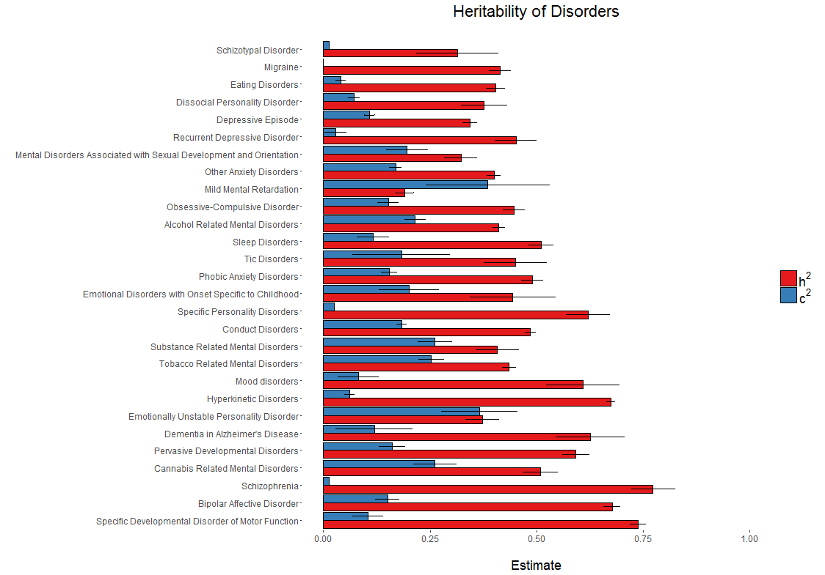
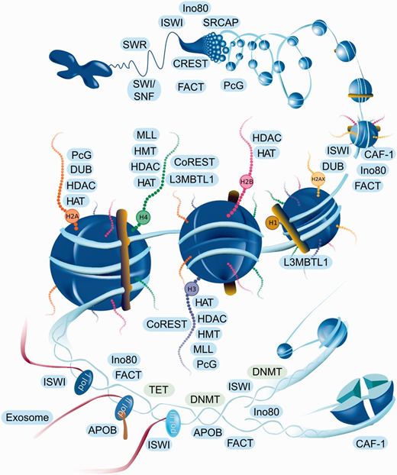
Genetics to Epigenetic Variation and Human Disease
Heritability (h²)
Shared environmental effects (c²)
Polderman et al. (2015). Meta-analysis of the heritability of human traits based on fifty years of twin studies. Nature Genetics, 47(7), 702-709.
Medvedeva, Y.A. et al. EpiFactors: a comprehensive database of human epigenetic factors and complexes. Database (Oxford) 2015, bav067 (2015).

Slide 7

PheWAS Maps Genetic Variation in Epigenetic Factors with Human Disease
Marshfield Clinic Personalized Medicine Research Project
20,000 Genome-wide exome-chip array data
30 year electrical medical records history
High diversity phenotypes (>6,221 phenotypes)
Serum and blood samples are accessible
PBS super-computer-cluster plus UW-Madison HTCondor resource
Aim
To identify genetic variation in epigenetic factor genes in 6,221 phenotypes
Identify significant signals between phenotypes and epigenetics factors
Verify the epigenetic variations in involved in these diseases with bioinformatics and wet lab experiments.
Prediction model based on genetic and epigenetic factors for multi-class outcomes.
Investigate the linear/non-linear relationship between heritability and genome-wide DNA methylation in 6221 phenotype

Slide 8
PheWAS Maps Genetic Variation in Epigenetic Factors with Human Disease
Genome-wide
Exome-Array
Shicheng
6,221 Phenotypes
Methylation sequencing, microarray and RRBS experiments
Do the data analysis with instruction from Prof. Schrodi and Prof. Mark
Prof. Schrodi:
Variations in Epigenetic Factors
5873 SNPs (P<8.5x10⁻⁶)
Train Shicheng on PhenWAS association statistical and genetic method
Train Shicheng to propose pathway based method
Prof. Craven:
Traditional Statistic Method? Propose new method?
Allele based? Gene-based?
How to estimated power?
How to reduce false positive?
Train Shicheng to do multi-class machine learning methods
Train Shicheng to do feature selection or not? Or risk score?
Train Shicheng to build software with R or Python
Significant Genes and 100 Phenotypes ?
Multi-class classification based on genetics and epigenetics features
Random forecast?
SVM?
Neural network?
Validate association with bioinformatics
Validate association with BS-Sequencing
20 Phenotypes?
Build a R package for this project to be used for further analysis
Validate association with MH450K array
Validate association with RRBS
Prediction model for Genetic and Epigenetic related diseases

Slide 9

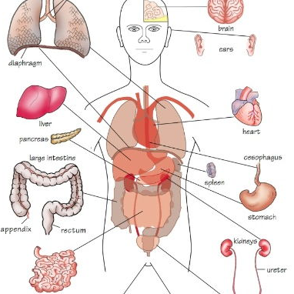
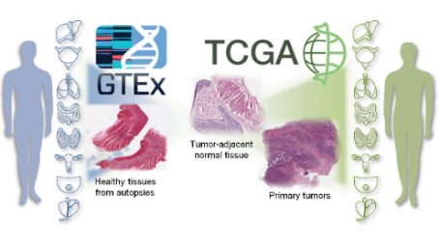



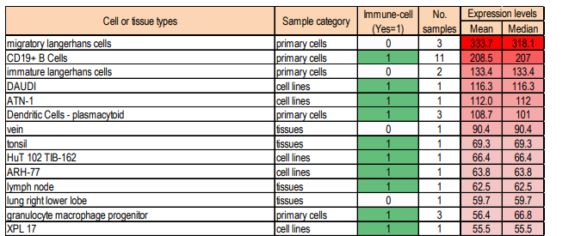
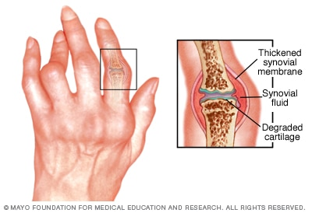
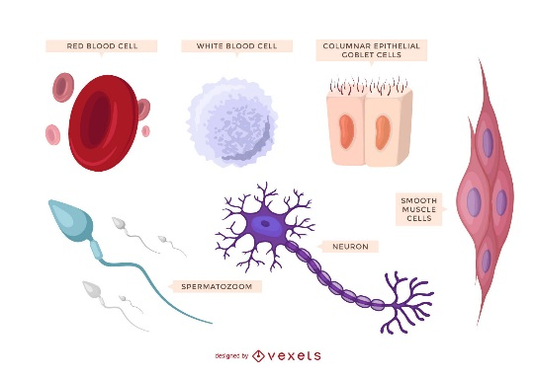
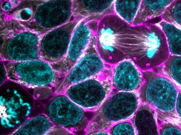
Mapping Genetic Variation in Epigenetic Factors to potential specific cell types and diseases
PheWAS identified Phenotype Assocatied Epigenetic Factors
Tissue specific and Disease associated Epigenetics Genes
Tissue and Phenotype Deconvolution

Slide 10
Validation 2: Genome-wide DNA methylation estimation to Significant Associations with multiple methylation technique
Phase 1: Human Repeat Elements to indicate Genome-wide DNA methylation Profile:
Alu element
LINE-1
low cost with median accuracy and low resolution
50 diseases
Phase 2: Illumina methylation 450K microarray
low cost with high coverage but low resolution
5 diseases
Phase 3: Reduced representation bisulfite sequencing (RRBS)
Cover 90% of CpG island of human genome
Single base resolution
Median cost with high coverage and high resolution
2 diseases
Guo, S., Diep, D., Plongthongkum, N., Fung, H.L. & Zhang, K. Identification of methylation haplotype blocks aids in deconvolution of heterogeneous tissue samples and tumor tissue-of-origin mapping from plasma DNA. Nat Genet 49, 635-642 (2017).
Guo, S. et al. Genome-wide DNA methylation patterns in CD4+ T cells from Chinese Han patients with rheumatoid arthritis. Mod Rheumatol 27, 441-447 (2017).
Wang, C. et al. Identification of Hyper-Methylated Tumor Suppressor Genes-Based Diagnostic Panel for Esophageal Squamous Cell Carcinoma (ESCC) in a Chinese Han Population. Front Genet 9, 356 (2018).

Slide 11
Acknowledgement
Dr. Steven Schrodi Marshfield Clinic Research Institute
Dr. Kun Zhang University of California, San Diego
Dr. Momiao Xiong University of Texas Health Science Center in Houston
Dr. Li Jin Fudan University

Slide 12
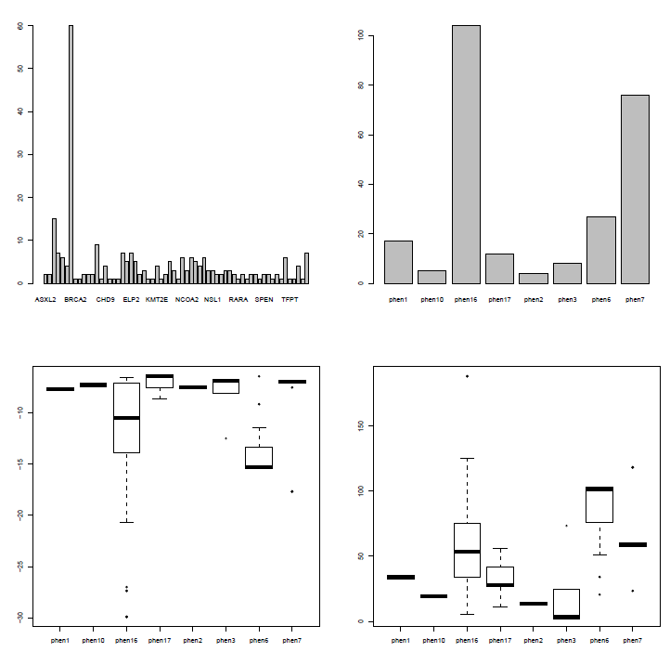
Preliminary Result: Phenome-wide Association Study Maps Genetic Variation in Epigenetic Factors with Human Complex Disease
IRB for 6221 phenotype is on the way, However, we have 15 approved phenotypes
Rheumatoid Arthritis (RA) (h2=0.6)
Systemic Lupus Erythematosus (SLE)
Multiple Sclerosis (MS)
Type 1 Diabetes (T1D)
Hemochromatosis
Premature Myocardial Infarction (PMI)
Chronic Lymphocytic Leukemia (CLL)
Obsessive Compulsive Disorder (OCD, h2=0.29)
Autoimmune Thyroid Disease (ATD)
Axial Spondyloarthritis (AS)
Psoriatic Arthritis (PA)
Autoimmune Thyroid Disease (ATD)
Systemic Sclerosis (SSc)
Chronic Lymphocyte Leukemia
Severe Stage Glaucoma
Iron overload (h2=0.25-0.4)
1737 Significant Signals
Iron overload
BRCA1
OCD and OCPD
Rheumatoid Arthritis
Notes:
cd /gpfs/home/guosa/hpc/hemochromatosis/plink
for i in {1..24}
do
for j in {1..15}
do
echo \#PBS -N chr$i > phen$j.chr$i.job
echo \#PBS -l nodes=1:ppn=1 >> phen$j.chr$i.job
echo cd $(pwd) >> phen$j.chr$i.job
echo plink --file exomechip_SNV_PASS_BEAGLE_chr$i\_phased_sel2 --allow-no-sex --pheno two_alof_all_combed_v4.phen --mpheno $j --assoc --out /gpfs/home/guosa/hpc/project/CIBM/plink/phen$j.chr$i >> phen$j.chr$i.job
qsub phen$j.chr$i.job
done
done

