Slide 1

The Future of Rheumatoid Arthritis Genetics
Steven J. Schrodi
Department of Medical Genetics
University of Wisconsin-Madison
诸事有其好的一面，但不是人人都能看到

Slide 2
Outline
History of rheumatoid arthritis genetics
Heritability
Linkage studies
GWAS
Genetic architecture of rheumatoid arthritis
New tools and horizons
Statistical genomics and machine learning
Sequencing and natural human knockouts
Antigen-Antibody screening
Population-specific effects
Single cell approaches
Epigenomics
Multi-Omics prediction

Slide 3





Heritability of Rheumatoid Arthritis
$$Var\left(RA\right)=V_{G}+V_{E}+V_{G×E}$$
$$H_{B}^{2}=V_{G}{\left[Var\left(RA\right)\right]}^{−1}$$
$$H_{B}^{2}=2\left({corr}_{MZ}−{corr}_{DZ}\right)$$
$$Var\left(RA\right)=V_{GA}+V_{GD}+V_{G×G}+V_{E}+V_{G×E}$$
$$h_{n}^{2}=V_{GA}{\left[Var\left(RA\right)\right]}^{−1}$$
$$h_{n}^{2}≈60\%$$
HLA-DRB1, PADI4, PTPN22, STAT4, TRAF1, IRF5, CTLA4, CCR6, CD40, … unknown factors

Slide 4
Heritability of Rheumatoid Arthritis
Over half of the RA heritability remains unexplained

Slide 5
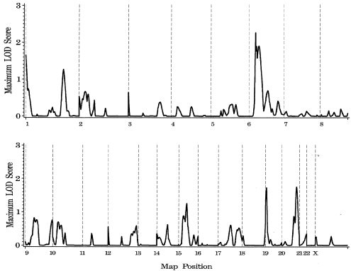
History of Rheumatoid Arthritis Genetics Lessons from Linkage Studies
Thompson et al, 2004
Poor utility for discovery of RA genes
Models of low locus heterogeneity
are incorrect
Models of rare variants with very
large effect sizes are incorrect

Slide 6
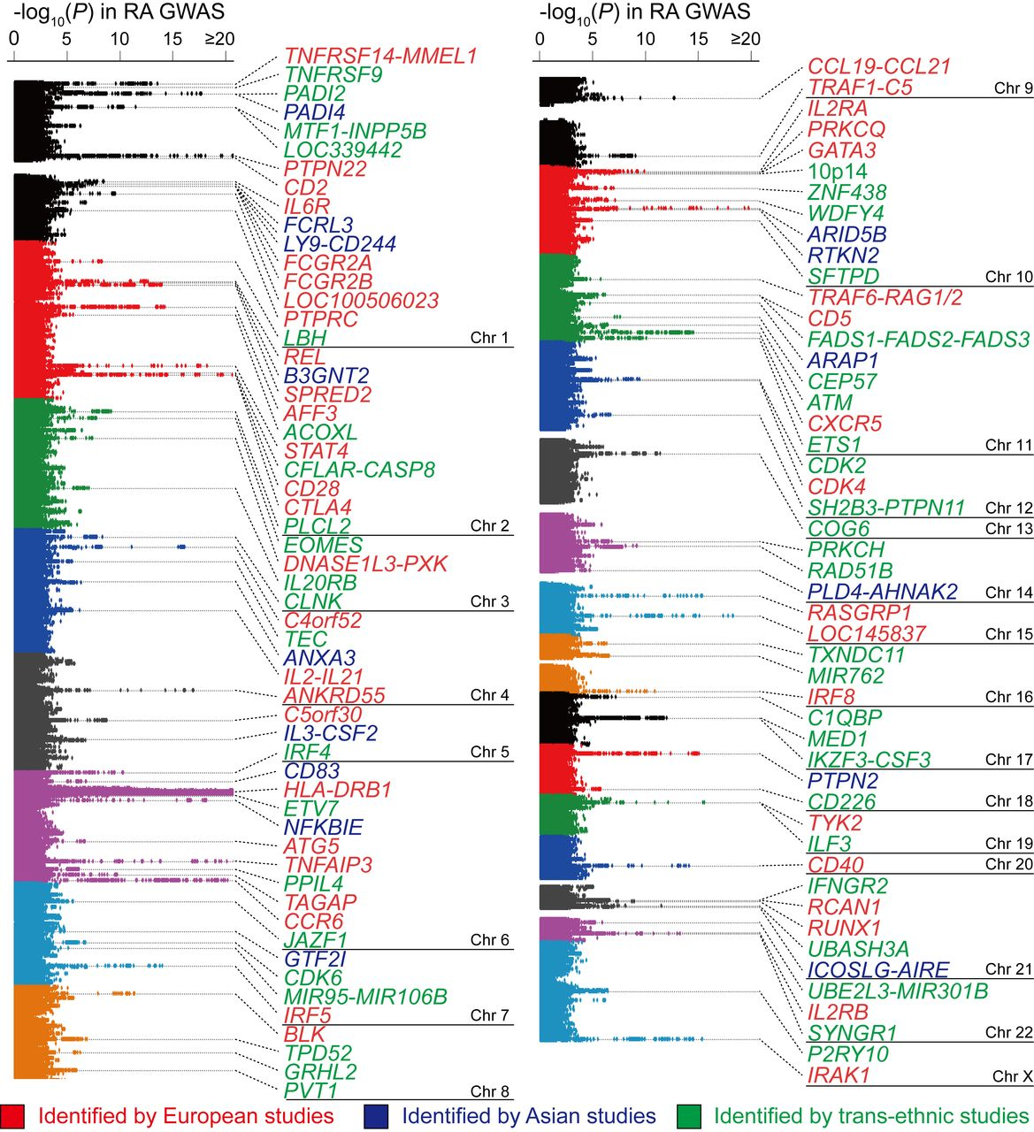
History of Rheumatoid Arthritis Genetics Genome-wide Association Studies
>100 RA susceptibility genes discovered
Models of common alleles explaining the majority of RA heritability are incorrect
New pathways and mechanisms identified
Shared and distinct RA genes across populations
Okada et al, 2018

Slide 7
History of Rheumatoid Arthritis Genetics Genome-wide Association Studies
Multiple RA predisposing alleles are found in:
Antigen presentation processes
Reduced pruning of B-cell clones
NFkB signaling
Increased T-cell proliferation
T-cells hyperprone to activation, mediated through CD28
Hyper-citrullination of peptides and subsequent molecular mimicry
Increased TH17 differentiation
TNF-α pathway upregulation
80% of RA GWAS SNPs are noncoding
Significant heterogeneity within RA and population-specific effects
Majority of alleles have small effect sizes

Slide 8
Genetic Architecture of Rheumatoid Arthritis Plausible Disease Genetics Models for RA
Population-based sequencing studies and theoretical work show that the reservoir of rare variants in human populations is vast
Comparing results from linkage studies, GWAS and sequencing-based studies in cases/controls to disease genetics models, suggest that models of high allelic heterogeneity and moderately high locus heterogeneity are likely
Compound heterozygosity may also be a principal driver
of RA genetic susceptibility

Slide 9
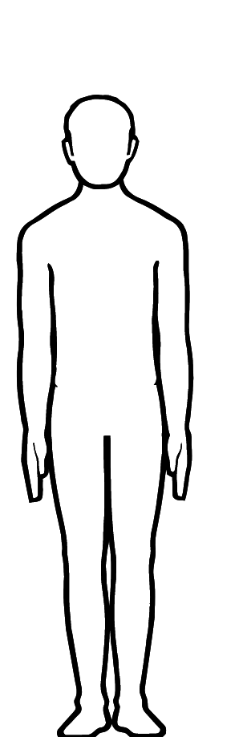
Genetic Architecture of Rheumatoid Arthritis Plausible Disease Genetics Models for RA
?
RA
RA
RA
RA
RA
RA
RA
RA
RA
RA
RA
RA
RA
RA
SNP1 OR=1.4
SNP1 OR=1.4
SNP2 OR=1.4
SNP2 OR=1.4
SNP3 OR=1.4
SNP3 OR=1.4
SNP4 OR=1.4
SNP4 OR=1.4
SNP5 OR=1.4
SNP5 OR=1.4
SNP6 OR=1.4
SNP6 OR=1.4

Slide 10
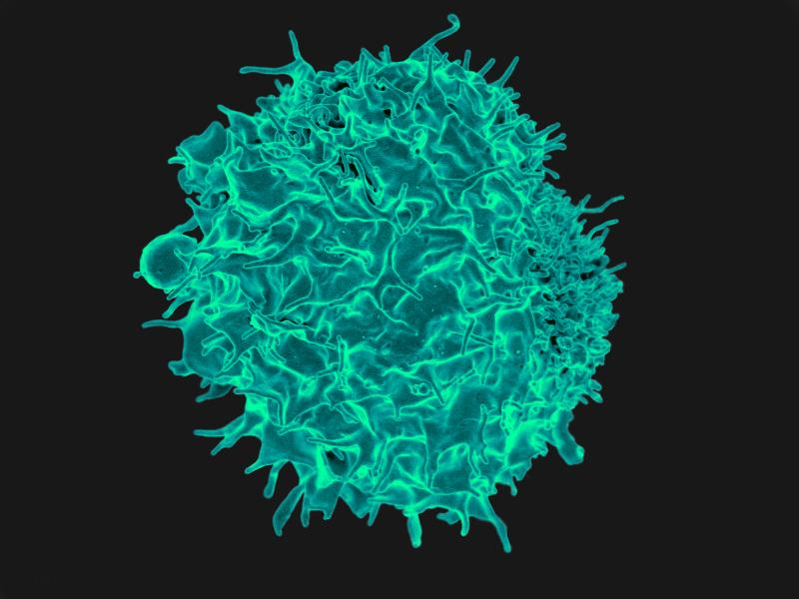
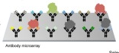
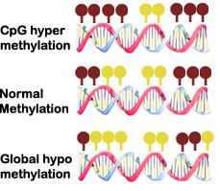
Tools and Approaches for the Future
How will we dissect the considerable heterogeneity of RA etiological factors?
Reduce complexity of
the RA Phenotype
Perform experiments
designed to have high
power to detect effects
from realistic disease models
Use of new high-throughput
molecular and cellular tools
PC2
DNAseq RNAseq
R&D
Compound heterozygosity
Antigen-Ab screens
Kibat et al, 2016
WGBS DNA methylation
PC1
Multiplex families or kinships

Slide 11
Tools and Approaches for the Future
How will we dissect the considerable heterogeneity of RA etiological factors?
Heavy reliance on statistical genomics and machine learning methods
Sequencing to identify rare variants and compound heterozygotes
Novel experimental designs
Immune cell genomics
Large-scale screening of antigen/antibody responses
Epigenomics (DNA methylation, ncRNA, histone acetylation)
Investigations in different populations
Synthesis of multi-omics data for RA prediction and RA subgroups

Slide 12

Statistical Genomics
中国人不确定是不舒服，但要确定是荒谬的。
As human genetics becomes data-rich, the most important task becomes identifying true positive signals from false positives.
Permutation routines
Probabilistic framework (Bayesian approaches)
Be aware of mechanisms that can produce false positives
Check the analysis pipeline with null data
$$P\left(RA | Molecular Data\right)$$
Null Data
Analysis Pipeline
No Significant
Results

Slide 13
Population-Specific Effects
Shared
pathogenic
mutations
Examples of genes with large effect differences
between populations:
PADI4
PTPN22
TYK2
CTLA4
FCRL3
NFKBIE
Population-specific
pathogenic
mutation
Population-specific
Environmental exposure
Population 1
Population 2

Slide 14

Machine Learning
不管黑猫白猫，捉到老鼠就是好猫。
As RA studies of molecular pathogenesis become data-rich, computational methods to analyze high-dimensional data are necessary
Sure Independence Screening for feature selection
Bayesian networks, Ridge Regression, Neural Networks are powerful approaches for classification

Slide 15
Sequencing
Rapid reduction in cost has enabled large NGS-based studies
Useful in fine-mapping regions of RA association
Useful in identifying additional rare variants in key RA genes
Westra et al, 2018

Slide 16
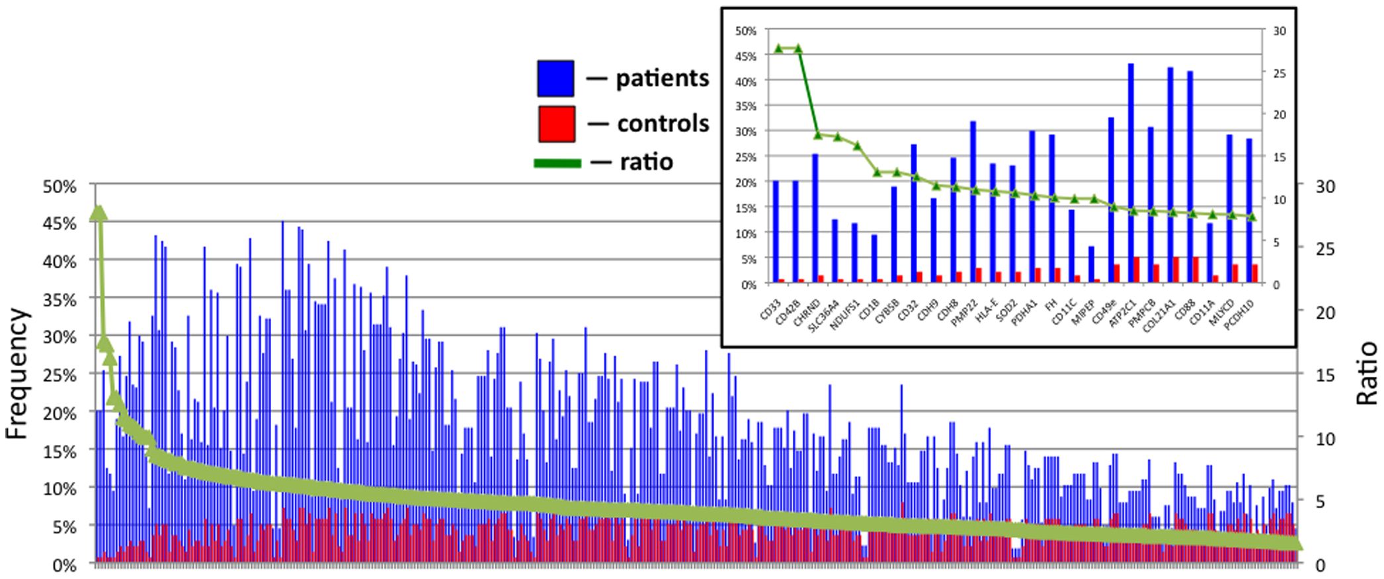
Antigen/Antibody Screening
Kalantari-Dehaghi et al 2016

Slide 17
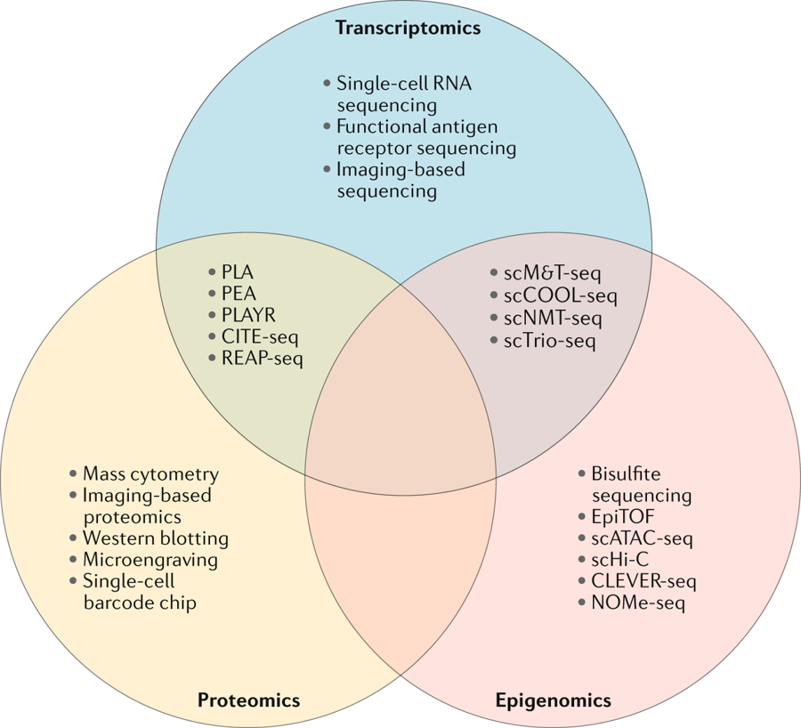
Single Cell Genomics
Nat Rheum
Zhang et al, 2018
Single Cell Genomic Technologies
Transcriptome and mass cytometry-based immune
cell states in RA synovial tissues

Slide 18
Epigenomics
cg06642177 SLC2A12
cg08867893 ZNF365
cg06778273 TNFRSF18
versus
TNF-receptor superfamily
Expressed during T-cell activation
Self-tolerance CD25+/CD4+ Treg
Ince-Askan et al, 2019

Slide 19
Multi-Omics Prediction of RA
GWAS markers are insufficient for accurate prediction of RA
Combination of clinical features, dynamic biomarkers, epigenetics and DNA variants will likely dramatically improve RA predictive models
Using sophisticated feature selection algorithms and machine learning classification models will enable prediction of RA and identification of clinically meaningful RA subtypes
Prediction of pre-T2D
SNPs+metabolites+proteins
AUC 0.912
Carter et al, 2016

Slide 20



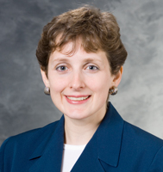

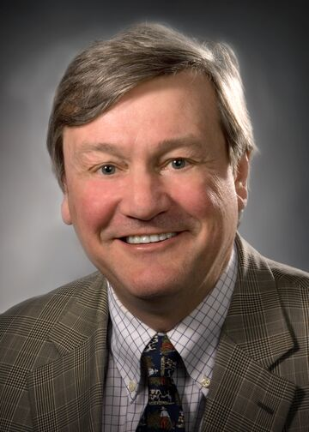

Acknowledgements
Dr. Shicheng Guo
Dr. Dongyi He
Dr. Shelef
Dr. Smith
Dr. Begovich
Dr. Gregersen
Dr. Huizinga

