Slide 1
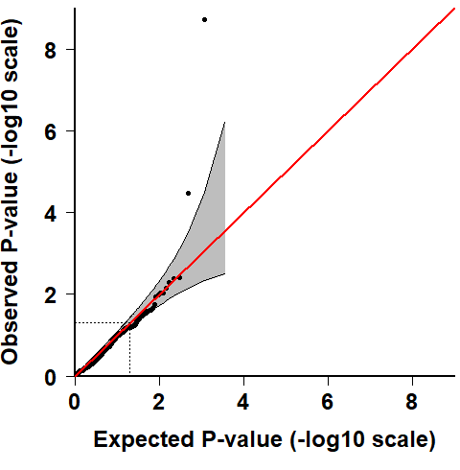
Genome-wide Association identifies 34 potential RA Susceptibility SNPs
HLA-DRB1
PTPN22
PMRP: Personalized Medicine Research Project, Phase 1 dataset, 398 RA vs 3458 Control

Slide 2
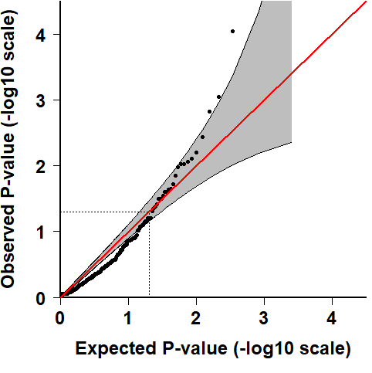
Genome-wide Association identifies 27 potential RA Susceptibility SNPs
AMPD1
PMRP: Personalized Medicine Research Project, Phase 2 dataset, 92 RA vs 4657 Control

Slide 3
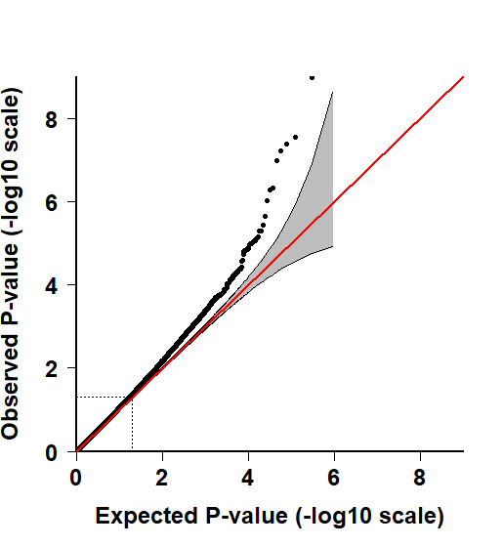
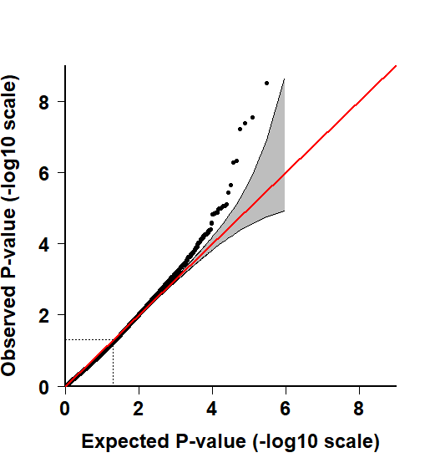
Meta-analysis to Genome-wide Association of Marshfield PMRP dataset
Fix-effect based Meta-analysis Random-effect based Meta analysis
HLA-DRB1
HLA-DRB1
COL6A5
COL6A5

Slide 4
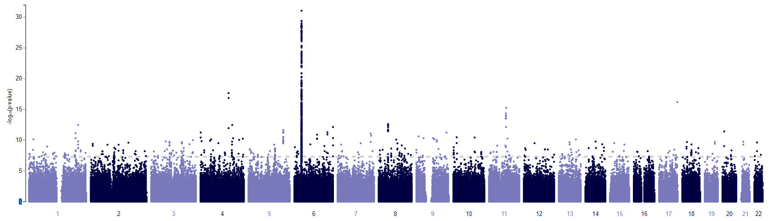
Genome-wide Association study identifies 45 RA Susceptibility SNPs by UK-Biobank dataset
HLA-DRB1
ADAD1
RAB40B
LRRC32
PADI4
PTPN22
FSTL1
Figure: Significant of RA associated genes identified by UK-biobank and Marshfield Clinic Personalized medicine research project (PMRP)
MTHFD1 rs2236225, AMPD1rs17602729, ITPA rs1127354 and ATIC rs2372536
rs12617656, located in an intron of DPP4
rs12379034, located in the coding region of CDK5RAP2
UK-Biobank: Biobank-RA Project, 50 most significant SNPs (P<3.0x10⁻¹⁰)

