Slide 1
Identification of methylation haplotype blocks aids in deconvolution of heterogeneous tissue samples and tumor tissue-of-origin mapping from plasma DNA
Shicheng Guo
March 24 2017
Notes:
各位老师，同学，大家晚上好，欢迎你们来参加我的博士论文预答辩。今天我汇报的题目是基于全基因组DNA甲基化谱式的肿瘤诊断及预后生物标记物研究。我的导师是金力教授，王久存教授，指导小组还包括熊墨淼教授。

Slide 2
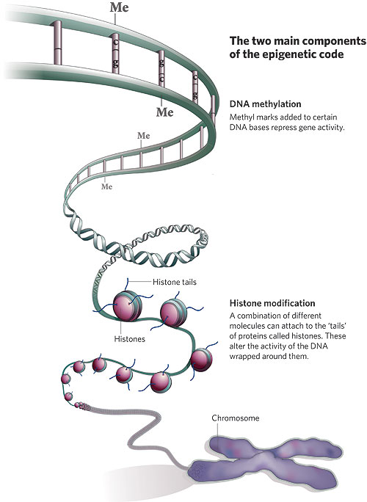
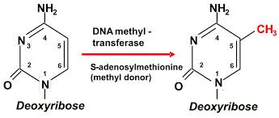
DNA甲基化基本知识介绍
DNA 甲基化：发生在DNA碱基上的甲基化修饰
DNA甲基转移酶
S-SAM为唯一甲基供体
对特定碱基的进行甲基化修饰
人类成熟体细胞的基因组DNA甲基化特点
发生在CpG二核苷酸对
70-80% 的CpG二核苷酸呈甲基化状态
其余20%左右非甲基化状态的CpG一般聚集成簇
研究背景
Notes:
DNA 甲基化是指发生在DNA碱基上的甲基化修饰。他是由DNA甲基转移酶以S-腺苷甲硫氨酸为唯一甲基供体对对特定碱基的碳原子或者其他原子的过程。一般而言人类成熟体细胞基因组上的DNA甲基化只发生在CpG二核苷酸对上，基因组中70-80% 的CpG二核苷酸是呈甲基化状态，其余20%左右非甲基化状态存在，且一般聚集成簇，形成所谓的CpG岛区域。

Slide 3

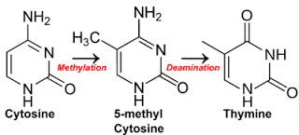
DNA甲基化：衔接进化和发育的桥梁
进化
发育
DNA 甲基化
突变类型(CpG->TpG)
突变频率 (10-40倍)
减数分裂重组热点
基因表达
可变剪切
染色体沉默
基因组稳定性
配子形成
早期胚胎发育
衰老
复杂疾病
DNA甲基化：存储量巨大的信息载体
DNA甲基化对各种生理、病理状态具有强大的区分能力
DNA甲基化作为肿瘤标记物的巨大潜力
研究背景
Notes:
DNA甲基化系统是为数不多的同时对进化和发育具有重要作用的基因组元件。从进化角度看，DNA甲基化为进化提供来自突变及重组两个原动力，可以引起CpG向TpG的定向突变，且这种突变在甲基化的CpG比非甲基化的CpG高10-40倍。从发育角度看，DNA甲基化参与基因表达，可变剪切，参与X染色体沉默，基因组的稳定性的调控，在配子形成，早期胚胎发育，衰老，以及一系列复杂疾病的发生种发挥重要作用。DNA甲基化是巨大的信息载体，因此理论上可以对各种生理、病理状态具有强大的区分能力。因此本论文旨在全面评估DNA甲基化作为肿瘤标记物的巨大潜力。

Slide 4
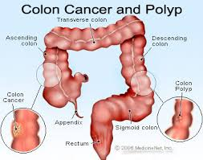

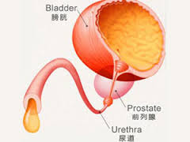
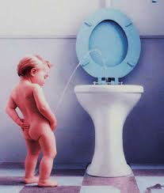
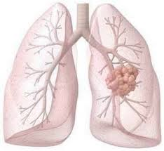
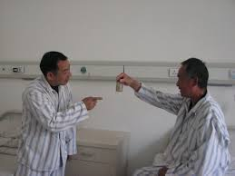
背景： 多肿瘤筛查
目前肿瘤的筛查尚处于单肿瘤预测阶段
肠癌-粪便
膀胱癌-尿液
肺癌-肺泡灌洗液
1，费时
2，需要前期征兆
3，前期处理方法不同
4，没有远端体液（胰腺癌等）
血浆游离DNA
多肿瘤预测
全基因组甲基化图谱揭示泛癌甲基化特征
Notes:
目前对于临床上对于肿瘤的诊断尚处于单肿瘤诊断阶段。比如用便便中DNA诊断colon cancer，用尿沉淀细胞DNA诊断膀胱癌，肺泡盥洗液DNA诊断肺癌。对于局部位置出现明显肿瘤疾病征兆的情况下，固然可以采用特异的肿瘤筛查方法，然而绝大多数肿瘤在早期没有明显的疾病征兆，如果此时进行肿瘤筛查，则需要采用不同的方法进行筛查。

Slide 5
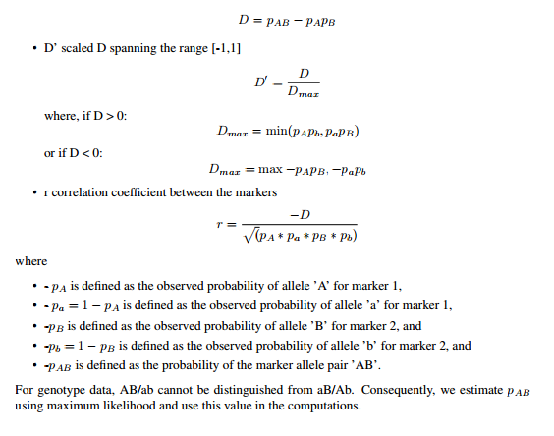
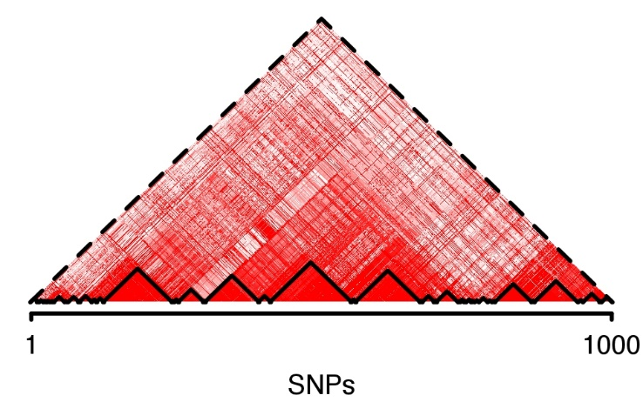
Methylation haplotype and block in individual level
Bulk BS-Seq data
Formula
CTCTCTCTCTCTCTCTCT
CTCTTCTCTTTTCTTCTC
CTCTTTTCTTCTCTTCTT
TTTTTCTTTTTTCTTCTC
CTTTTTTCTTCTCTTCTC
r
Methylations haplotype blocks

Slide 6
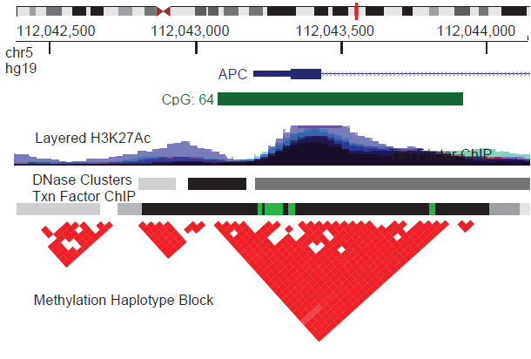
Methylation haplotype in real WGBS data
61 WGBS samples (10 N37, 36 SALK, 10 H1, 3 WBC and 2 Cancer)
(MHB)
MHB: Not Stochastic Genomic Distribution

Slide 7
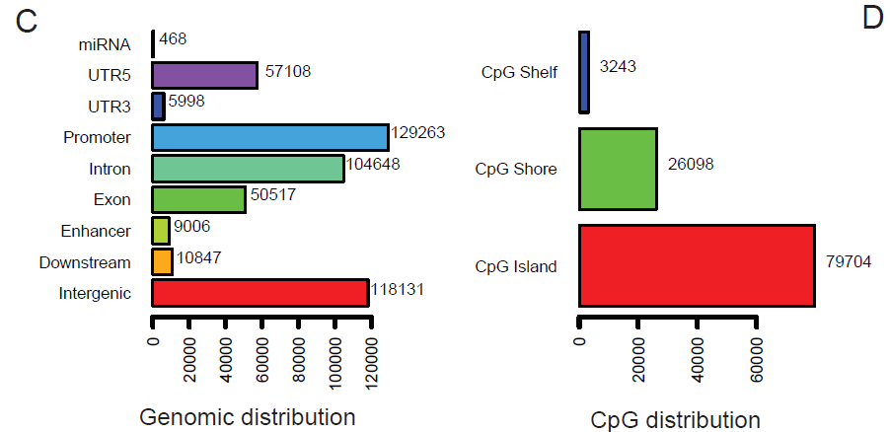
Methylation Haplotype Blocks
61 WGBS samples (10 N37, 36 SALK, 10 H1, 3 WBC and 2 Cancer)
R2>=0.5, N=147,888
Methylation blocks widely disperse in human genome.
represent a distinct type of genomic feature that partially overlaps with well-documented genomic elements

Slide 8
Sample and Data
WGBS-tissue:
10 human tissues: lung, liver, colon, pancreas, stomach
51 public dataset: ENCODE, Roadmap
RRBS: tissue and matched plasma
5 colon cancer solid tissue and corresponding plasma
5 lung cancer solid tissue and corresponding plasma
RRBS-plasma:
30 colon cancer plasma
29 lung cancer plasma
75 normal plasma
Notes:
11种肿瘤的数据量如表所示，经过data cleanning处理，我们获得包括接近35万个甲基化位点，1278个肿瘤样本的数据矩阵。探针之间的相关性分析发现绝大多数位点的相关性较低。且整体水平甲基化位点在肿瘤和癌旁中无明显差异。

Slide 9
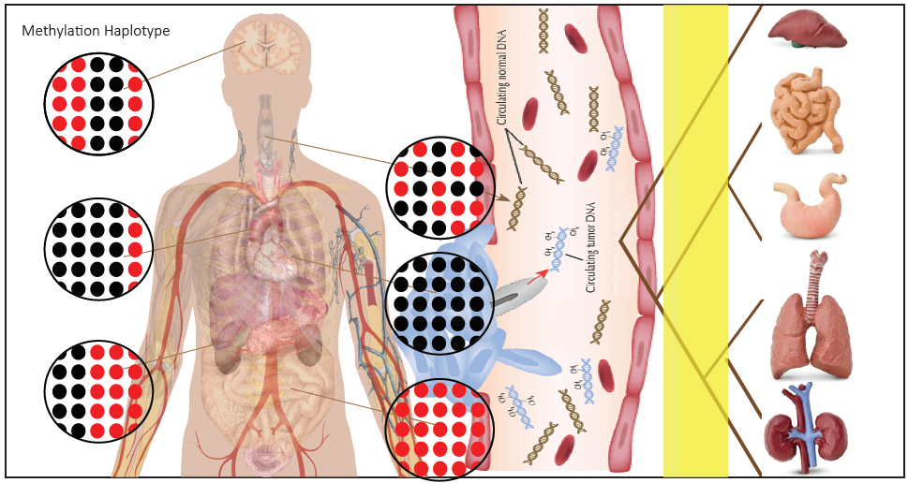
Methylation-haplotype in human normal, cancer tissue and cancer plasma
High-methylation haplotype(HMH)
Tissue DNA => Plasma
10 cancer tissue and corresponding 10 plasma
49 cancer tissue and 65 plasma
N=55
N=87
307 (35%) MHM identified from match-samples can be validated in independent samples.
WDR37, VAX1, SMPD1

Slide 10
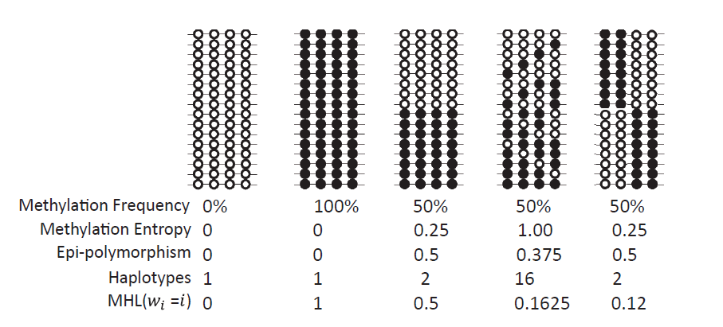
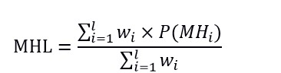
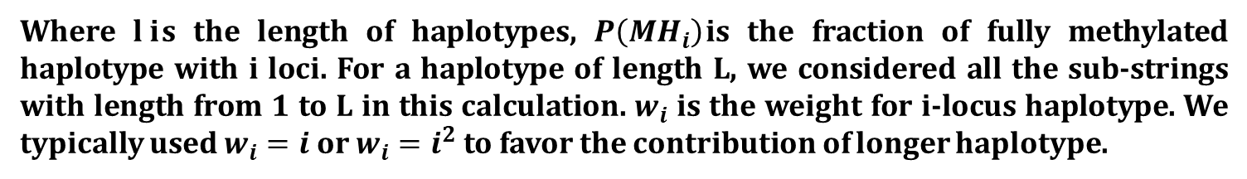
Methylation Haplotype Load Definition
Give different weight to the CpG in each haplotype
Where $l i$s the length of haplotypes, $P\left({MH}_{i}\right)$is the fraction of fully methylated haplotype with i loci. For a haplotype of length L, we considered all the sub-strings with length from 1 to L in this calculation. $w_{i}$ is the weight for i-locus haplotype. We typically used $w_{i}=i$ or $w_{i}=i^{2}$ to favor the contribution of longer haplotype.
Methylation level and pattern of co-methylation (complexity)

Slide 11
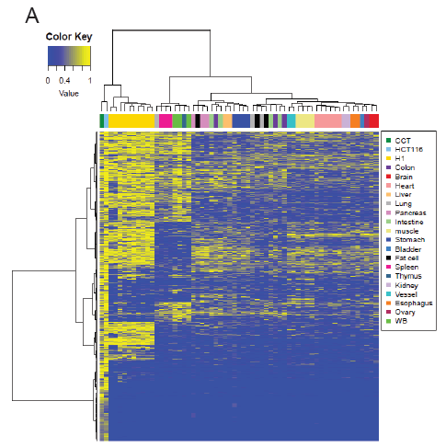
Genome-wide MHL could represent the tissue similarity
61 WGBS samples (10 N37, 36 SALK, 10 H1, 3 WBC and 2 Cancer)
Quantile Normalize and Batch effect elimination
Samples of the same tissue origin clustered together
Cancer and Stem cell are quite different with adult normal tissues.
Tissue Mapping and Cancer Diagnosis

Slide 12
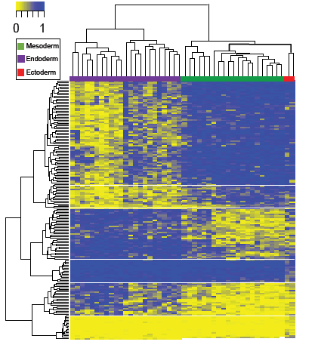
MHBs could reveal epigenetic insights on germ layer speciation

Slide 13
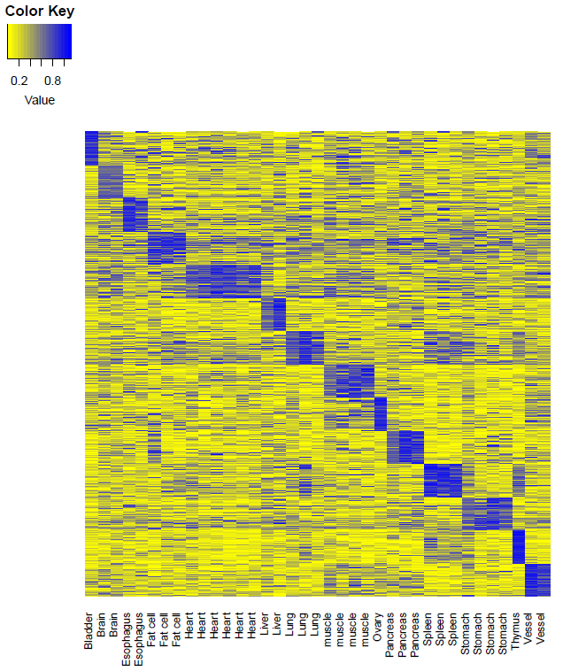
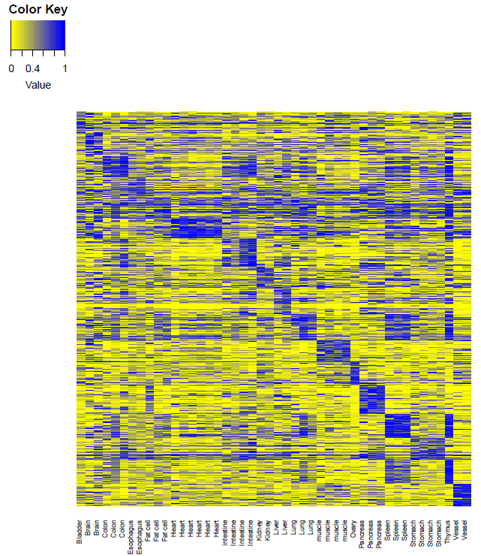
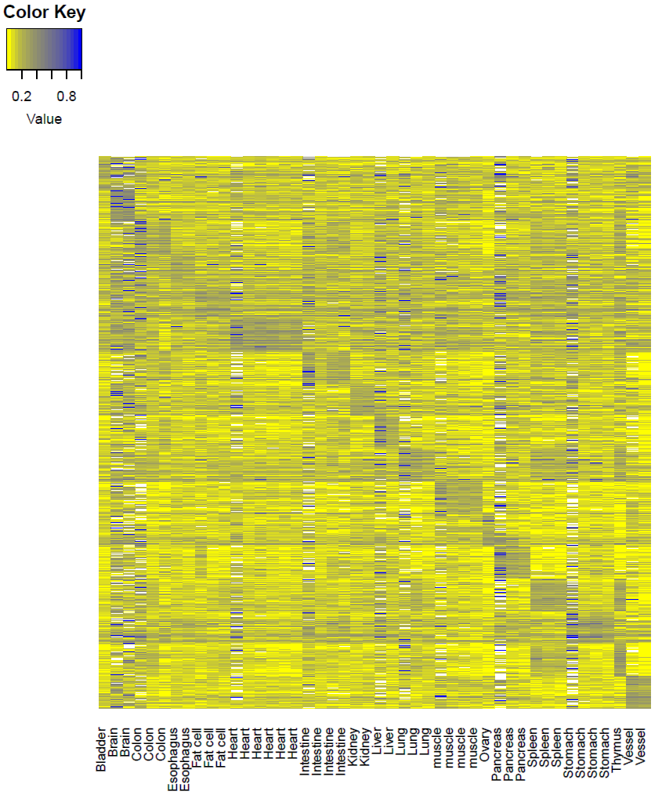
Tissue specific hyper-methylation MHB regions show tissue specificity
MFs
MHL
AMS
AMF
7647
Data extracting
MHL was a stronger characteristic which can be applied for plasma DNA tissue mapping

Slide 14
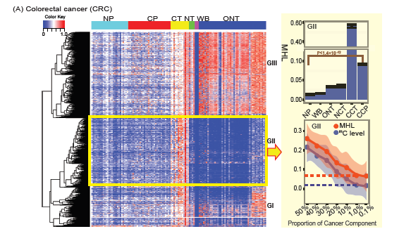
Estimate cancer plasma composition by methylation-haplotype load
2782
Standard curve between average MHL and cancer component established by sampling with different proportion of cancer and WB samples

Slide 15
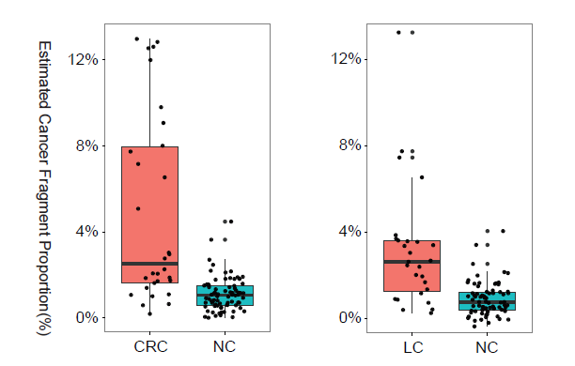
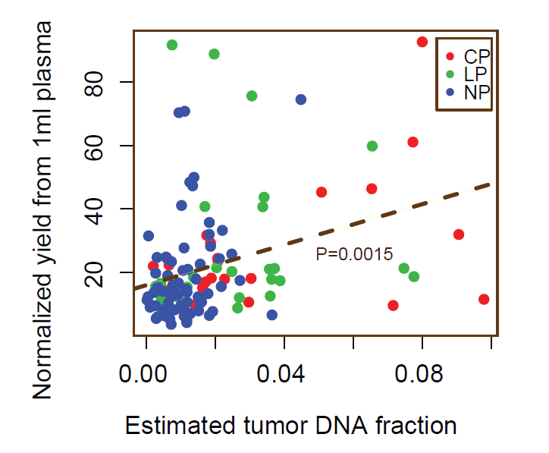
Estimate cancer fragment proportion in the plasma by MHL
N=4
2.7%
N=5
3.6%
N=4
N=4
Estimated ct-DNA in cancer plasma were significantly higher than that in normal plasma.
Estimated ct-DNA in the plasma was significantly correlated with cell-free circulating DNA.

Slide 16
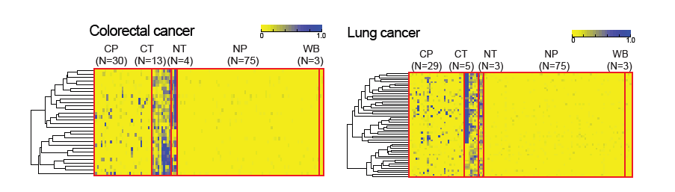
Prediction: tumor-of-origin prediction based on tissue-specific MHBs
Random Forest, SVM and Neural Networks
Sparse data caused by low coverage dataset
10 multi-class prediction

Slide 17
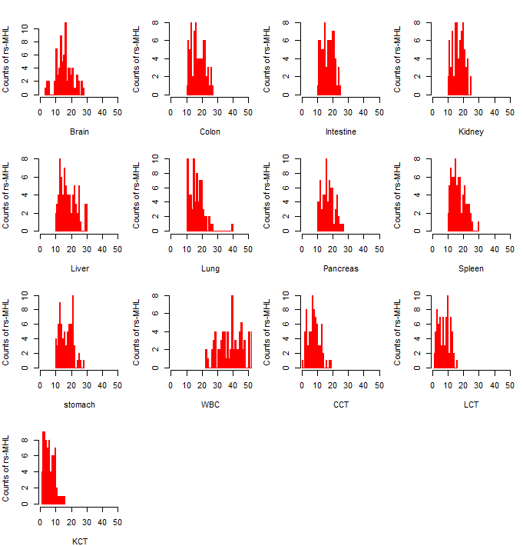
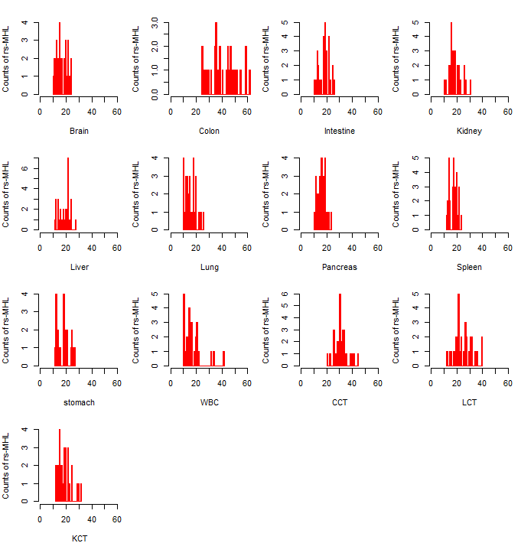
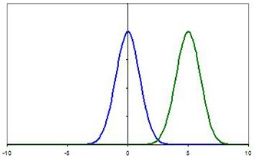
Distribution of reference specific MHL region in human normal plasma
75 Normal Plasma
30 Colon cancer
Tissue-of-origin
Pathology Status
Normal Plasma
CCR Plasma
Z-Score
200 regions for each reference were included.
MHL>0.135 defined as positive detection.
75 normal plasma samples
1, By Z-score rather than # ts-MHL
2, Control FDR (Type-I error)
3, Introduce CCT as reference
Significant higher WBC specific MHL

Slide 18
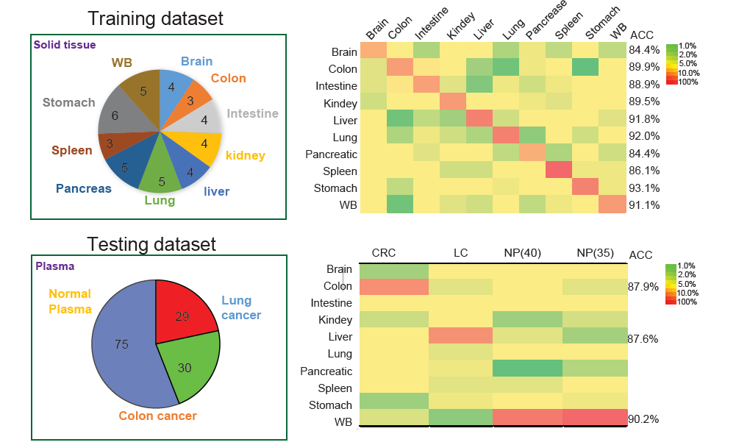
Performance of maximum tissue-specific MHL based tissue-of-origin mapping
Sensitivity: 87.9%
Sensitivity: 87.6%
Specificity: 90.2%
Our method and pipeline is powerful for the tumor-of-origin prediction.

Slide 19
Summary
We proposed MHB to indicate high linkage methylation regions
We found MHB overlapped with all kinds of Genomic Functional Regions
We proposed MHL to replace AMF to indicate methylation level and complexity simultaneously.
We find MHL can be applied to strength methylation signal in plasma
Tissue-of-origin can be inferred by tissue-specific MHL signals with certain statistic frame.

Slide 20
Thanks

