Slide 1
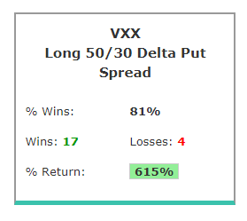
➡ The average percent return per trade was 28.9% (in 90 days). ➡ The average percent return per winning trade was 52.7% (in 90 days). ➡ The average percent return per losing trade was -72.4% (in 90 days).

Slide 2
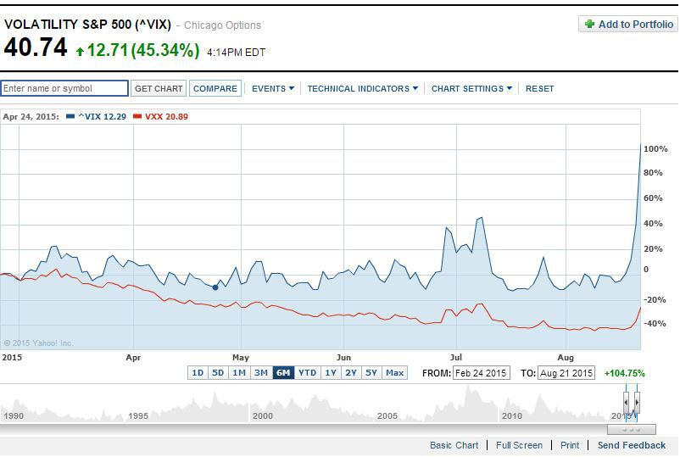
Why is that? Why did the VXX crash 77.62% on a year the VIX crashed only 20.06%?

