Slide 1

UK Biobank Whole-Exome Sequence Binary Phenome Analysis with Robust Region-Based Rare-Variant Test
Shicheng Guo
Center for Precision Medicine Research,
Marshfield Clinic Research Institute 01/20/2019

Slide 2
Methods: Apply GWAS to Identify Disease Associated Genes
Gene A
Gene A
Common variant model:
Additive
Multiplicative
Dominant
Recessive
Codominance
Over-dominant
Multiple tests
Considerable heterogeneity among studies
Rare variants model:
Group-based association study (rare variants)
1. Burden test (effect, weight)
2. Kernel-based variance-component test (SKAT)
Compound heterozygosity study
1. Strong assumption
2. Functional variants
Dr. Scott J Hebbring
Dr. Steven Schrodi
Notes:
Common variants model can also be called single loci model. Group based association or compound heterogyosity can be called multiple-loci model. Burden tests are more powerful when most variants in a region are causal and the effects are in the same direction, whereas SKAT is more powerful when a large fraction of the variants in a region are noncausal or the effects of causal variants are in different directions.

Slide 3

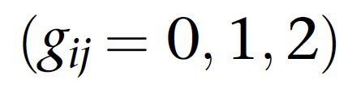
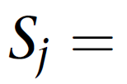
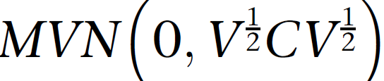
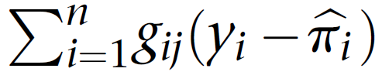
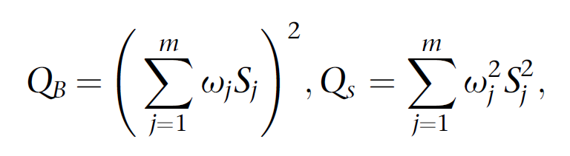
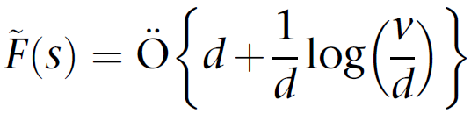

Robust Region-based Rare-Variant Tests for Binary Traits
Estimated Disease Probability
~
Binary Phenotype
Imbalanced => Severe Skewed
SPA (saddle point approximation)
ER (efficient sampling)
SKAT-O Test
Burden Test
SKAT Test

Slide 4
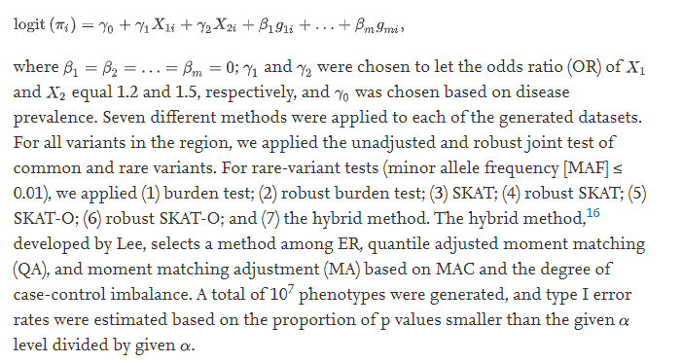
Power and Type I Error Simulations
Age
OR=1.2
Gender
OR=1.5
Generalized linear model
10⁷ phenotypes
1K, 2K and 3K genomic regions
Alternative: 3-8-2 / 3-1-0 rule
Genetic Factors
Prevalence
Normal
Bernoulli
calibrated coalescent model

Slide 5
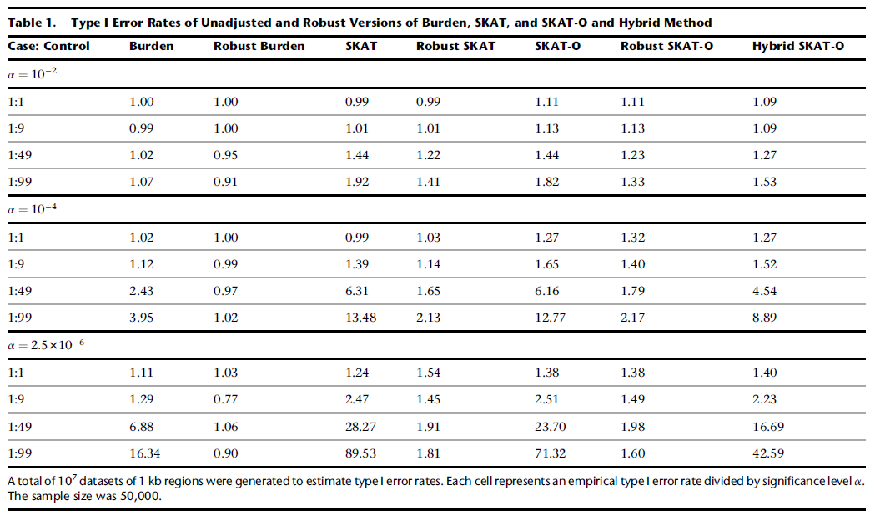
Inflated Type I Error Rates of Unadjusted Burden, SKAT, and SKAT-O

Slide 6
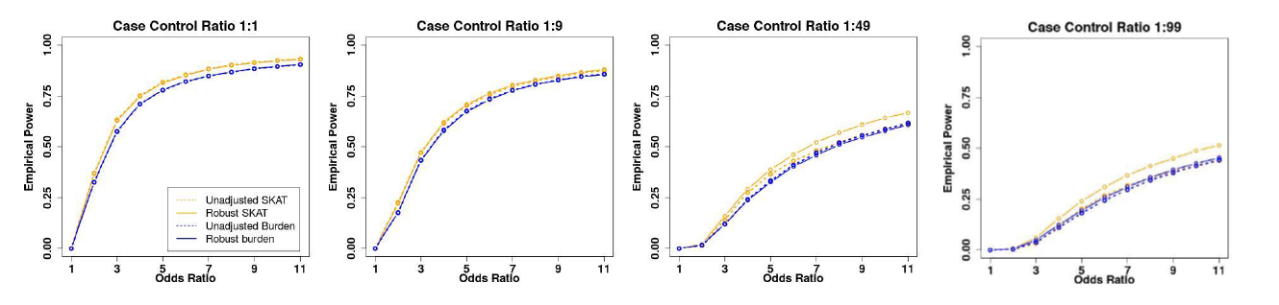
Robust SKAT shows higher power to identify causal variants
3-8-2 rule:
30% total variants are causal variants
80% causal variants are risk factors
20% causal variants are protective
Robust SKAT

Slide 7
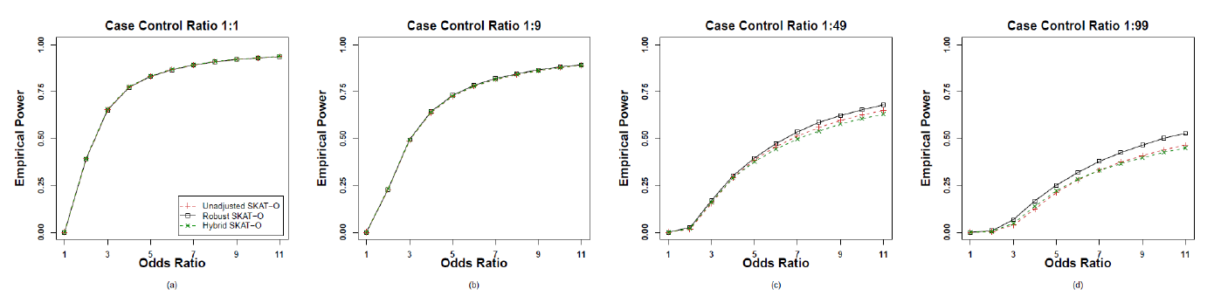
Robust SKAT-O shows higher power to identify causal variants
3-1-0 rule:
30% total variants are causal variants
100% causal variants are risk factors
0% causal variants are protective
Robust SKAT-O

Slide 8
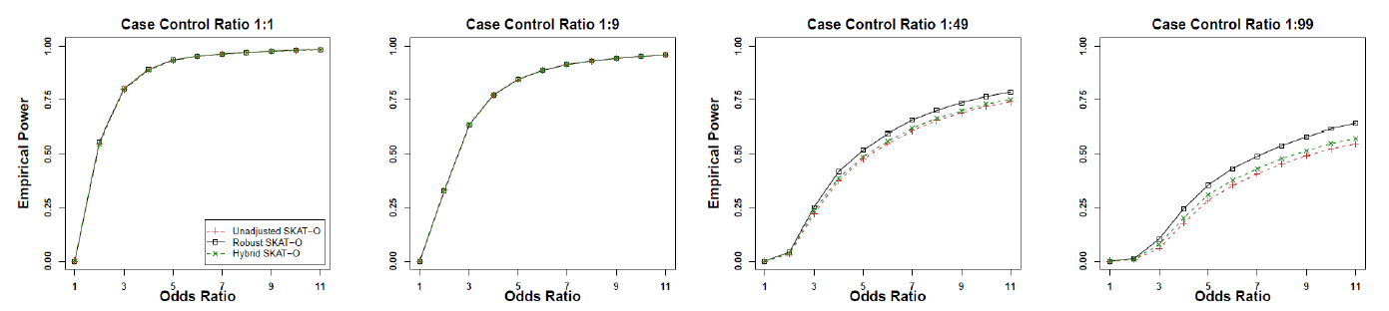
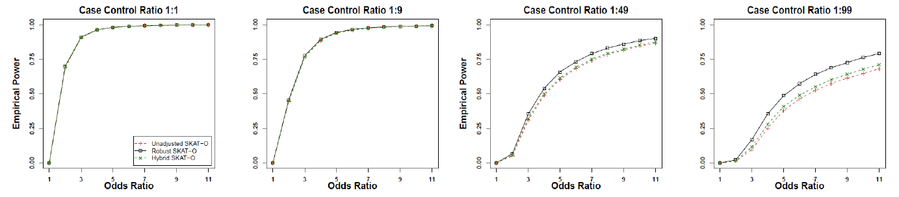
Power evaluation: robust SKAT-O showed length independence
Region=2K
Robust SKAT-O
3-8-2 rule:
30% total variants are causal variants
80% causal variants are risk factors
20% causal variants are protective
Region=3K
Robust SKAT-O

Slide 9
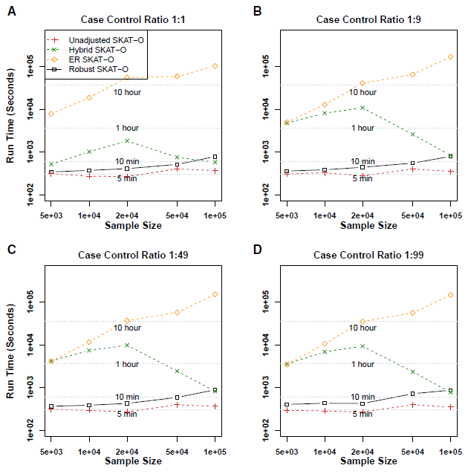

Computational time: robust SKAT-O require 140x times
Computational times is almost similar between 5,000 and 100,000 samples
791 UK biobank phenotypes and 50,000 samples require 453 CPU days
1 phenotypes and 50,000 samples require 13.7 CPU hours
2.7 hours
18 server nodes with 160 cores of computer power
100K
500K sample ~ 30 days

Slide 10
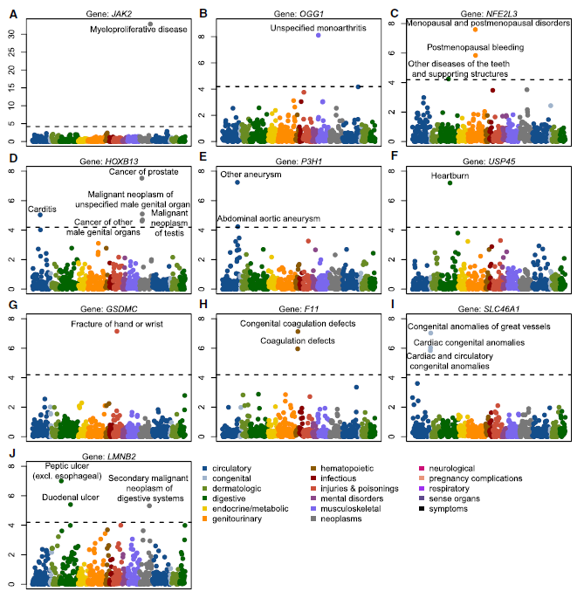
Robust SKAT-O analyses identify novel diseases associated genes
Rare nonsynonymous and splicing variants
18,360 genes and 791 phenotypes
Control the maximum C:N ratio<1:99
Unadjusted SKAT-O detected 73,723 hits
Robust burden test detected 34 signals
Robust SKAT detected 99 signals
Robust SKAT-O detected 111 signals
All above significant rare variants associated signals are still significant with the adjustment of nearby common variants

Slide 11
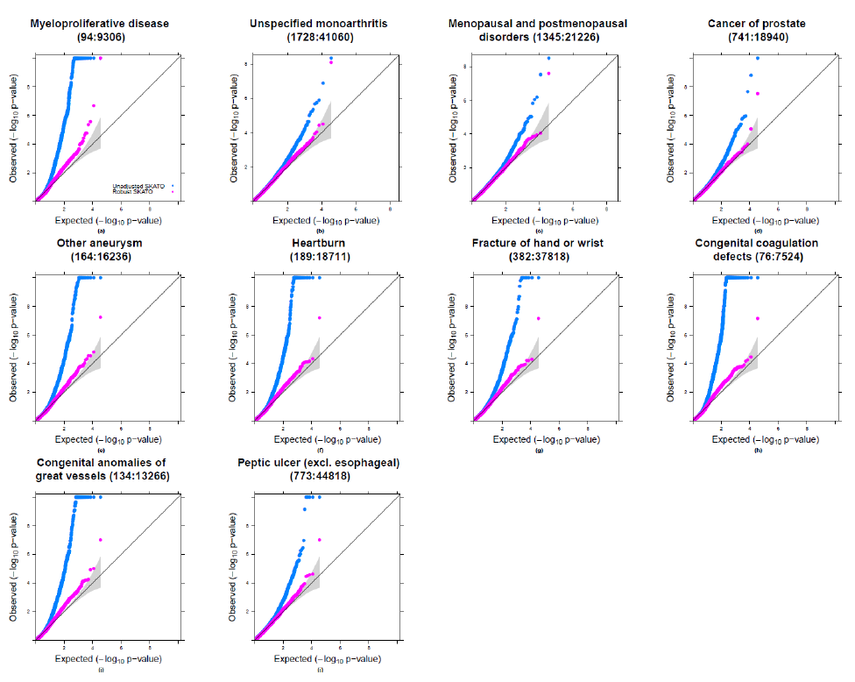
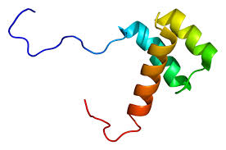
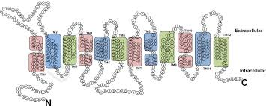
Robust SKAT-O analyses showed controlled type I errors
HOXB13
Cancer of prostate
SKAT-O
Robust SKAT-O
HOXB13, which encodes a transcription factor belonging to the highly conserved homeobox gene family, plays a role in normal prostate development. Genetic analyses revealed a HOXB13 G84E carrier frequency of 1.4% in men with familial prostate cancer compared with 0.1% in non-affected controls
Congenital anomalies of great vessels
SLC46A1
This gene encodes a transmembrane proton-coupled folate transporter protein that facilitates the movement of folate and antifolate substrates across cell membranes, optimally in acidic pH environments. This protein is also expressed in the brain and choroid plexus where it transports folates into the central nervous system. This protein further functions as a heme transporter in duodenal enterocytes, and potentially in other tissues like liver and kidney.
SKAT-O
Robust SKAT-O

Slide 12
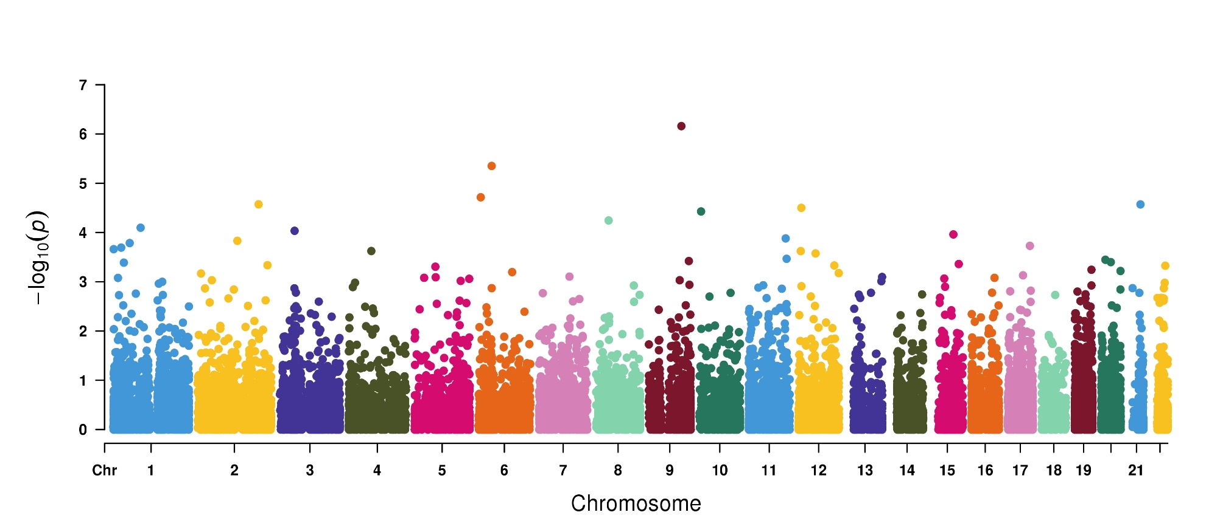
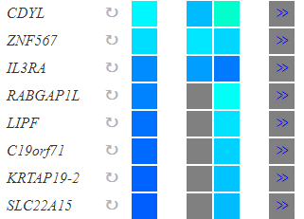

Robust SKAT-O analyses to Rheumatoid Arthritis
ZNF462
XPO5
CHAF1B
KCTD18
SNRNP48
ZNF595
ZNF718
ZNF774
ZNF438
ZNF438
169 ZNF-ChIP-Seq

Slide 13
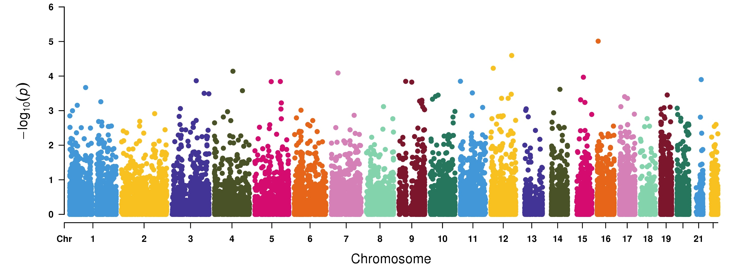
Robust SKAT-O analyses to Multiple Sclerosis
UBN1
BRAP
ADH6
TBX20
HEBP1
CYR61
RIPPLY3
UBN1: acts as a novel regulator of senescence. Involved in the formation of senescence-associated heterochromatin foci, which represses expression of proliferation-promoting genes. Binds to proliferation-promoting genes. May be required for replication-independent chromatin assembly

Slide 14
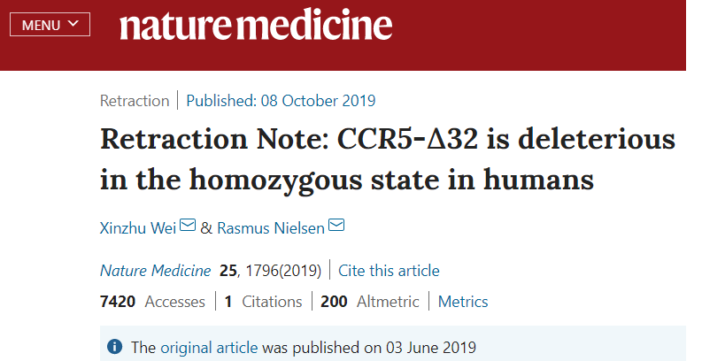
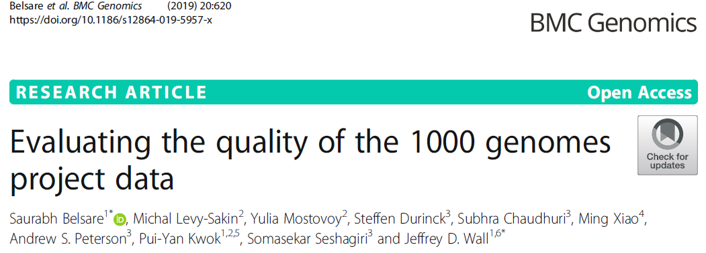
Challenge: low data quality both in genotyping and phenotyping
Regeneron Seal Point Balinese (SPB)
Retracted ~ July 2019
Genotyping calling bias
10th December, 2019
Functionally Equivalent pipeline (FE)
Retracted or update
https://www.biorxiv.org/content/biorxiv/early/2019/12/10/868570.full.pdf
Technique quality control, negative and positive control
should be set as much as possible

Slide 15
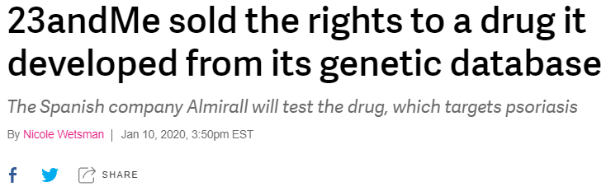
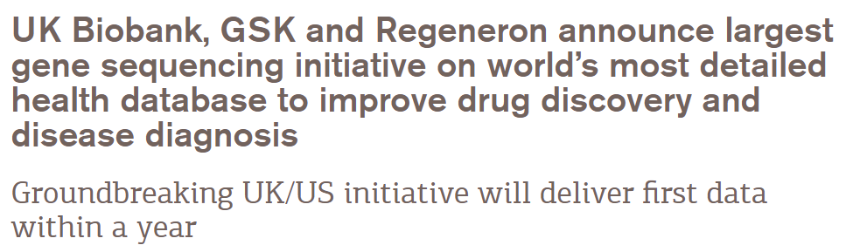
Summary and Discussion
Developed a region based computational pipeline to identify rare disease variants in imbalance dataset
Advantage:
Identify novel rare disease associated variants with imbalanced dataset
Computational time is scalable for large biobank dataset ~ 500,000 samples
Limitation:
Only works in unrelated individuals, 30% samples should be excluded
It will suffer inflated type I error if case: control ratio > 1: 99 which is common in large biobank
Phenotyping accuracy is one of the concerns: ICD10 => PheCode
Opportunity:
Generalized linear mixed
model (GLMM)

Slide 16
Thanks

Slide 17
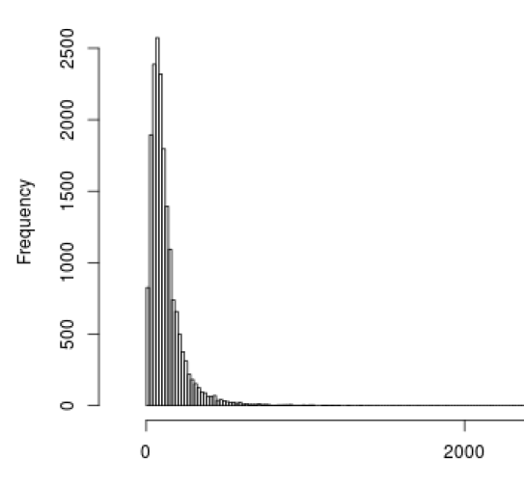
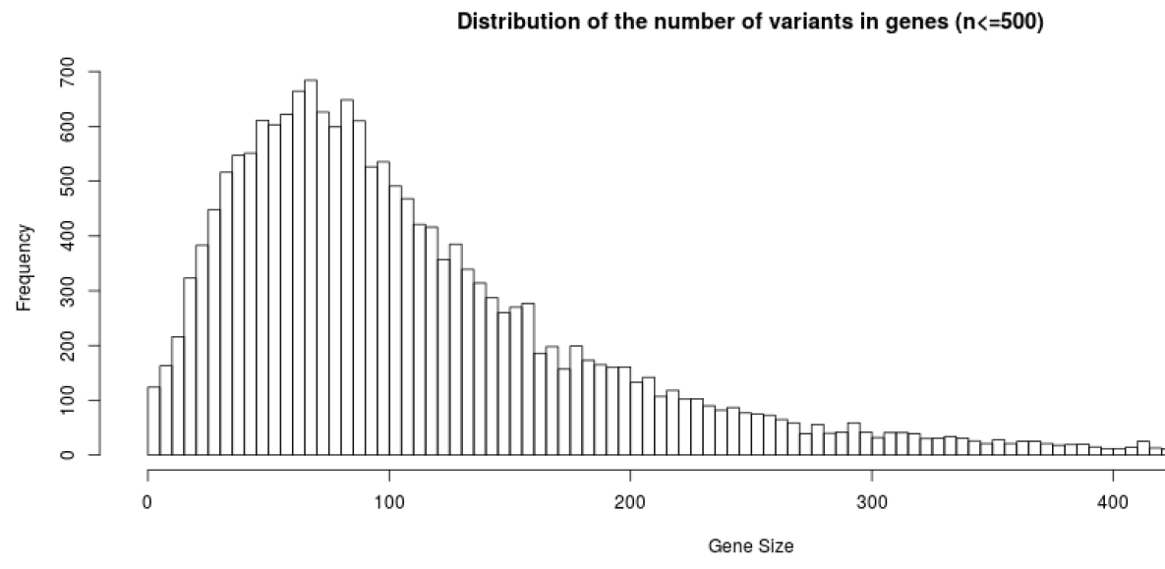
Real-Data Characteristics about Variants and Genes
The Distribution of the Number of Variants in Genes in the UK-Biobank WES data

