Slide 1
Identify autism associated genetic variation with MRI and exon-sequencing data

Slide 2
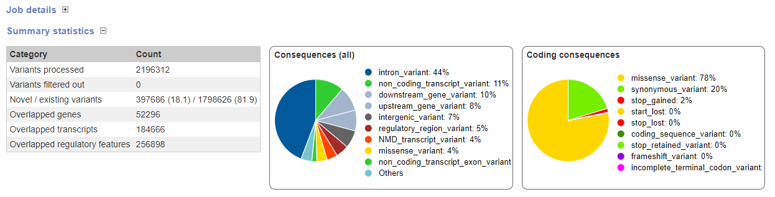

Slide 3
Data Cleaning and pre-processing
# 314 samples listed in quantitative iffusion tensor MRI data file
# 256 samples have whole-exom sequencing data
# 14 samples don't have MRI quantitative measurement
# 19 samples were removed since quality control
# 242 samples were included for the assciation study (MRI ~ Allele + age)
# Outlier samples
1, 2 low call rate ( u70704cl, u69388s)
2, Gender discrepancy(u38386cl,u65210cl,317814-UW)
3.1, Family(336051,395993 remove, keep 372278)
3.2, Family(370121 remove, keep 386915)
3.3 MZ twin(u28908s remove, keep u28906s-B-Redo)
3.4 duplicated samples (Saliva vs cell line) (u68413d remove, keep u68413s)
4.0 9 PCA outlier(u62997s,u1941001s,u90503s,u59502cl,u64061s,u65457s,u810031s,u810030s,u59504s)
totally, these samples were removed (space sparate): u62997s,u1941001s,u90503s,u59502cl,u64061s,u65457s,u810031s,u810030s,u59504s,u28908s,u68413s,370121,336051,395993,u38386cl,u65210cl,317814-UW,u70704cl,u69388s
Actually, I found the data have already removed 4.0, 3.4, 3.3,

Slide 4
44 Phenotype correlation matrix
Average R=0.8

Slide 5
Analysis 1: Linear regression with age as confounder
We have 44 MRI measurements, however, we only identified 79 significant association (P<3.1×10⁻⁸) between genotype variation with BCC.MD.Z (N=25), lPLIC.FA (N=8), BCC.RD.Z(N=8), rSLF.RD.Z(N=1), lPLIC.RD (N= 6) and lALIC.MD (N= 5) and rRLIC.MD.Z (N=4) in non-permutation analysis.
Analysis 2: Linear regression with age as confounder and 50000 permutation
Only 3 variants were identified in 3 phenotypes
Phenotype | CHR | ID | EMP1 | EMP2 | Nearby Gene
lALIC.FA.Z.assoc.linear.mperm | 24 | rs9786510 | 0.00784 | 0.03982 | VCY/NLGN4Y
rALIC.FA.Z.assoc.linear.mperm | 20 | kgp180885 | 0.0086 | 0.04898 | BMP2/LINC01428
SCC.MD.Z.assoc.linear.mperm | 2 | exm184366 | 0.0038 | 0.02192 | EHD3 $$$
Analysis 3: Linear regression with age as confounder and 50000 permutation only in case samples
 | CHR | ID | EMP1 | EMP2 | Position | Nearby Gene
lRLIC.FA.Z.assoc.linear.mperm | 2 | kgp4738539 | 0.00366 | 0.02148 | 19816939 | miR-4757/TTC32/WDR35
rALIC.AD.Z.assoc.linear.mperm | 6 | kgp8664031 | 0.00422 | 0.02258 | 13269160 | PHACTR1***
rRLIC.FA.Z.assoc.linear.mperm | 6 | kgp8664031 | 0.00684 | 0.0441 | 13269160 | PHACTR1***
SCC.RD.Z.assoc.linear.mperm | 6 | kgp8664031 | 0.00554 | 0.03476 | 13269160 | PHACTR1***
Kgp8664031 and kgp4738539 are significant only in EMP1 of analysis 2
Rs9786510, kgp180885 and exm184366 lost polymorphism in case samples
$$$ Prasad, A., et al., A discovery resource of rare copy number variations in individuals with autism spectrum disorder. 2012. 2(12): p. 1665-85.
***Homs, A., et al., Genetic and epigenetic methylation defects and implication of the ERMN gene in autism spectrum disorders. Transl Psychiatry, 2016. 6(7): p. e855.

Slide 6
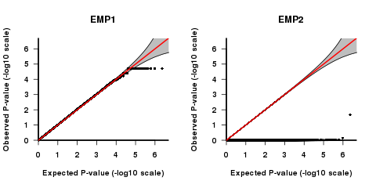
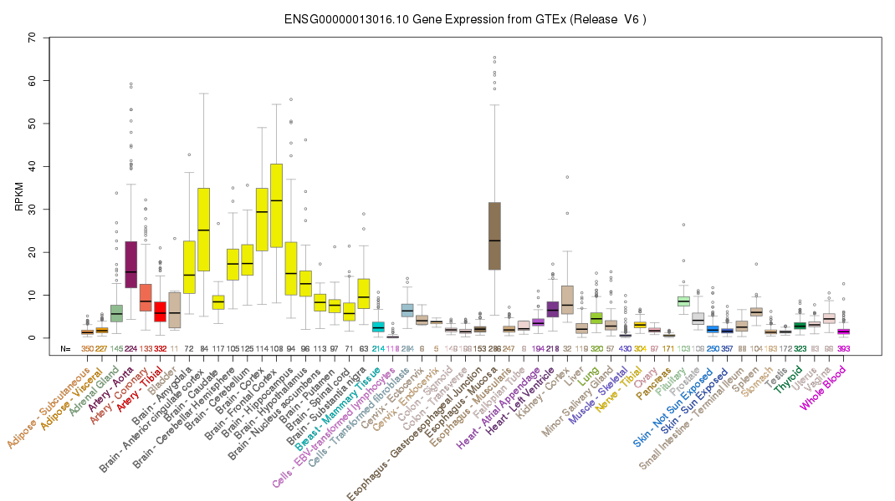
QQ plot for Association between SCC.MD and EHD3(exm184366) in permutation test mode
(total samples)
Beta=-2.418
95%CI= -2.38, -2.45
P-value=4x10⁻³
EHD3 is highly expressed in brain tissues.
ATP- and membrane-binding protein that controls membrane reorganization/tubulation upon ATP hydrolysis. A Discovery Resource of Rare Copy Number Variations in Individuals with Autism Spectrum Disorder found a CNV in EHD3 regions.
Prasad, A., et al., A discovery resource of rare copy number variations in individuals with autism spectrum disorder. 2012. 2(12): p. 1665-85.

Slide 7
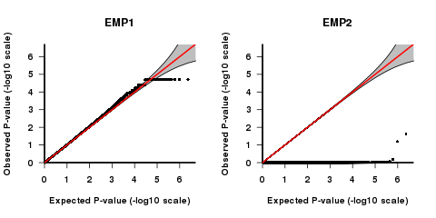
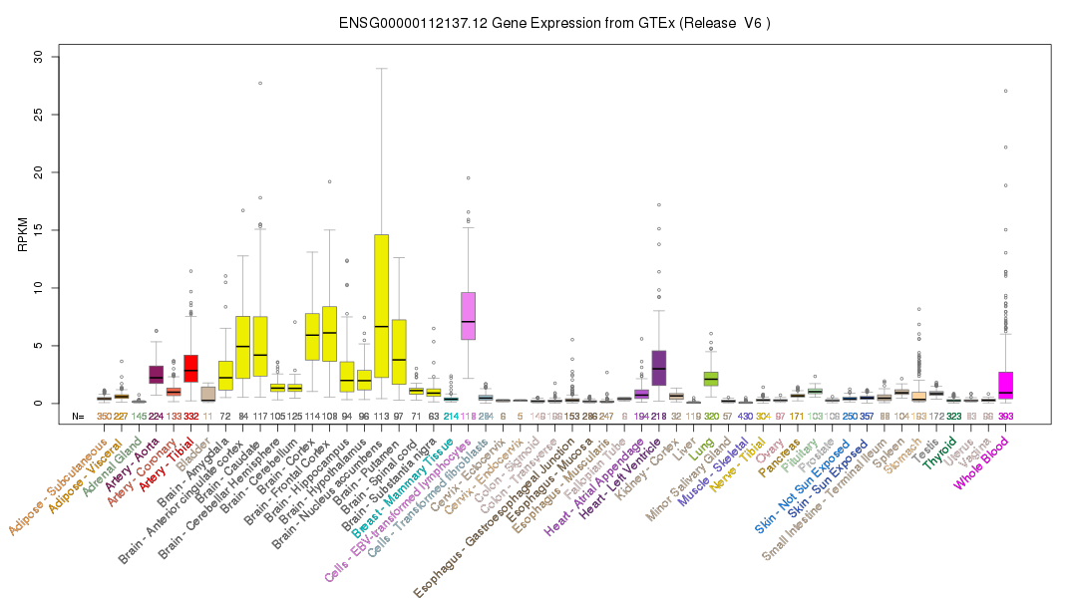
QQ plot for Association between rALIC.AD and PHACTR1(kgp8664031) in permutation test mode
(Only in case)
Homs, A., et al., Genetic and epigenetic methylation defects and implication of the ERMN gene in autism spectrum disorders. Transl Psychiatry, 2016. 6(7): p. e855.
Other DMRs in single-ASD patients affected the regulation of genes involved in the development and function of the nervous system (PHACTR1,⁶³ PIK3CD⁶⁴ and PKD1⁶⁵)

Slide 8
Result
1, We identify 79 significant MRI measurements associated genetic variants (include 55 unique SNPs) by traditional linear regression adjusted by average age. (P-value<3.1x10⁻⁸)
2, Apply permutation analysis, 3 significant association and 4 significant association were identified with total samples and case-only samples, respectively.
3, EHD3 and PHACTR1 identified by permutation analysis supported by non-permutation analysis and also have partial support by previous research.

Slide 9
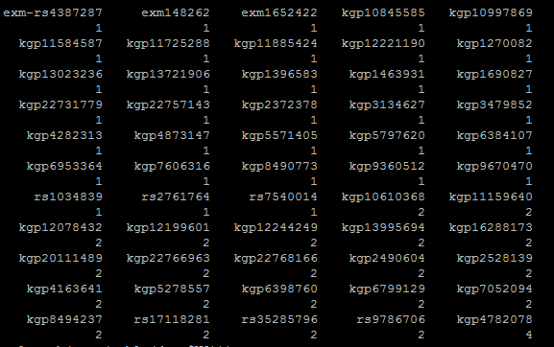
Supplementary
We identify 79 significant MRI measurements associated genetic variants (include 55 unique SNPs) .
Kgp4782078 (IMMP2L ) come out in 4 different phenotypes and it was supported to be associated with autism with latest paper published in 2018
Zhang, Y., et al., Association of IMMP2L deletions with autism spectrum disorder: A trio family study and meta-analysis. Am J Med Genet B Neuropsychiatr Genet, 2018. 177(1): p. 93-100.

