Slide 1





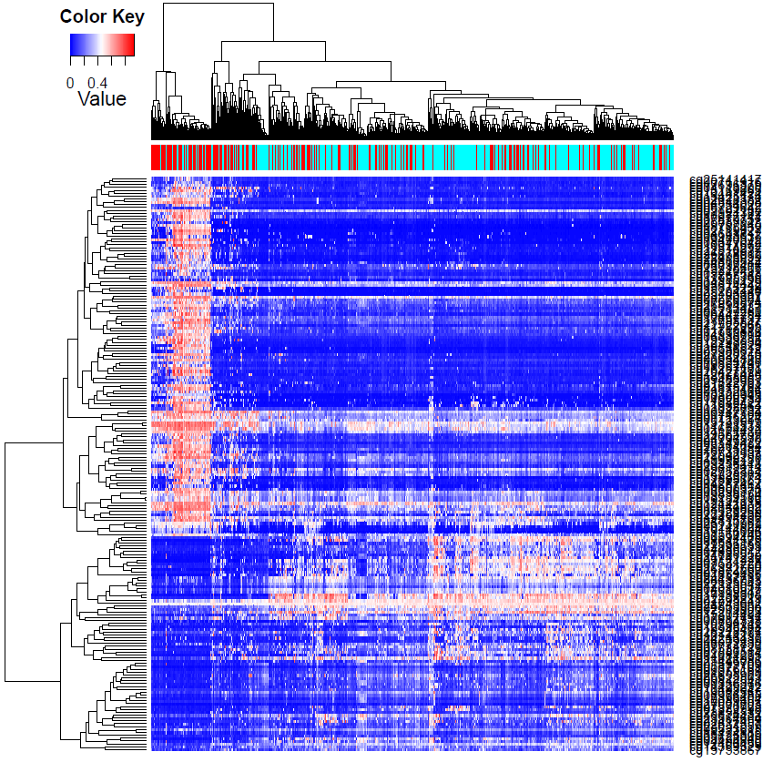
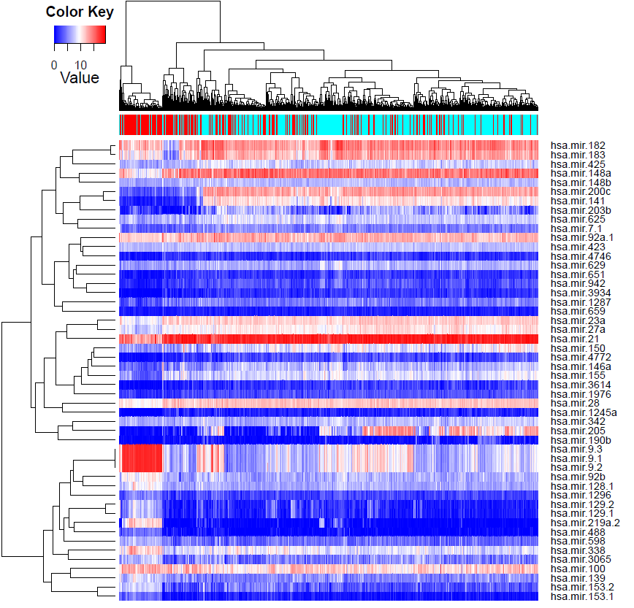
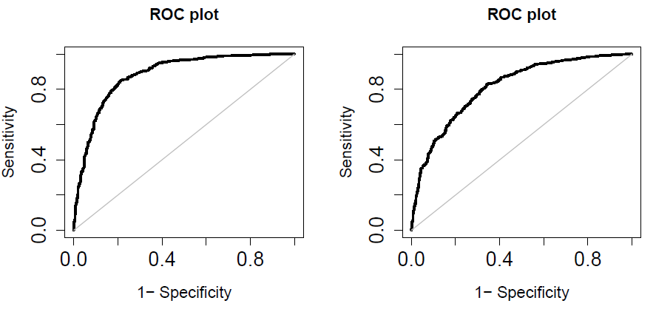
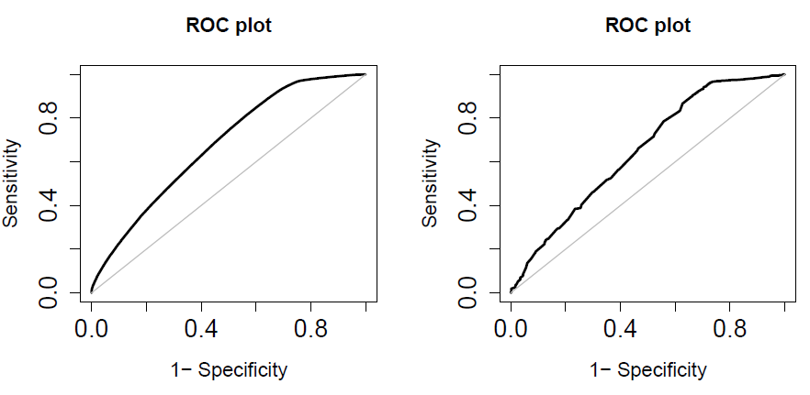
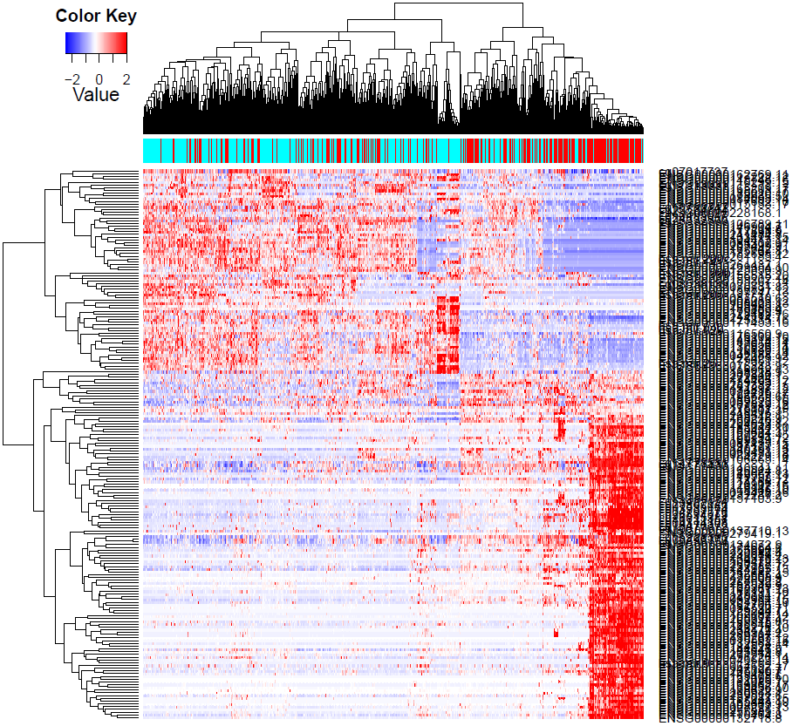
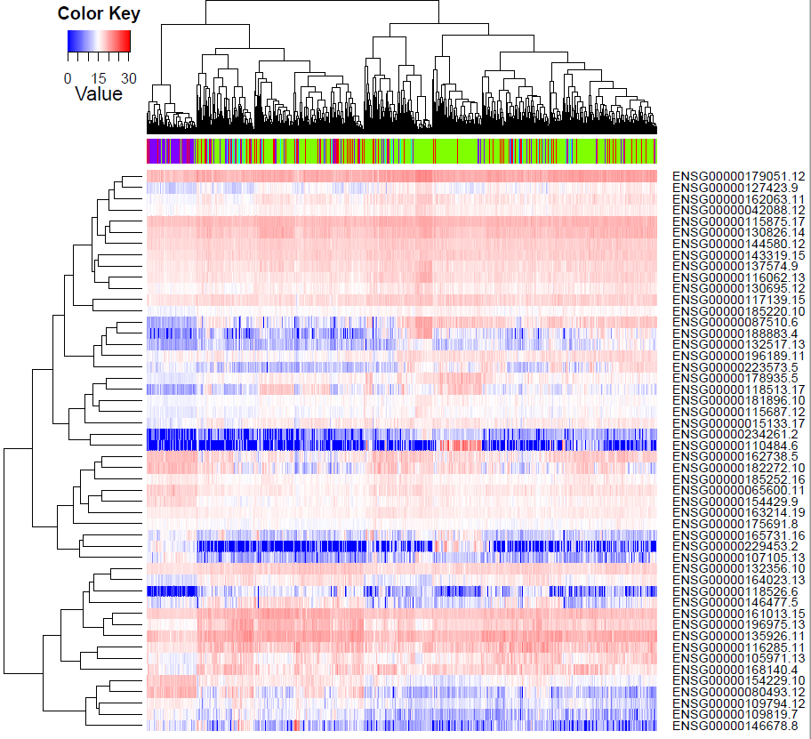
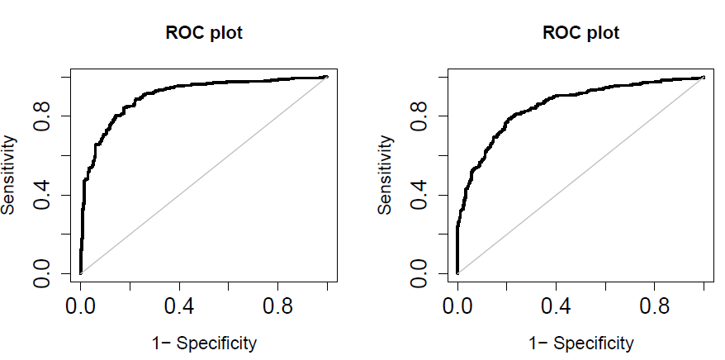
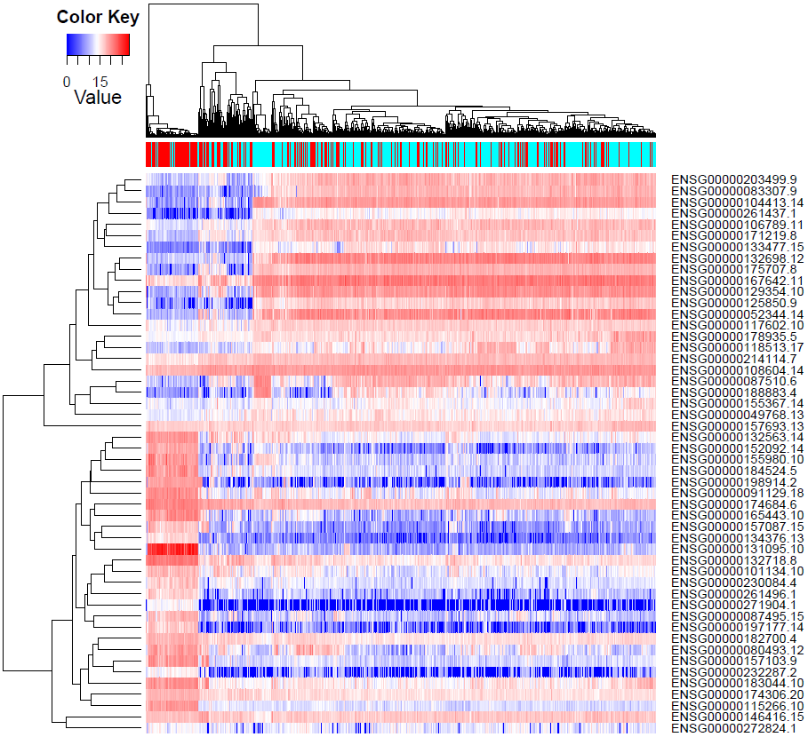
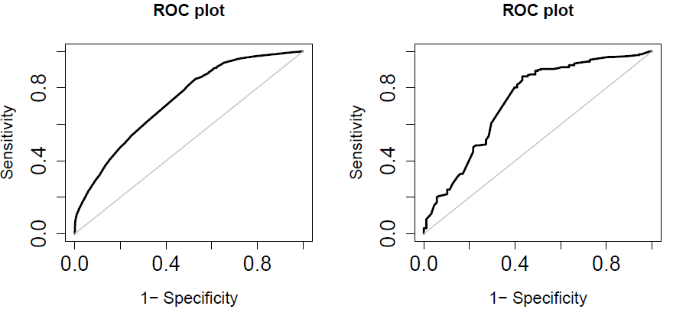
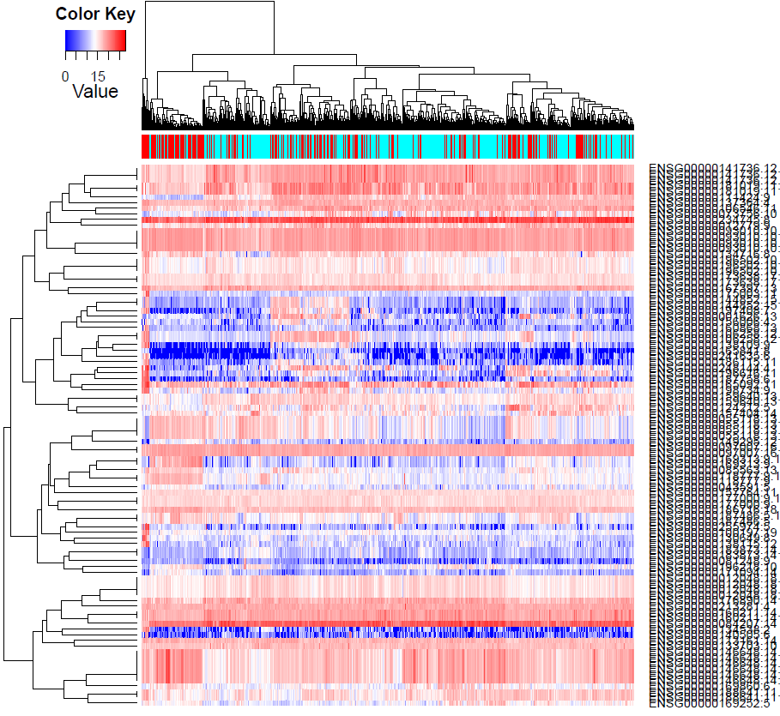
Deep Learning Prediction of Chemotherapy Response using Multi-Omics Features
Shicheng Guo^{1, #},Steven J. Schrodi^{1,2}
¹Center for Precision Medicine Research, Marshfield Clinic Research Institute, Marshfield, WI, USA
²Computation and Informatics in Biology and Medicine, University of Wisconsin-Madison, Madison, WI, USA
Abstract
Combining deep learning algorithms with multi-omics data provide an opportunity to improve precision medicine, especially for personalized therapy treatment. In this study, we investigated the performance of deep-learning algorithms applied to multi-omics genomic data from the Cancer Genome Atlas (TCGA) project. Drug response status including complete response (n=815), partial response (n=102), stable disease (n=182) and clinical progressive (n=327) across 32 cancers were evaluated. For computational efficiency and classifier performance, we proposed an approach using Sure Independence Screening (SIS) and Gini impurity index (SII) for feature selection from ultrahigh dimensional genomic feature set followed by conditional generative adversarial networks (CGAN) to produce predictive models for chemotherapy response, internally validated by 10-fold cross-validation. mRNA, miRNA, and methylation datasets were used both independently and jointly. For the miRNA-based prediction, we identified 23 highly informative features, including miR-141, miR-200c, miR-205, miR-9 and miRR-338, which, in combination, produced an AUC=0.64 for discriminating complete and partial response from stable disease and clinical progressive endpoints. Using mRNA-seq data, we identified 264 highly informative features including MYCBP, KLF15, IGIP, and GRIA3. The mRNA-based predictive model yielded an average AUC=0.71. The DNA methylation model attained a higher level of performance with AUC=0.81 (95% CI: 0.78-0.84). Combining mRNA-seq, miRNA, and methylation data improved the predictive performance with accuracy of 84.2% and an AUC=0.86 (95% CI: 0.82-0.90). Functional enrichment analysis for mRNA and DNA methylation selected features showed enrichment for the antioxidant response pathway and basal transcription factors associated with the platinum drug resistance (PDR) pathway. Importantly, our chemotherapy response classifier substantially outperforms a predictive model focused on mRNA and methylation features within PDR pathway (hsa01524 in KEGG) AUC=0.62, demonstrating that taking a broad approach using genome-wide multi-omics data dramatically improves discrimination. In summary, this work demonstrates that applying deep-learning algorithms to multi-omics data can generate informative predictive models for chemotherapy response across numerous cancers.
Result
Fig. 3. Chemotherapy response prediction based on DNA methylation and important features selected by multiple models.) Supervised heatmap analysis to show the distinguish performance based on differential expressed methylation loci. (B) ROC curve to show prediction performance in training and test dataset with neural networks, AUC=0.88 and AUC=0.81 respectively.
Fig. 1. Chemotherapy response prediction based on miRNA-seq and important features selected by multiple models. (A) Supervised heatmap analysis to show the distinguish performance based on differential expressed miRNA. (B) ROC curve to show prediction performance in training and test dataset with neural networks, AUC=0.67 and AUC=0.64 respectively.
Introduction
Cancer is the second leading cause of death globally, and is responsible for an estimated 9.6 million deaths in 2018. Although Immunotherapy received significant progression in cancer therapy, chemotherapy treatment is still the first line choice for the treatment to cancer patients. Chemotherapy response prediction, therefore, is one of most important task for precision medicine for cancer therapy. In the precious research, chemotherapy response prediction were mainly completed by single molecule features such as mutation, DNA methylation, miRNA and mRNA. We observed the prediction performance is very limited just based on single molecules. In this study, We applied multi-omics genomic data which included miRNA-seq, mRNA-seq and DNA methylation data to predict chemotherapy treatment responses. We combined all the chemotherapy drugs and expected to build a uniform prediction model to general chemotherapy response.
Data and Method
Sample: Drug response status including complete response (n=815), partial response (n=102), stable disease (n=182) and clinical progressive (n=327) across 32 cancers were collected. Drug response status were recorded as the first chemotherapy response status if multiple records occurred.
Molecular Profiles: DNA methylation microarray (D_{i}=450K) and RNA-seq data (D_{i}=), miRNA-seq (D_{i}=1,881) were collected to above mentioned samples. Gene expression levels will be quantified as E_{i,j}=log₂(TPM_{i,j}+1), where TPM_{i,j} refers to the TPM for gene i in sample j, as calculated by RSEM in paired-end mode
Pathway analysis: KEGG pathway and Reactome pathway were applied to infer the molecular functions for differential expressed genes, differential methylation and differential miRNAs as well as the interaction network.
Prediction and machine learning Features including mRNA, DNA methylation, microRNA were used in multiple machine learning algorithms. For computational efficiency and classifier performance, we proposed an approach using Sure Independence Screening (SIS) and Gini impurity index (SII) for feature selection from ultrahigh dimensional genomic feature set followed by conditional generative adversarial networks (CGAN) to produce predictive models for chemotherapy response, internally validated by 10-fold cross-validation. mRNA, miRNA, and methylation datasets were used both independently and jointly.
Fig. 3. Chemotherapy response prediction based on DNA methylation, miRNA and mRNA. Supervised heatmap analysis to show the distinguish performance based on differential expressed methylation loci (Z-score transform). (B) ROC curve to show prediction performance in training and test dataset with neural networks, AUC=0.90 and AUC=0.86 respectively. Meanwhile, we also tried prediction model by genes in platinum drug resistance pathway(rhsa01524 in KEGG). We found the prediction performance based on VIPs is limited with AUC=0.71 and AUC=0.62 in training and test datasets, respectively. Finally, Meanwhile, we also tried prediction model by 96 very important pharmacogenes (VIPs). (C) We found the prediction performance based on VIPs is limited with AUC=0.66 and AUC=0.65 in training and test datasets, respectively. Heatmap based on 99 VIPs to show the molecular profiles between responders and non-responders is as the following.
Fig. 2. Chemotherapy response prediction based on mRNA-seq and important features selected by multiple models. Supervised heatmap analysis to show the distinguish performance based on differential expressed miRNA (Y=4, A and Y=2, B). (C) ROC curve to show prediction performance in training and test dataset with neural networks, AUC=0.73 and AUC=0.71 respectively.

