Slide 1
Identify autism associated genetic variation with MRI and exon-sequencing data

Slide 2
Data Cleaning and pre-processing
# 314 samples listed in quantitative iffusion tensor MRI data file
# 256 samples have whole-exom sequencing data
# 14 samples don't have MRI quantitative measurement
# 19 samples were removed since quality control
# 242 samples were included for the assciation study (MRI ~ Allele + age)
# Outlier samples
1, 2 low call rate ( u70704cl, u69388s)
2, Gender discrepancy(u38386cl,u65210cl,317814-UW)
3.1, Family(336051,395993 remove, keep 372278)
3.2, Family(370121 remove, keep 386915)
3.3 MZ twin(u28908s remove, keep u28906s-B-Redo)
3.4 duplicated samples (Saliva vs cell line) (u68413d remove, keep u68413s)
4.0 9 PCA outlier(u62997s,u1941001s,u90503s,u59502cl,u64061s,u65457s,u810031s,u810030s,u59504s)
totally, these samples were removed (space sparate): u62997s,u1941001s,u90503s,u59502cl,u64061s,u65457s,u810031s,u810030s,u59504s,u28908s,u68413s,370121,336051,395993,u38386cl,u65210cl,317814-UW,u70704cl,u69388s
Actually, I found the data have already removed 4.0, 3.4, 3.3,

Slide 3
Phenotype correlation matrix
Average R=0.8

Slide 4
Linear regression with age as confounder
We have 44 MRI measurements, however, we only identified significant association (P<3.1×10⁻⁸) between genotype variation with BCC.MD.Z (N=2038), GCC.RD.Z(N=1), lPLIC.MD.Z(N=1), rSLF.RD.Z(N=1), GCC.MD.Z(N=30) and BCC.RD.Z(N=789) in non-permutation analysis.
Linear regression with age as confounder and 50000 permutation
Only 6 variants were identified in 5 phenotypes
 | CHR | SNP | EMP1 | EMP2 | Nearby Gene
BCC.MD.Z.assoc.linear.mperm | 5 | kgp334896 | 0.00175 | 0.02686 | FAM193B
lALIC.AD.Z.assoc.linear.mperm | 19 | kgp12379442 | 0.00293 | 0.01876 | ZNF431/ZNF714
lRLIC.AD.Z.assoc.linear.mperm¹⁷ | 1 | rs11161438 | 0.00196 | 0.0033 | SSX2IP/LPAR3/LINC01555
lSLF.AD.Z.assoc.linear.mperm³⁶ | 14 | kgp8810402 | 0.00268 | 0.01324 | AKAP6%%
lSLF.MD.Z.assoc.linear.mperm³⁸ | 2 | kgp5133951 | 0.00327 | 0.04488 | EPB41L5
rALIC.FA.Z.assoc.linear.mperm²⁵ | 18 | rs3018274 | 0.00311 | 0.02312 | DOK6$$
%% Gozes, I., A. Van Dijck, G. Hacohen-Kleiman, I. Grigg, G. Karmon, E. Giladi, M. Eger, Y. Gabet, M. Pasmanik-Chor, E. Cappuyns, O. Elpeleg, R.F. Kooy, and S. Bedrosian-Sermone, Premature primary tooth eruption in cognitive/motor-delayed ADNP-mutated children. Transl Psychiatry, 2017. 7(2): p. e1043.
$$ Ben-David, E., E. Granot-Hershkovitz, G. Monderer-Rothkoff, E. Lerer, S. Levi, M. Yaari, R.P. Ebstein, N. Yirmiya, and S. Shifman, Identification of a functional rare variant in autism using genome-wide screen for monoallelic expression. Hum Mol Genet, 2011. 20(18): p. 3632-41.

Slide 5
Linear regression with age as confounder
Phenotype: 44 MRI
Genotype: 1,618,874
Multiple test correction P-value: 0.05/1618874=3.1x10^-8
We have 44 MRI measurements, however, we only identified significant association (P<3.1×10⁻⁸) between genotype variation with BCC.MD.Z (N=2038), GCC.RD.Z(N=1), lPLIC.MD.Z(N=1), rSLF.RD.Z(N=1), GCC.MD.Z(N=30) and BCC.RD.Z(N=789) in non-permutation analysis.
rs8011867 was significantly identified in 4 different MRI measurements (BCC.MD, BCC.RD, GCC.MD and GCC.RD). rs35802157 was significantly identified in lPLIC.MD measurement. rs6500552 was significantly identified in 2 different MRI measurements (BCC.MD.Z and rSLF.RD.Z)
rs8011867 might associated with RNA gene RP11-168L7.1 or TCONS_00022880 and the functions for this SNPs have never been touched before since the difficulty of the function validation for noncoding-RNA. rs35802157 located in intron regions of FOXN3 which significantly differential expression in different brain region (high in cerebellar hemisphere and cerebellum and quite low in other brain regions). rs6500552 located in TRAP1 exon regions and the previous research found Autism is significantly present in many of the boys with TRAP1-related disease (R.G. Boles et al. / Mitochondrion 23 (2015) 64–70).
BTW:
Rs8011867/ rs6500552 is significant in EMP1, not EMP2

Slide 6
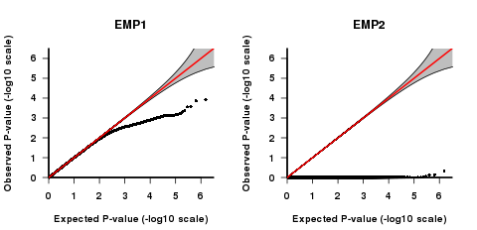

QQ plot for Association between rALIC.FA and rs3018274 in permutation test mode
without Age Adjustment
rs3018274
with Age Adjustment
rs3018274
Normality of the phenotype is not so good and caused the ‘compressed’ or blow the null hypothesis region

Slide 7


QQ plot for Association between lSLF.AD and kgp8810402in permutation test mode
without Age Adjustment
with Age Adjustment

Slide 8
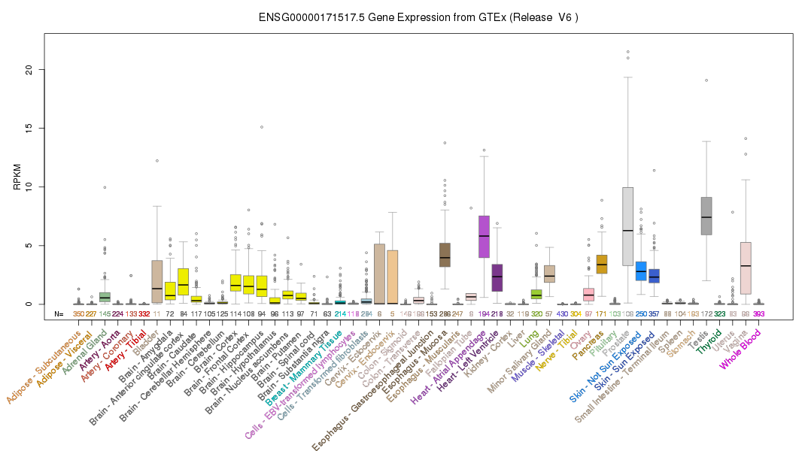
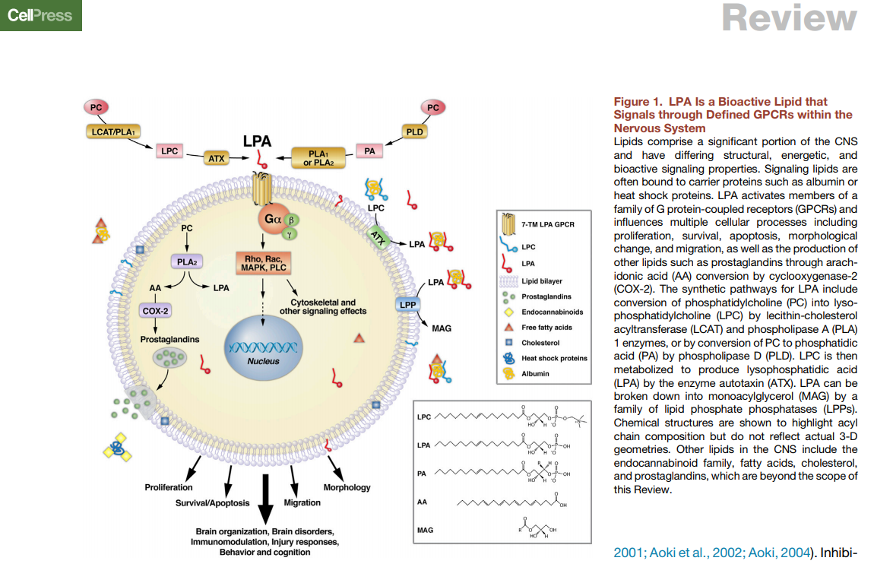
LPAR3
Lysophosphatidic acid (LPA) signaling. a member of the G protein-coupled receptor family, as well as the EDG family of proteins. This protein functions as a cellular receptor for lysophosphatidic acid and mediates lysophosphatidic acid-evoked calcium mobilization
Yung, Y.C., N.C. Stoddard, H. Mirendil, and J. Chun, Lysophosphatidic Acid signaling in the nervous system. Neuron, 2015. 85(4): p. 669-82

Slide 9
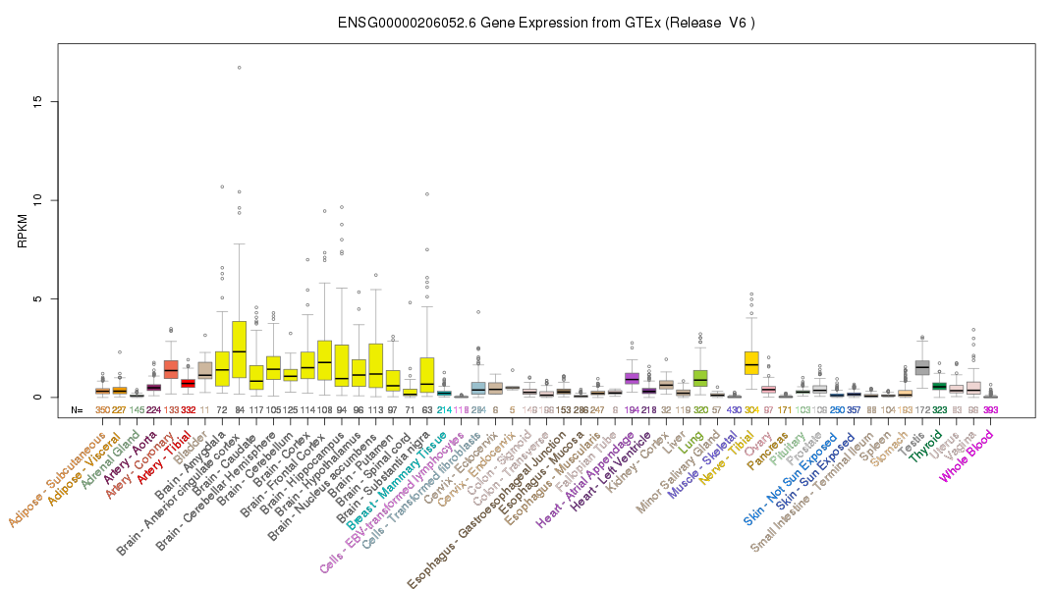
DOK6
DOK proteins are enzymatically inert adaptor or scaffolding proteins. They provide a docking platform for the assembly of multimolecular signaling complexes. DOK6 promotes Ret-mediated neurite growth. May have a role in brain development and/or maintenance.

Slide 10
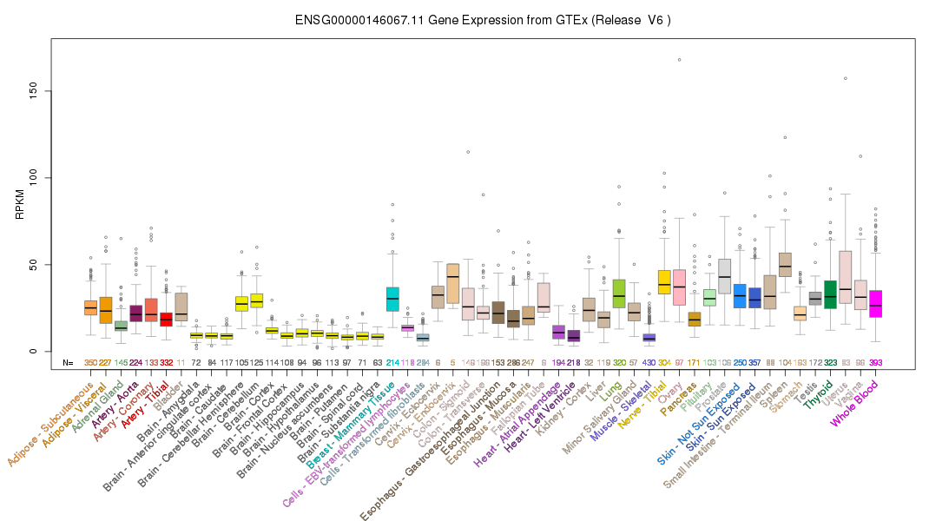
FAM193B
May contribute to the correct positioning of tight junctions during the establishment of polarity in epithelial cells.

Slide 11
Conclusion:
With permutation based linear regression to 44 MRI phenotype in our . We

