Slide 1
Autism Genetic Research
dbNSFP4.0
Exome Variants
ANNOVAR

Slide 2
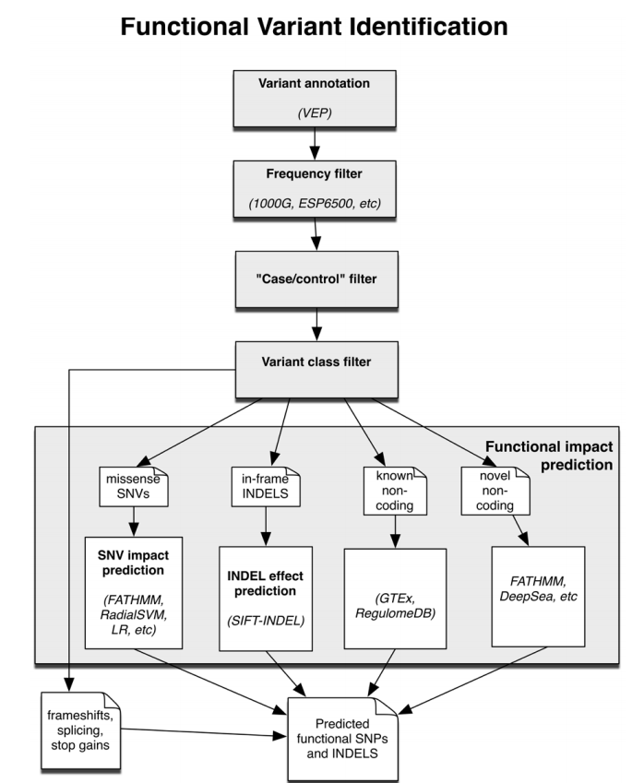
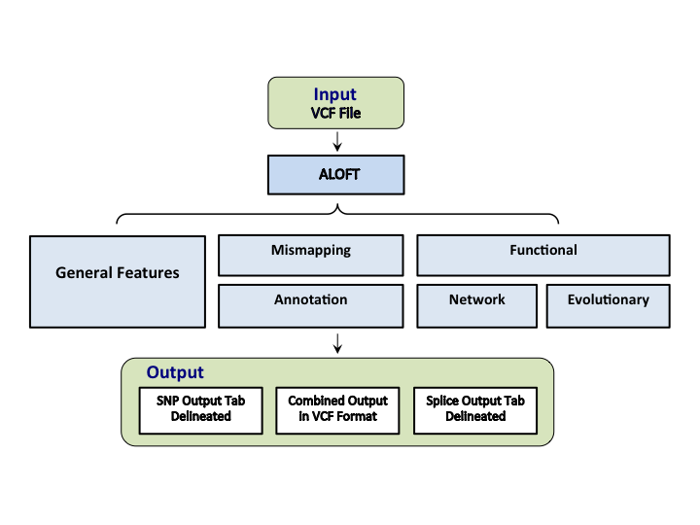

Slide 3
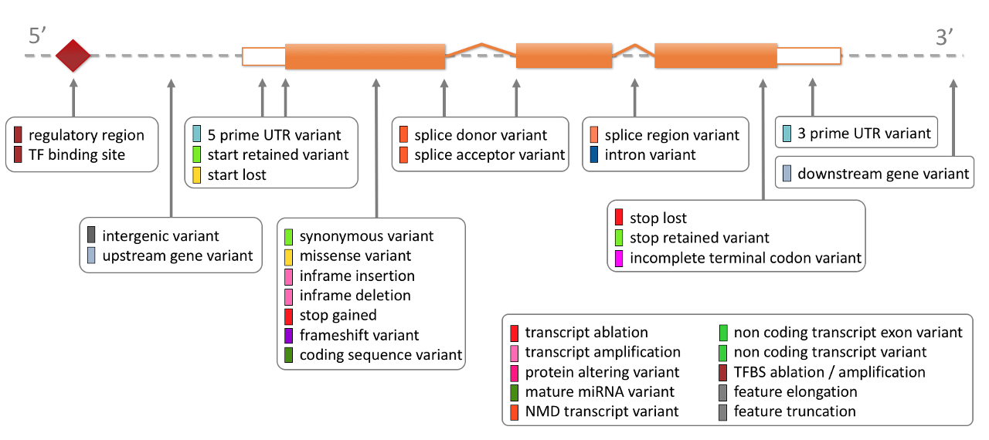

Slide 4


Slide 5


