Slide 1
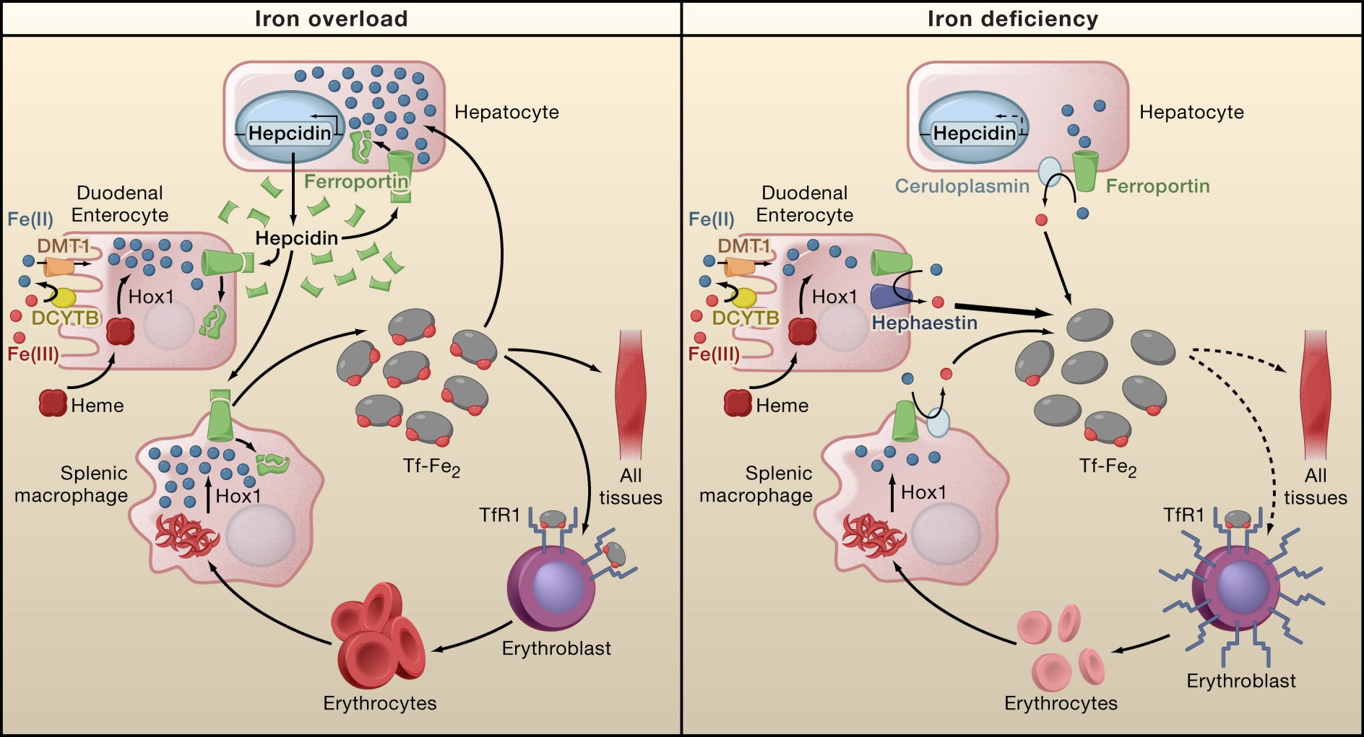

Slide 2
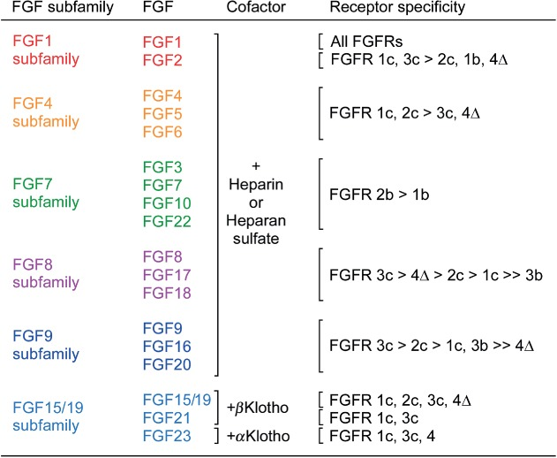
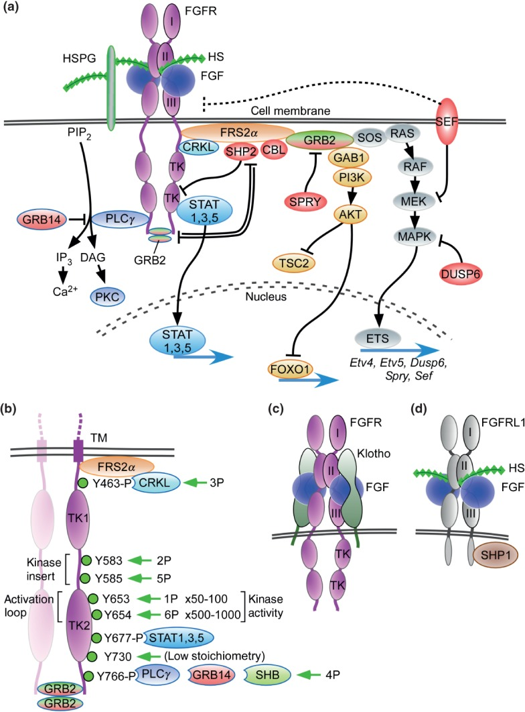
STAT1
STAT3
STAT5
FOXO1
ETV4
ETV5
DUSP6
SPRY
SEF
HAMP

Slide 3
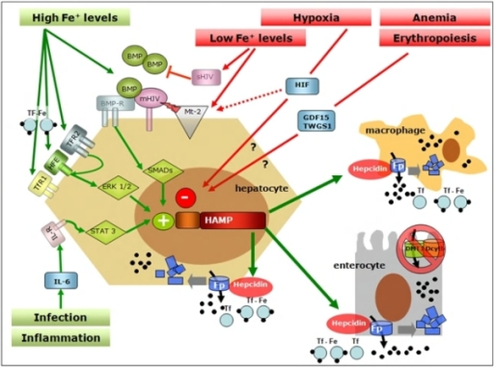
Paracrine FGF6 interacts with FGFR with Heparin or heparan sulphate proteoglycan (HPSG) as the cofactor to initial FGF pathway (Nobuyuki itoh, JBC, 2011). Activated FGFRs have the ability to phosphorylate specific tyrosine residues and activate RAS-MAPK pathway, PI3K-AKT pathway, PLCγ pathway and STAT pathway (Turner, Nature Review Cancer 2010). Iron overload, and inflammation could positively regulate hepcidin by BMP/Smad pathway (Ivana, JCI, 2007) and inflammatory IL-6/STAT3 pathways (Thomas, JCI, 2010 and Diedra, blood, 2006). However, loss-of-function mutation of FGF6 will silence FGF6-FGFR pathway and cause low expression of hapcidin which will decrease the inhibition of irons transfer from intestinal cell to blood.

Slide 4
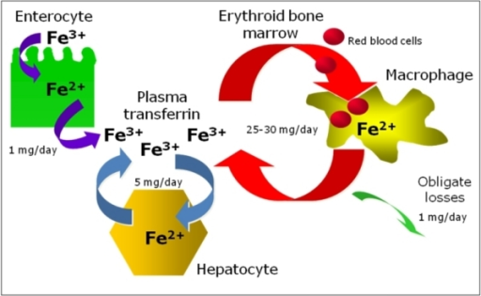
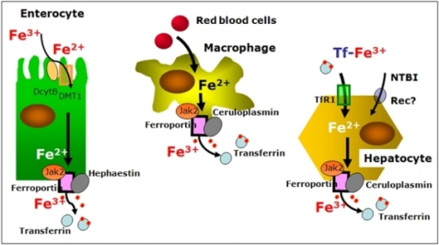

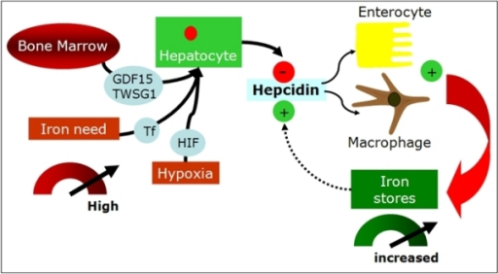
Notes:
f3-mjhid-1-1-e2009006: Signal pathways in systemic regulation of hepcidin. Many stimuli regulate expression of Hepcidin gene (HAMP) in the liver. One of the best known positive modulator is represented by Bone Morphogenetic Proteins (BMPs) that bind BMP-Receptor (BMP-R) on the surface of the hepatocyte resulting in SMAD-mediated induction of HAMP transcription. Hemojuvelin (mHJV) increases this signal acting as BMP co-receptor on the cell surface. In contrast, the soluble forms of HJV (sHJV), produced by HJV cleavage by furin at position 335, act as “decoy-receptor” competing with mHJV for the BMP ligand. Matriptase-2 (Mt2), which is activated by iron deficiency and by hypoxia, is the most potent inhibitor of hepcidin production by cleaving mHJV on hepatocyte surface and so preventing BMP-mediated hepcidin production. HAMP expression is also stimulated by inflammation, via the soluble mediator Interleukin-6 (IL6) and its specific membrane receptor (IL6-R) activating a STAT3-dependent signal pathway promoting HAMP transcription. HFE, TfR2 and TfR1 positively influence HAMP transcription in a ERK1/2 mediated way acting as a functional molecular complex on the cell surface playing a primary role in the hepatocyte sensing of circulating iron levels. Erythropoiesis, via the soluble mediator Growth Differentiation Factor 15 (GDF15) and Twisted Gastrulation (TWSG) 1, and hypoxia, via Hypoxia Inducible Factor (HIF), decrease HAMP expression (see text for further explanation).

