Slide 1
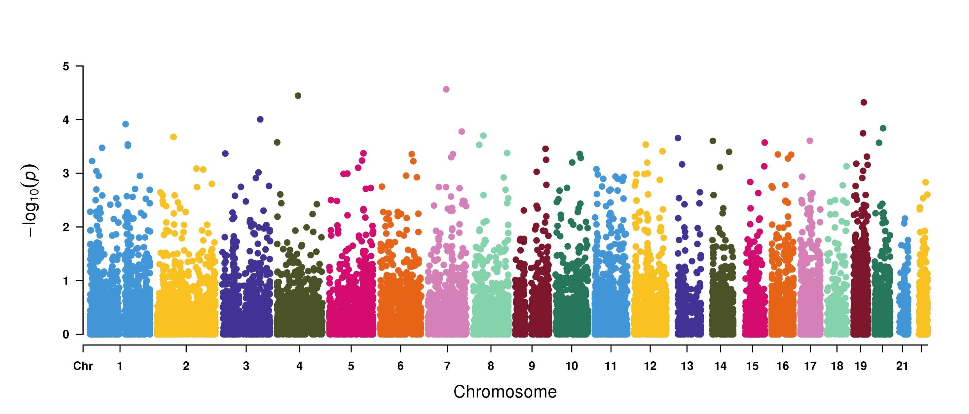
Genome-wide Robust SKAT-O based association study to identify chronic liver disease and cirrhosis associated genes in 50K UKBB exome-sequencing data
KLHL8
RCC1L
PAFAH1B3
BCL9
CCNL1
APLF
KLRG2
MPHOSPH8
SYCN
TRPC4AP
SFRP1
ICD10 code: 571
313 cases and 30,987 controls

