Slide 1


Deep Learning Prediction of Chemotherapy Response using Multi-Omics Features
Shicheng Guo
Center for Precision Medicine Research
Marshfield Clinic Research Institute
15/10/2019

Slide 3
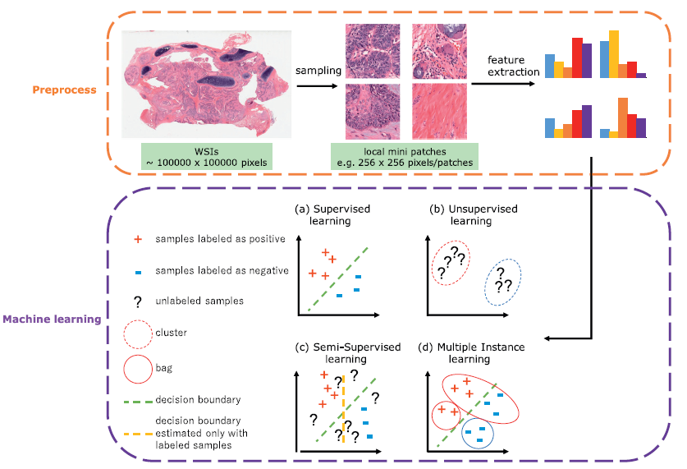
Flowchart for machine learning in digital histological image analysis
D. Komura, S. Ishikawa / Computational and Structural Biotechnology Journal 16 (2018) 34–42

Slide 5
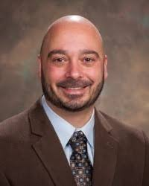
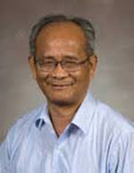
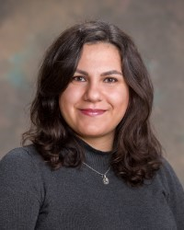
Acknowledgements
Dr. Steven Schrodi
MCRI
Marshfield, WI
Dr. Momiao Xiong
University of Texas
Houston, TX
Dr. Fereshteh Bashiri
MCRI
Marshfield, WI

Slide 6


Slide 7
