Slide 1
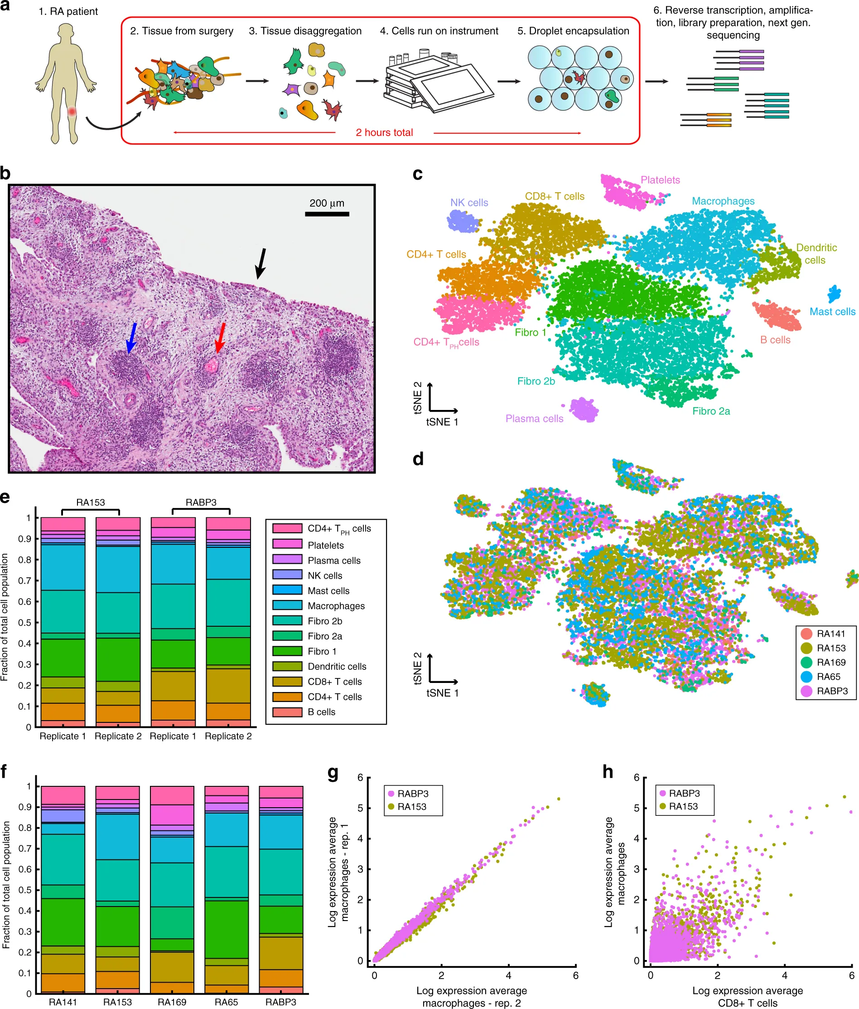
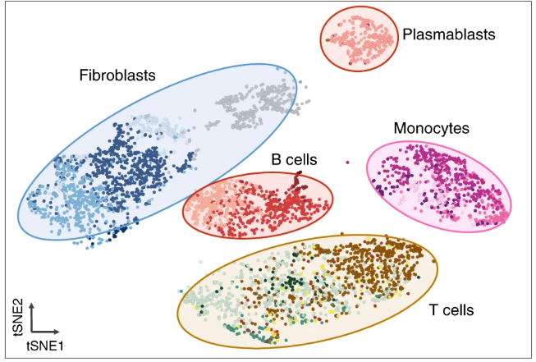
Single cell subpopulations of synovium improve pathogenesis of rheumatoid arthritis
13 subpopulations, 2018
18 subpopulations, 2019
Three putative fibroblasts subpopulations
Fibroblast 1: CD55⁺ lining fibroblasts
Fibroblast 2a:
Fibroblast 2b
Four putative fibroblasts subpopulations
SC-F1: CD34⁺ sublining fibroblasts
SC-F2: HLA-DRA^{hi} sublining fibroblasts
SC-F3: DKK3⁺ sublining fibroblasts
SC-F4: CD55⁺ lining fibroblasts
CD90⁺ and CXCL12,MMP2, MMP3
Stephenson et al, Nature Communications: 9, 791 (2018)
Fan Zhang et al, Nature Immunology:20,928–942 (2019)

Slide 2
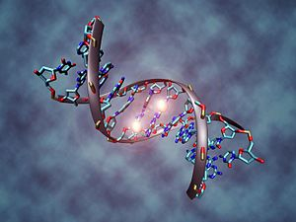
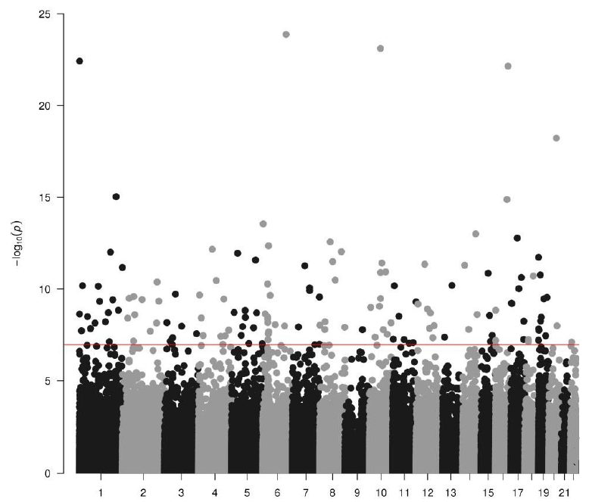
DNA methylation research in rheumatoid arthritis reveals epigenetic involvement in RA
SLC2A12
TNFRSF18
MLLT6
ZNF365
Methylation Difference Between RA and non-RA
NCOA5
Guo, 2017
Zhu, ARD, 2019
CD4+
PBMC
B vs T
Fibroblast
Glossop, Epigenetics, 2014
Rizi, NC, 2018
Ince-Askan, ARD, 2019
DNA methylation of Next Generation influenced by Mon-with-RA
Glossop JR, et al. Epigenetics. 2014;9(9):1228-37
Guo S, et al. Modern Rheum 2017; 27(3):441-447
Zhu H, et al. Ann Rheum Dis 2019;78:36–42
Rizi Ai et al. Nat Commun. 2018 9(1):1921
Ince-Askan, et al. Ann Rheum Dis 2019 May 29th.
Maternal RA disease during pregnancy might have lifelong consequences for the offspring.

