Slide 1
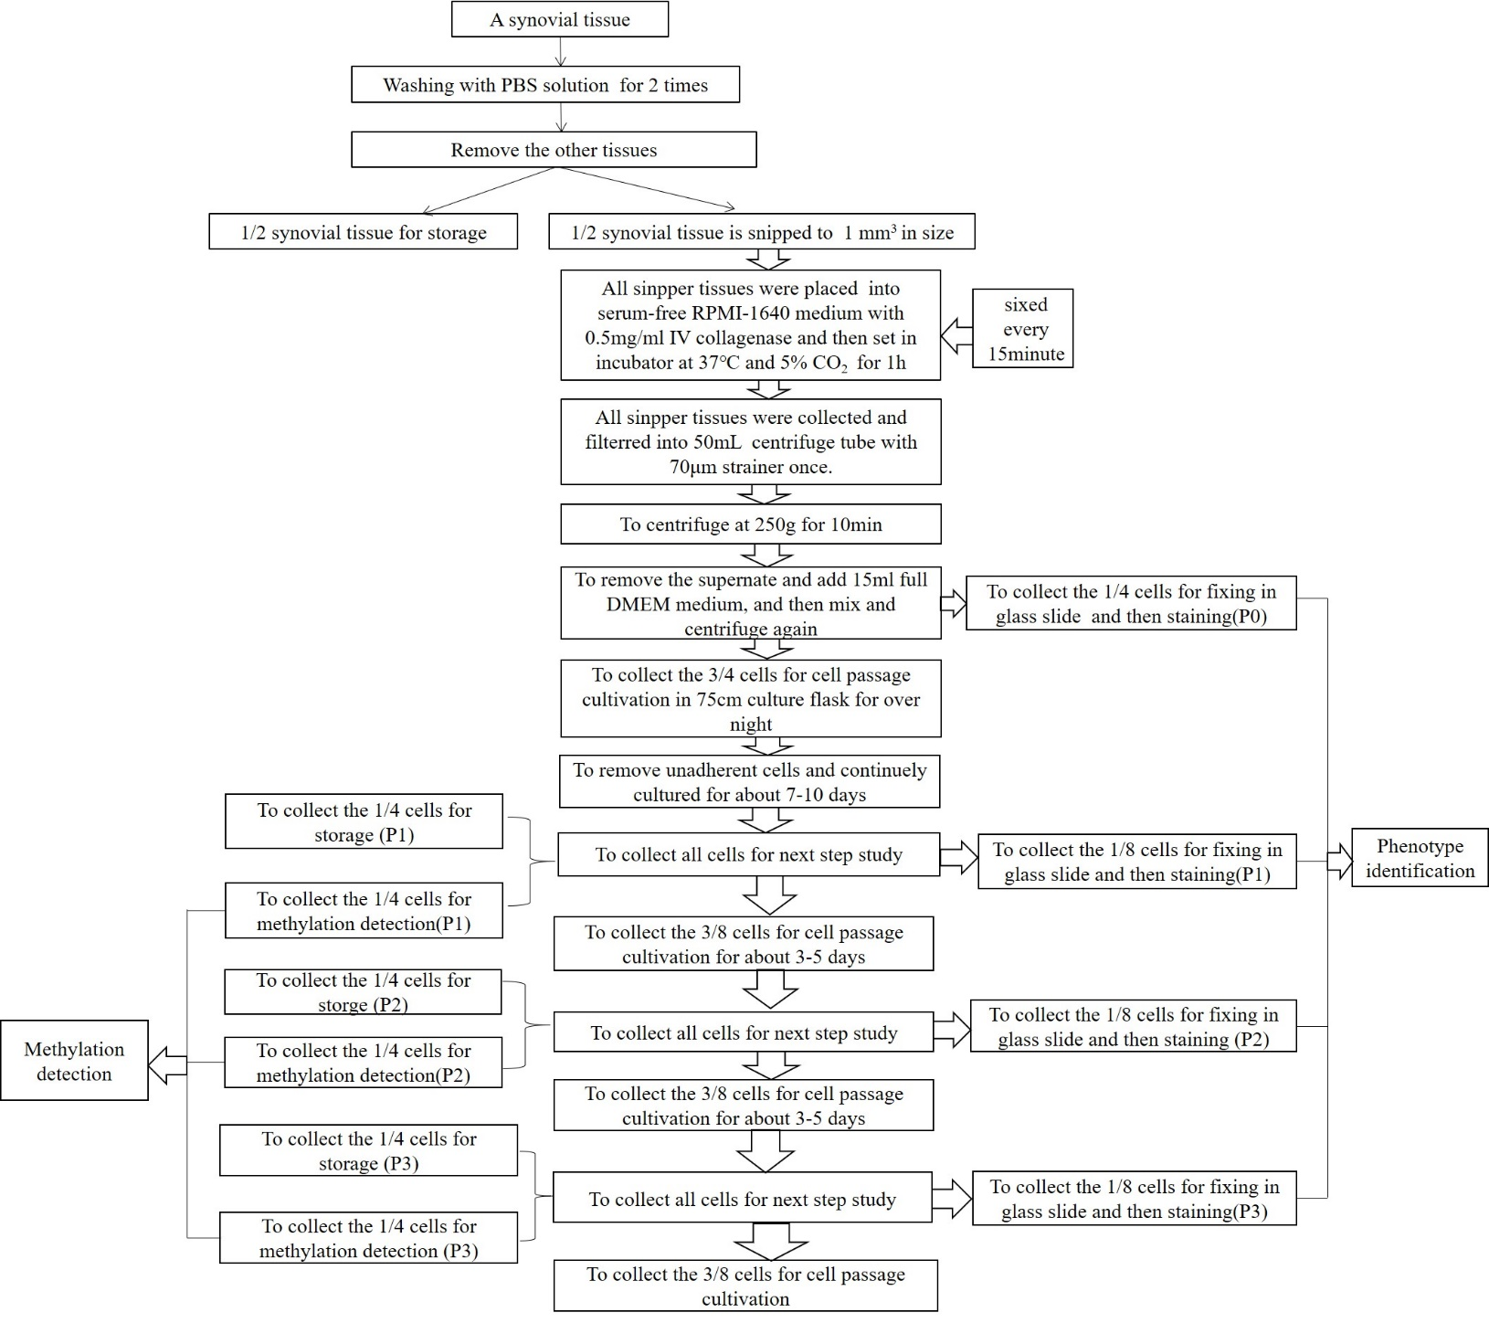
Female, RF+, CCP+
RNA-seq: 4x1000=4000RMB
meEPIC: 4x2800=11,200RMB
3 biological repeat
P3: HFLS and RA-FLS
RNA-seq: 2x1000=2,000RMB
meEPIC: 2x2800=5,600RMB
Total: ~51,600 RMB
All the unused specimen should be
saved in -80 for future use.
500ng-DNA Meth-EPIC
500ng-RNA mRNA-seq
500ng-DNA Meth-EPIC
500ng-RNA mRNA-seq
500ng-DNA Meth-EPIC
500ng-RNA mRNA-seq
P3: HFLS and RA-FLS commercial cell line
500ng-DNA Meth-EPIC
500ng-RNA mRNA-seq
500ng-DNA Meth-EPIC
500ng-RNA mRNA-seq
500ng-DNA Meth-EPIC
500ng-RNA mRNA-seq

