Slide 1
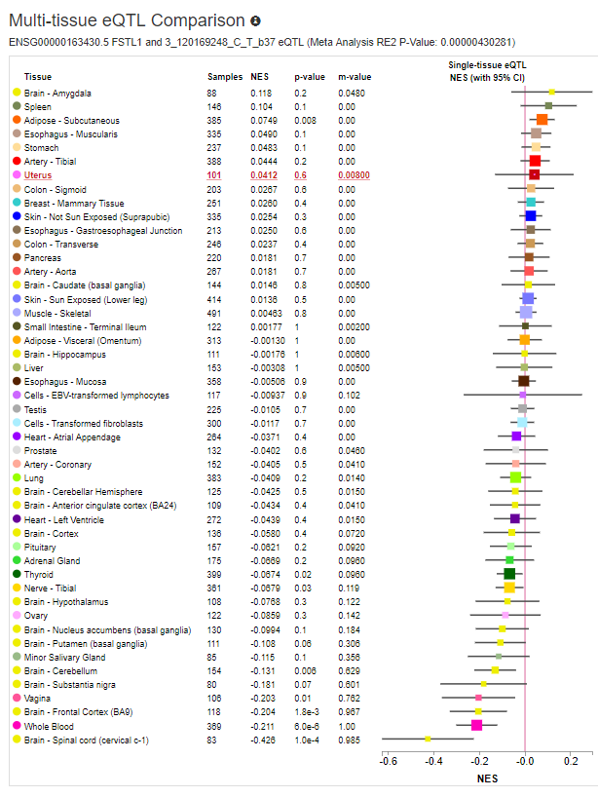
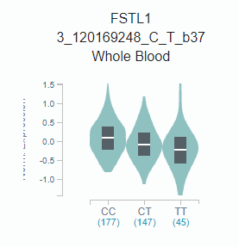
rs1147707

Slide 2

Follistatin-N-terminal Domain-Like
Kazal Type Serine Protease Inhibitors Domain
rs1147707 (eQTL)
rs374114238 (P>A)
rs199556968 (D>N)
rs113155123 (E->G, Deleterious, WGAS)
EFh_SPARC_FSTL1
rs199863523 (N>D)
rs150197564 (R>C)
EF-hand domain
Von Willebrand Factor (vWF) type C Domain
rs754750214(E->K/Q)

Slide 3
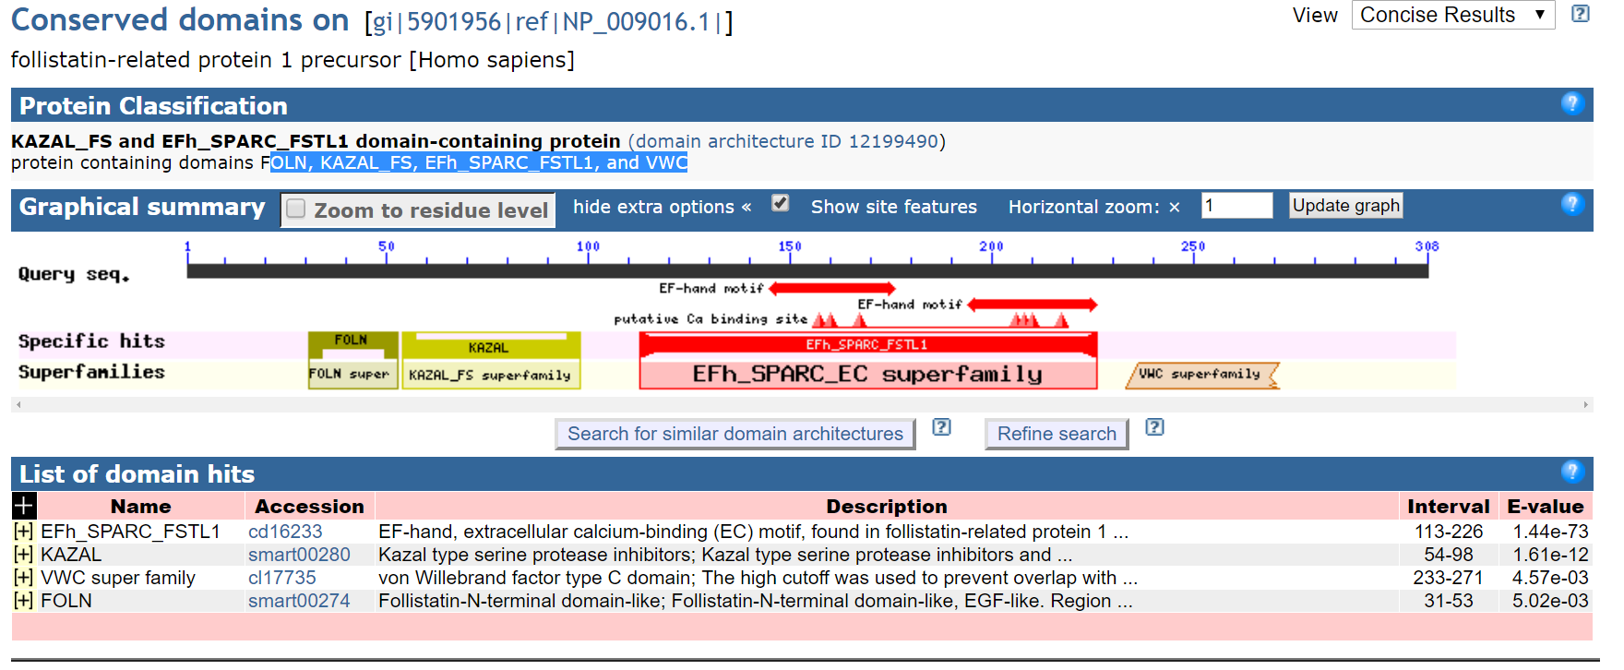

Slide 4
rs1147707
Follistatin-N-terminal Domain-Like
rs113155123 (E->G)
Notes:
>NM_007085.4_2 Homo sapiens follistatin like 1 (FSTL1), mRNA GEWGGAGGAGRRGRRGLKGRRGEVAFPPRLAIGGAPTSAYSSLPPSCPAPPGDLDQTTMW KRWLALALALVAVAWVRAEEELRSKSKICANVFCGAGRECAVTEKGEPTCLCIEQCKPHK RPVCGSNGKTYLNHCELHRDACLTGSKIQVDYDGHCKEKKSVSPSASPVVCYQSNRDELR RRIIQWLEAEIIPDGWFSKGSNYSEILDKYFKNFDNGDSRLDSSEFLKFVEQNETAINIT TYPDQENNKLLRGLCVDALIELSDENADWKLSFQEFLKCLNPSFNPPEKKCALEDETYAD GAETEVDCNRCVCACGNWVCTAMTCDGKNQKGAQTQTEEEMTRYVQELQKHQETAEKTKR VSTKEI**GGTDQCLDPSIFSTSALSSVYTSVCYSRQITSICLYSNEFYFVYLFCNKGYE GGWLGREGPQPSFLGVL*EKL*MVLWGWRLVRKLHHD*KRNRPKSEPLLSLLHLSAGCRE CTRCQRELSRVSPEERFGKLHGEERSLLPASFHCRQHDRPPASTHLLVPITASRYIAILL VNPVSLRLGWSFWEGTPK*CRYLYTLSPLAT*PNFKNTFYQRCYFSVKHFFLAS*LYSSI IIIILLFFNILFS*LGIKLL*LFFSSPTTS*VEGVWGSSWCRG*NNPDAPTLPHTRCSP* LAPLASSSPLSARGARVP*TEARGRSIFIKNFQDPNINLFLFILRS*GKSVFPRMATRAA KQGLGYPSLPICSFD*LGG*VGPVSSFFWTSVSSVSW*ECTNLLI**VINSVVLIIGPEG R*VPVIFPSSL*NK*NLVTRTRNVRWPKTR*PDLISA**PYRSCYDMESSWVKQEESGKE NHPTLSSYLHFMFNLRLEIESIPLEMRIKESFRFNRGKKMEI*S*NCDLGRSVIYS*SCV FRLL*LLTPLTTLFQMHLEYQRLNP*HKISFAESRLKTIRRKLFRL*CTGNCEKLLCQK* NSF*FFLFSFERRKFHFV*HFKLLCIHPI*KLFKLHLFSLKCSSLSKCLGELTAARLNQR FYQPLDTMGGGQEYTNLLKARNHSVSSLVI*NMVIIQDYSTLQH*TPKSKSTFLLSSAAS V*IGQLSSMP*NHMI*GPFMEAAK*PSLGSLP*SFAWSKQTGLN*VWFLQPSKSIGLSLQ ASLGFLCVCSFVNTIASVKIQCPWKHSHMP*LWTISVFGKQGSSAC*QAHVDQSECLSFT PMFLSSQTSRNNLNKFLLHMCL*TCICI**ASILHLTCFCNS*FFLFGYY**IKKLK*WF YWFPFPQLRPNKVVRTLPIX

Slide 5
>NP_009016.1 follistatin-related protein 1 precursor [Homo sapiens] MWKRWLALALALVAVAWVRAEEELRSKSKICANVFCGAGRECAVTEKGEPTCLCIEQCKPHKRPVCGSNG KTYLNHCELHRDACLTGSKIQVDYDGHCKEKKSVSPSASPVVCYQSNRDELRRRIIQWLEAEIIPDGWFS KGSNYSEILDKYFKNFDNGDSRLDSSEFLKFVEQNETAINITTYPDQENNKLLRGLCVDALIELSDENAD WKLSFQEFLKCLNPSFNPPEKKCALEDETYADGAETEVDCNRCVCACGNWVCTAMTCDGKNQKGAQTQTE EEMTRYVQELQKHQETAEKTKRVSTKEI

Slide 6
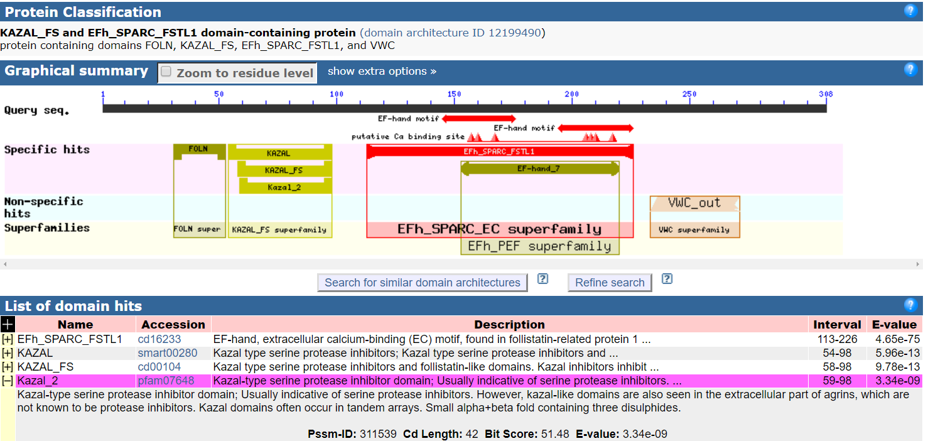

Slide 7
Figure. Evolutionary relationships of taxa
The evolutionary history was inferred using the Neighbor-Joining method [1]. The optimal tree with the sum of branch length = 0.46304082 is shown. The evolutionary distances were computed using the Poisson correction method [2] and are in the units of the number of amino acid substitutions per site. The analysis involved 55 amino acid sequences. All positions containing gaps and missing data were eliminated. There were a total of 286 positions in the final dataset. Evolutionary analyses were conducted in MEGA7 [3].
1. Saitou N. and Nei M. (1987). The neighbor-joining method: A new method for reconstructing phylogenetic trees. Molecular Biology and Evolution 4:406-425.
2. Zuckerkandl E. and Pauling L. (1965). Evolutionary divergence and convergence in proteins. Edited in Evolving Genes and Proteins by V. Bryson and H.J. Vogel, pp. 97-166. Academic Press, New York.
3. Kumar S., Stecher G., and Tamura K. (2016). MEGA7: Molecular Evolutionary Genetics Analysis version 7.0 for bigger datasets.Molecular Biology and Evolution 33:1870-1874.
Disclaimer: Although utmost care has been taken to ensure the correctness of the caption, the caption text is provided "as is" without any warranty of any kind. Authors advise the user to carefully check the caption prior to its use for any purpose and report any errors or problems to the authors immediately (www.megasoftware.net). In no event shall the authors and their employers be liable for any damages, including but not limited to special, consequential, or other damages. Authors specifically disclaim all other warranties expressed or implied, including but not limited to the determination of suitability of this caption text for a specific purpose, use, or application.

