Slide 1
The use of gene-based functional exome scans for compound heterozygosity with application to hemochromatosis
Shicheng Guo
Steven Schrodi
……..
2018/01/18
Nature Genetics (Letters / Technical Reports)

Slide 2
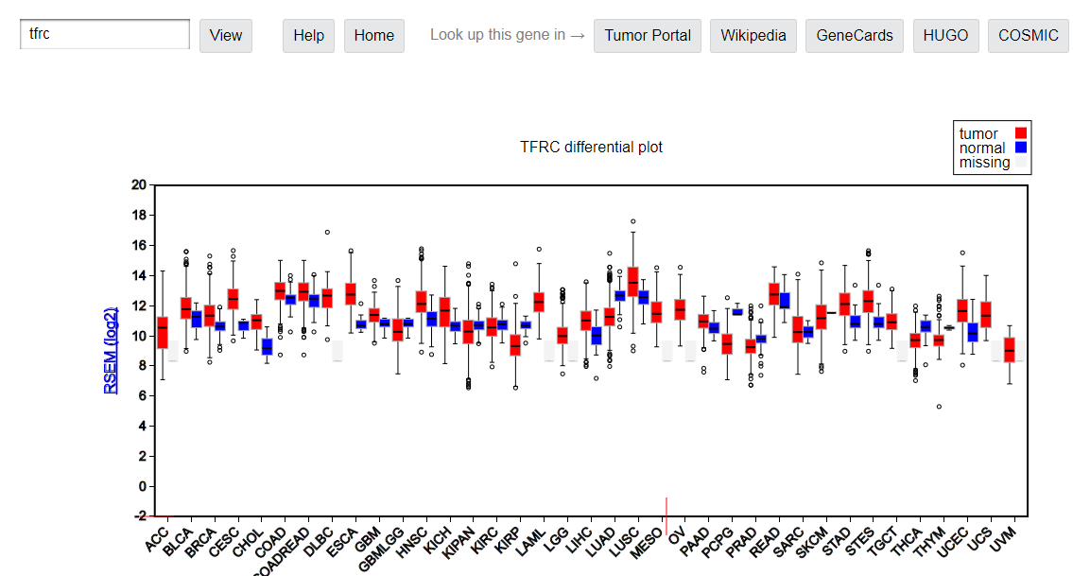
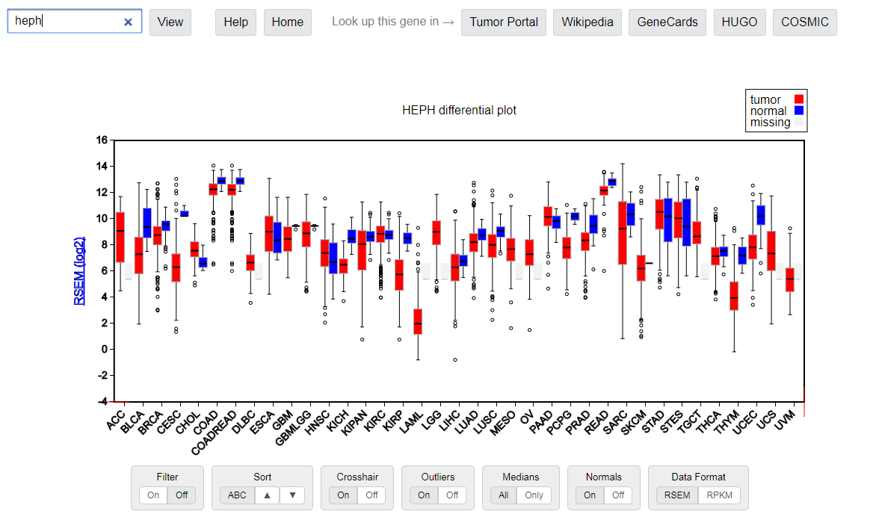

Slide 3
Result 1: Statistic part
Compound hetrogygosity scanning for hemochromatosis susceptibility genes
1, Power calculation
2, Significant novel susceptibility genes
FGF6
FGFR10P
MTAP
Meanwhile, mention FGF26 has been reported by PNAS.
3, Haplotype association details
most frequent haplotype
Table 1

Slide 4
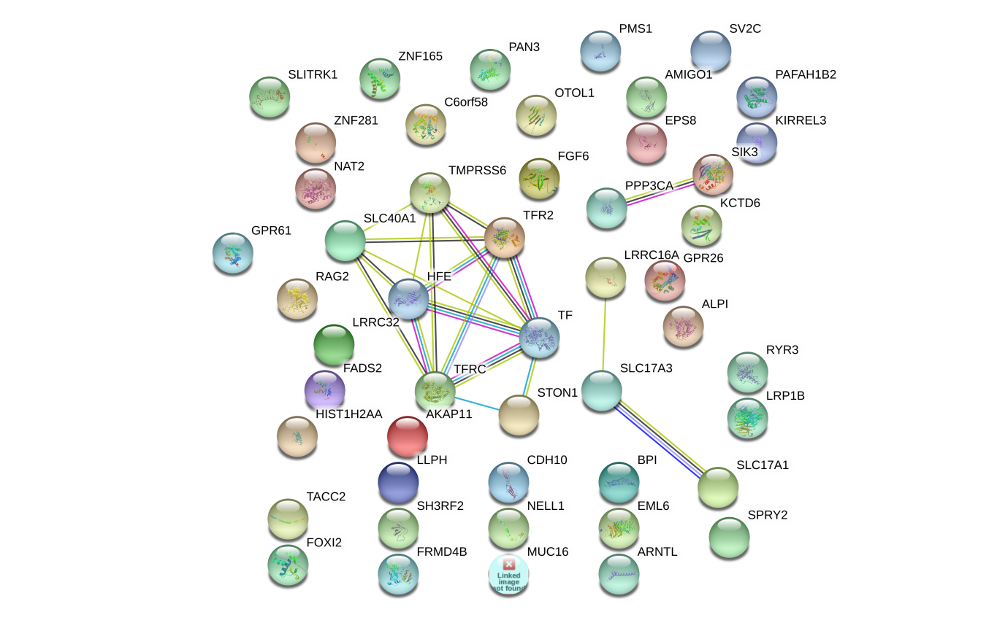
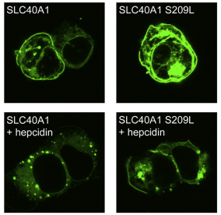
Result 2: In vitro cell study
FGF6 and FGF23: Biology Function in iron metabolism pathway
iron metabolism gene transcriptome network turbulence (regulator)
iron metabolism protein cell locating turbulence (Carrier)
Hemoglobin (HBA1, HBA2, and HBB)
Ferritin (FTH1)
Lactoferrin (LT/LFT)
transferrin (TF)
FGF6
FGF23
PPP3CA
SIK3
LRRC16A
SLC17A3
SLC17A1
TF
FPN
CDH10
SLC40A1
HFE
TMPRSS6
TFR2
STON1
Iron-binding proteins are carrier proteins and metalloproteins which play many important roles in metabolism. Iron is required by humans and bacteria for enzymes and metabolism to function properly. Iron-binding proteins bind iron tightly which make it unavailable for microbial use, limiting growth. Four iron-binding proteins are Hemoglobin, Ferritin, lactoferrin and transferrin. Hemoglobin is located in red blood cells. Transferrin is found in blood and tissue fluids. Lactoferrin is found in milk, blood, tears and saliva. Ferritin is found in every cell type.
https://string-db.org/
KEGG pathway(?)
Another interaction network method.
Figure 1. (a): Network
Figure 1. (b): location

Slide 5
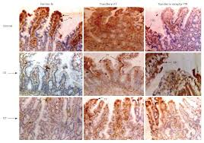
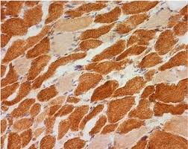
Result 3: FGF6 Gene knock-out mice model
Liver
Liver
Muscle
Figure 3: immunohistochemistry to show Iron quantification in different tissues
Answer the question:
FGF6 most significantly play iron overload roles in muscle or liver or both?

Slide 6
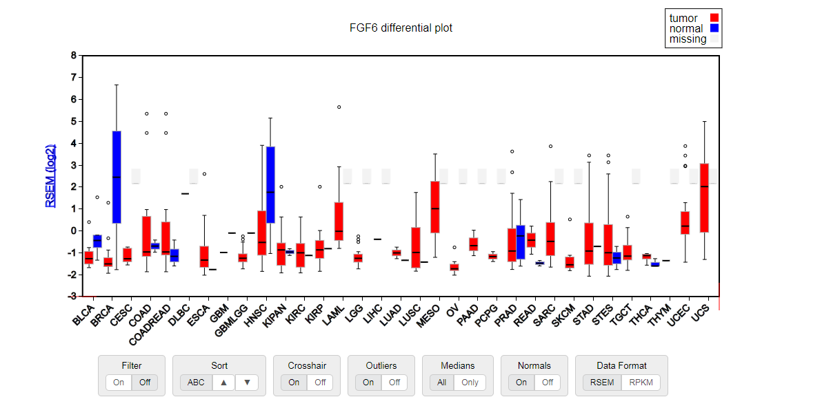
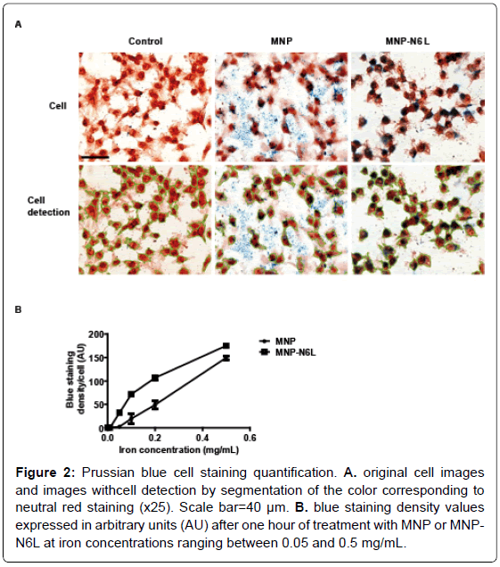
Result 4: FGF6 depression and cancer iron metabolism
FGF6 depression and cancer cellular nutrient
Immunohistochemistry for FGF6 and Iron at same time in Breast cancer and adjacent normal breast
Fe is an essential cellular nutrient that is critical for DNA synthesis and therefore cancer need more Fe
We found FGF6 is down-regulated (Loss-of-Function) in the majority cancer types which data is available.

Slide 7
Conclusion
1, We proposed a new compound heterozygosity method to identify loss-of-function variants
2, We identify new FGF6 causal genes for hemochromatosis

Slide 8
Other question:
The common C282Y mutation of the HFE gene is not found in Chinese Why?
Evolution view/role of FGF6 and any interesting story with this study.
Evolution: Fibroblast growth factors: from molecular evolution to roles in development, metabolism and disease

Slide 9
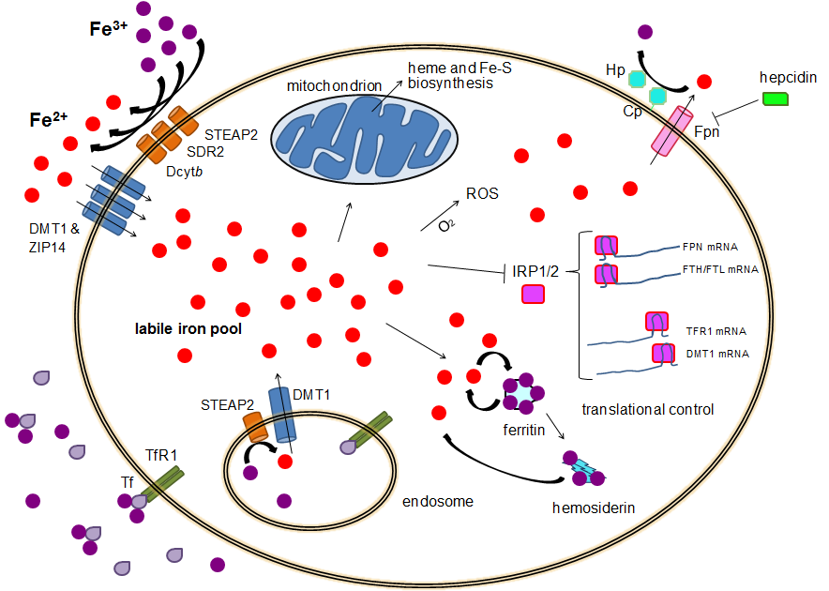

Slide 10
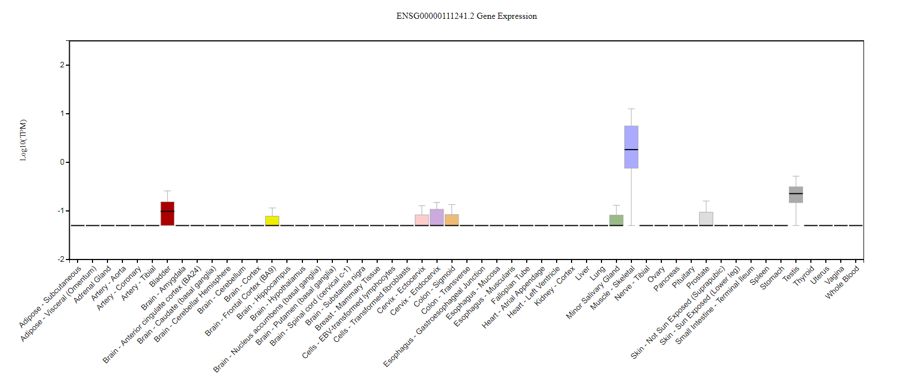

Slide 11
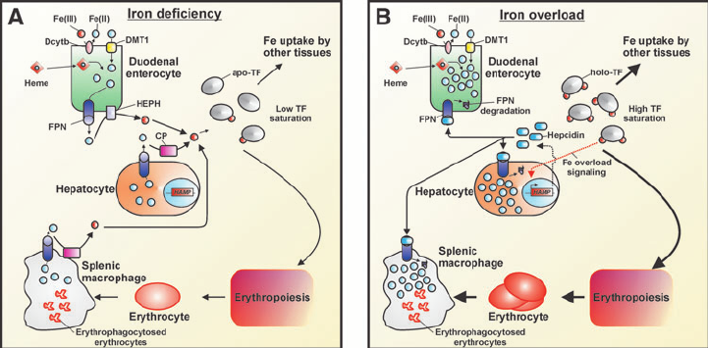

Slide 12
CHR | GENE | P | ORIG_SNP | NOHOM_SNP | X1 | X2 | X3 | X4
6 | HFE | 1.29E-08 | 14 | 10 | 8 | 10 | 189 | 6707
12 | FGF6 | 1.99E-06 | 10 | 6 | 6 | 12 | 153 | 6743
21 | KRTAP15-1 | 7.55E-05 | 5 | 2 | 11 | 7 | 1271 | 5625
20 | XKR7 | 0.000118 | 7 | 3 | 3 | 15 | 35 | 6861
20 | CABLES2 | 0.000128 | 7 | 5 | 3 | 15 | 36 | 6860
22 | THOC5 | 0.000138 | 9 | 6 | 13 | 5 | 1945 | 4951
18 | CABYR | 0.000254 | 17 | 10 | 5 | 13 | 229 | 6667
3 | CMSS1 | 0.000309 | 10 | 7 | 5 | 13 | 239 | 6657
5 | PCDHB2 | 0.000377 | 11 | 5 | 3 | 15 | 53 | 6843
9 | ZFP37 | 0.001067 | 16 | 7 | 9 | 9 | 1137 | 5759
3 | C3orf30 | 0.001156 | 28 | 12 | 13 | 5 | 2361 | 4535
12 | DENND5B | 0.001286 | 11 | 7 | 9 | 9 | 1166 | 5730
6 | MRS2 | 0.001299 | 10 | 8 | 4 | 14 | 188 | 6708
6 | BCLAF1 | 0.001686 | 29 | 20 | 4 | 14 | 202 | 6694
1 | NBPF3 | 0.001793 | 7 | 3 | 9 | 9 | 1220 | 5676
1 | BRDT | 0.002315 | 20 | 13 | 6 | 12 | 560 | 6336
17 | CAMKK1 | 0.002332 | 7 | 4 | 9 | 9 | 1265 | 5631
3 | CELSR3 | 0.002353 | 56 | 32 | 3 | 15 | 102 | 6794
12 | UHRF1BP1L | 0.002353 | 40 | 21 | 3 | 15 | 102 | 6794

Slide 13
FGF6 and FGF23: Biology Function in iron metabolism pathway
Another FGF genes
iron metabolism gene transcriptome network turbulence (regulator)
iron metabolism protein cell locating turbulence (Carrier)
FGF6
FGF23
PPP3CA
SIK3
LRRC16A
SLC17A3
SLC17A1
SLC40A1
LEAP1
TF
FPN
CDH10
HFE
TMPRSS6
TFR2
STON1
Hemoglobin (HBA1, HBA2, and HBB)
Ferritin (FTH1)
Lactoferrin (LT/LFT)
transferrin (TF)
Iron-binding proteins are carrier proteins and metalloproteins which play many important roles in metabolism. Iron is required by humans and bacteria for enzymes and metabolism to function properly. Iron-binding proteins bind iron tightly which make it unavailable for microbial use, limiting growth. Four iron-binding proteins are Hemoglobin, Ferritin, lactoferrin and transferrin. Hemoglobin is located in red blood cells. Transferrin is found in blood and tissue fluids. Lactoferrin is found in milk, blood, tears and saliva. Ferritin is found in every cell type.
https://string-db.org/
KEGG pathway(?)
Another interaction network method.

Slide 14
FGF6/FGF23 and Iron metabolism network
Step 1. Download all Liver RNA-seq data from TCGA with gdc-client
Do it in BIRCDEV13-LC (installed gdc-client)
Download confirmation file (LIHC and Kidney)
C:\Admin\gdc-client.exe
gdc-client.exe download -m gdc_manifest.2018-01-11T01_08_53.324183.txt -d
Step 2. collect all RNAseq data from rsem.genes.normalized_results
Notes:
gdc-client.exe download -m \\mcrfnas2\bigdata\Genetic\Projects\shg047\LIHC\gdc_manifest.2018-01-11T01_08_53.324183.txt -d \\mcrfnas2\bigdata\Genetic\Projects\shg047\LIHC\

Slide 15
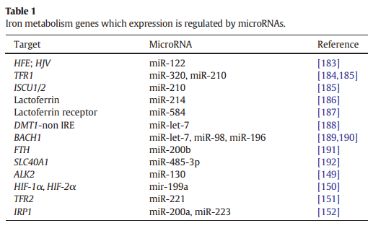
FGF6 and FGF23: Biology Function in iron metabolism pathway
and FGF23
hsa.miR.320a
hsa.miR.210.3p
hsa.miR.214.3p
hsa.miR.584.5p
hsa.miR.200b.3p
hsa.miR.485.3p
hsa.miR.221.3p
hsa.miR.200a.3p
hsa.miR.98.5p
hsa.miR.223.3p
hsa.miR.122.5p
(LTF)
Validate any miR-214-3p here target FGF6? We do it.
Validate any miR-122-5p here target FGF23? Yes. It is validated.
ComiR: Combinatorial miRNA target prediction tool

Slide 16
ENSEMBL_ID | GENE_ID | miR.320a | miR.210.3p | miR.214.3p | miR.584.5p | miR.200b.3p | miR.485.3p | miR.221.3p | miR.200a.3p | miR.98.5p | miR.223.3p | miR.122.5p
ENSG00000213066 | FGFR1OP | 1 | 0.8815 | 0.9996 | 0.826 | 0.93 | 1 | 1 | 1 | 0.9777 | 1 | 1
ENSG00000099810 | MTAP | 0.9617 | 0.8815 | 0.8725 | 0.962 | 0.93 | 0.8032 | 0.8491 | 0.8155 | 1 | 0.8565 | 0.984
ENSG00000124557 | BTN1A1 | 0.9912 | 0.8815 | 0.8725 | 0.826 | 0.767 | 0.8032 | 0.8491 | 0.8155 | 0.8519 | 0.8565 | 0.8757
ENSG00000171189 | GRIK1 | 0.8141 | 0.8815 | 0.8725 | 0.826 | 0.767 | 0.8032 | 0.8491 | 0.8155 | 0.8519 | 0.8565 | 0.8757
ENSG00000138675 | FGF5 | 0.8141 | 0.8815 | 0.8725 | 0.826 | 0.767 | 0.8032 | 0.9729 | 0.8155 | 0.9777 | 0.9762 | 0.984
ENSG00000186895 | FGF3 | 0.8141 | 0.8815 | 0.8725 | 0.826 | 0.767 | 0.8032 | 0.8491 | 0.8155 | 0.8519 | 0.8565 | 0.8757

Slide 17
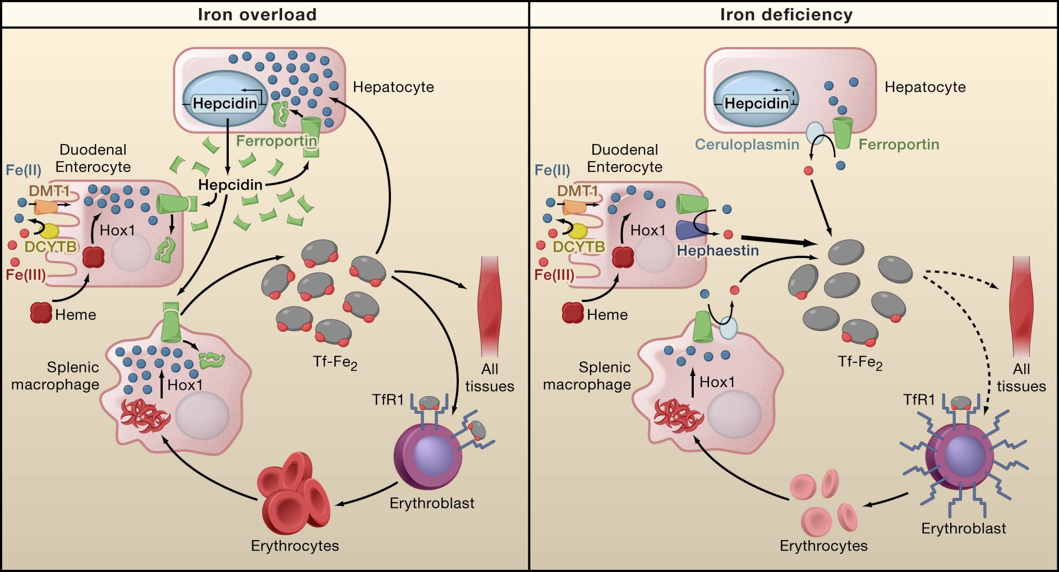

Slide 18
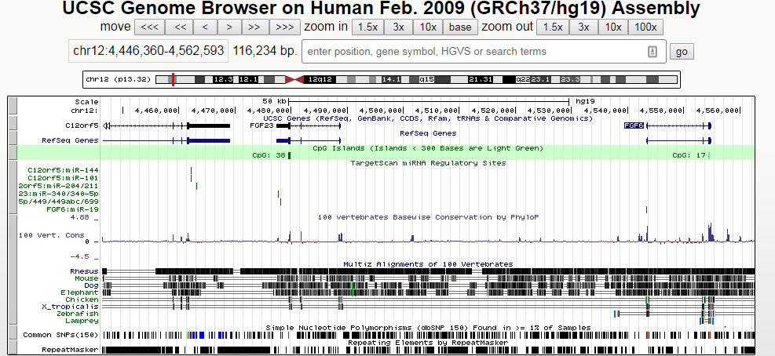
polycistronic miRNA cluster (miR-17,18,19 and 92)
Ferroportin (FPN) is the only known mammalian iron exporter. FPN expression is regulated at the transcriptional level by hypoxia-inducible factor-2alpha (HIF2α).
miR-19 promotes angiogenesis by directly targeting thrombospondin 1 (TSP-1) and connective tissue growth factor (CTGF)

Slide 19
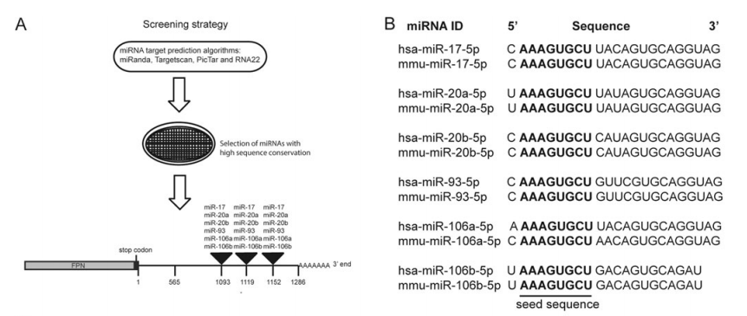

Slide 20
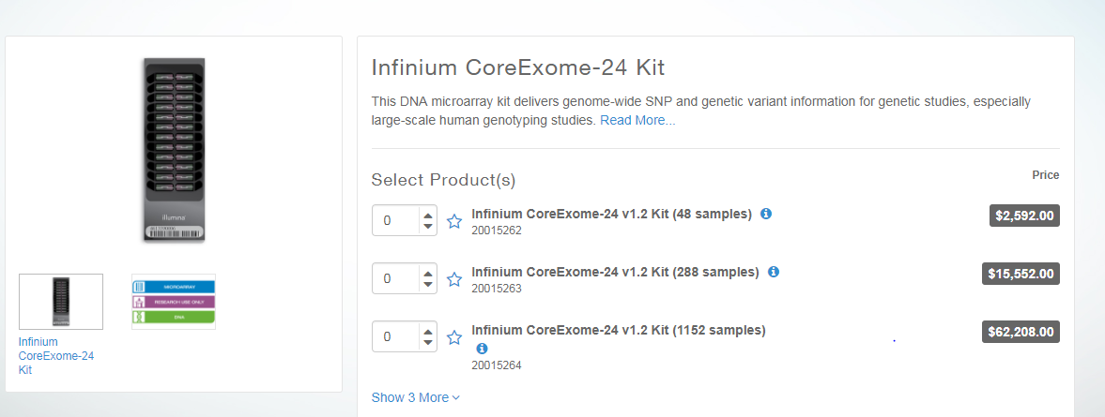
Find the annotation file and design the probes, including probe regions
Infinium CoreExome-24 v1.2 Support Files (hg19 human genome)
https://support.illumina.com/downloads/infinium-coreexome-24-v1-2-support-files.html

Slide 21

FGF6: Exon 1
>hg19_dna range=chr12:4543246-4543643 5'pad=0 3'pad=0 strand=+ repeatMasking=none
AAACAACTGAGGTCTCCCCAAGCACAGGATAAGCCTGATTCAGAAGCCAT GGAGGGCAAGGGGAATTCTTCGCTGGTGCAAAATTTCAATCGAACAGATG ATGCTTTAAATCTGTGAGCCTTCTTTTGTGGGTCCTTAGATCCTGGGAAG GAAATGAGTGACAGTCATGATCGGGGACACCTTGCTGCCCCGCTTTACCC GTCCGTATTTGCTCAGGGCAATGTAGGTCCCTTGGTACAAGTCTGACTCG TAGGCATTGTAATTGTTGGGCAGGAGGGTTTCTCTGAACTTGCATTCTTC TTGGAAGCTGGGCTGTGGAAGACATGGGCAAACAGCAGAGACTGGGTTAC AAATGAGGAGTGCTGCAGATGCCAGCTGGGCCGCAGAGAGTAGGCCCC
>hg19_dna range=chr12:4553194-4553510 5'pad=0 3'pad=0 strand=+ repeatMasking=none CCATTTAGATAGTCACTTCTCTACTCAGGACTTCATATTATTTTCTTCAA CTGTGTAAGCATCAAGCCTTGTAAACCTGGCACTTCCCCGGCCTGGTGAA CTCACCGTTGCGTACAATCTTCCTTTACTGTTCATGGCAACGAAGAGGGC ACTTCTCACTCCAAAGAGACTCACCACGCCTCGCTCCACAGTGGAAATTT CCAGCAGGCCTGACAAGGAAAGGGGGGCCACATTACCTAAGGCTTGTGCA AATCAGAGTGGGAACTTGAGCCGACAAGGGCATCTCAGTCCATCCCCCTT CTCCTAGAAAGCCAGAC
>hg19_dna range=chr12:4554200-4554846 5'pad=0 3'pad=0 strand=+ repeatMasking=none CACCAGGATGCTTGGACCGCAGTATATTGAGCTTGCACCCAGGCAGGGTC ACGTGGAATCATCTAAGTGGTGAGCAGCATTTCTGCCCCCTTTATCGTGC ATCCTGTCCGCTAGAGCAGGGCCCCTTCACCTTTTAGCCCTGCATGAGCC CAAACCCCCAAGCGTCCCGACTGGCTGCAGCTGGCACTCACTGTAGGGGT TCTCCTCGTGGGTCCCGCTGATCCGGCCGTCGGGGAGCACCTGGAGGTGA AAGCCGATGCCCACGTTGCAGTAGAGCCTCCGCTGCCGCTTGATCCCCAC CAAATAGCCACTTTCCCAGTTCACCCCGGCAATCTCTCCAGCTAGCCCGG CGCGAGACCTGGACAGCAGGGTGCCCCAGCCCCTCGAGTCCAGCAGCGTG TTGTTGGCACGGGTGCCTGCAGGCGAGGGCACCACCATGCCCACTAGGAT GCCTAGGAAGACGAGAGCCCACAGCGTGCCCTGCAGACGTCCTGCTCCCC GGGACATAGTGATGAACAGTTTCTGTCCCAGGGCCATCCACCTTGCCTCT CAGGCACGTGGTCAGAATTAATGGCCCTAAAAATACCGCCCTTCTTGTTT TTCTCCCTCCGGCATGGCGGCAGGGGCTTATTTTTGGAAGGCAGATG

Slide 22
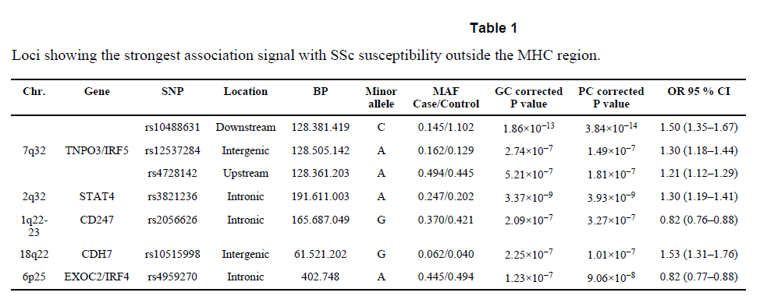
Nature genetics: first GWAS for SSc.
http://exac.broadinstitute.org/variant/4-186320906-C-G

Slide 23
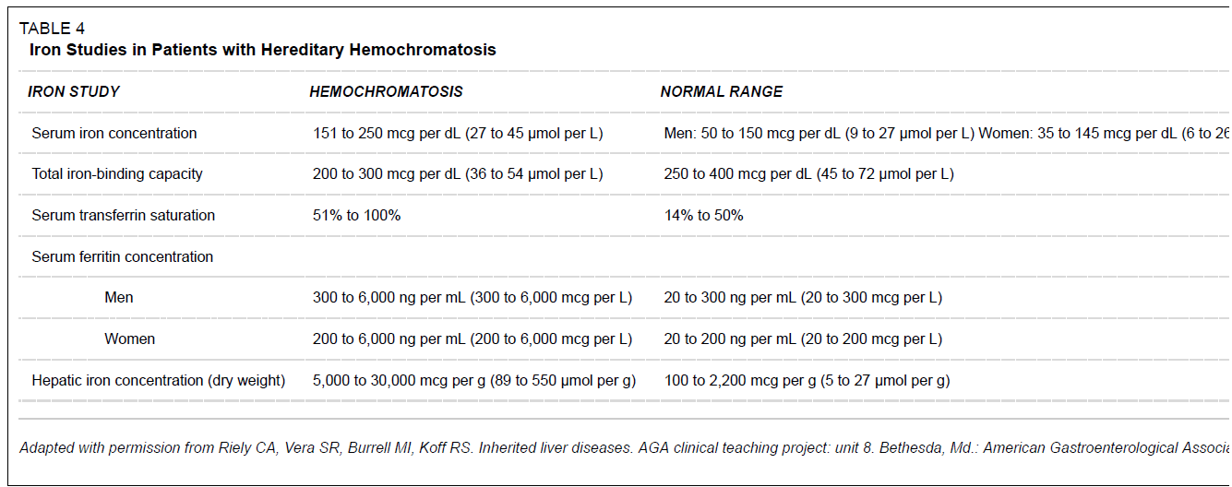
Inclusion criteria: Hemochromatosis
Serum transferrin saturation(STS) >45%
Serum ferritin levels >300 ng/mL in males and >200 ng/mL in females
Brandhagen, D.J., V.F. Fairbanks, and W. Baldus, Recognition and management of hereditary hemochromatosis. Am Fam Physician, 2002. 65(5): p. 853-60.

Slide 24
# Select all items from asian and european
grep rs7574865 ssc.gwas.txt
grep rs76285340 ssc.gwas.txt
grep rs146891517 ssc.gwas.txt
grep rs75287745 ssc.gwas.txt
grep rs45471499 ssc.gwas.txt
grep rs4317244 ssc.gwas.txt
grep rs114778719 ssc.gwas.txt
grep rs10488631 ssc.gwas.txt
grep rs12537284 ssc.gwas.txt
grep rs4728142 ssc.gwas.txt
grep rs3821236 ssc.gwas.txt
grep rs2056626 ssc.gwas.txt
grep rs10515998 ssc.gwas.txt
grep rs4959270 ssc.gwas.txt
#

Slide 25
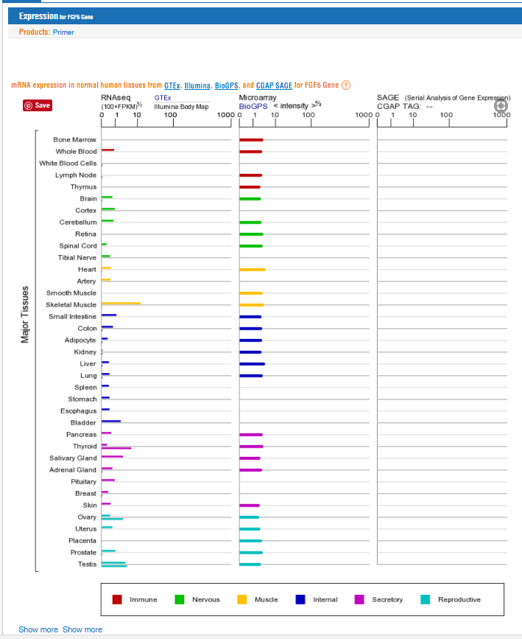
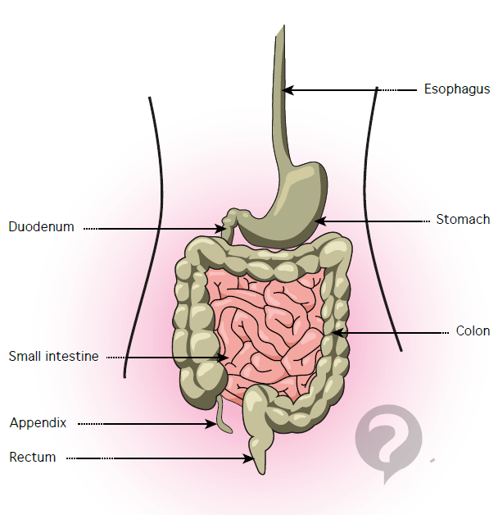
The portion of the small intestine called the duodenum is the chief area where iron absorption takes place. There may be a second minor absorption site near the end of the small intestinal tract. Once iron is absorbed it is carried (transported) by a protein called transferrin.

