Slide 1
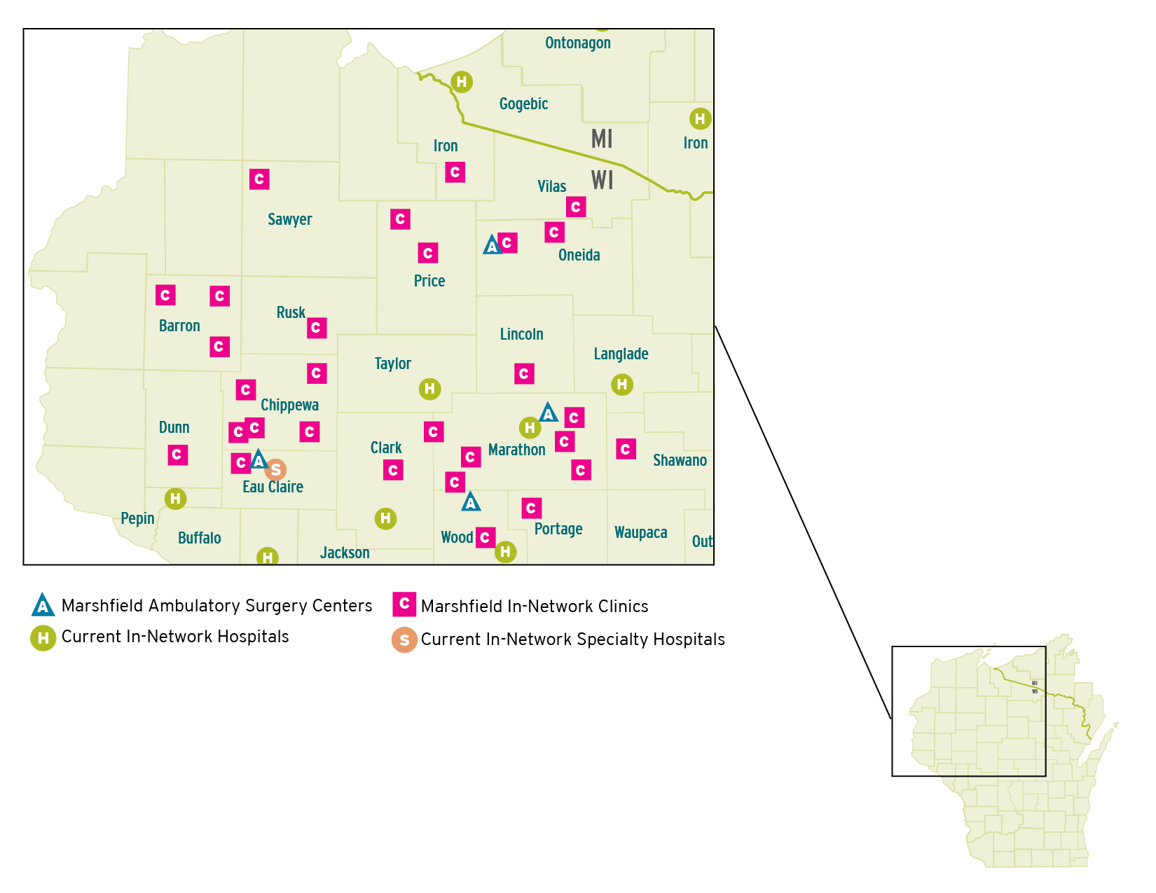
Marshfield Clinic and Center for Precision Medicine Research
Marshfield Clinic was founded in 1916 and is celebrating 100 years of service to patients this year. In fiscal year 2014, the clinic delivered primary and specialty care to more than 350,000 unique patients at more than 50 locations.
Marshfield Clinic Health System (MCHS) is an integrated health system serving Wisconsin with more than 10,000 employees and more than 1,200 providers comprising 86 specialties, a health plan, and research and education programs.
The Clinic had nearly 3.5 million patient encounters for the year ended September 30, 2017, and reported approximately 328,000 unique patients in the health system during this same period.

Slide 2
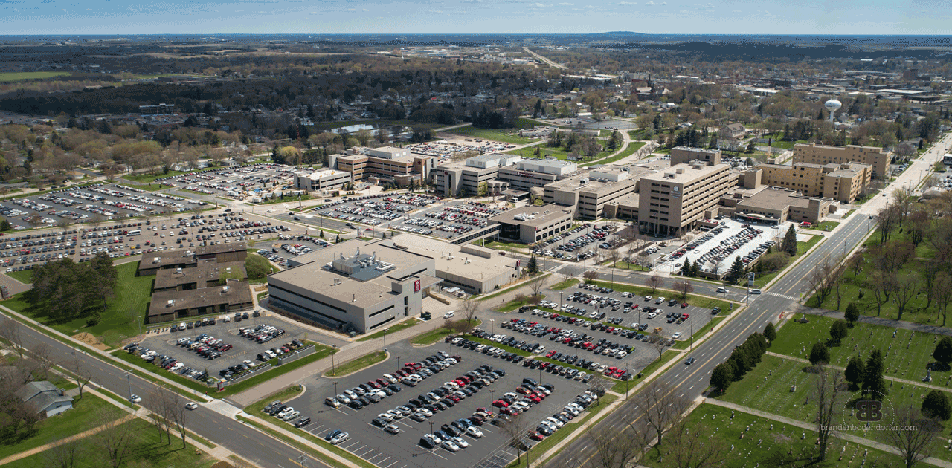
Marshfield Clinic Headquarters (Marshfield, Wisconsin)

Slide 3
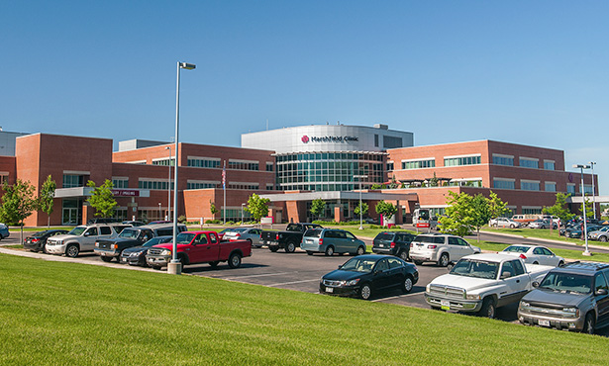
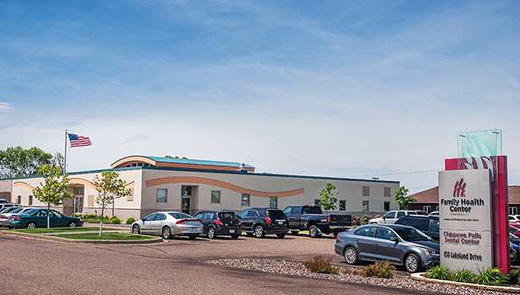
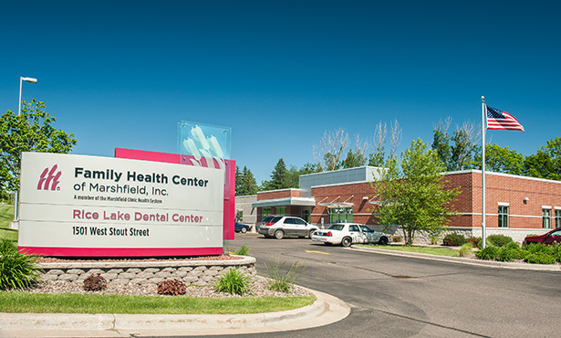
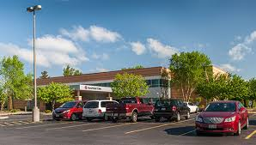

Slide 4
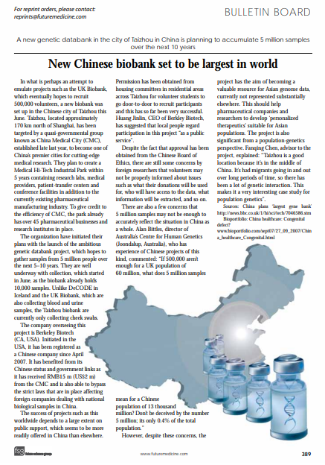
Biobank: Path to Personalized Medicine and Precision Medicine (PMRP)
Disease specific and general biobanks
“All of Us” biobank
Target size: 1 million participants
UK Biobank
Size: 500,000 participants
….
PMRP:
Phase I: 10,125 samples with exomchip
Phase II: 8,648 samples with exomchip
Exomchip: 550,585 SNPs

Slide 5
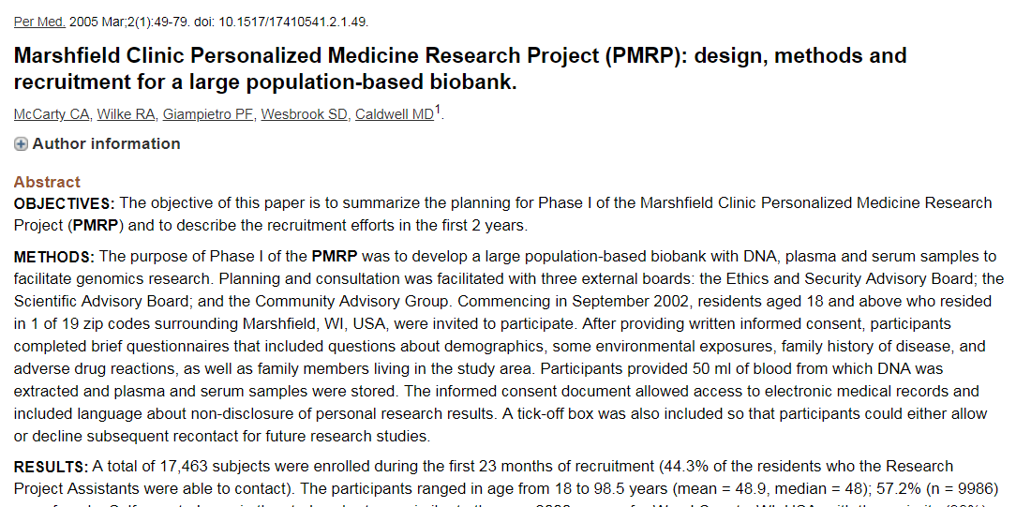
Marshfield Clinic Personalized Medicine Research Project (PMRP) Biobank
Stage: 2003 -> 2005 -> 2008

Slide 6
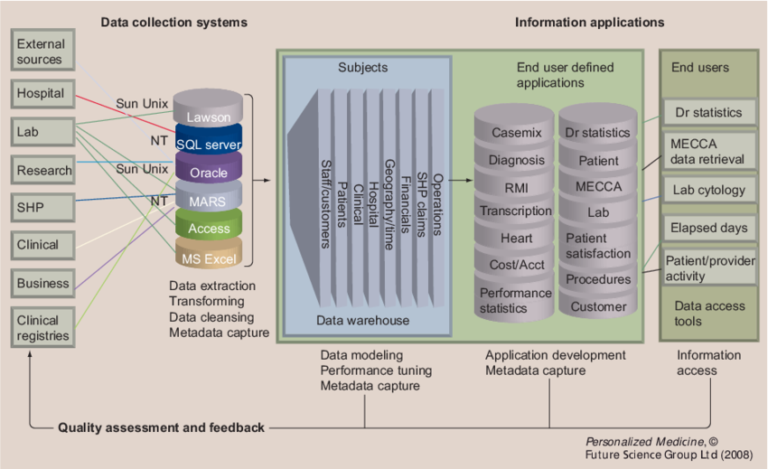
The Marshfield Clinic data warehouse

Slide 7
Importance of the biobank and application
Clinical epidemiology
Genetic epidemiology
Pharmaceutical genetics
Personalized Medicine and Precision Medicine

Slide 8
Big data Strategy for Guanghua Hospital
Collect the data with higher efficiency
Store the data within one big database
Let Guanghua become a smart hospital
Thinking get more data with less money (data-in, data-out)

Slide 9
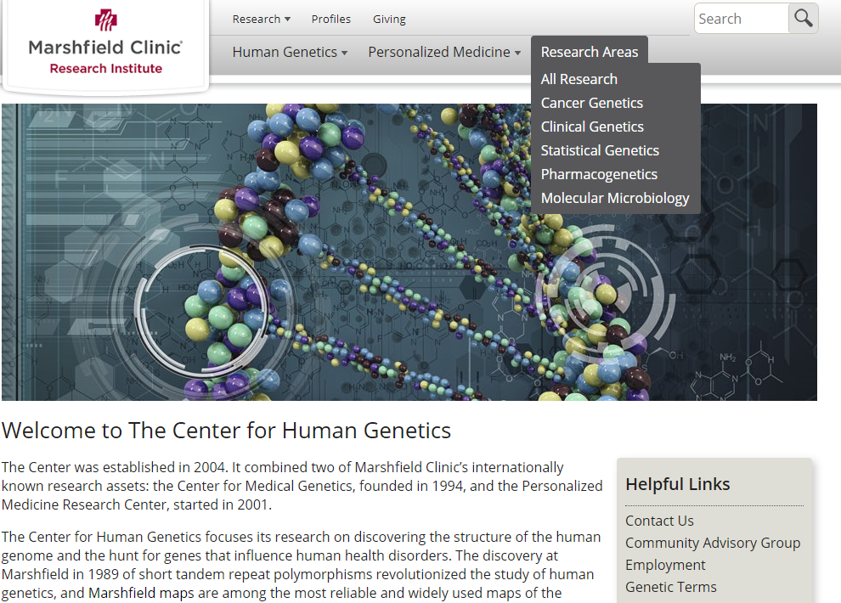
Dr. Steven Schrodi Lab: Genetics and Epigenetics for Complex Diseases
Dr. Steven Schrodi:
Human Genetics Disease Genetics Theory Bayesian Statistics and Applied Probability Systemic Inflammation Traits Autoimmune Genetics Predictive Modeling
Shicheng Guo:
Rheumatoid Arthritis Susceptibility Genes.
Genetic and Epigenetic Interaction
Predictive Modeling
Biomarker for diagnosis and prognosis

Slide 10
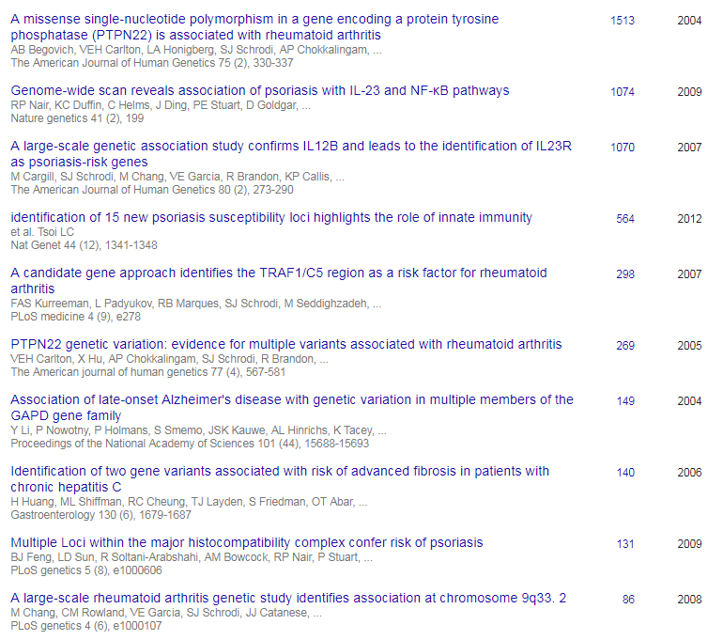
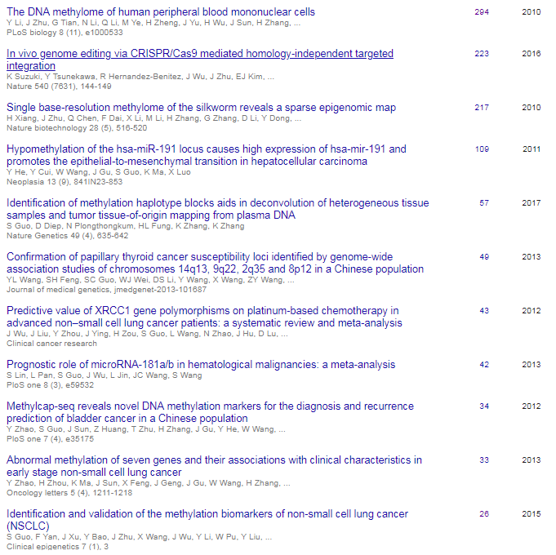
Dr. Steven Schrodi Lab: Previous Publication and Interested Project

Slide 11
临床医生如何找到适合自己的科研模式 How to make yourself survive in the career of clinical research as a doctor
郭士成
Marshfield Clinic Research Institute
09/06/2018

Slide 12
Rare phenotype and rare case
Rare phenotype
Rare response to drug
Rare family with specific traits or disease cluster.
Manuscript type: Case reports
1. Short
2. Swift

Slide 13
Collaboration and extend research
Follow top journals (Nature Review Rheumatology, AR)
Check our own data
Comments or make further investigate.
Manuscipt type： Brief Report
Fast
Swift
But require systemic data collection system

Slide 14
Guanghua Research Style
We have our own research advantage and professional in this field
Big data support
Collaboration to extend research depth.
Professional in certain field and extend to other field.
Manuscipt type：Research Study
Fast
Swift
But require systemic data collection system

Slide 15
Perspective and review
When we have enough research in certain field, we will obtain respect from other institute and then we can publish ‘review paper’
Manuscipt type：Review
Deep understand to certain field
Big benefit to achieve collaboration from other institutes

Slide 16
经验分享 1. 文章发表时reviewer不管你是不是临床医生而决定接受或者拒绝你的稿子，审稿时只看文章的新颖性和扎实性。 2. 课题的设计部分要严谨，尽量寻找多种前期数据或者文章给自己做坚实的基础，降低课题失败的概率 3. 合作，合作，合作，贡献自己的那一部分，或者灵感，或者临床知识，或者数据收集。一篇文章需要生物信息，统计，医学，生物学多种知识的共同叠加。 4. 紧跟领域最前沿杂志，需要一个本领域的讨论群，接受最新的信息，做好数据积累，一旦机会到来，抓住机遇

