Slide 1
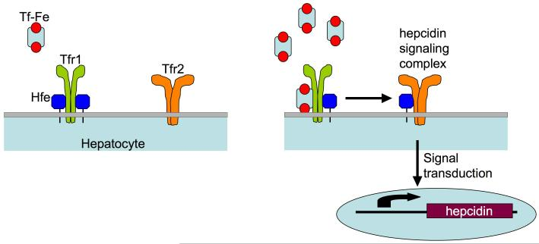
Hfe-Tfr1 complexes on the surface of hepatocytes sense the saturation of iron-bound transferrin in the serum. At low transferrin saturations, Hfe is sequestered by Tfr1 (left). As serum iron saturation increases, Hfe is dislodged from its overlapping binding site on Tfr1 by Fe-Tf (right). Hfe is then free to interact with Tfr2 and signal in some manner for the upregulation of hepcidin. Increased levels of circulating hepcidin lead to a reduction in both intestinal iron absorption and macrophage iron release. If either Hfe or Tfr2 is mutated or absent, the complex is unable to sense increased serum Tf saturation and dysregulation of iron homeostasis occurs.

