Slide 1
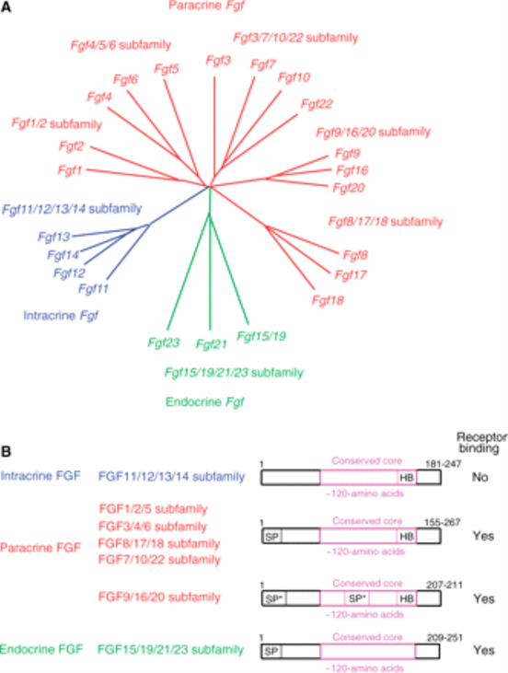
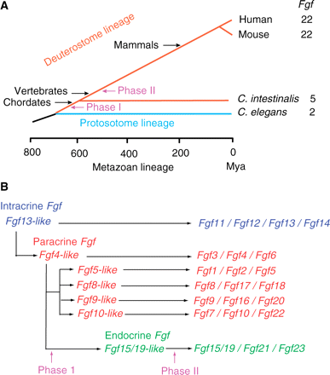

Slide 2
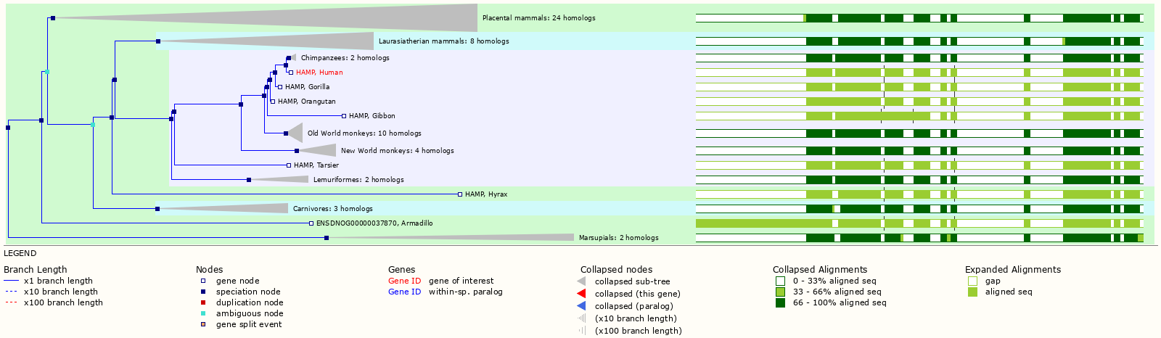
TFR1, TFR2, HAMP, HFE, NGAL, DMT1, DMT1nonIRE,, IREG1, HEPH, CP, HJV, FTH1
HAMP

Slide 3
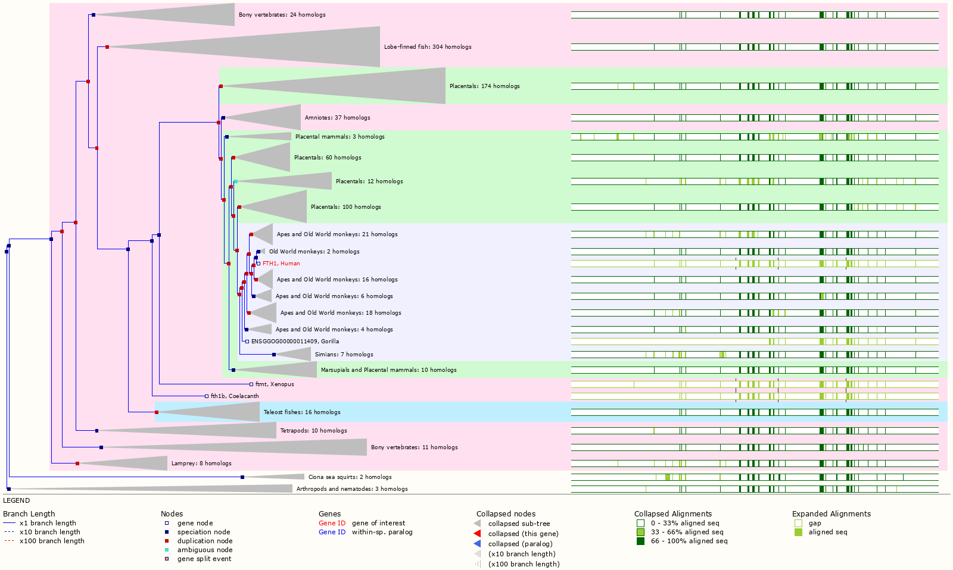
FTH1

