Slide 1
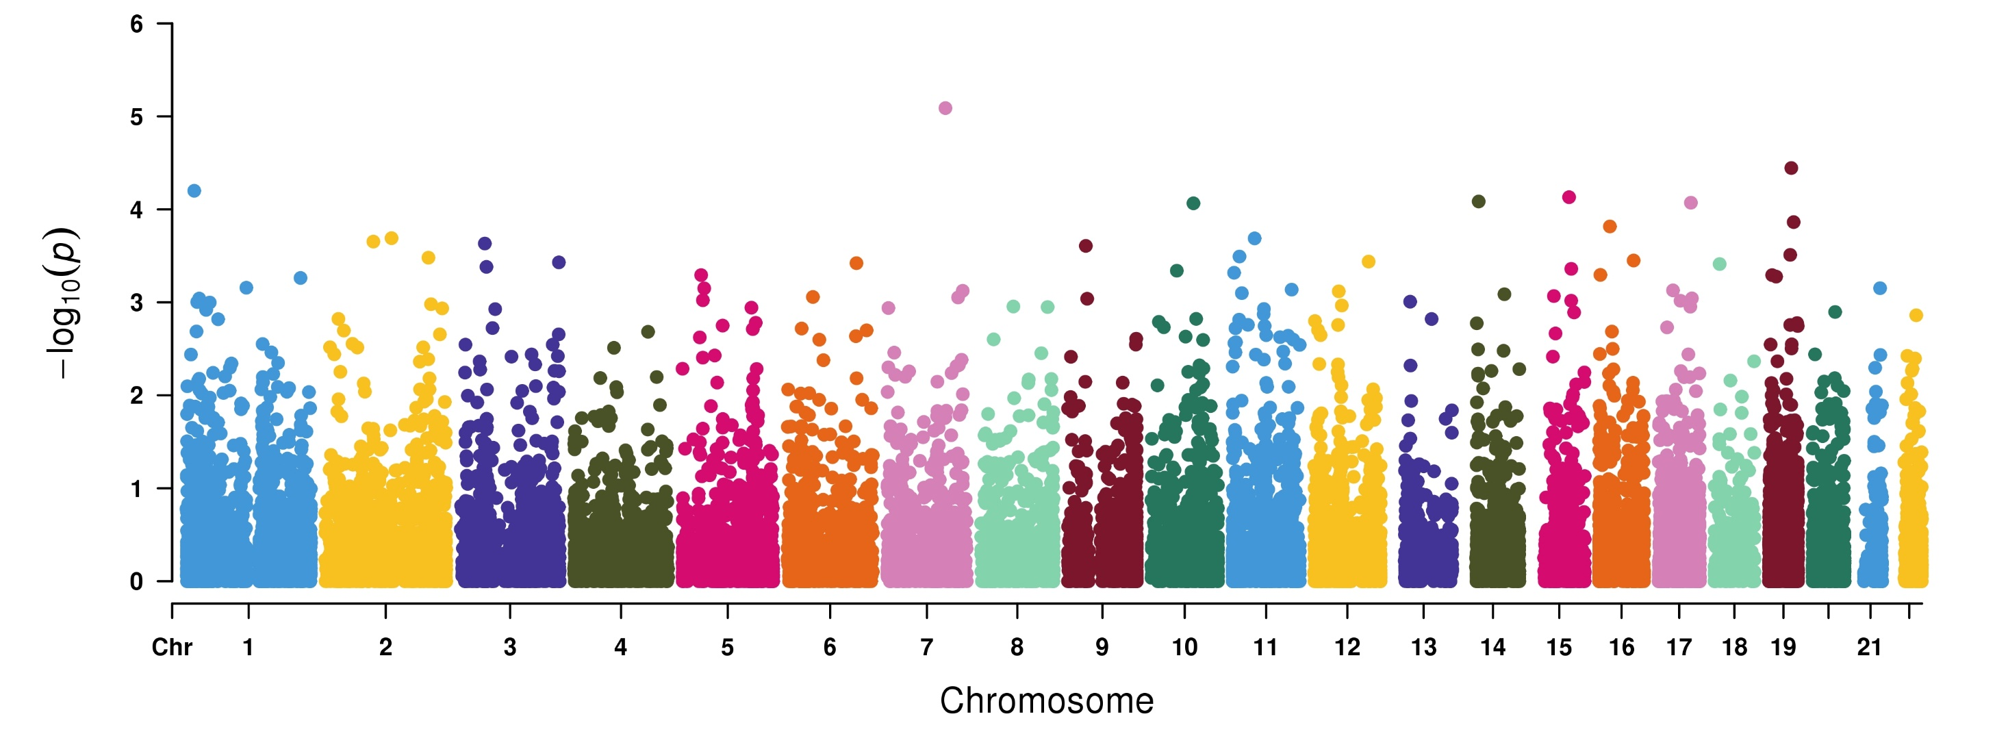
Genome-wide Robust SKAT-O based association study to identify lung cancer associated genes
CAV2
UACA
APOC4
RSC1A1
LRIT1
LRRC37A3
GPR39
CCDC51
TPM2
REC8
TEX264
166 cases and 16,434 controls

Slide 2
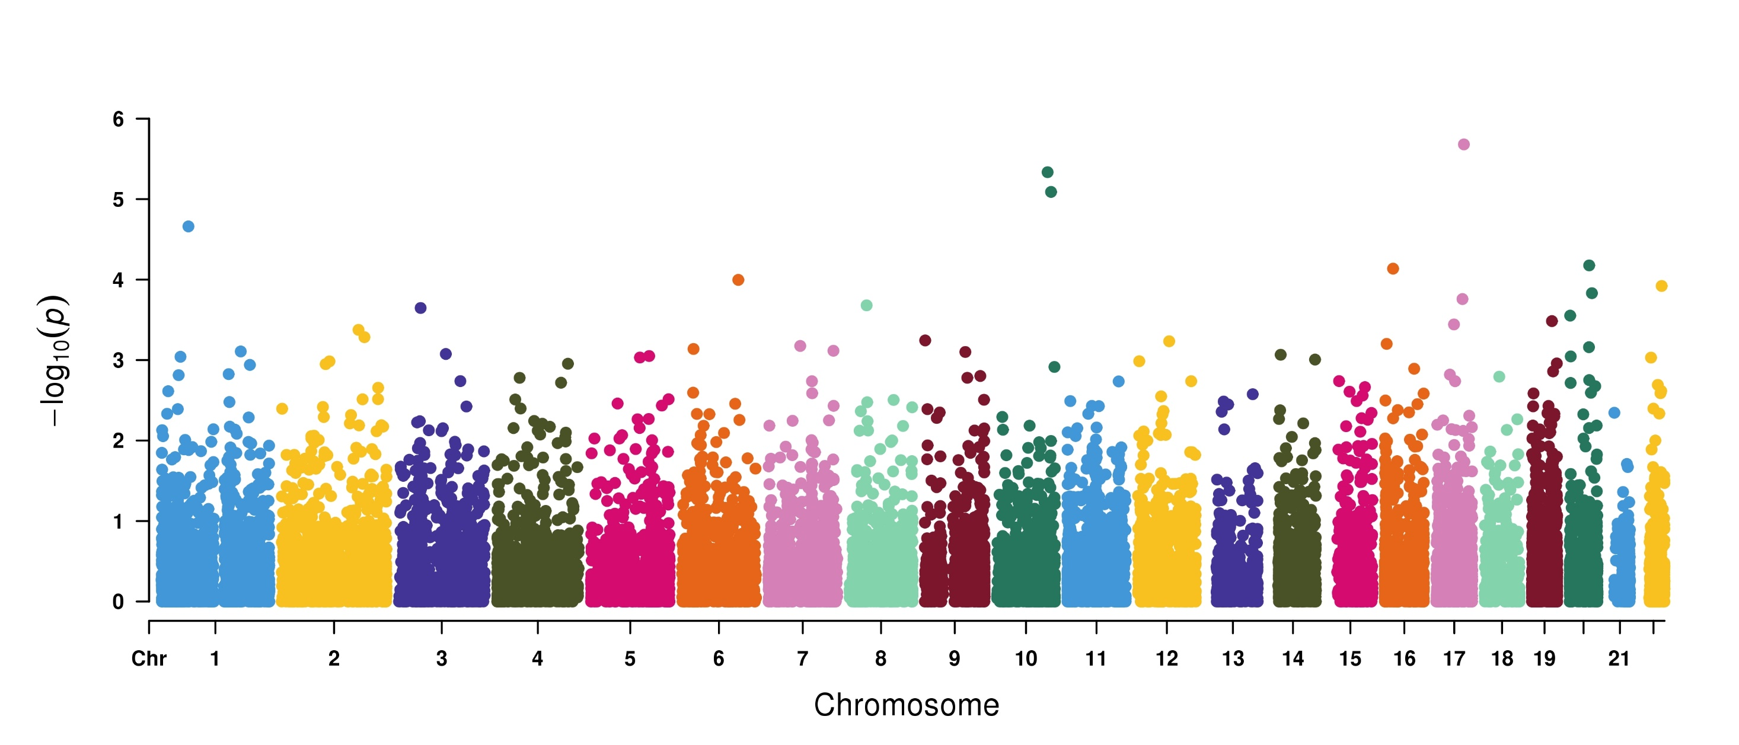
Genome-wide Robust SKAT-O based association study to identify Benign Neoplasm of Colon associated genes
CCDC47
PNLIPRP2
KANK4
FAM53B
L3MBTL3
TMC7
KCNS1
SEMA3F
ADAM32
C17orf64
2,257 cases and 43,090 controls

