Slide 1
Which TFs regulated METTL14 and why METTL14 was significantly down-regulated in thyroid cancer?
1, I will scan all the TFs and find the most potential TFs regulated METTL14 with public database
2, I will find which TFs are silenced, therefore METTL14 was down-regulated
3, over-expression this TF and check whether METTL14 can be increased.
4, We can also check histone modification such as H3K4ac and find why METT14 was down-regulated
What will happen if METT14 was totally knocked?
1, knock-down METTL14 in cell line, and conducted RNA-seq, I will identify which pathway or genes are regulated..
2, knock-down METTL14 can check genome-wide m6A methylation change
3, knock-down METTL14 can check genome-wide m5C DNA methylation change with RRBS
Here, one of METTL14 or METT3 will be okay. I just use METTL14 as a representative

Slide 2
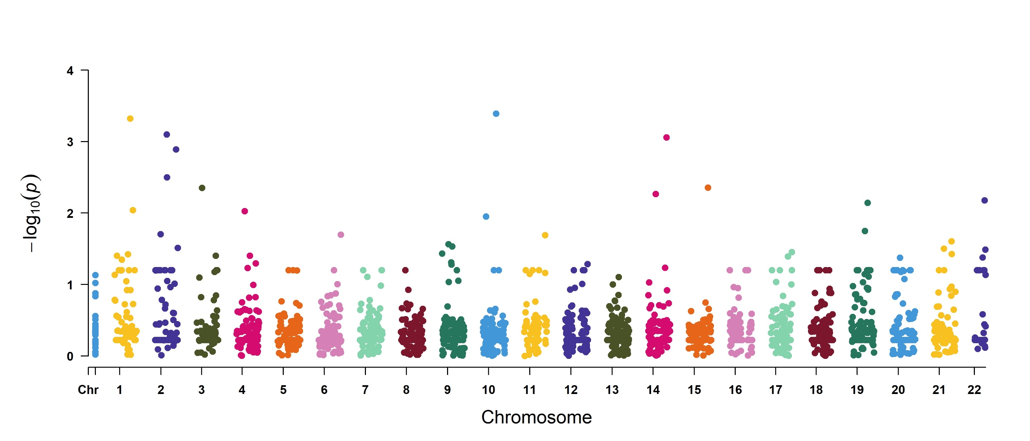
glpD
ptrP
pflB
dpV
pflA
adhE
gltD
hslV
narK
tpiA
murI
ald
arcC

