Slide 1
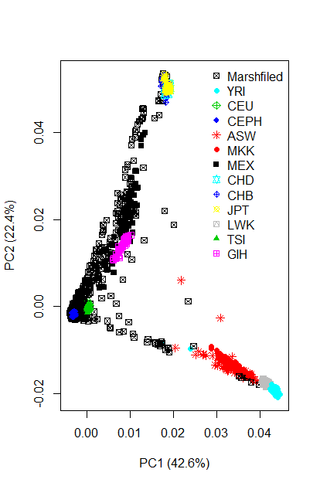
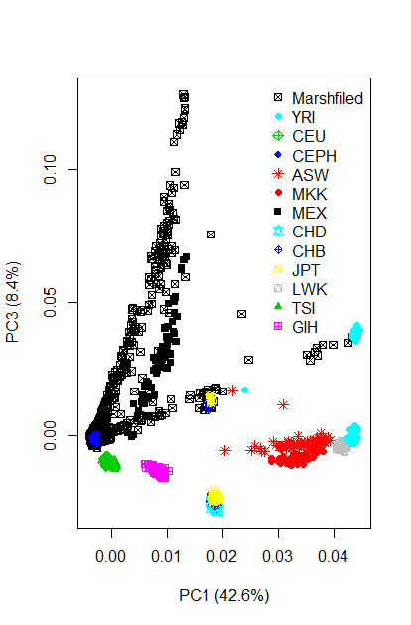
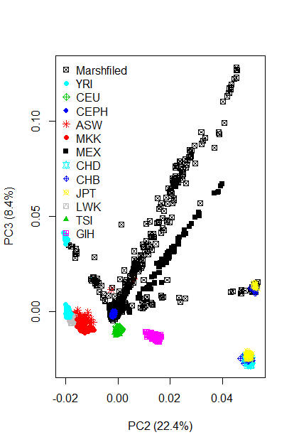
N=8500
ASW African ancestry in Southwest USA
CEU Utah residents with Northern and Western European ancestry from the CEPH collection
CHB Han Chinese in Beijing, China
CHD Chinese in Metropolitan Denver, Colorado
GIH Gujarati Indians in Houston, Texas
JPT Japanese in Tokyo, Japan
LWK Luhya in Webuye, Kenya
MXL Mexican ancestry in Los Angeles, California
MKK Maasai in Kinyawa, Kenya
TSI Toscani in Italia
YRI Yoruba in Ibadan, Nigeria

