Slide 1
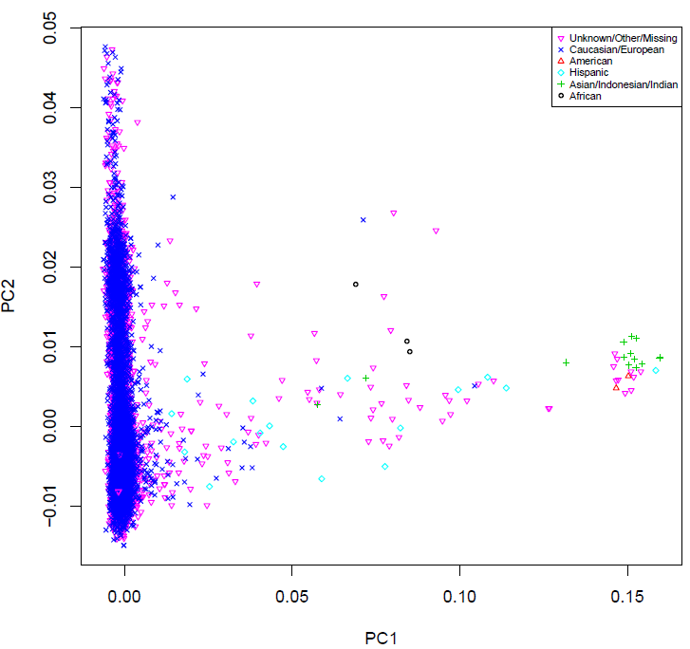
PMPR Phase I genotype data
Eigen-Value | Phase 1 | Phase 2 | EVP1 | EVP2
PC1 | 16.6006 | 50.3657 | 0.21327271 | 0.426369113
PC2 | 11.9216 | 26.4634 | 0.15316025 | 0.224025009
PC3 | 8.30266 | 9.94993 | 0.10666668 | 0.084230793
PC4 | 6.48869 | 5.35342 | 0.08336208 | 0.045319194
PC5 | 6.23224 | 4.94479 | 0.08006739 | 0.041859951
PC6 | 6.07716 | 4.80721 | 0.07807503 | 0.040695272
PC7 | 5.91141 | 4.49841 | 0.0759456 | 0.038081136
PC8 | 5.66893 | 4.01757 | 0.07283039 | 0.034010602
PC9 | 5.40722 | 3.86853 | 0.06946812 | 0.032748909
PC10 | 5.22692 | 3.85803 | 0.06715175 | 0.032660021
Sum | 77.83743 | 118.127

