Slide 1
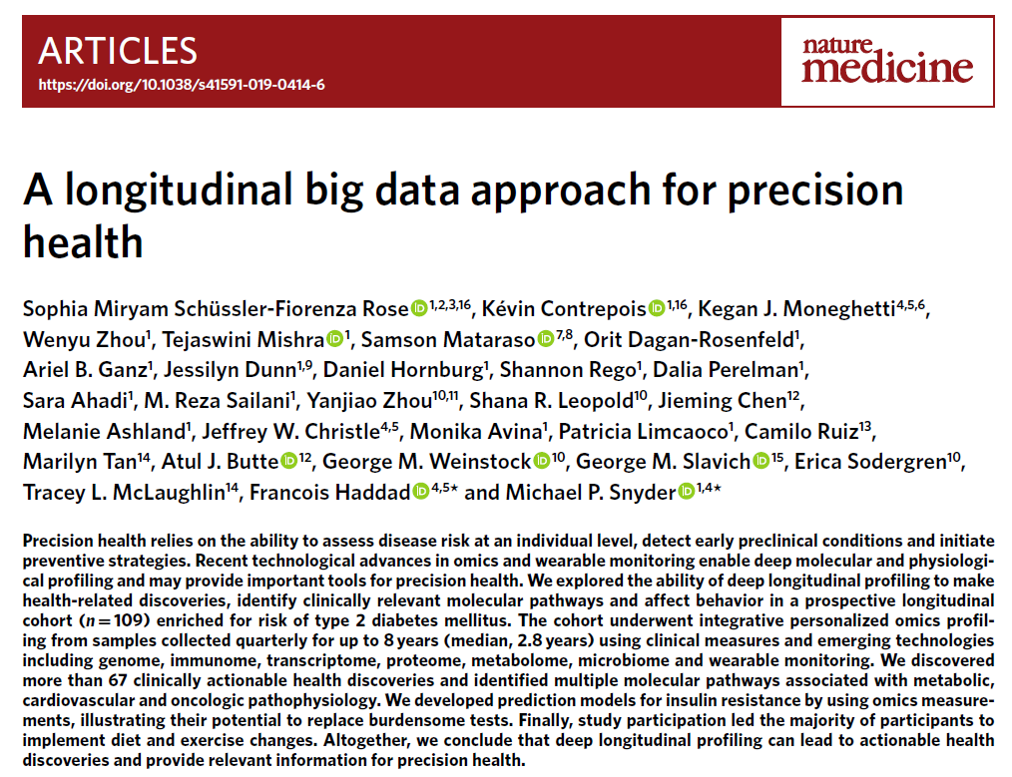
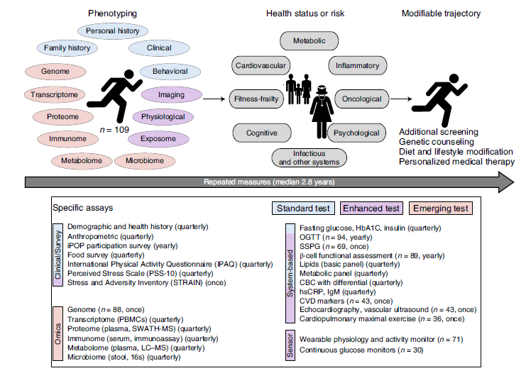
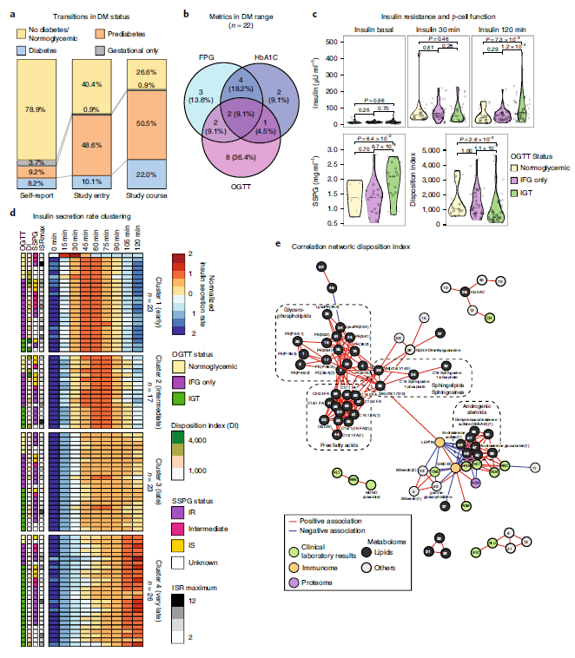
Stanford Model: longitudinal big data approach for precision health

Slide 2
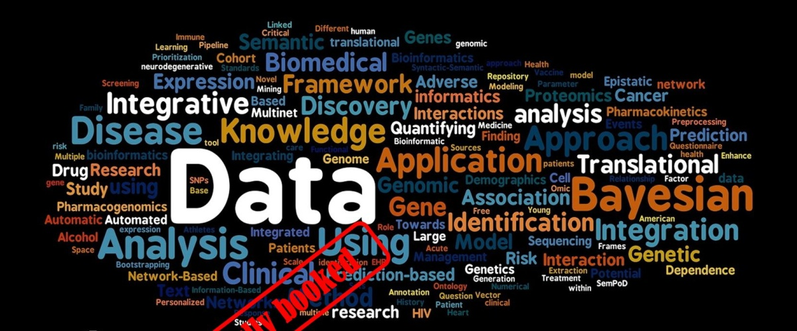

Slide 3
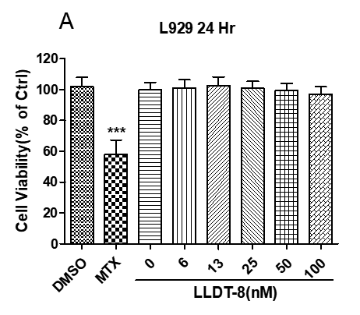
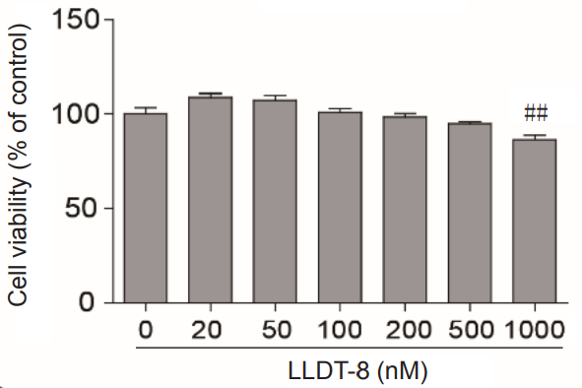
B
Astrocytes 24Hr

Slide 4
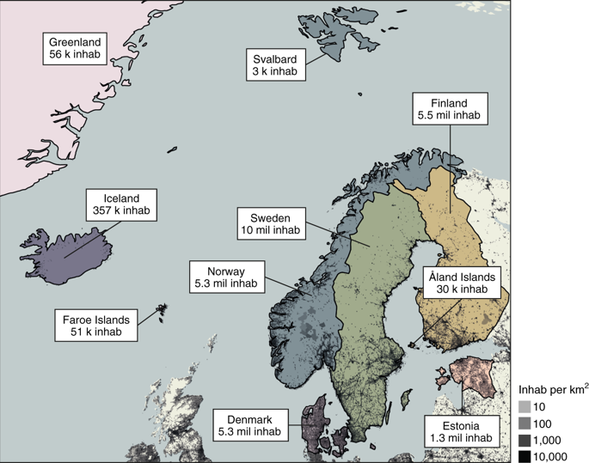
Roadmap for a precision-medicine initiative in the Nordic region
The Nordic countries, a geographical and cultural region in Northern Europe and the North and Norwegian Seas.

Slide 5
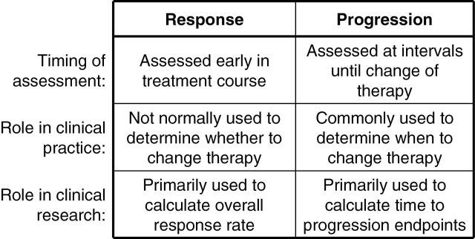
Response and progression as distinct events in solid tumor oncology care and research. Because response and progression play two very different roles, the two may be better conceptualized as distinct events rather than as the two ends of a single spectrum, and each can be studied and critiqued separately.
J Natl Cancer Inst. 2012 Oct 17; 104(20): 1534–1541

Slide 6
To date, whole exome sequencing has been performed on approximately 90,000 samples and are linked to their EHR under a protocol approved by Geisinger Institutional Review Board. Additionally, Geisinger also maintains a separate cancer registry, which contains information on all patients who have been diagnosed with cancer. The Geisinger cancer registry also contributes patient data to the National Cancer Database. There were 8,791 patients out of 90,000 sequenced patients diagnosed with any type of cancer from the cancer registry and 481 EMCA cases were identified among them using ICD-9 site codes – C54.3, C54.9, C54.1 and C54.0. The control population consisted of a subset of age and BMI matched patients out of 90,000 sequenced samples with no history of cancer diagnosis based on the absence of any ICD9/ICD10 code related to cancer in a problem-list entry of the diagnosis code, an inpatient hospitalization-discharge diagnosis code, or an encounter diagnosis code.”

Slide 7
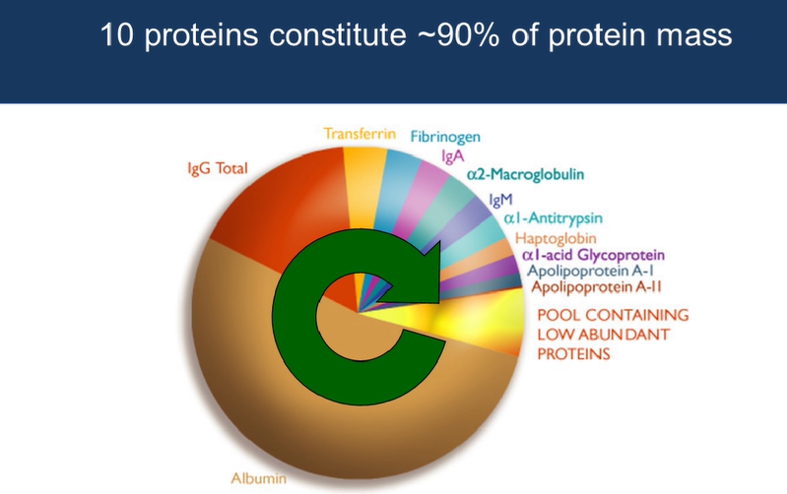
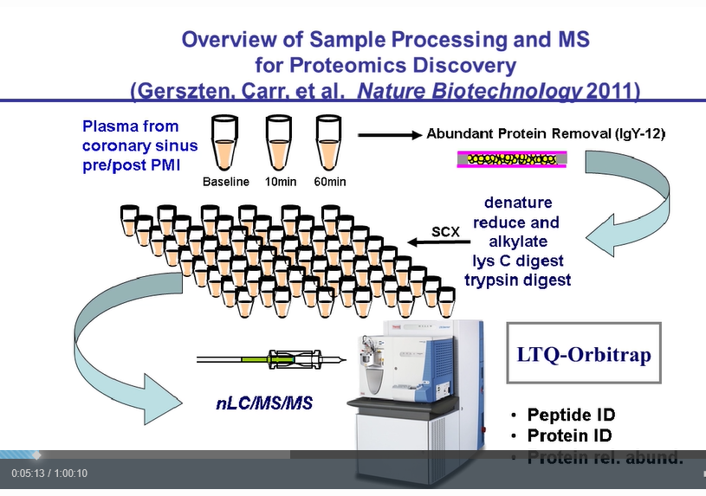

Slide 8
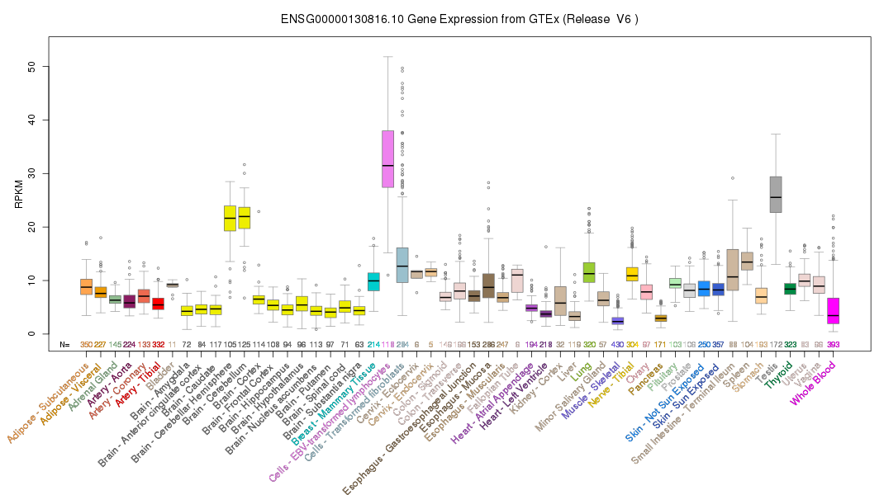
Mechanism of increased expression of DNMT1 in Hemisphere, Cerebellum and Testis
Which transcriptional factor regulate this specific DNMT1 expression in different tissues?
Why Hemisphere, Cerebellum and Testis require high level DNMT1 gene expression?
miRNA, lncRNA, TF, regulate DNMT1, DNMT3A, 3B?

Slide 9
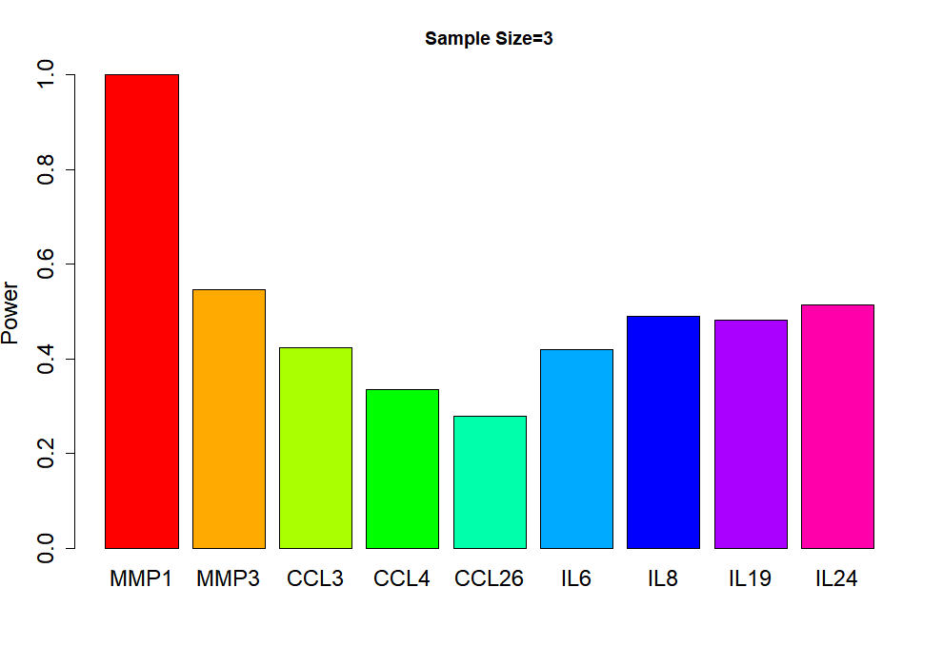
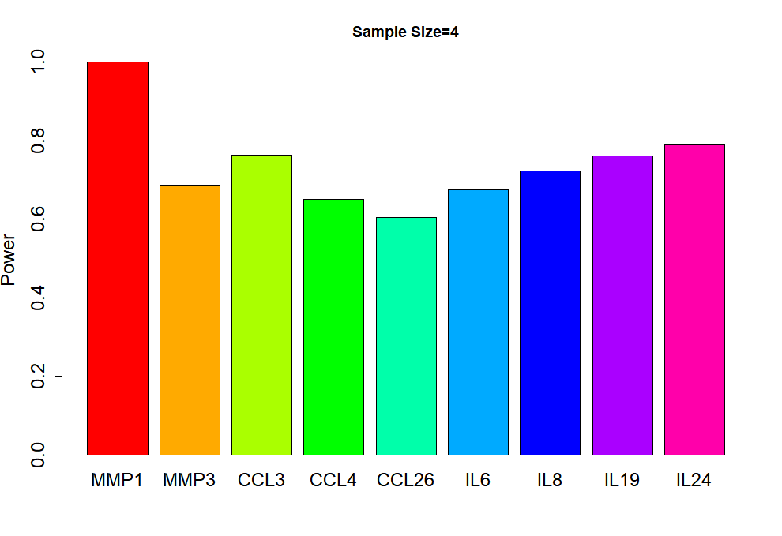
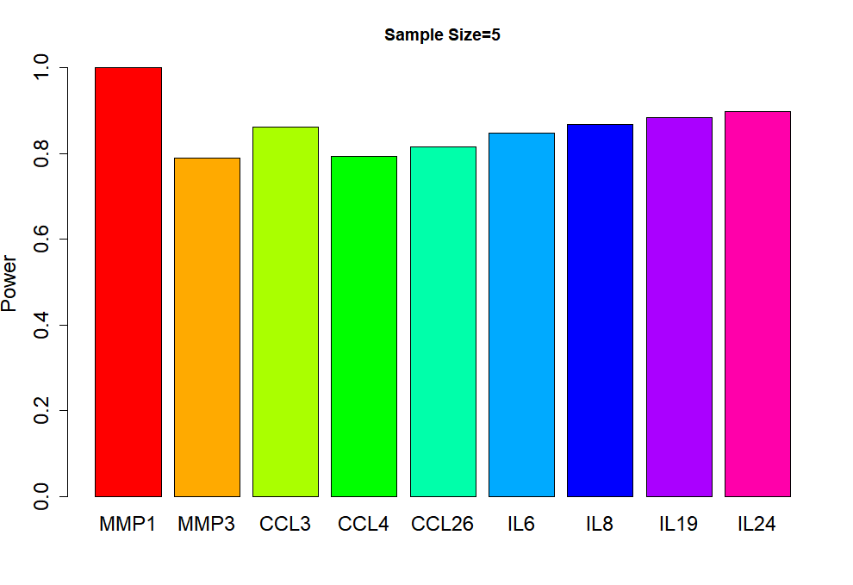
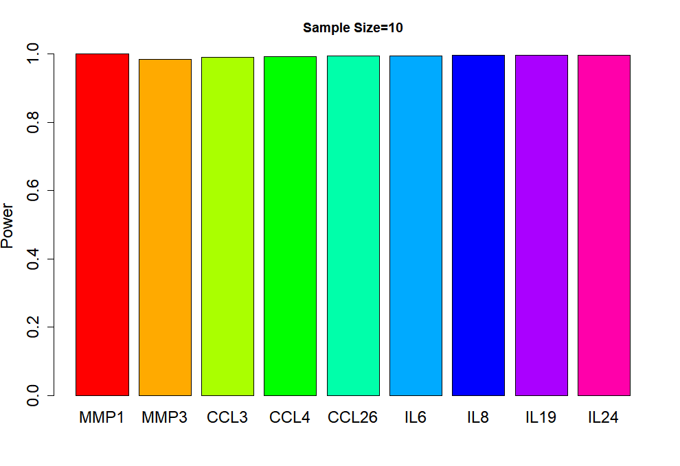
A
B
D

Slide 10
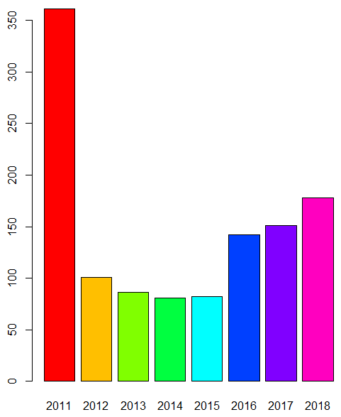
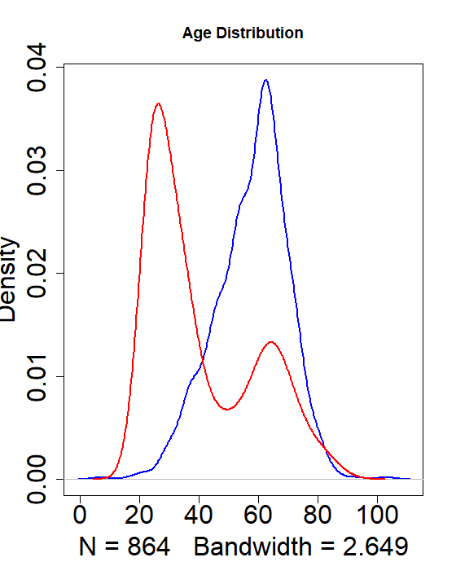
GH

