Slide 1
The use of gene-based functional exome scans for compound heterozygosity with application to hemochromatosis

Slide 2
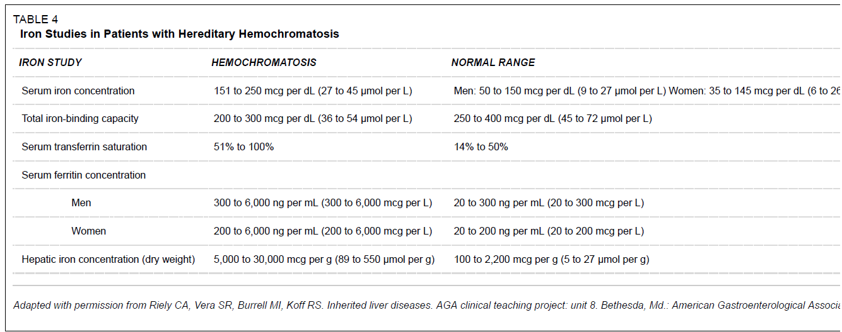
Inclusion criteria: Hemochromatosis
Criteria in Guanghua hospital (Shanghai, Prof. Dongyi He)
Serum transferrin saturation(STS) >48%
Serum iron concentration (SI) >27µmol/L
Total iron-binding capacity(TIBC) < 54 µmol/L
Brandhagen, D.J., V.F. Fairbanks, and W. Baldus, Recognition and management of hereditary hemochromatosis. Am Fam Physician, 2002. 65(5): p. 853-60.

Slide 3
CHR | GENE | P | ORIG_SNP | NOHOM_SNP | X1 | X2 | X3 | X4
6 | HFE | 1.29E-08 | 14 | 10 | 8 | 10 | 189 | 6707
12 | FGF6 | 1.99E-06 | 10 | 6 | 6 | 12 | 153 | 6743
21 | KRTAP15-1 | 7.55E-05 | 5 | 2 | 11 | 7 | 1271 | 5625
20 | XKR7 | 0.000118 | 7 | 3 | 3 | 15 | 35 | 6861
20 | CABLES2 | 0.000128 | 7 | 5 | 3 | 15 | 36 | 6860
22 | THOC5 | 0.000138 | 9 | 6 | 13 | 5 | 1945 | 4951
18 | CABYR | 0.000254 | 17 | 10 | 5 | 13 | 229 | 6667
3 | CMSS1 | 0.000309 | 10 | 7 | 5 | 13 | 239 | 6657
5 | PCDHB2 | 0.000377 | 11 | 5 | 3 | 15 | 53 | 6843
9 | ZFP37 | 0.001067 | 16 | 7 | 9 | 9 | 1137 | 5759
3 | C3orf30 | 0.001156 | 28 | 12 | 13 | 5 | 2361 | 4535
12 | DENND5B | 0.001286 | 11 | 7 | 9 | 9 | 1166 | 5730
6 | MRS2 | 0.001299 | 10 | 8 | 4 | 14 | 188 | 6708
6 | BCLAF1 | 0.001686 | 29 | 20 | 4 | 14 | 202 | 6694
1 | NBPF3 | 0.001793 | 7 | 3 | 9 | 9 | 1220 | 5676
1 | BRDT | 0.002315 | 20 | 13 | 6 | 12 | 560 | 6336
17 | CAMKK1 | 0.002332 | 7 | 4 | 9 | 9 | 1265 | 5631
3 | CELSR3 | 0.002353 | 56 | 32 | 3 | 15 | 102 | 6794
12 | UHRF1BP1L | 0.002353 | 40 | 21 | 3 | 15 | 102 | 6794

