Slide 1
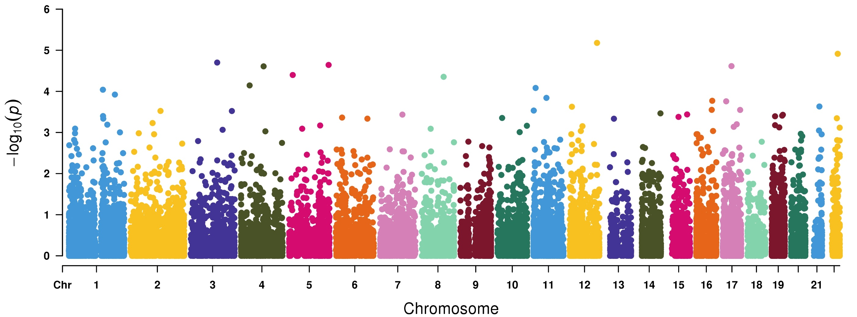
Genome-wide Robust SKAT-O based association study to identify Psoriasis Related Disorders of Colon associated genes in 50K UKBB exome-sequencing data
CCDC62
XRCC6
CD80
BANK1
DDX41
MED1
NIPAL2
PGLYRP3
ZNF143
FAM114A1
238 cases and 23,562 controls

Slide 2
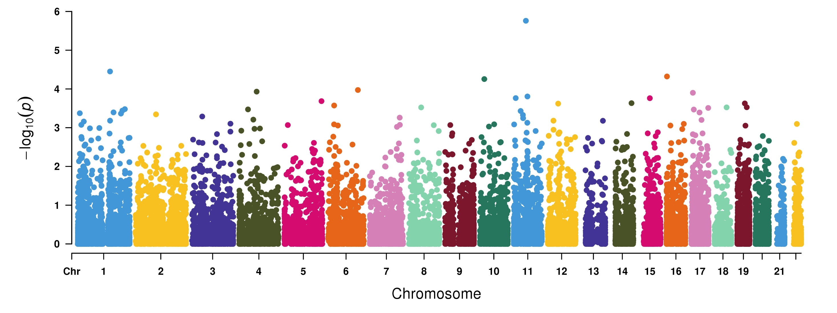
Genome-wide Robust SKAT-O based association study to identify Psoriatic arthropathy associated genes in 50K UKBB exome-sequencing data
OR9Q1
DCST1
C10orf113
SLC9A3R2
HELQ
VTA1
RELA
POLR2A
DDX41
SDCBP
AQP2
USP50
TMEM131
ZNF143
72 cases and 7,128 controls

