Slide 1
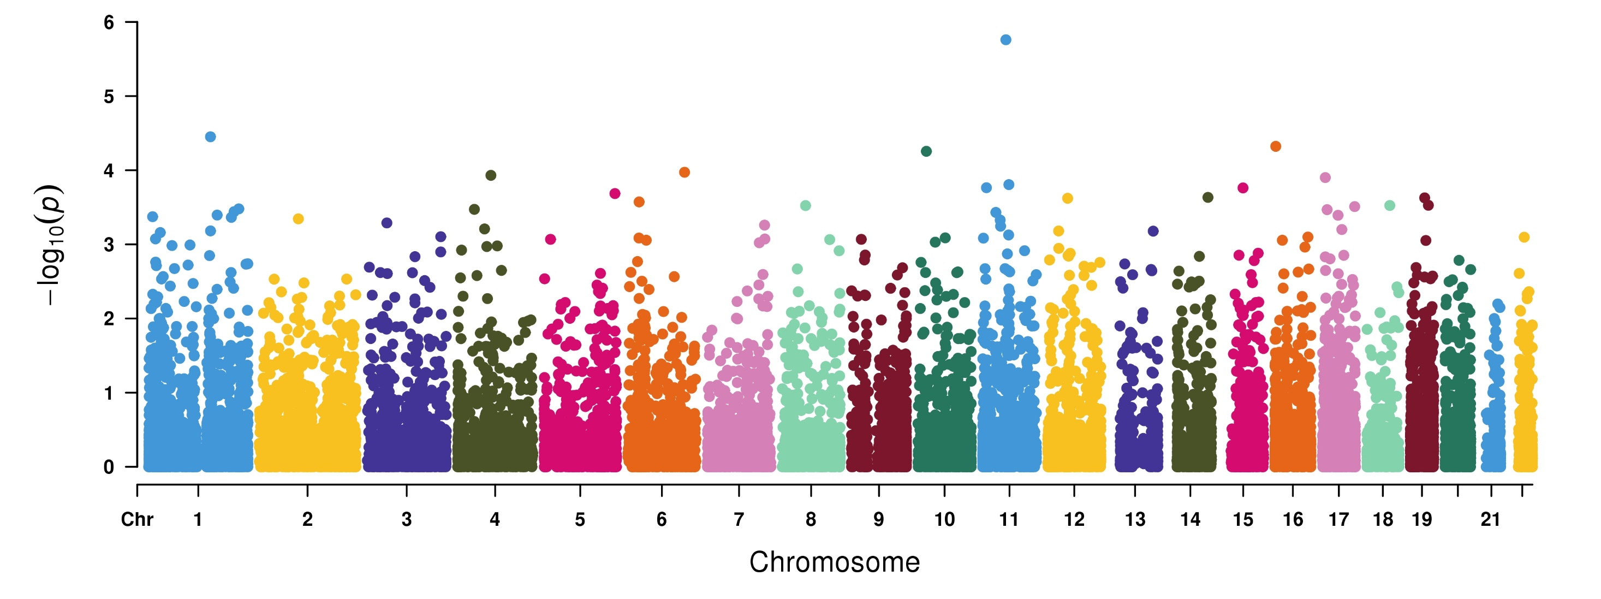
Genome-wide Robust SKAT-O based association study to identify Psoriatic arthropathy associated genes in 50K UKBB exome-sequencing data
OR9Q1
DCST1
C10orf113
SLC9A3R2
HELQ
VTA1
RELA
POLR2A
DDX41
SDCBP
AQP2
USP50
TMEM131
ZNF143
72 cases and 7,128 controls

Slide 2
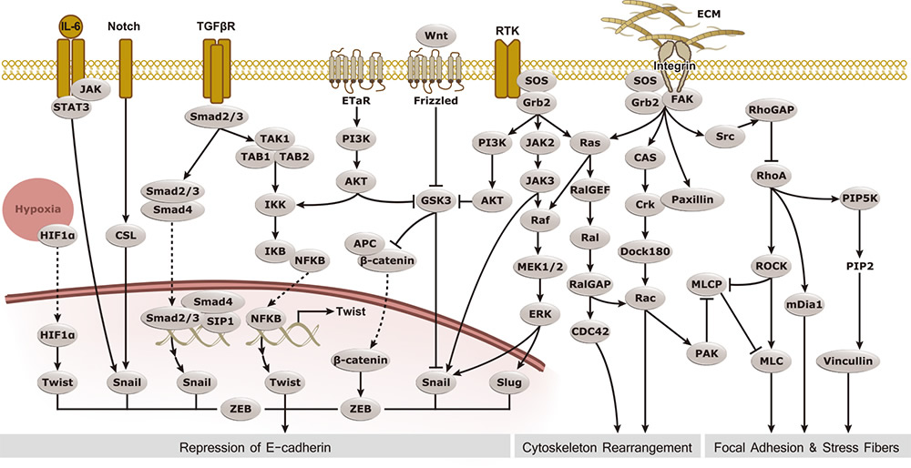
Epithelial–mesenchymal transition (EMT) Pathway
Epithelial–mesenchymal transition (EMT) is a process whereby tightly-interacting and immotile epithelial cells acquire the phenotype of loosely-adherent and motile mesenchymal cells. EMT not only facilitates morphogenesis during embryonic development but also promotes invasion and metastasis in tumors. Pathological EMT is associated with E-cadherin repression, which has been shown to contribute to tumor progression. Several oncogenic pathways (TGF-β, Wnt/β-catenin, Integrins, Notch, etc) have been reported to induce EMT via cytoskeleton reorganization and activation of E-Cadherin repressors, including Snail, Slug, SIP1, and TCF3. GeneTex is proud to introduce our new line of antibodies for the study of EMT.
RALGPS1
RALGPS1
https://www.genetex.com/MarketingMaterial/Index/EMT_pathway?utm_source=Genecards&utm_medium=referral&utm_campaign=Genecards_pathway

Slide 3
