Slide 1
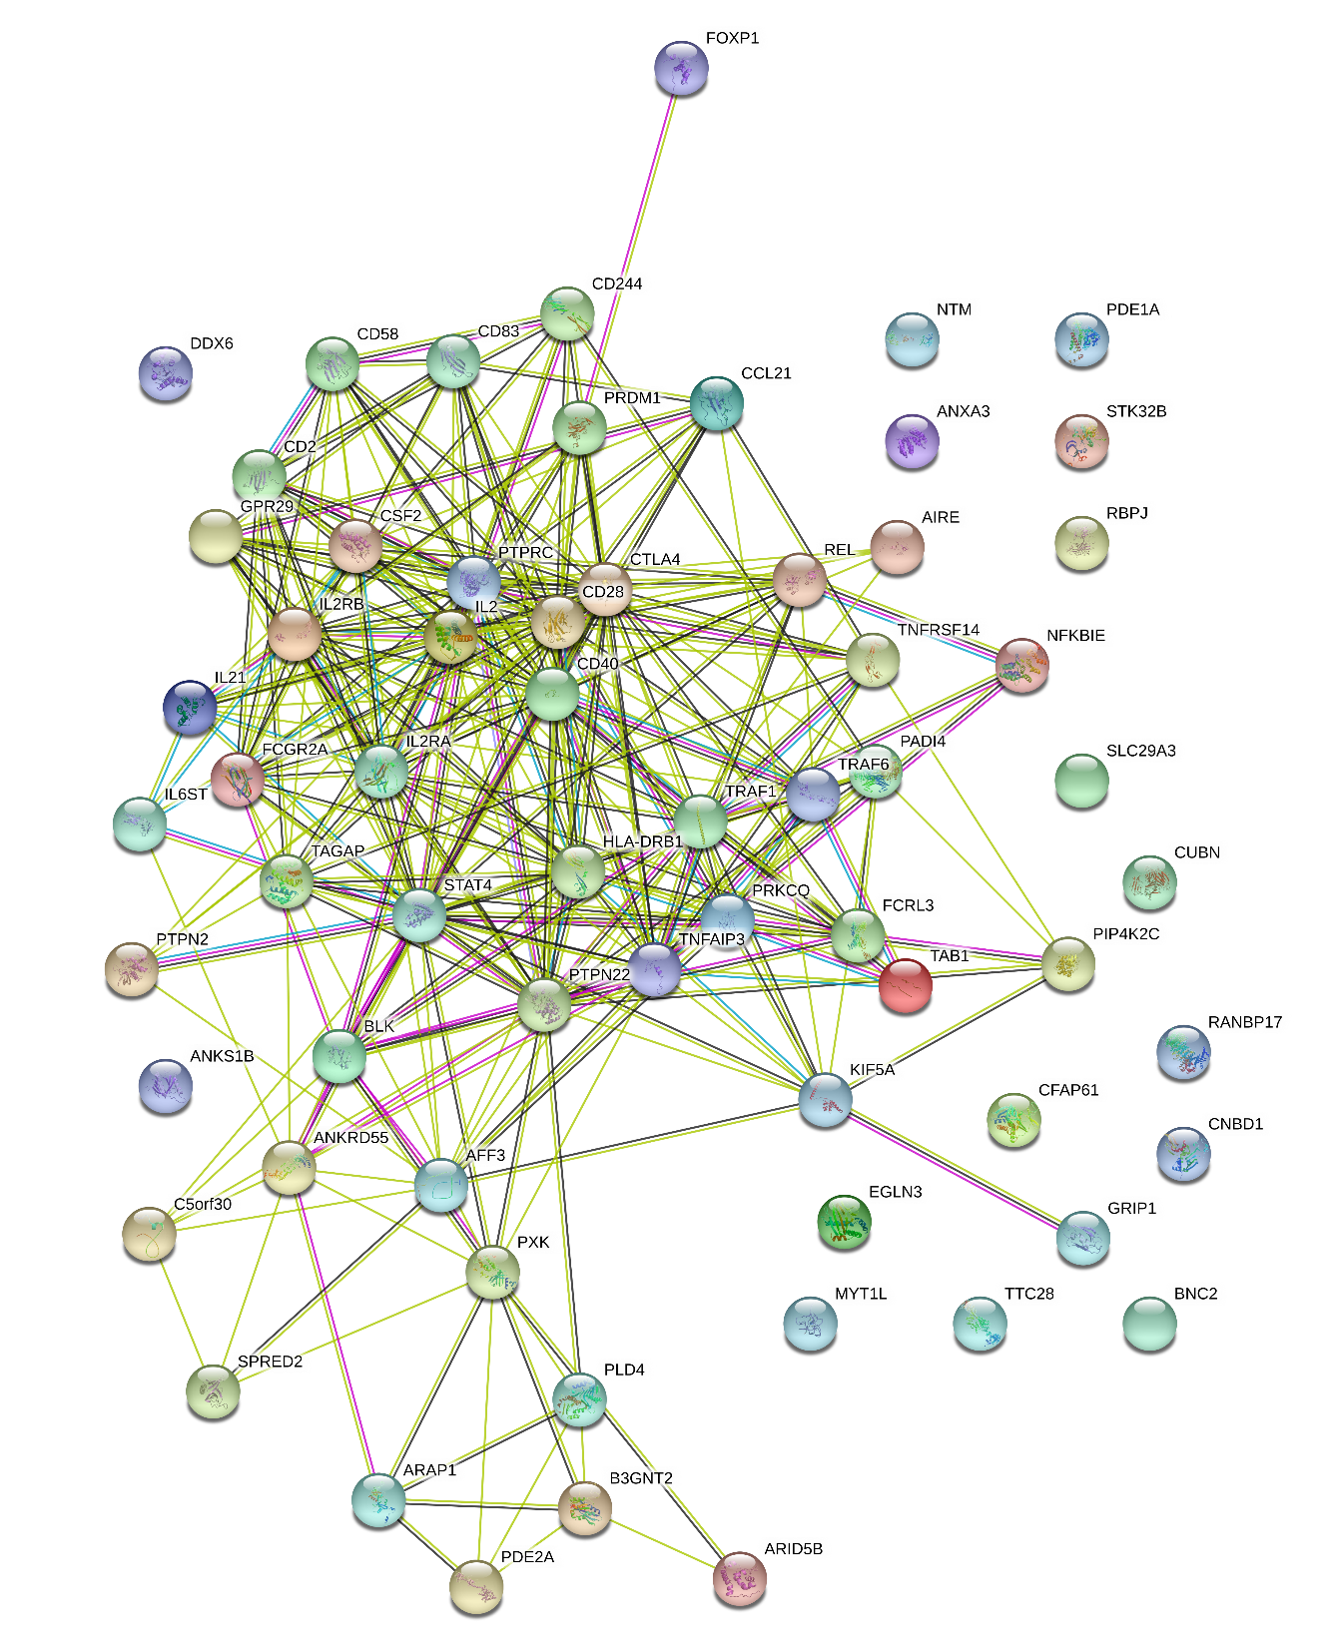
CHR | POS | RSID | Overlapped Gene | REF | NMISS | OR | STAT | P
9 | 1218816 | rs10960475 | RPS27AP14 | T | 2121 | 0.625 | -4.096 | 4.21E-05
2 | 2485163 | rs1024143 | MYT1L | G | 2052 | 1.338 | 4.092 | 4.27E-05
2 | 2797454 | rs13017799 | AC018685.2 | G | 2116 | 1.372 | 3.918 | 8.93E-05
4 | 5125724 | rs1374621 | STK32B | T | 2120 | 1.309 | 3.935 | 8.34E-05
3 | 5851784 | rs80177608 | AC026202.5 | C | 2118 | 0.6737 | -3.912 | 9.17E-05
9 | 7664428 | rs11792985 | RP11-366I21.1 | G | 2120 | 1.405 | 4.176 | 2.97E-05
9 | 7664684 | rs16926559 | RP11-366I21.1 | T | 2119 | 1.413 | 4.242 | 2.22E-05
7 | 13481626 | rs1432486 | AC011288.2 | C | 2107 | 0.7707 | -3.998 | 6.40E-05
11 | 13806237 | rs78575335 | RP11-23B7.4 | G | 2123 | 0.4672 | -4.19 | 2.79E-05
9 | 16576129 | rs75958865 | BNC2 | T | 2112 | 1.384 | 4.356 | 1.32E-05
10 | 17142526 | rs6602175 | CUBN | G | 2120 | 0.7606 | -4.082 | 4.47E-05
10 | 17146590 | rs12571671 | CUBN | A | 2121 | 0.7113 | -4.33 | 1.49E-05
10 | 17158973 | rs12243895 | CUBN | G | 2120 | 0.7144 | -4.523 | 6.10E-06
20 | 20065793 | rs6046608 | C20orf26 | G | 2123 | 0.5587 | -4.122 | 3.76E-05
20 | 20067476 | rs6035547 | C20orf26 | A | 2122 | 0.5577 | -4.172 | 3.02E-05
22 | 28755220 | rs113318464 | TTC28 | A | 2062 | 1.847 | 4.046 | 5.21E-05
14 | 34935962 | rs9972241 | EGLN3 | G | 2115 | 0.7348 | -4.668 | 3.04E-06
13 | 38594658 | rs189053172 | HSPD1P9 | T | 2120 | 2.531 | 4.016 | 5.93E-05
22 | 39813759 | rs35469986 | TAB1 | T | 2120 | 0.6166 | -4.393 | 1.12E-05
7 | 46851363 | rs1534103 | EPS15P1 | G | 2105 | 1.469 | 4.236 | 2.28E-05
1 | 49237533 | rs12756584 | AGBL4 | A | 2120 | 0.7663 | -3.989 | 6.65E-05
13 | 51446114 | rs12429206 | DLEU7-AS1 | A | 2106 | 1.3 | 3.947 | 7.92E-05
11 | 60833321 | rs2074203 | RP11-881M11.8 | A | 2119 | 1.401 | 4.047 | 5.18E-05
3 | 64718258 | rs2371767 | ADAMTS9-AS2 | G | 2107 | 1.4 | 4 | 6.33E-05
3 | 64786430 | rs2371756 | ADAMTS9-AS2 | G | 2119 | 0.7826 | -3.913 | 9.13E-05
3 | 64802234 | rs10510924 | ADAMTS9-AS2 | G | 2121 | 0.7664 | -4.242 | 2.22E-05
10 | 65856496 | rs150700246 | RP11-174J11.1 | C | 2122 | 3.471 | 4.078 | 4.55E-05
12 | 66853883 | rs11176197 | GRIP1 | T | 2121 | 0.664 | -4.083 | 4.44E-05
10 | 70827582 | rs6480379 | ACTBP14 | C | 2118 | 0.7814 | -3.91 | 9.23E-05
3 | 71511868 | rs145044897 | FOXP1 | T | 2121 | 0.5315 | -4.094 | 4.24E-05
3 | 71531046 | rs140612058 | FOXP1 | G | 2118 | 0.4912 | -4.305 | 1.67E-05
3 | 71557864 | rs144054676 | FOXP1 | C | 2107 | 0.491 | -4.278 | 1.88E-05
10 | 73115942 | rs2252996 | SLC29A3 | G | 2122 | 0.7484 | -4.185 | 2.85E-05
7 | 74126034 | rs117026326 | GTF2I | C | 2112 | 1.409 | 3.97 | 7.19E-05
1 | 78772699 | rs117929741 | RP11-183M13.1 | C | 2122 | 0.2968 | -3.915 | 9.06E-05
8 | 87915494 | rs78891779 | CNBD1 | A | 2118 | 2.564 | 4.287 | 1.81E-05
8 | 88395551 | rs144562892 | CNBD1 | C | 2112 | 2.673 | 3.903 | 9.50E-05
12 | 1E+08 | rs11109987 | ANKS1B | A | 2122 | 1.314 | 4.186 | 2.83E-05
4 | 1.12E+08 | rs17042125 | PITX2 | A | 2123 | 1.962 | 3.968 | 7.24E-05
11 | 1.27E+08 | rs78878163 | RP11-168K9.1 | T | 2121 | 0.4265 | -4.21 | 2.56E-05
11 | 1.32E+08 | rs574322 | NTM | G | 2118 | 0.7604 | -3.924 | 8.72E-05
7 | 1.36E+08 | rs6972344 | AC009784.3 | C | 2123 | 0.4878 | -4.339 | 1.43E-05
23 | 1.46E+08 | rs2103903 | RNA5SP517 | C | 2118 | 1.317 | 3.917 | 8.95E-05
5 | 1.51E+08 | rs6579891 | CTB-113P19.1 | T | 2122 | 0.7738 | -4.013 | 5.99E-05
5 | 1.71E+08 | rs17073388 | RANBP17 | A | 2123 | 1.593 | 4.472 | 7.75E-06
5 | 1.71E+08 | rs75306051 | RANBP17 | G | 2078 | 1.582 | 4.315 | 1.60E-05
5 | 1.71E+08 | rs2278255 | RANBP17 | C | 2117 | 1.544 | 4.14 | 3.47E-05
2 | 1.83E+08 | rs6433973 | PDE1A | C | 2120 | 1.634 | 3.92 | 8.85E-05
2 | 1.83E+08 | rs1560374 | PDE1A | C | 2123 | 1.629 | 3.912 | 9.17E-05
2 | 1.83E+08 | rs10169102 | PDE1A | C | 2116 | 1.648 | 3.995 | 6.46E-05

