Slide 1
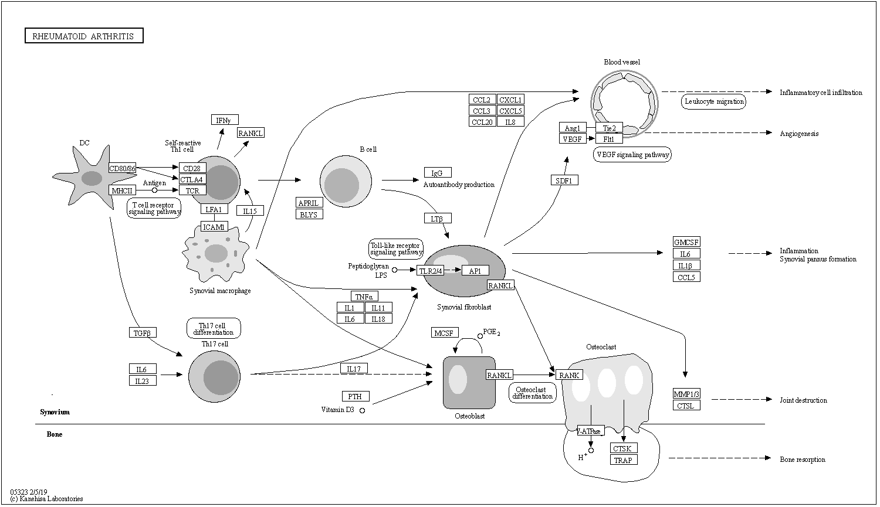
Rheumatoid arthritis pathway
https://www.genome.jp/kegg-bin/show_pathway?map05323

