Slide 1
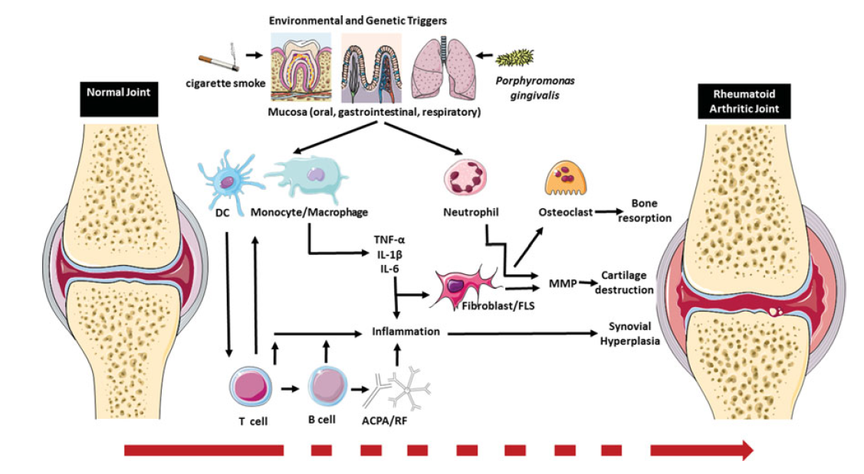
Figure . Pathogenesis of Rheumatoid Arthritis. In individuals susceptible to rheumatoid arthritis (RA) there is break down in self-tolerance.
Genetic and environmental triggers including toxic products such as cigarette smoke and pathogens (e.g. Porphyromonas gingivalis) are
considered to play a role in the pathogenesis of RA. These triggers ultimately result in the activation ofmacrophages and neutrophils. These
cells produce TNF-α, IL-β and IL-, enhancing local inflammation. The dendritic cells (DC) migrate to lymph nodes and present antigens
to T cells which through epitope spreading activate self-reactive T cells and enhance the generation of autoantibodies by B cells. Activated
auto reactive lymphocytes enhance local joint inflammation and also produce plasma cells and produce rheumatoid factor (RF) and
anti-citrullinated protein antibodies (ACPA). In the synovium these antibodies further enhance joint inflammation. Activated T cells stimulate
macrophages resulting in activation of fibroblasts and fibroblast-like synoviocytes (FLS). The activated neutrophils, fibroblasts and
FLS produce matrix metalloproteinases (MMPs) which degrade cartilage in affected joints. They also activate osteoclasts through RANKL
promoting bone resorption leading to osteoporosis. Fibroblasts and FLS proliferate resulting in synovial hyperplasia which eventually lead
to pannus formation.

