Slide 1
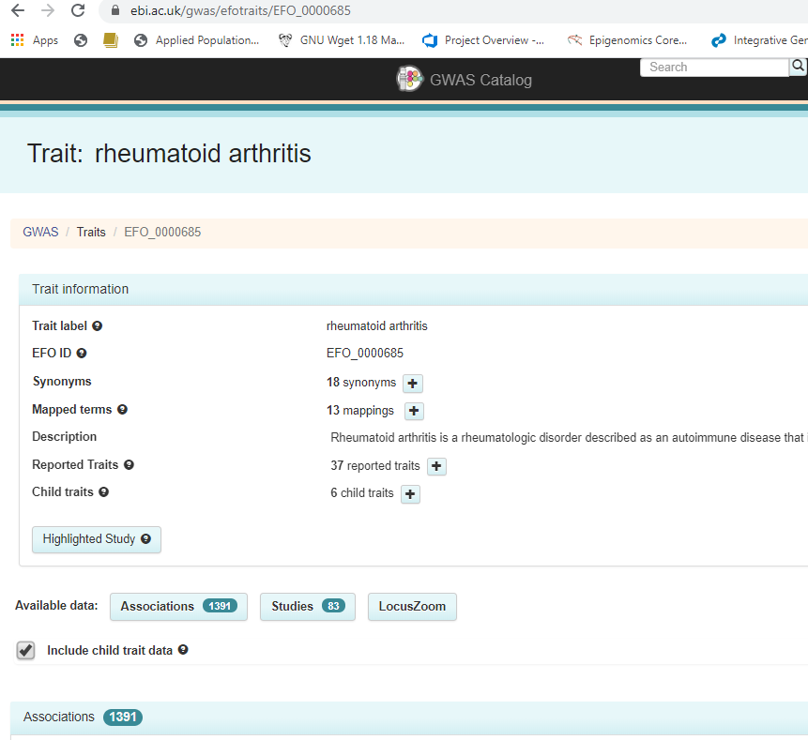
Rheumatoid arthritis and CCR6 in GWAS-catalog
What’s CCR6? Why CCR6 is important in RA?
83 GWAS in RA and 1391 significant SNPs were identified
https://www.ebi.ac.uk/gwas/efotraits/EFO_0000685

Slide 2
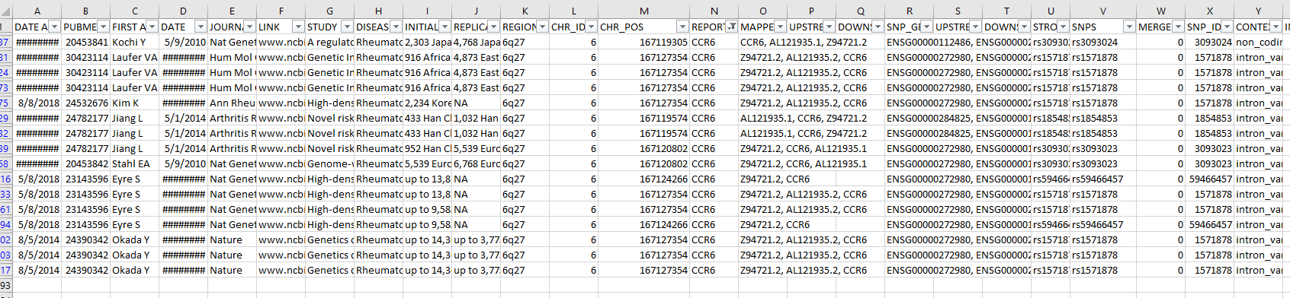
Rheumatoid arthritis and CCR6 in GWAS-catalog
Only 7 GWAS in RA showed significant association with CCR6

