Slide 1
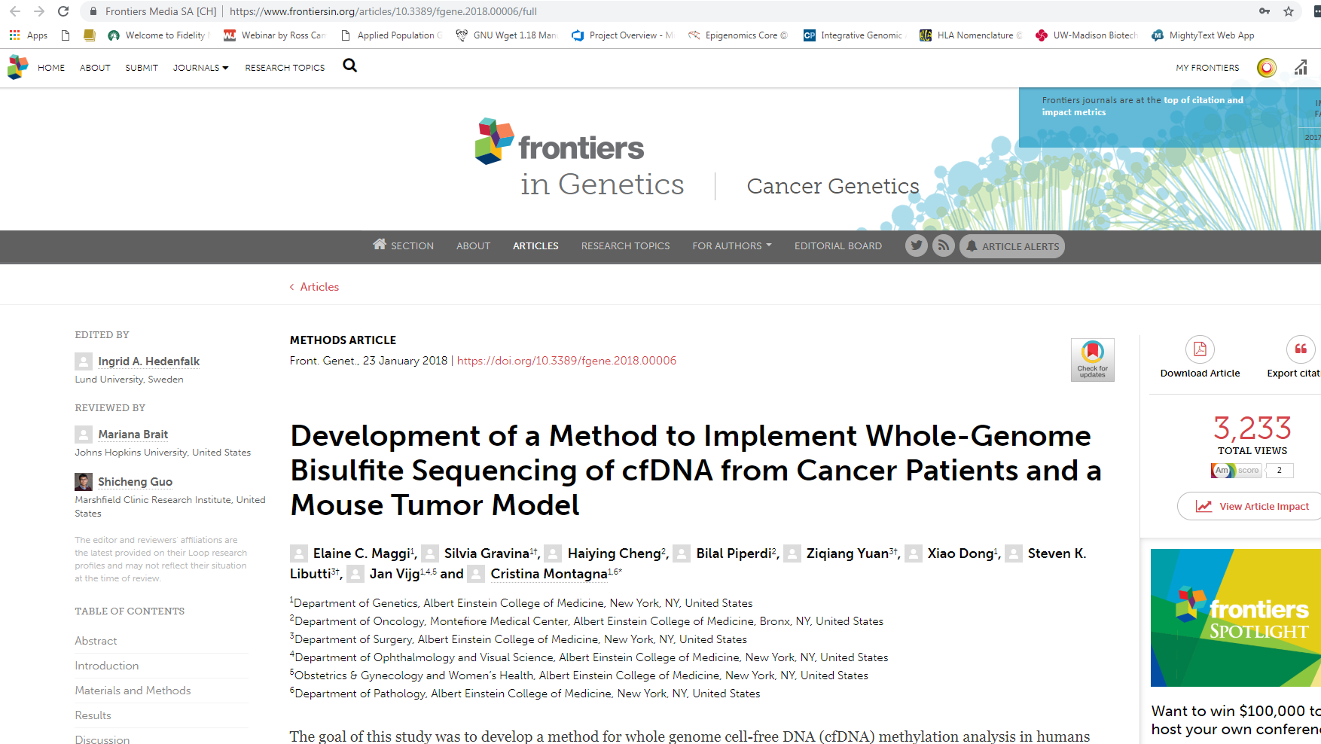
https://www.frontiersin.org/articles/10.3389/fgene.2018.00006/full

Slide 2
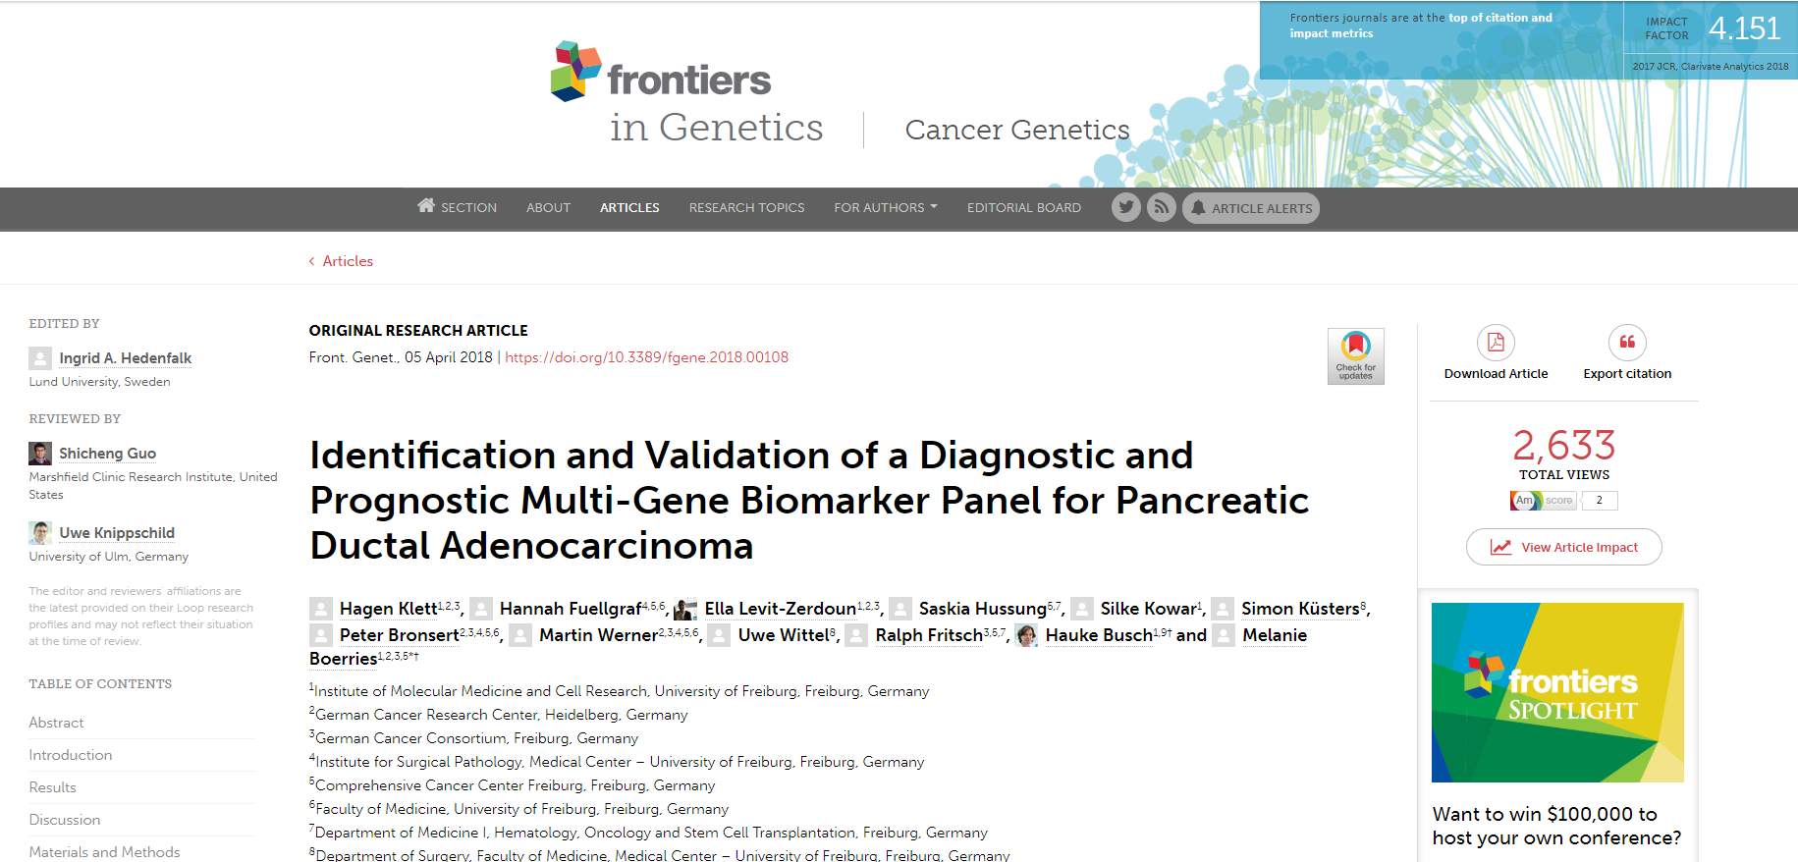
https://www.frontiersin.org/articles/10.3389/fgene.2018.00108/full

Slide 3
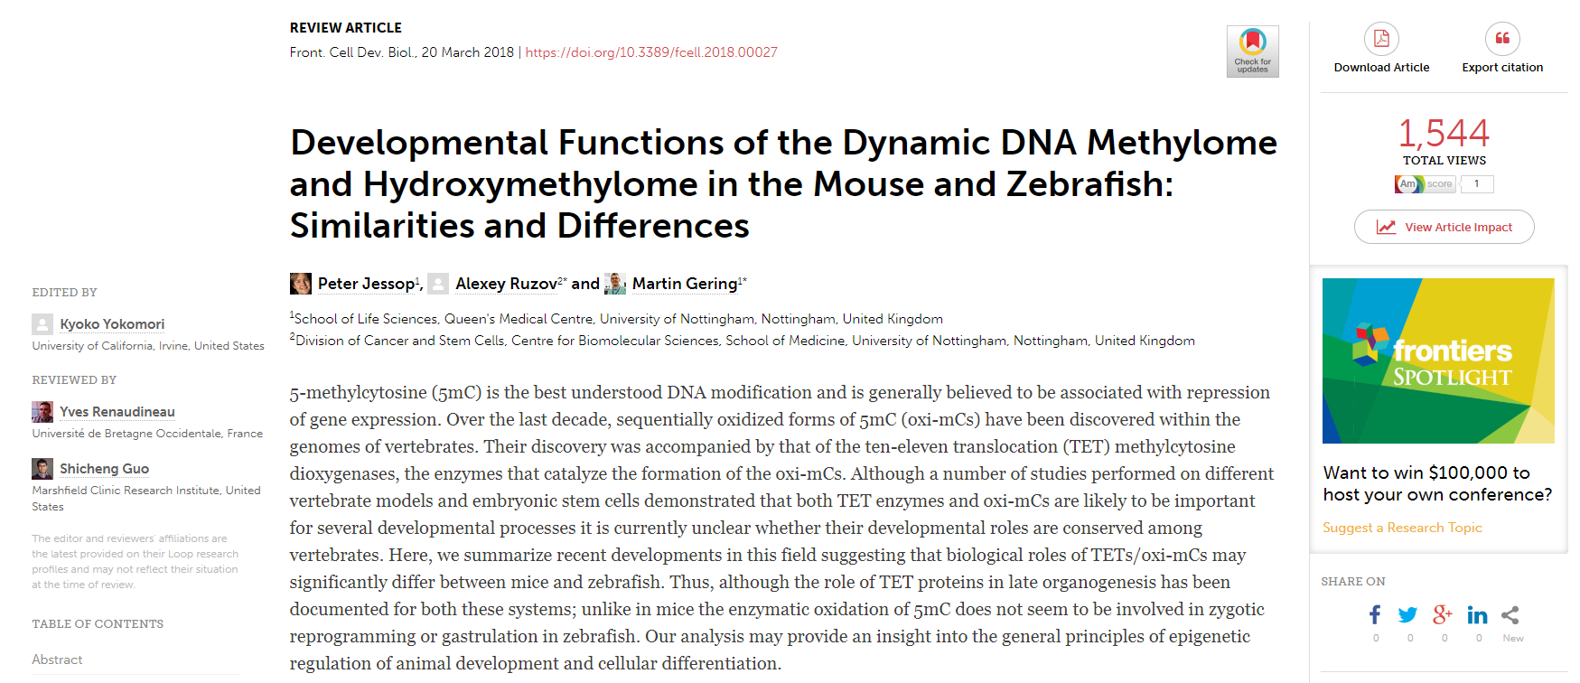
https://www.frontiersin.org/articles/10.3389/fcell.2018.00027/full

Slide 4
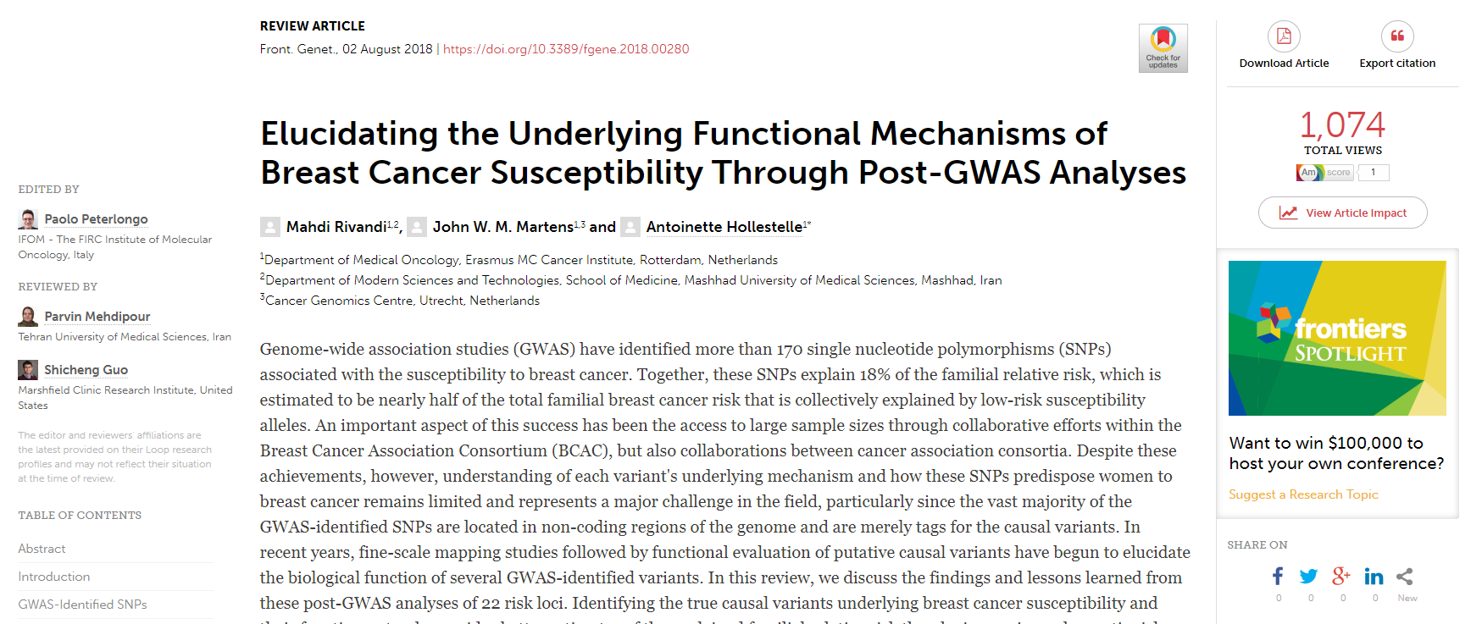
https://www.frontiersin.org/articles/10.3389/fgene.2018.00280/full

Slide 5
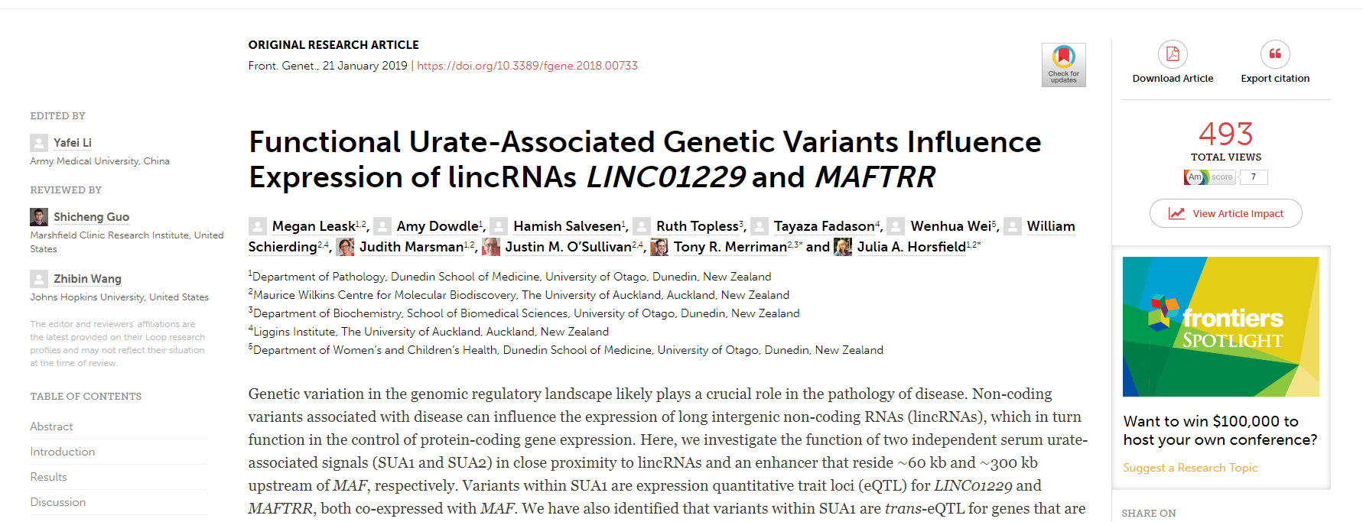
https://www.frontiersin.org/articles/10.3389/fgene.2018.00733/full

