Slide 1
UK Biobank Whole-Exome Sequence Binary Phenome Analysis with Robust Region-Based Rare-Variant Test
Shicheng Guo
Center for Precision Medicine Research,
Marshfield Clinic Research Institute 01/24/2019

Slide 2
Methods: Apply GWAS to Identify Disease Associated Genes
Gene A
Gene A
Common variant model:
Additive
Multiplicative
Dominant
Recessive
Codominance
Over-dominant
Multiple tests
Considerable heterogeneity among studies
Rare variants model:
Group-based association study (rare variants)
1. Burden test (effect, weight)
2. Kernel-based variance-component test (SKAT)
Compound heterozygosity study
1. Strong assumption
2. Functional variants
Dr. Scott J Hebbring
Dr. Steven Schrodi
Notes:
Common variants model can also be called single loci model. Group based association or compound heterogyosity can be called multiple-loci model. Burden tests are more powerful when most variants in a region are causal and the effects are in the same direction, whereas SKAT is more powerful when a large fraction of the variants in a region are noncausal or the effects of causal variants are in different directions.

Slide 3

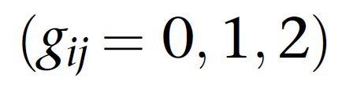
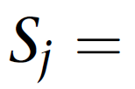
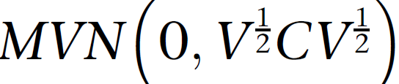
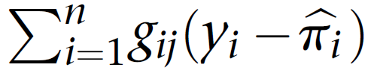
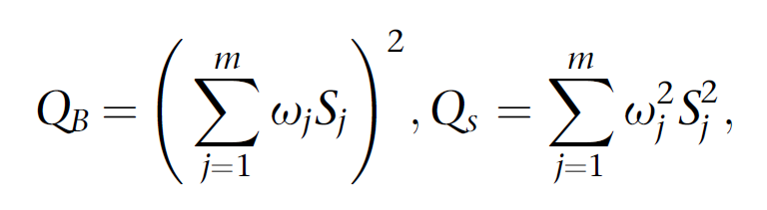
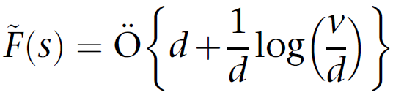

Robust Region-based Rare-Variant Tests for Binary Traits
Estimated Disease Probability
~
Binary Phenotype
Imbalanced => Severe Skewed
SPA (saddle point approximation)
ER (efficient sampling)
SKAT-O Test
Burden Test
SKAT Test

Slide 4
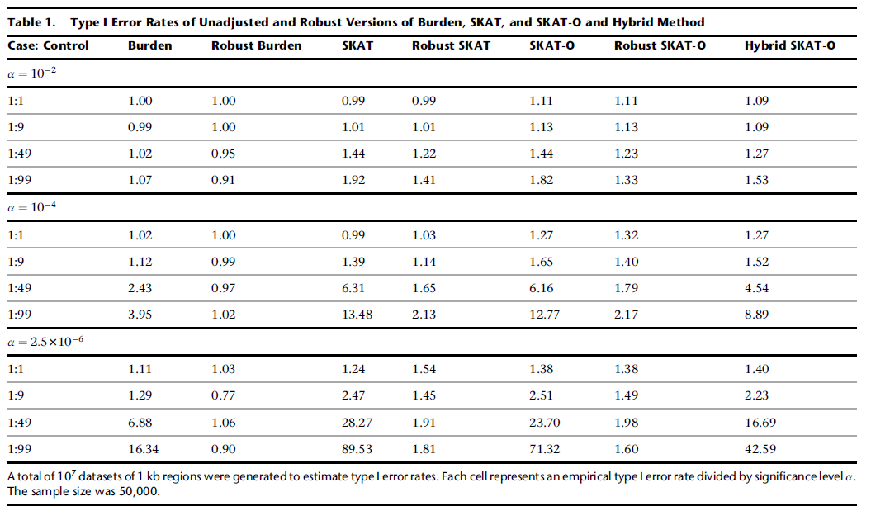
Inflated Type I Error Rates of Unadjusted Burden, SKAT, and SKAT-O

Slide 5
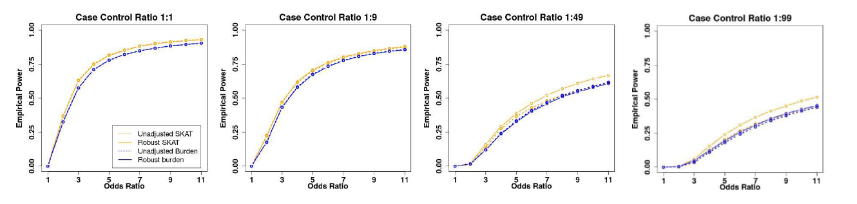
Robust SKAT shows higher power to identify causal variants
3-8-2 rule:
30% total variants are causal variants
80% causal variants are risk factors
20% causal variants are protective
Robust SKAT

Slide 6
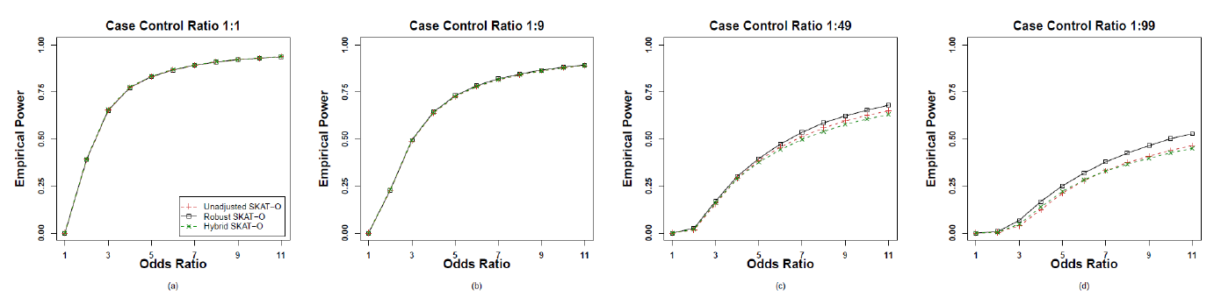
Robust SKAT-O shows higher power to identify causal variants
3-1-0 rule:
30% total variants are causal variants
100% causal variants are risk factors
0% causal variants are protective
Robust SKAT-O

Slide 7
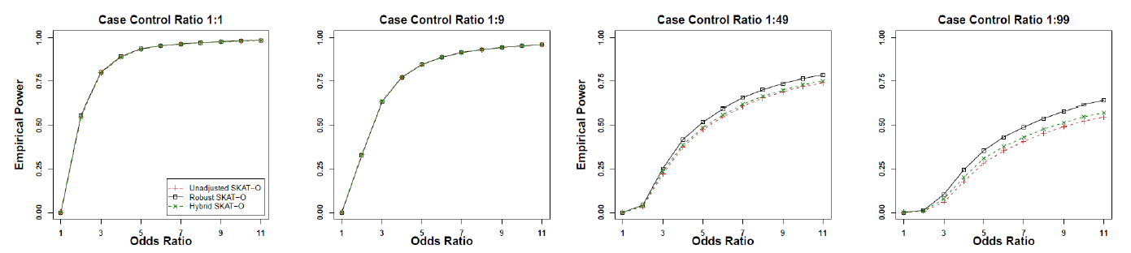
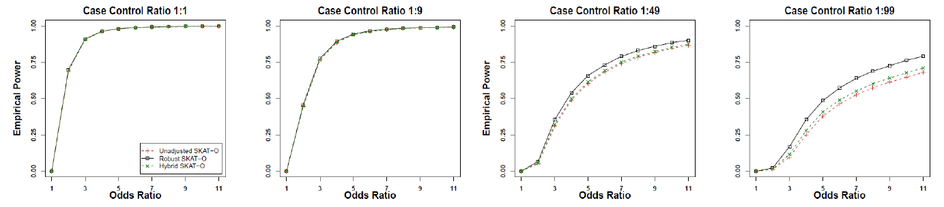
Power evaluation: robust SKAT-O showed length independence
Region=2K
Robust SKAT-O
3-8-2 rule:
30% total variants are causal variants
80% causal variants are risk factors
20% causal variants are protective
Region=3K
Robust SKAT-O

Slide 8
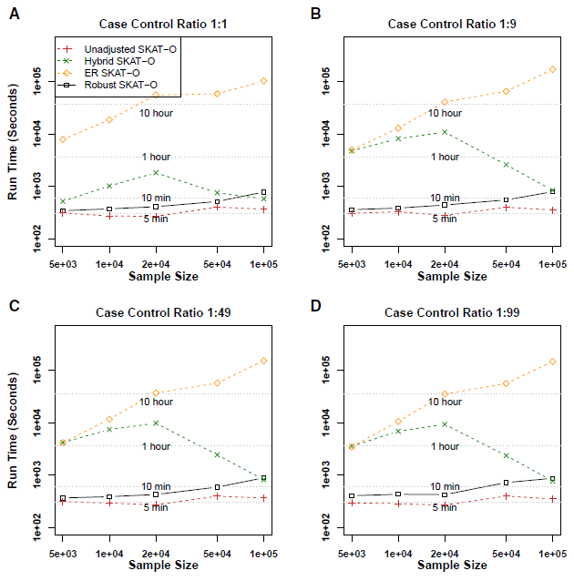
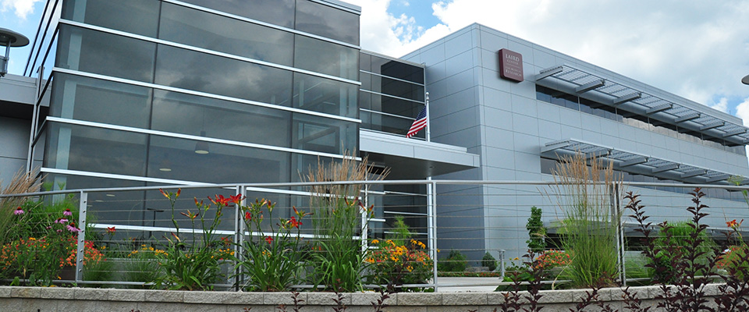
Computational time: robust SKAT-O require 140x times
Computational times is almost similar between 5,000 and 100,000 samples
791 UK biobank phenotypes and 50,000 samples require 453 CPU days
1 phenotypes and 50,000 samples require 13.7 CPU hours
2.7 hours
18 server nodes with 160 cores of computer power
100K
500K sample ~ 30 days

Slide 9
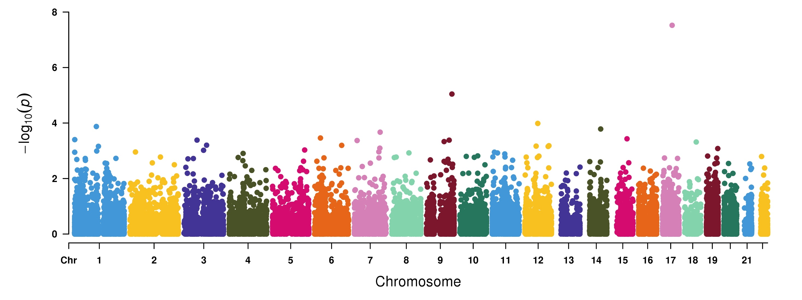
Robust SKAT-O analyses to Prostate Cancer
HOXB13
RALGPS1
ATXN7L2
GNS
AREL1
MAGI1
MOG
SMO
PARP6
741 cases and 18,940 controls

Slide 10
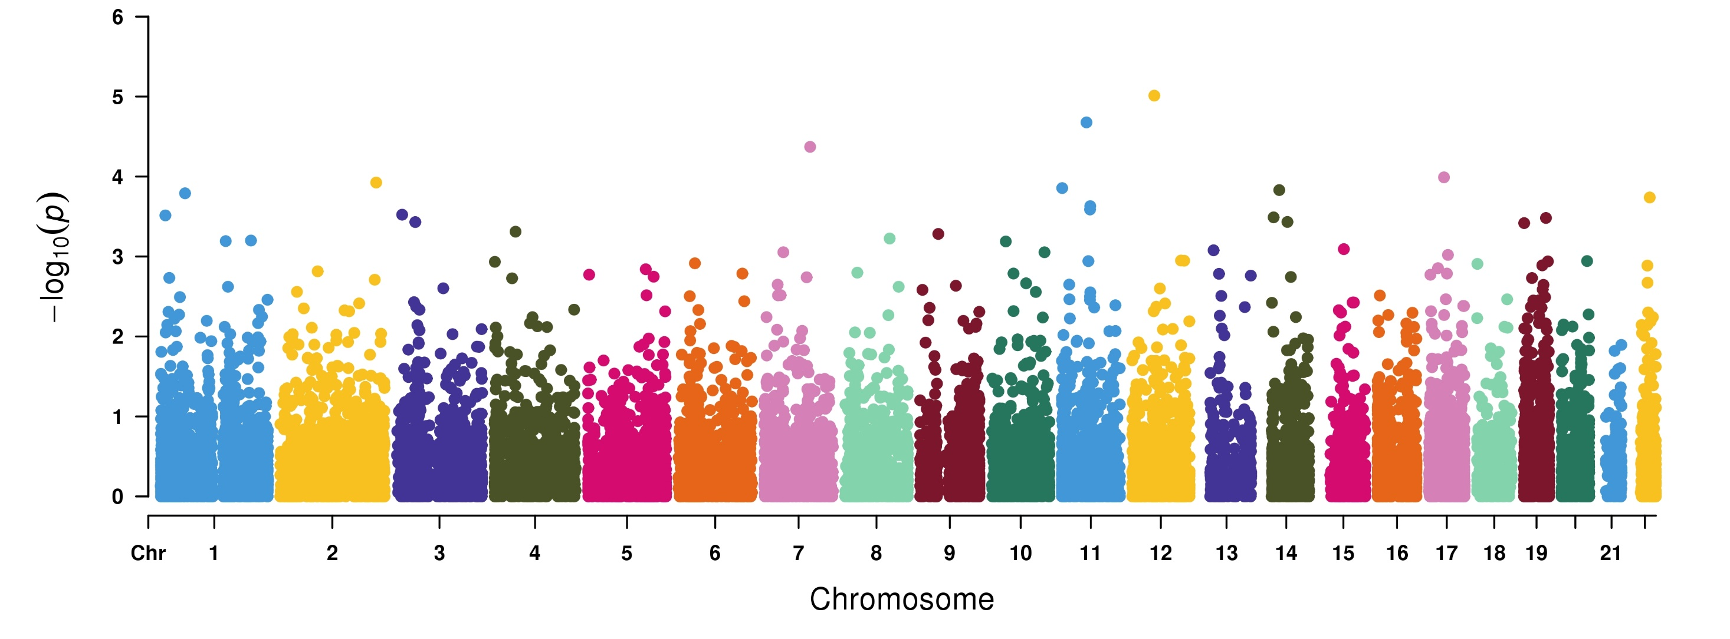
Robust SKAT-O analyses to Skin Cancer
SLC4A8
NAMPT
FARSB
LRRC55
SFTA3
RAD51D
1,551 cases and 44,015 control

Slide 11
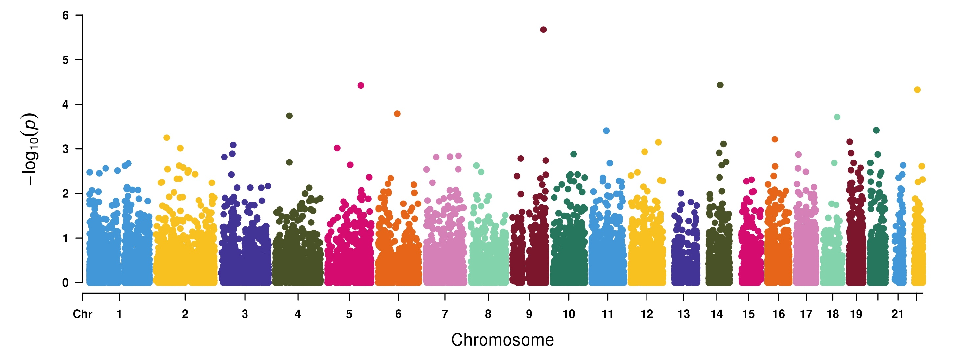
Robust SKAT-O analyses to Breast Cancer
ST6GALNAC6
WNT8A
RDH11
CHEK2
POLR2B
MALT1
BCKDHB
1,398 cases and 22,668 control

Slide 12
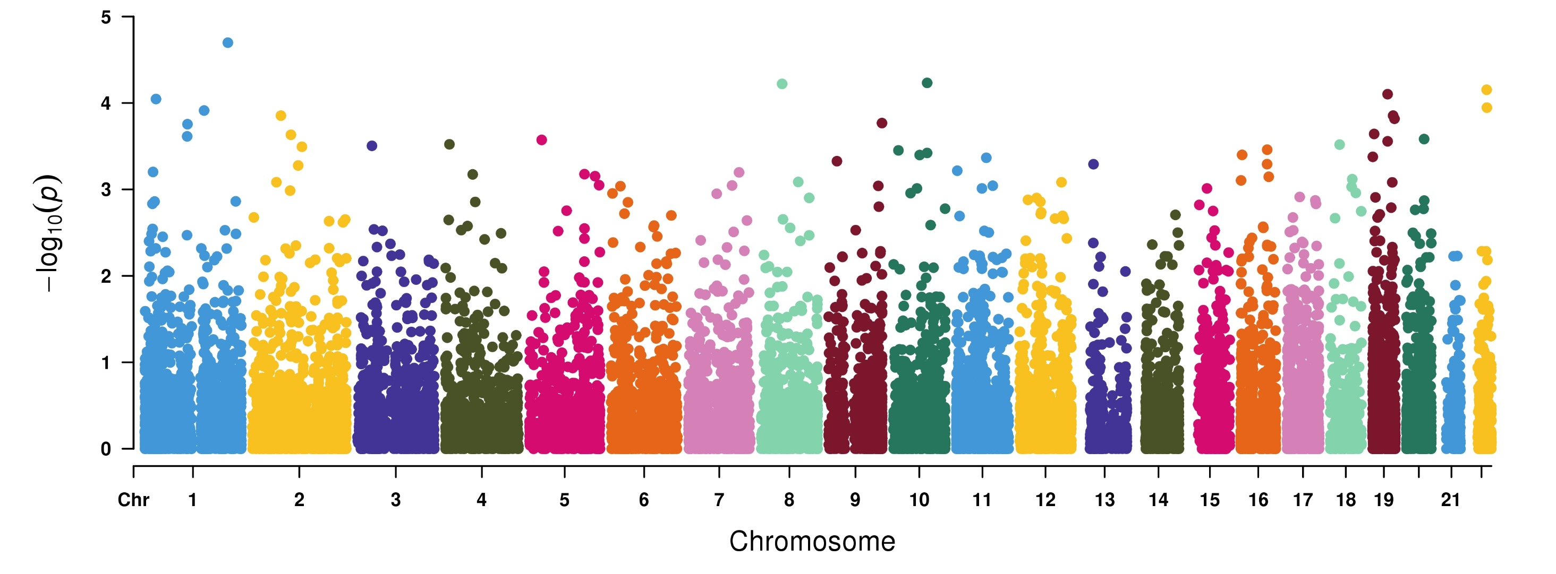
Robust SKAT-O analyses to Bladder Cancer
SMYD2
GLUD1
ECH1
GTPBP1
MECR
ATP6V1H
245 cases and 24,255 control

Slide 13
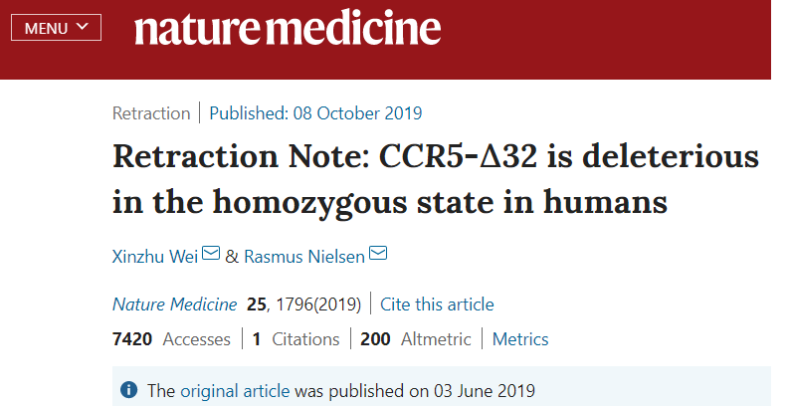
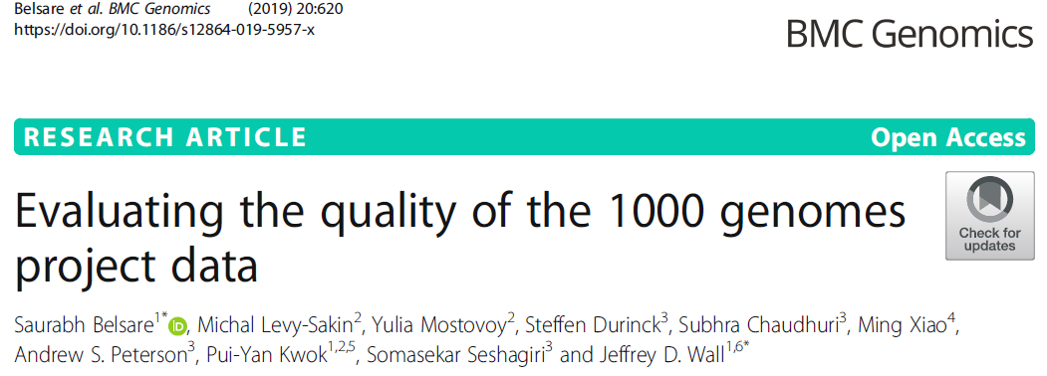
Challenge: low data quality both in genotyping and phenotyping
Regeneron Seal Point Balinese (SPB)
Retracted ~ July 2019
Genotyping calling bias
10th December, 2019
Functionally Equivalent pipeline (FE)
Retracted or update
https://www.biorxiv.org/content/biorxiv/early/2019/12/10/868570.full.pdf
Technique quality control, negative and positive control
should be set as much as possible

Slide 14
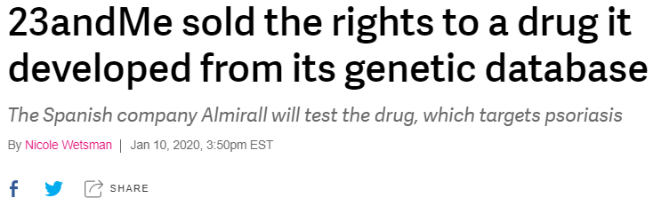
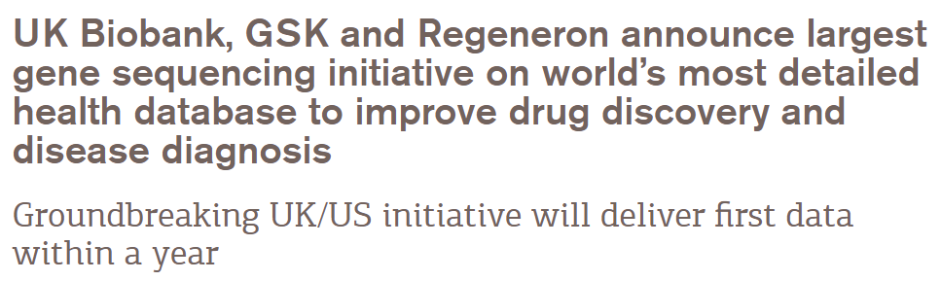
Summary and Discussion
Developed a region based computational pipeline to identify rare disease variants in imbalance dataset
Advantage:
Identify novel rare disease associated variants with imbalanced dataset
Computational time is scalable for large biobank dataset ~ 500,000 samples
Limitation:
Only works in unrelated individuals, 30% samples should be excluded
It will suffer inflated type I error if case: control ratio > 1: 99 which is common in large biobank
Phenotyping accuracy is one of the concerns: ICD10 => PheCode
Opportunity:
Generalized linear mixed
model (GLMM)

Slide 15
Thanks

