Slide 1
DNA Methylation Research in Rheumatology Arthritis: Promising and Challenging
Shicheng Guo
Marshfield Clinic Research Institute
Sept 7th 2018

Slide 2
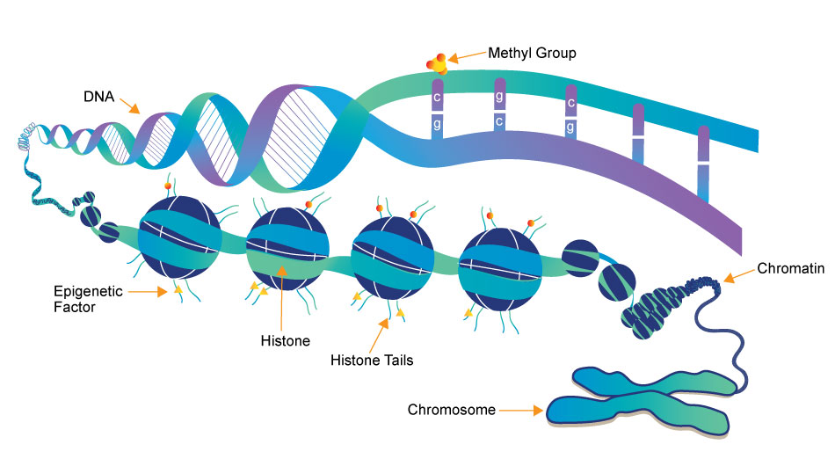
DNA Methylation as the interaction interface between Genetics and Environment
Gene Expression
Splicing
Mutation
Chromosome stability
TFBS
Embryonic development
Susceptibility
Disease progress

Slide 3
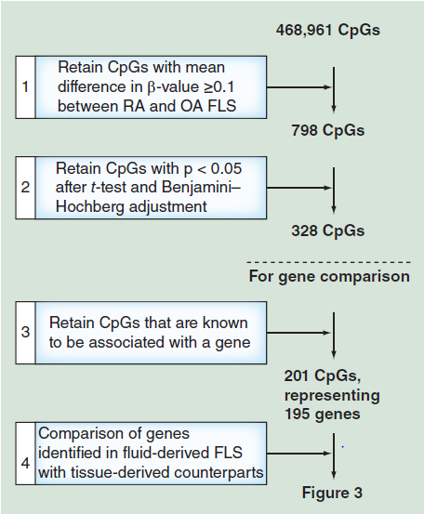
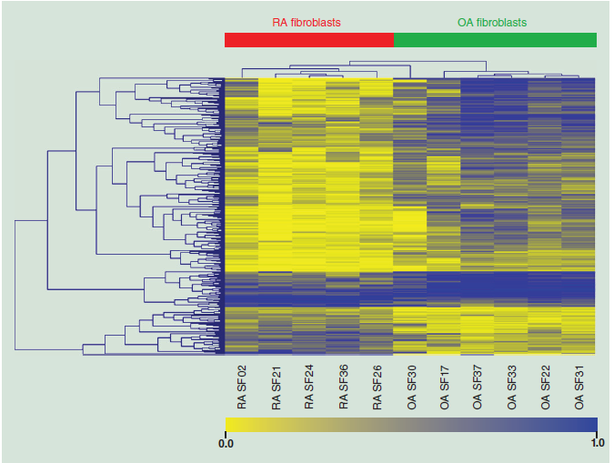
DNA methylation profiling of synovial fluid FLS in rheumatoid arthritis reveals changes common with tissue-derived FLS
Heatmap and clustering for the 328 CpGs identified as differentially methylated between rheumatoid arthritis and osteoarthritis fluid-derived fibroblast-like synoviocytes
Epigenomics. 2015;7(4):539-51. doi: 10.2217/epi.15.15.
DNA methylation profiling of synovial fluid FLS in rheumatoid arthritis reveals changes common with tissue-derived FLS.
Glossop JR^{1,2}, Haworth KE¹, Emes RD^{3,4}, Nixon NB², Packham JC², Dawes PT², Fryer AA¹, Mattey DL^{1,2}, Farrell WE¹.

Slide 4
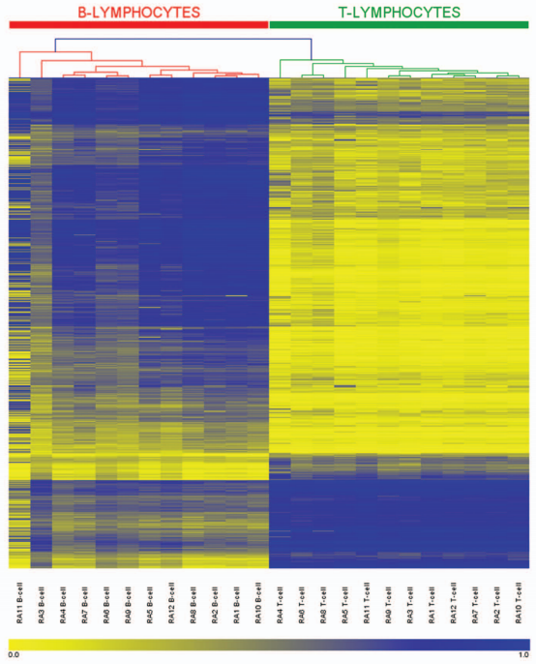
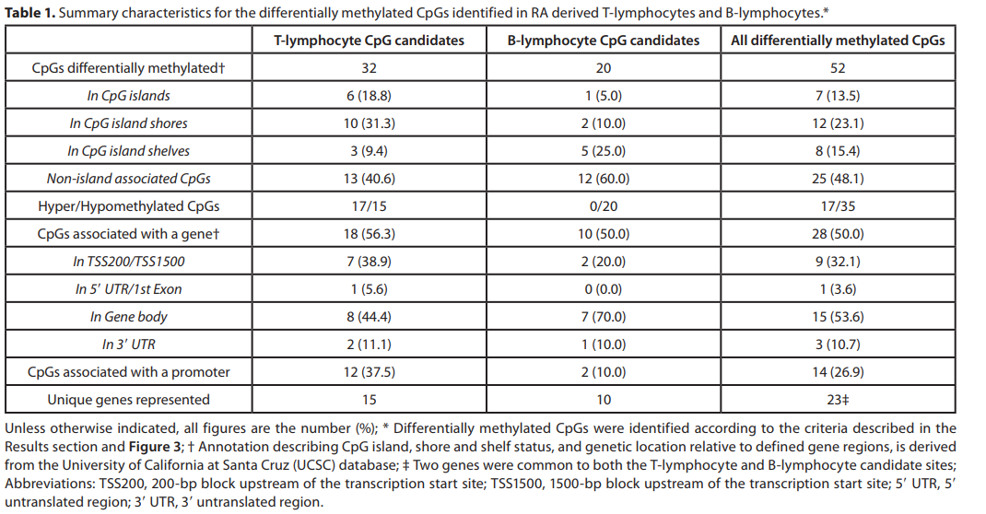
Genome-wide DNA methylation profiling T- and B-lymphocyte of from rheumatoid arthritis
Epigenetics. 2014 Sep;9(9):1228-37. doi: 10.4161/epi.29718. Epub 2014 Jul 7.
Genome-wide DNA methylation profiling in rheumatoid arthritis identifies disease-associated methylation changes that are distinct to individual T- and B-lymphocyte populations.
Glossop JR¹, Emes RD², Nixon NB³, Haworth KE⁴, Packham JC³, Dawes PT³, Fryer AA⁴, Mattey DL¹, Farrell WE⁴.

Slide 5
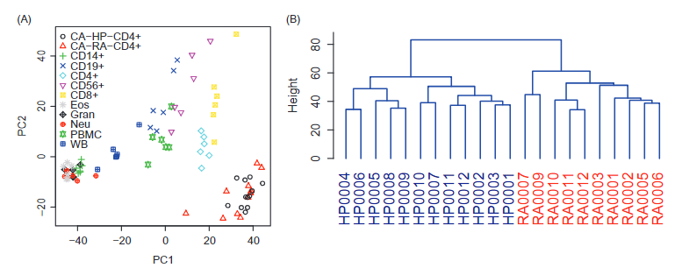
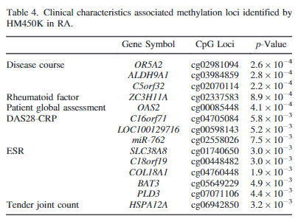
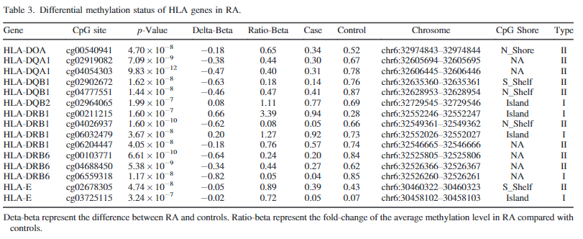
Genome-wide DNA methylation patterns in CD4+ T cells from Chinese Han patients with rheumatoid arthritis.
Mod Rheumatol. 2017 May;27(3):441-447. doi: 10.1080/14397595.2016.1218595. Epub 2016 Sep 1.
Genome-wide DNA methylation patterns in CD4+ T cells from Chinese Han patients with rheumatoid arthritis.
Guo S¹, Zhu Q¹, Jiang T^{1,2}, Wang R^{1,2}, Shen Y^{1,2}, Zhu X³, Wang Y¹, Bai F^{1,2}, Ding Q^{1,2}, Zhou X⁴, Chen G⁵, He DY^{1,2}.

Slide 6
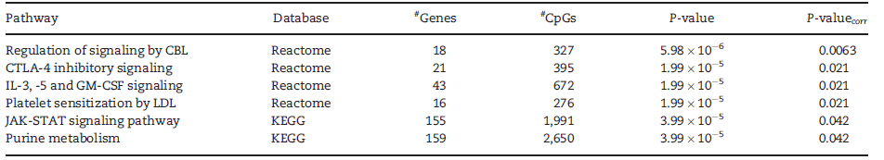
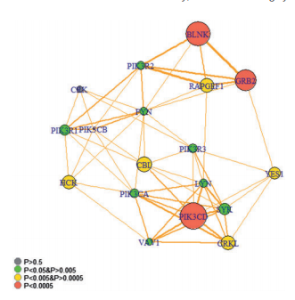
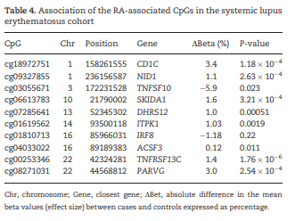
Epigenome-wide association study of rheumatoid arthritis identifies differentially methylated loci in B cells
Discovery cohort (N=50) and controls (N=75).
Validation cohort (N=15) and controls (N=15)
Additional case-control cohort (N =24)
SLE corhort (N=47) and controls (N=56)
Hum Mol Genet. 2017 Jul 15;26(14):2803-2811. doi: 10.1093/hmg/ddx177.
Epigenome-wide association study of rheumatoid arthritis identifies differentially methylated loci in B cells.
Julià A¹, Absher D², López-Lasanta M¹, Palau N¹, Pluma A¹, Waite Jones L², Glossop JR³, Farrell WE³, Myers RM⁴, Marsal S¹.
Notes:
Epigenetic regulation of immune cell types could be critical for the development and maintenance of autoimmune diseases like rheumatoid arthritis (RA). B cells are highly relevant in RA, since patients express autoantibodies and depleting this cell type is a successful therapeutic approach. Epigenetic variation, such as DNA methylation, may mediate the pathogenic activity of B cells. In this study, we performed an epigenome-wide association study (EWAS) for RA with three different replication cohorts, to identify disease-specific alterations in DNA methylation in B cells. CpG methylation in isolated B lymphocytes was assayed on the Illumina HumanMethylation450 BeadChip in a discovery cohort of RA patients (N = 50) and controls (N = 75). Differential methylation was observed in 64 CpG sites (q < 0.05). Six biological pathways were also differentially methylated in RA B cells. Analysis in an independent cohort of patients (N = 15) and controls (N = 15) validated the association of 10 CpG sites located on 8 genes CD1C, TNFSF10, PARVG, NID1, DHRS12, ITPK1, ACSF3 and TNFRSF13C, and 2 intergenic regions. Differential methylation at the CBL signaling pathway was replicated. Using an additional case-control cohort (N = 24), the association between RA risk and CpGs cg18972751 at CD1C (P = 2.26 × 10-9) and cg03055671 at TNFSF10 (P = 1.67 × 10-8) genes was further validated. Differential methylation at genes CD1C, TNFSF10, PARVG, NID1, DHRS12, ITPK1, ACSF3, TNFRSF13C and intergenic region chr10p12.31 was replicated in a cohort of systemic lupus erythematosus (SLE) patients (N = 47) and controls (N = 56). Our results highlight genes that may drive the pathogenic activity of B cells in RA and suggest shared methylation patterns with SLE.

Slide 7
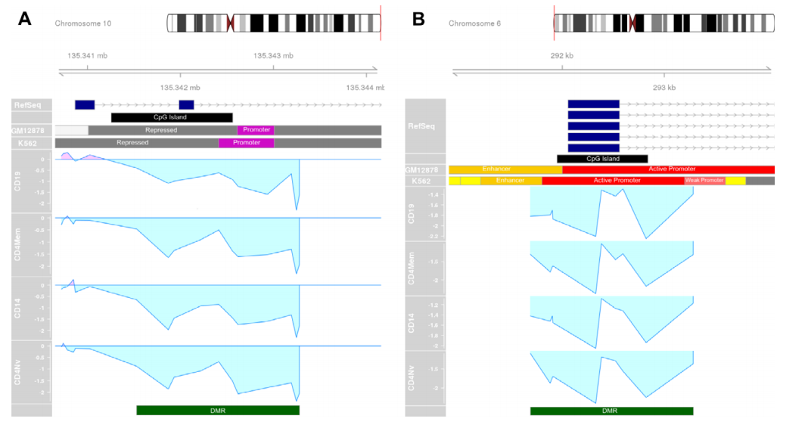
Hypomethylation of CYP2E1 and DUSP22 Promoters Associated With Disease Activity Among Rheumatoid Arthritis Patients
CD10
CD4 naive
CD14
CD4 memory
N=229
Arthritis Rheumatol. 2018 Apr;70(4):528-536. doi: 10.1002/art.40408. Epub 2018 Feb 18.
Hypomethylation of CYP2E1 and DUSP22 Promoters Associated With Disease Activity and Erosive Disease Among Rheumatoid Arthritis Patients.
Mok A¹, Rhead B¹, Holingue C¹, Shao X¹, Quach HL¹, Quach D¹, Sinclair E², Graf J², Imboden J², Link T², Harrison R², Chernitskiy V², Barcellos LF¹, Criswell LA²
Notes:
In this study, we aimed to determine whether differential DNA methylation in peripheral blood cell subpopulations is associated with any of 4 clinical outcomes among RA patients. METHODS: Peripheral blood samples were obtained from 63 patients in the University of California, San Francisco RA cohort (all satisfied the American College of Rheumatology classification criteria; 57 were seropositive for rheumatoid factor and/or anti-cyclic citrullinated protein). Fluorescence-activated cell sorting was used to separate the cells into 4 immune cell subpopulations (CD14+ monocytes, CD19+ B cells, CD4+ naive T cells, and CD4+ memory T cells) per individual, and 229 epigenome-wide DNA methylation profiles were generated using Illumina HumanMethylation450 BeadChips. Differentially methylated positions and regions associated with the Clinical Disease Activity Index score, erosive disease, RA Articular Damage score, Sharp score, medication at time of blood draw, smoking status, and disease duration were identified using robust regression models and empirical Bayes variance estimators.
RESULTS: Differential methylation of CpG sites associated with clinical outcomes was observed in all 4 cell types. Hypomethylated regions in the CYP2E1 and DUSP22 gene promoters were associated with active and erosive disease, respectively. Pathway analyses suggested that the biologic mechanisms underlying each clinical outcome are cell type-specific. Evidence of independent effects on DNA methylationfrom smoking, medication use, and disease duration were also identified.
CONCLUSION: Methylation signatures specific to RA clinical outcomes may have utility as biomarkers or predictors of exposure, disease progression, and disease severity.
糜烂性疾病

Slide 8
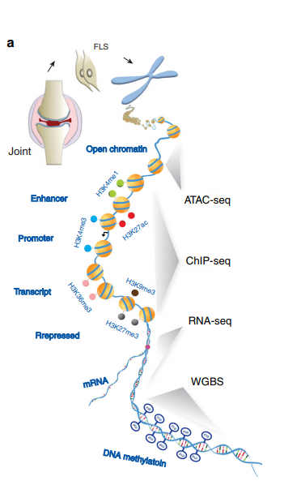
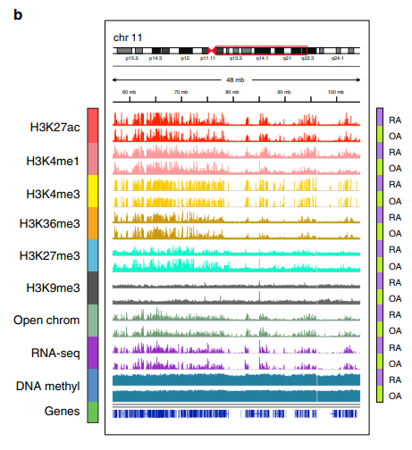
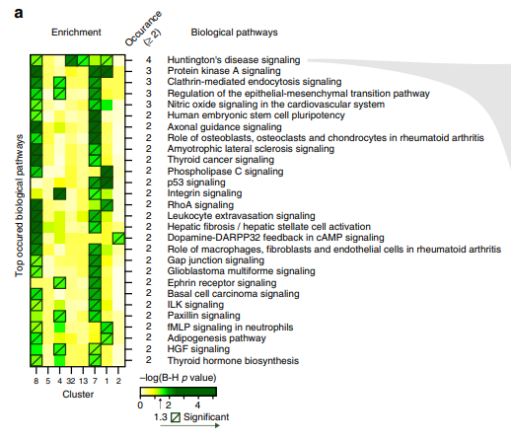
Comprehensive epigenetic landscape of rheumatoid arthritis fibroblast-like synoviocytes.
Nat Commun. 2018 May 15;9(1):1921. doi: 10.1038/s41467-018-04310-9.
Comprehensive epigenetic landscape of rheumatoid arthritis fibroblast-like synoviocytes.
Ai R¹, Laragione T², Hammaker D³, Boyle DL³, Wildberg A¹, Maeshima K³, Palescandolo E⁴, Krishna V⁴,
Pocalyko D⁴, Whitaker JW⁴, Bai Y⁴, Nagpal S⁴, Bachman KE⁴, Ainsworth RI¹, Wang M¹, Ding B¹, Gulko PS⁵, Wang W^{6,7}, Firestein GS⁸.
Firestein GS
Notes:
Epigenetics contributes to the pathogenesis of immune-mediated diseases like rheumatoid arthritis (RA). Here we show the first comprehensive epigenomic characterization of RA fibroblast-like synoviocytes (FLS), including histone modifications (H3K27ac, H3K4me1, H3K4me3, H3K36me3, H3K27me3, and H3K9me3), open chromatin, RNA expression and whole-genome DNA methylation. To address complex multidimensional relationship and reveal epigenetic regulation of RA, we perform integrative analyses using a novel unbiased method to identify genomic regions with similar profiles. Epigenomically similar regions exist in RA cells and are associated with active enhancers and promoters and specific transcription factor binding motifs. Differentially marked genes are enriched for immunological and unexpected pathways, with "Huntington's Disease Signaling" identified as particularly prominent. We validate the relevance of this pathway to RA by showing that Huntingtin-interacting protein-1 regulates FLS invasion into matrix. This work establishes a high-resolution epigenomic landscape of RA and demonstrates the potential for integrative analyses to identify unanticipated therapeutic targets.

Slide 9
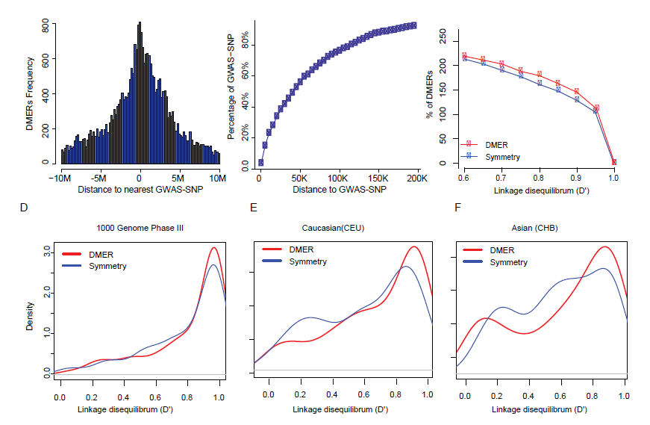
Linkage Disequilibrium in Epigenetic Results Reveals Surprisingly Frequent Correlation between Regulatory Regions and Rheumatoid Arthritis GWAS SNPs
Shicheng Guo, Steven Schrodi, Incorporation of Linkage Disequilibrium in Epigenetic Results Reveals Surprisingly Frequent Correlation between Regulatory Regions and Rheumatoid Arthritis GWAS SNPs (non-published)

Slide 10
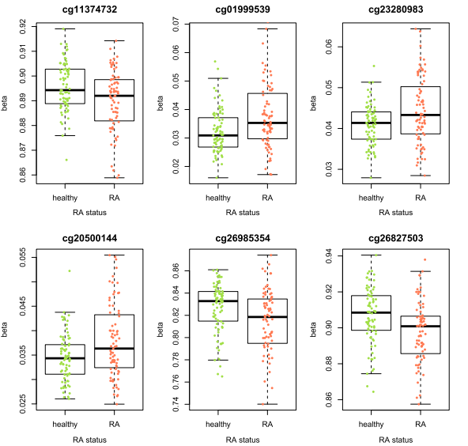
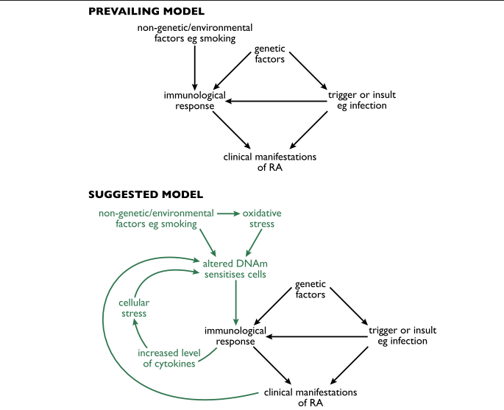
Epigenetic variability as an emerging component in autoimmune disorders
79 monozygotic twin pairs
UK
Genome Med. 2018 Sep 4;10(1):64. doi: 10.1186/s13073-018-0575-9.
Increased DNA methylation variability in rheumatoid arthritis-discordant monozygotic twins.
Webster AP^{1,2}, Plant D³, Ecker S⁴, Zufferey F⁵, Bell JT⁵, Feber A^{4,6}, Paul DS⁷, Beck S⁴, Barton A^{8,3}, Williams FMK⁵, Worthington J^{9,10}.
Notes:
To investigate possible contributions of DNA methylation to the aetiology of rheumatoid arthritiswith minimum confounding genetic heterogeneity, we investigated genome-wide DNA methylation in disease-discordant monozygotic twin pairs.
METHODS: Genome-wide DNA methylation was assessed in 79 monozygotic twin pairs discordant for rheumatoid arthritis using the HumanMethylation450 BeadChip array (Illumina). Discordant twins were tested for both differential DNA methylation and methylationvariability between rheumatoid arthritis and healthy twins. The methylation variability signature was then compared with methylationvariants from studies of other autoimmune diseases and with an independent healthy population.
RESULTS: We have identified a differentially variable DNA methylation signature that suggests multiple stress response pathways may be involved in the aetiology of the disease. This methylation variability signature also highlighted potential epigenetic disruption of multiple RUNX3 transcription factor binding sites as being associated with disease development. Comparison with previously performed epigenome-wide association studies of rheumatoid arthritis and type 1 diabetes identified shared pathways for autoimmune disorders, suggesting that epigenetics plays a role in autoimmunity and offering the possibility of identifying new targets for intervention.
CONCLUSIONS: Through genome-wide analysis of DNA methylation in disease-discordant monozygotic twins, we have identified a differentially variable DNA methylation signature, in the absence of differential methylation in rheumatoid arthritis. This finding supports the importance of epigenetic variability as an emerging component in autoimmune disorders.

Slide 11
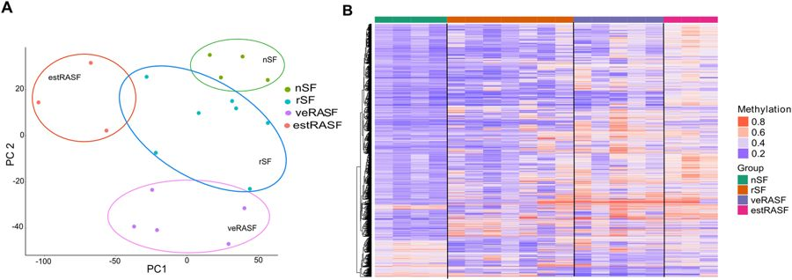
Differentially methylated CpGs at promoter sites (DMPs) differ between diseases and disease stage
Healthy individuals (nSF) and patients with resolving, acute arthritis (rSF), very early rheumatoid arthritis (veRA) and patients fulfilling the criteria for the diagnosis of RA (estRA),
Sci Rep. 2018 May 9;8(1):7370. doi: 10.1038/s41598-018-24240-2.
Analysis of early changes in DNA methylation in synovial fibroblasts of RA patients before diagnosis.
Karouzakis E¹, Raza K^{2,3}, Kolling C⁴, Buckley CD², Gay S⁵, Filer A^{2,6}, Ospelt C⁵.
UK Birmingham early arthritis (BEACON) cohort

Slide 12
Pharmacogenomic Biomarkers in Drug Labeling (personalized genomic medicine drugs for RA)
Drug | Therapeutic Area* | Biomarker† | Labeling Sections
Azathioprine | Rheumatology | TPMT | Dosage and Administration, Warnings, Precautions, Drug Interactions, Adverse Reactions, Clinical Pharmacology
Carisoprodol | Rheumatology | CYP2C19 | Use in Specific Populations, Clinical Pharmacology
Celecoxib | Rheumatology | CYP2C9 | Dosage and Administration, Use in Specific Populations, Clinical Pharmacology
Flurbiprofen | Rheumatology | CYP2C9 | Clinical Pharmacology
Lesinurad | Rheumatology | CYP2C9 | Drug Interactions, Clinical Pharmacology
Pegloticase | Rheumatology | G6PD | Boxed Warning, Contraindications, Warnings and Precautions, Patient Counseling Information
Piroxicam | Rheumatology | CYP2C9 | Clinical Pharmacology
This list and further details relating to these drugs can be found at the FDA's website
Notes:
https://www.fda.gov/Drugs/ScienceResearch/ucm572698.htm

Slide 13
Pharmacogenomic studies in patients with rheumatoid arthritis treated with traditional disease-modifying anti-rheumatic drugs.
Drugs | (SNP) gene | Response/toxicity
Methotrexate | (3435C > T) MDR1 | TT genotype is associated with high remission rate
 | (3435C>T) MDR1 | TT genotype is associated with nonresponder status
 | (1236C>T) ABCB1, (23 + 56T> C) ABCC2, (1249G>A and 1058G> A) ABCC2 and (2677C> T) MTHFR | Genotypes are associated with overall toxicity (especially hepatic, intestinal and alopecia) with variable frequency in different ethnic groups
 | (-401CC) GGH, (347GG) ATIC, (1298AC/CC)MTHFR, (2756AA) MS, (66GG) MTRR | Genotypes are associated with toxicity
 | (34TT) AMPD1, (347CC) ATIC, (94CC) ITPA | Genotypes are associated with a good clinical response
 | (677T-1298A) MTHFR | Genotypes are associated with toxicity
 | (1298CC) MTHFR | CC genotype is associated with toxicity
 | (677C/T) MTHFR | TT or C/T are associated with toxicity
 | (677T, 1298C) MTHFR | Genotypes are associated with a good clinical response
 | (1289A, rs48466051C) MTHFR | Genotypes are associated with toxicity
 | (677T-1298A) MTHFR | Genotypes are not associated with toxicity or efficacy
 | (TSER*2/*3) TYMS, (347CG) ATIC, (80GA) SLC19A1 | Genotypes are associated with diminished activity
Sulfasalazine | NAT2 | Slow acetylator phenotype is associated with toxicity
Leflunomide | (19C> A) DHODH | C allele is associated with a good clinical response
*MDR1, MTHFR, MTRR, SLC19A1, DHODH
* SNP (CNV, m5C…)

Slide 14
Pharmacogenomic studies in patients with rheumatoid arthritis treated with anti-tumor necrosis factor agents
Drugs | (SNP) gene | Response/toxicity
Etanercept | HLA-DRB1, LTA-TNF | Genotypes are associated with response to treatment in early RA
 | (−308G/G) TNF-alpha | Genotype is associated with better responses than −308A/G
 | (158V/F) FCGRIIIA | No association with clinical response
 | (−308) TNF-alpha, (-1087) IL10 | Genotypes are associated with a good clinical response
 | (−857C/T) TNF-alpha | Genotype is associated with good clinical response
Infliximab | IL1B, IL1-RN, TNF-alpha | Genotypes are not associated with clinical response
 | HLA-DRB1, HLA-DQA1, HLA-DQB1 and BAT2 | Genotypes are associated with good clinical response
 | HLA-DRB1, TNF-alpha | No association with treatment response
 | (158V/F) FCGRIIIA | No association with treatment response
 | (196M/R) TNFRSF1B | Genotype is associated with treatment response
 | (-238G/A) TNF-alpha | Genotype is associated with poorer response
 | (131R/H) FCGR2A, (158F/V) FCGR3A | Both genotypes influence treatment response
Adalimumab | (−308G/G) TNF-alpha | Genotype is associated with a good clinical response
 | (−238G/−308G/−857C) TNF | Genotypes are associated with diminished treatment response
Any anti-TNF* | (−308G/G) TNF-alpha GG | genotype is associated with better response than A/G or A/A
 | (676T >G) TNFSF1B | Genotype is not associated with treatment response
 | MAFB, IFN-k, PON1, IL10 | Genotypes are associated with good clinical response
TNF-alpha, HLA-DRB1, IL-10

Slide 15
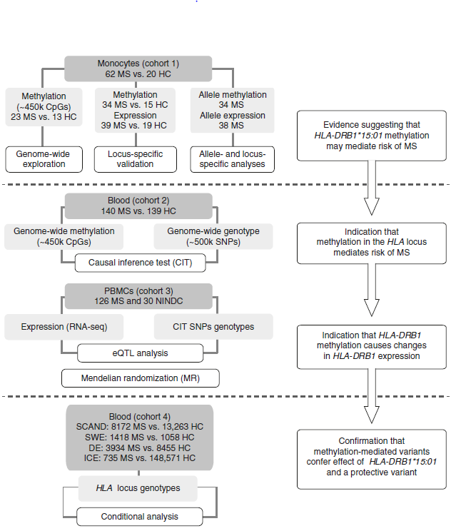
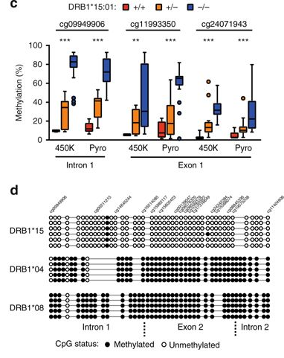
DNA methylation as a mediator of HLA-DRB1*15:01 and a protective variant in multiple sclerosis
Nat Commun. 2018 Jun 19;9(1):2397. doi: 10.1038/s41467-018-04732-5.
DNA methylation as a mediator of HLA-DRB1*15:01 and a protective variant in multiple sclerosis.
Kular L¹, Liu Y^{2,3}, Ruhrmann S¹, Zheleznyakova G¹, Marabita F¹, Gomez-Cabrero D⁴, James T¹, Ewing E¹, Lindén M¹, Górnikiewicz B¹, Aeinehband S¹, Stridh P¹, Link J¹

Slide 16
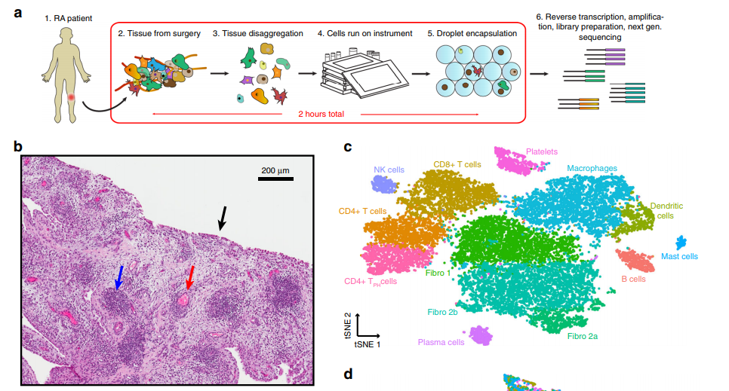
Single-cell RNA-seq of rheumatoid arthritis synovial tissue using low-cost microfluidic instrumentation
Nat Commun. 2018 Feb 23;9(1):791. doi: 10.1038/s41467-017-02659-x.
Single-cell RNA-seq of rheumatoid arthritis synovial tissue using low-cost microfluidicinstrumentation.
Stephenson W¹, Donlin LT^{2,3}, Butler A^{4,5}, Rozo C², Bracken B^{4,5}, Rashidfarrokhi A^{4,6}, Goodman SM^{2,3}, Ivashkiv LB^{2,3}, Bykerk VP^{2,3}, Orange DE^{2,7}, Darnell RB^{4,7,8}, Swerdlow HP⁹, Satija R^{10,11}.

Slide 17
Long-term Precision Medicine Roadmap for Rheumatoid Arthritis
Single-cell
Multi-disease Validation
CD19+
CD8+
Multi-omics
Twins
FLS
Cross-Validation
B cell
CD4+
Case-Control
Methylation and Susceptibility
Methylation and Precision Medicine
Methylation and Environment triggers
Methylation and Genetic Interactions
RA based Genetic and Epigenetic Biobank
Comprehensive clinical information
Population based analysis

Slide 18
Acknowledgement
Dr. Steven Schrodi, Marshfield Clinic Research Institute
Dr. Dongyi He at Guanghua Hospital
Dr. Kun Zhang at University of California, San Diego
Dr. Li Jin at Fudan University
Dr. Jiucun Wang at Fudan University

