Slide 2
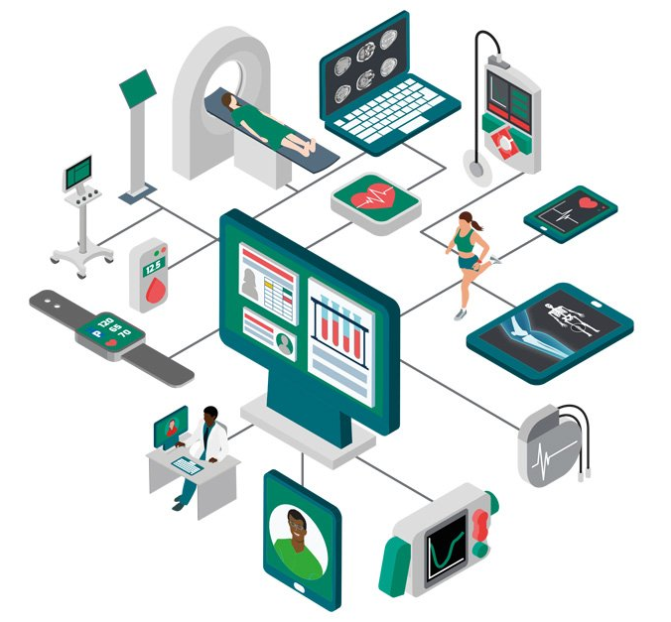
Internet of Medical Things (IoMT)
Notes:
With the Internet of Medical Things (IoMT) market estimated to be worth $158.1 billion in 2022, how can medical technology (Medtech) companies can get IoMT right from a business perspective and how they can use the opportunity to deliver more value to health care?

