Slide 1
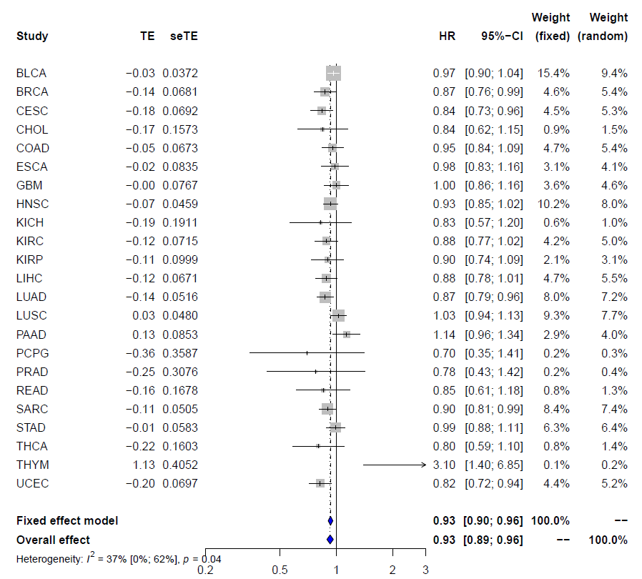
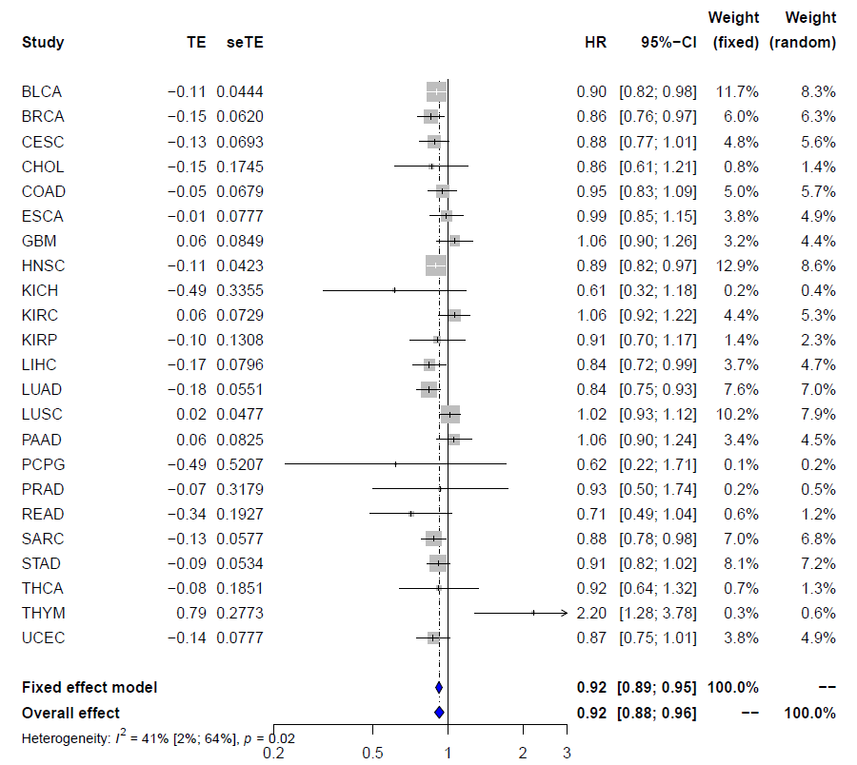
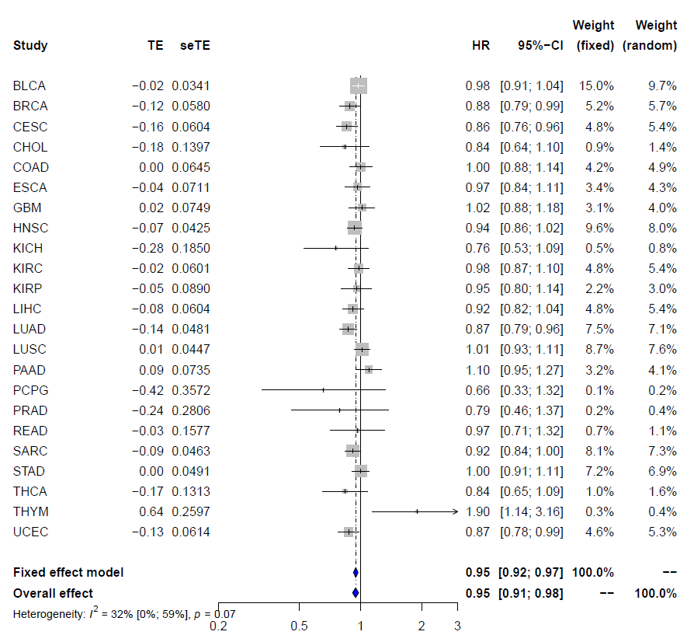
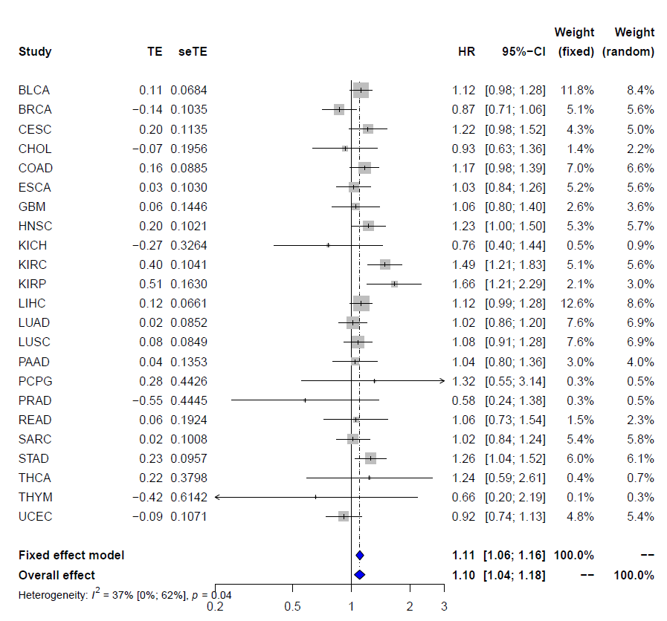
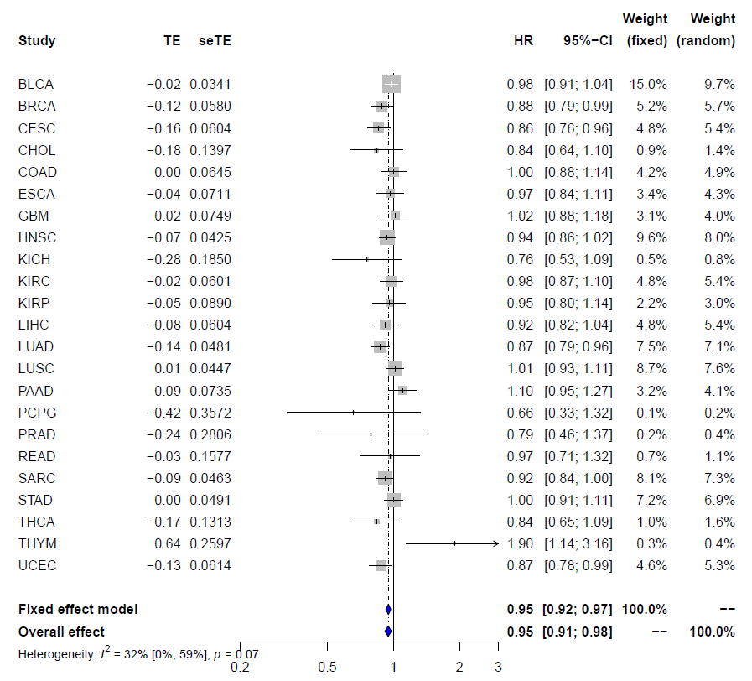
HLA-DRA (HR=0.93, P=1.1x10⁻⁶)
CIITA(HR=0.92, P=5.5x10⁻⁸)
HLA-DPA1(HR=0.94, P=1.83x10⁻⁴)
TGFB1(HR=1.1, P=1.6x10⁻⁵)
HLA-DQA1(0.94, P=4.2x10⁻⁵)

