Slide 1
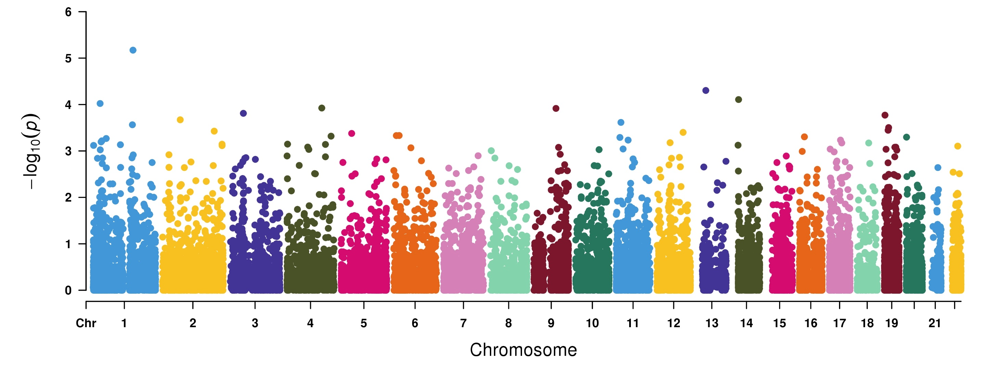
Genome-wide Robust SKAT-O based association study to identify myopia associated genes in 50K UKBB exome-sequencing data
IFI16
STARD13
AHDC1
TLR9
ELF2
SPATA31E1
ZNF219
LINGO3
111 cases and 10,989 control in 50,000 exome-sequencing data

