Slide 2
Department of the School of Medicine and Public Health (SMPH)
The successful candidate will have the majority of their time protected for the development of an internationally recognized collaborative research program that focuses on human somatic mutations. They also will be expected to 1) acquire and sustain robust extramural research funding, 2) teach students and postdoctoral trainees, 3) teach in an area commensurate with their research expertise, 4) participate in faculty governance, and 5) participate in professional, public, and university service. In addition, as a faculty member of the Center for Human Genomics and Precision Medicine, the successful candidate is expected to be an active participant in center-wide research and educational activities as well as interact and collaborate with Center investigators, clinicians and trainees, so as to promote the mission of the Center and advance human genomics research at UW-Madison. The candidate must fulfill University requirements to obtain tenure. The tenure home of the successful applicant will be from amongst a number of participating basic and clinical SMPH academic departments, including Biomolecular Chemistry, Biostatistics and Medical Informatics, Medical Genetics, Medicine, Pathology and Laboratory Medicine, and Pediatrics, with the opportunity for joint appointments where applicable.

Slide 3
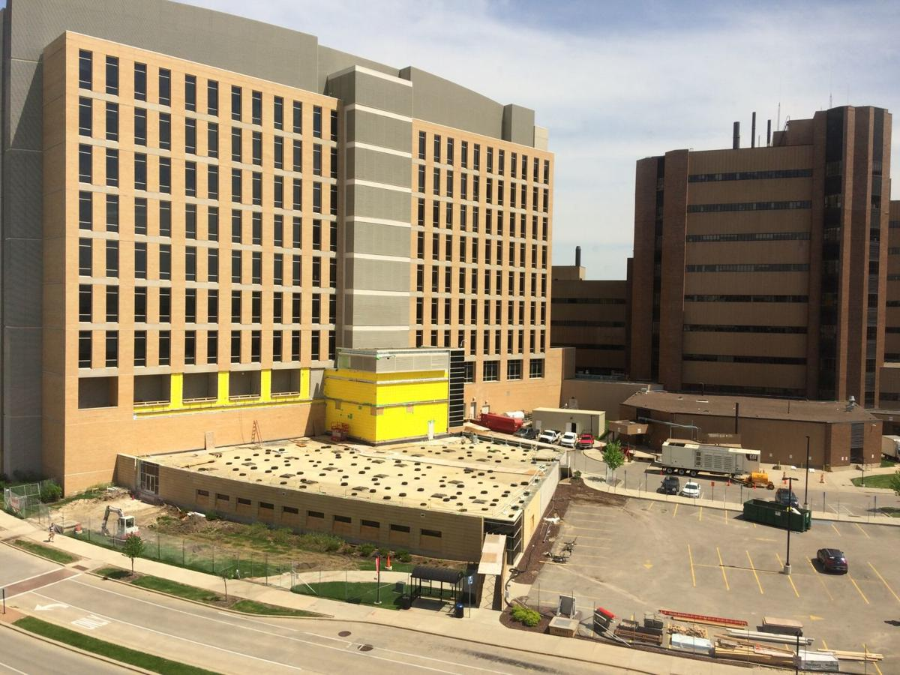
ASSISTANT, ASSOCIATE, OR PROFESSOR IN HUMAN GENOMICS AND PRECISION MEDICINE
To ensure full consideration, please apply by September 1, 2019. The position will remain open and applicants may be considered until the position is filled.
98946-FA 98948-FA
1) the role of somatic mutations in cancer or other human disease; and/or 2) development of new techniques for assessing somatic mosaicism, lineage tracing, and/or cell free DNA analyses.
At least three (3) years of post-doctoral training is required. Successful candidates will have a demonstrated potential for excellence in somatic genomic analysis exemplified through their research, publications, grants, teaching, or seminars. All candidates must have proven success in leading and conducting research and teaching appropriate to their stage of career. Associate/Full Professor candidates must possess experience and scholarly credentials for appointment with tenure at the University of Wisconsin-Madison (UW-Madison). A key consideration is the ability to and interest in working in a collaborative interdisciplinary environment.
Notes:
Preparation work is underway for construction of a $21 million building that will house the new UW Center for Human Genomics and Precision Medicine. The two-story facility will rise above the short wedge-shaped structure that is adjacent to the Wisconsin Institutes for Medical Research, left. In the background, on the right, is UW Hospital.

Slide 4
ASSISTANT, ASSOCIATE, OR PROFESSOR(CHS) IN HUMAN GENOMICS AND PRECISION MEDICINE
To ensure full consideration, please apply by September 1, 2019. The position will remain open and applicants may be considered until the position is filled.
98946-FA 98948-FA
1) the role of somatic mutations in cancer or other human disease; and/or 2) development of new techniques for assessing somatic mosaicism, lineage tracing, and/or cell free DNA analyses.
At least three (3) years of post-doctoral training is required. Successful candidates will have a demonstrated potential for excellence in somatic genomic analysis exemplified through their research, publications, grants, teaching, or seminars. All candidates must have proven success in leading and conducting research and teaching appropriate to their stage of career. Associate/Full Professor candidates must possess experience and scholarly credentials for appointment with tenure at the University of Wisconsin-Madison (UW-Madison). A key consideration is the ability to and interest in working in a collaborative interdisciplinary environment.
Notes:
Preparation work is underway for construction of a $21 million building that will house the new UW Center for Human Genomics and Precision Medicine. The two-story facility will rise above the short wedge-shaped structure that is adjacent to the Wisconsin Institutes for Medical Research, left. In the background, on the right, is UW Hospital.

