Slide 1
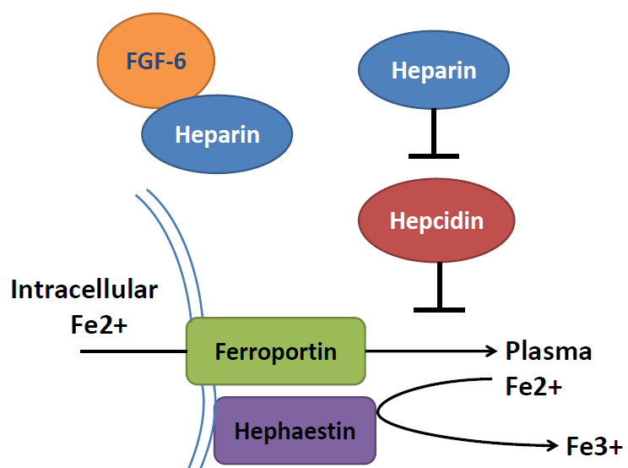
P
FGF-6
STAT3
Heparin
FGFR2
FGF-6
Heparin
FGFR2
Hepcidin
Hepcidin
Ferrous form
Ferric form
P
FGF-6
R188Q
FGF-6
STAT3
E172X
D174V
Heparin
FGFR2
Heparin
Heparin
FGF-6
FGFR2
Hepcidin
Hepcidin
Ferrous form
Ferric form

